Slide 1
Project: IEEE P802.15 Working Group for Wireless Personal Area Networks (WPANs)
Submission Title: 300-GHz 40-Gbps data transmission using SHIQM (Subharmonic IQ Mixer)
Date Submitted: July xx, 2014
Source: Atsushi Kanno, Norihiko Sekine, Akifumi Kasamatsu, Naokatsu Yamamoto, Iwao Hosako,
and Hiroyo Ogawa, NICT
4-2-1, Nukuikita, Koganei, 184-8795, Tokyo, Japan
Voice: +81 42 327 6876, FAX: +81 42 327 7938, E-Mail: kanno@nict.go.jp
Tetsuya Kawasnishi, Waseda Univeristy
3-4-1 Ohkubo, Shinjuku, 169-8555, Tokyo, Japan
Voice: +81 3 5386 2902, E-Mail: kawanishi@waseda.jp
Re: n/a
Abstract: The aim of this contribution is to provide technical achievements of 300-GHz signal transmission by optical subharmonic IQ mixer for middle-range link system.
Purpose: Informing 802.15 IGTHz on terahertz communication technologies for fixed point-to-point link.
Notice: This document has been prepared to assist the IEEE P802.15. It is offered as a basis for discussion and is not binding on the contributing individual(s) or organization(s). The material in this document is subject to change in form and content after further study. The contributor(s) reserve(s) the right to add, amend or withdraw material contained herein.
Release: The contributor acknowledges and accepts that this contribution becomes the property of IEEE and may be made publicly available by P802.15.

Slide 2
300-GHz 40-Gbps data transmission using SHIQM (Subharmonic IQ Mixer)
Atsushi Kanno, Norihiko Sekine, Akifumi Kasamatsu,
Naokatsu Yamamoto, Iwao Hosako, and Hiroyo Ogawa
National Institute of Information and Communications Technology (NICT), Japan
Tetsuya Kawanishi
Waseda University, Japan

Slide 3
New elements of this contribution
At the previous IEEE802.15 meeting, the technologies of radio-over-fiber-based fronthaul for broadband mobile/wireless access systems was proposed (doc.: IEEE 802.15-0177-03-003d). Newly developed elements for this contribution are as follows:
Achievement to 40-Gbps-class transmission capacity
Updates of theoretical transmission distance of THz transceiver using high-gain antenna with high-capacity transmission.

Slide 4
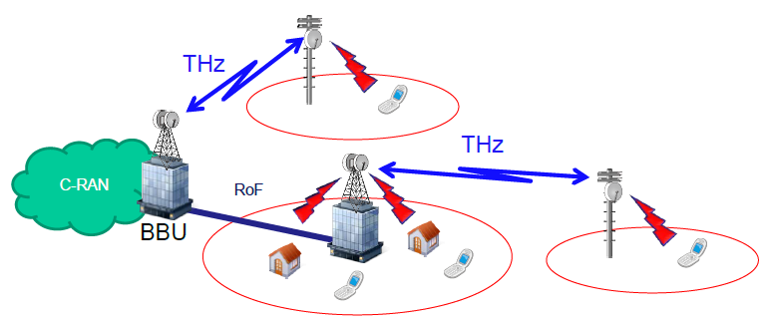
Mobile/wireless access networks using RoF-based terahertz fronthaul
doc.: IEEE 802.15-0177-03-003d

Slide 5
Block diagram of 300-GHz vector signal transmission by the optical subharmonic IQ mixer (SHIQM)
High-gain antenna
ex.) 46 dBi
THz Transmitter
LO
THz receiver
Optical
SHIQM
SHM
ADC
DSP
5–15 m
LO
IQ data

Slide 6
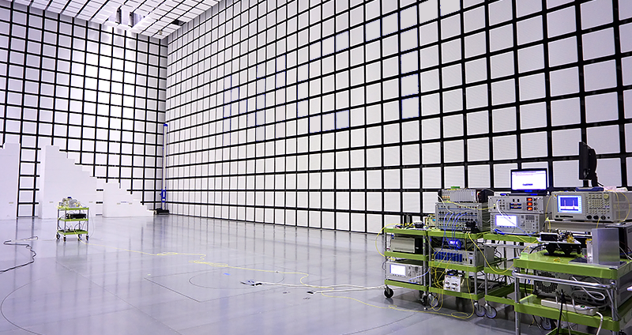
Experimental setups
Tx
10 m
Rx

Slide 7
Observed bit error rates

Slide 8
Estimated transmission distance
Assum. sensitivity
(-22dBm)

Slide 9
Estimated transmission distance under fogs with EIRP of 70 dBm
Assum. sensitivity
(-22dBm)
Only the Rayleigh scattering from ITU-R P840-6 is considered under 25℃.

Slide 10
Summary and Discussion
The 300-GHz transceiver by the subharmonic IQ mixer can provide 40-Gbps-class vector signal.
Broad bandwidth of the signal increases the noise level of the receiver, finally to degrade the sensitivity to -22 dBm, as compared with the previous input on doc.: IEEE 802.15-0177-03-003d.
The transceiver with the EIRP of 70 dBm has possibility of the transmission distance of 400 m even in a thick fog condition.

Slide 11
Question to the Meeting
The revision 13 of 100-Gb/s Study Group Technical Expectations Document (TED) is the last publication from IG-THz. TED consolidated useful information from the input contributions.
Do we need to update TED document in accordance with the input contributions to IGTHz?
Do we need to start drafting a new text for TED document?
Do we need to consider a new title as well as structure of the consolidated document?

