Slide 1
Project: IEEE P802.15 Working Group for Wireless Personal Area Networks (WPANs)
Submission Title: [Worldwide Overview of WiFi on Trains]
Date Submitted: [16 July, 2015]
Source: [Bing Hui, Junhyeong Kim, Hee-Sang Chung, and JunHwan Lee] Company [ETRI]
Address [218 Gajeong-ro, Yuseong-gu, Daejeon, 305-700, KOREA]
Voice:[+82-42-860-5324], FAX: [+82-42-860-6732], E-Mail:[huibing@etri.re.kr]
Abstract: []
Purpose: [For discussion]
Notice: This document has been prepared to assist the IEEE P802.15. It is offered as a basis for discussion and is not binding on the contributing individual(s) or organization(s). The material in this document is subject to change in form and content after further study. The contributor(s) reserve(s) the right to add, amend or withdraw material contained herein.
Release: The contributor acknowledges and accepts that this contribution becomes the property of IEEE and may be made publicly available by P802.15.

Slide 2
Worldwide Overview of WiFi on Trains

Slide 3
Outline
Background
WiFi on Trains
Necessity of New Standards for HRRC
Demonstration from Korea for HRRC

Slide 4
Background
Train Communications Systems 2015 Conference, held in June (10th and 11th), in London, and organized by BWCS
  The WiFi on train conference : directly focusing on the problems and opportunities of putting WiFi services onto trains
  To learn about the current state of communications to moving trains and the solutions of various vendors to meet growing demand

Slide 5
Worldwide Overview
US
  U.S. average 4G speed is just 7 Mbps ranking 27th of top 29 countries.
  Analysis shows U.S. commuter trains need at least 25-80 Mbps to meet growing demand and deliver customer satisfaction.
    Complaints from passengers about poor Wi-Fi increasing monthly
  U.S. airlines using next-generation Ka satellite for up to 12 Mbps per passenger.
Xentrans, “A U.S. perspective on broadband for trains”, in BWCS Train Conference, 2015.06.

Slide 6
Worldwide Overview
Denmark
  It is the Danish Government’s vision that most of future traffic growth should take place in public transport.
  A political agreement of “Train Fund Denmark” allocates DKK 28.5 billion to strengthen the Danish railway.
  DKK 100 million has been set aside in order to upgrade Banedanmark’s infrastructure to improve cellular coverage and capacity.
Banedanmark, “A unified solution for bringing internet on trains to a higher level - the Danish model of internet on trains”, in BWCS Train Conference, 2015.06.

Slide 7
Worldwide Overview
  The business model

Slide 8
Worldwide Overview
Sweden
  Customers rating of the added value of different services
    1.Internet
    2.Refundable ticket
    3.Money back guarantee
    4.Seat with electrical socket
    5.Personal service
    6.Change name on ticket
    7.Window seat
    8.Fleible ticket
    9.Seatmap
    10.Quiet compartment
  Willingness to pay
    1.Money back guarantee
    2.Refundable ticket
    3.Flexible ticket
    4.Change name on ticket
    5.Internet
    6.Quiet compartment
    7.Personal service
    8.Bicycle on board
    9.Leg space
    10.Seat with electrical socket
Their studies indicate that 50% of their passengers think it is worth an extra 4 pounds on their tickets.
SJ, “Beyond infotainment – meeting passengers demands for on-board WiFi services in Sweden”, in BWCS Train Conference, 2015.06.

Slide 9
Worldwide Overview
Spain
  Status
    Several tests on the past decade
      Using cellular technologies (HSPA+ & LTE)
      Low coverage -> Not enough for standalone WiFi service
      Spanish government promoting WiFi service high-speed lines
      Worldwide players running pilots
        Including from 3G/LTE to Satellite
  Challenges
    Low coverage in rural areas
      Standalone WiFi service is not “viable”
    High-speed(320km/h) and under-sized HSPA+/LTE infrastructure
    Who pays? Still to be defined…
Teldat, “WiFi on trains in Spain and other stories – highly reliable on-board communications”, in BWCS Train Conference, 2015.06.

Slide 10
Worldwide Overview
Dubai
  Status
    The Dubai Metro already had Wi-Fi.
    The buses are trialing Wi-Fi.
  The Dubai Roads and Transport Authority (RTA) awarded the telecoms operator du to provide passenger WiFi on the tram and water vehicles.
  Technically du was after:
    LTE backhaul from vehicles and stations
    802.11n
    Proven ability to work with Alstom
Icomera AB, “Connecting Dubai: smart transport in a smart city”, in BWCS Train Conference, 2015.06.

Slide 11
Worldwide Overview
UK
  Call for Evidence Released by Department of Transport
    Dropped calls and intermittent access to the internet are frustrations felt by many rail passengers.
    Mobile communications are so important to passengers that free Wi-Fi now appears in the top ten priorities for improvement according to a major survey last year.
Department for Transport and Department for Culture Media & Sport, “Improving mobile communications to UK rail passengers”, call for evidence, UK, 2015.06.

Slide 12
Worldwide Overview
  Technical Options
    On-train technical options
      On train Wi-Fi: roof-top antennas used to aggregate mobile network data signals and rebroadcast as a Wi-Fi signal within the train, in line with the Government policy announced in February 2015.
      Digital on-board repeaters (D-OBR): amplify external mobile signals within the carriages, reducing the signal attenuation effects of walls and windows.
      Femto cells: these act as mobile base stations providing connectivity within carriages and requiring connectivity with the mobile operators’ networks.
      Passive repeaters: high-gain external antennae on all train carriages with low loss coupling to internal antennae, potentially reducing the effect of cuttings due to the height of the antenna and eliminating the attenuation effects of the carriage.

Slide 13
Worldwide Overview
    Off-train technical options
      Every mobile network operator makes improvements to their off-rail infrastructure to improve coverage along the rail network. This would target not-spots to provide continuous coverage.
      Every mobile network operator utilizes Network Rail assets (including masts, facilities and telecommunications) to provide continuous coverage.
      One or more mobile network operators provide mobile coverage across the rail route.
      Instead of using mobile network operators, build a private network along the rail route with an alternative service provider.
      Instead of using mobile network operators, use train-to-satellite mobile broadband connectivity to deliver both voice and data services.
      Utilize future unmanned aerial vehicles (UAVs) or tethered balloons to deliver targeted connectivity to trains or some other innovative option.

Slide 14
Necessity of New Standards for HRRC
1 Gb/s Trackside Network Roadmap
Fluidmesh, “Fluidity train to ground technology – on-board WiFi at 100 Mbps”, call for evidence, UK, 2015.06.

Slide 15
Necessity of New Standards for HRRC
Market for Novel Rail Communications is Worldwide Open
  Demands of New Technology for HRRC - more and more on-board users are aspiring to having new technologies supporting HRRC with satisfaction.
Higher and Higher Data Rate Requirement
  Currently existed mature technologies can only support up to 100 Mbps (LTE based).
  It can be predicted that the requirement for even higher data rate will emerge very soon.
New Standards for HRRC
  Now is the right time to develop the new standards for HRRC.

Slide 16
Demonstration from Korea for HRRC
Demo for HRRC
  ETRI of Korea has performed a link test for HRRC
BS
UE
MHN Platform →

Slide 17
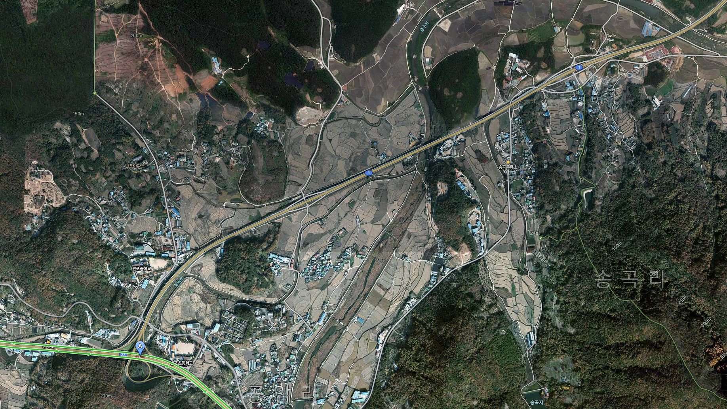
Demonstration from Korea for HRRC
D
A
← Route of demo
B
C
DL performance of demo →

