Slide 1
Project: IEEE P802.15 Working Group for Wireless Personal Area Networks (WPANs)
Submission Title: ETRI Proposal for Close Proximity MAC
Date Submitted: July 2015.
Source: Jae Seung Lee, Young-Hoon Kim, Hoo-Sung Lee, Gyung-Chul Sihn, Moon-Sik Lee, Jee-Yon Choi, Jae-Woo Park, Ik-Jae Chun, Dong-Seung Kwon
Company: ETRI
Address: 218 Gajeong-ro, Yuseong-gu, Daejeon, 305-700, Korea
Voice: +82-42-860-1326
FAX:
E-Mail: [jasonlee@etri.re.kr, yhkim23@etri.re.kr, hslee@etri.re.kr, neuro@etri.re.kr, moonsiklee@etri.re.kr, jychoi@etri.re.kr, parkjw@etri.re.kr, ijchun@etri.re.kr, dskwon@etri.re.kr]
Re: In response to TG3e High Rate Close Proximity Call for Proposals (15-15-0381-02-003e-tg3e)
Abstract: ETRI Proposal for IEEE 802.15 TG3e MAC (MAC Part of the Full Proposal)
Purpose: To be considered in TG3e baseline document
Notice: This document has been prepared to assist the IEEE P802.15. It is offered as a basis for discussion and is not binding on the contributing individual(s) or organization(s). The material in this document is subject to change in form and content after further study. The contributor(s) reserve(s) the right to add, amend or withdraw material contained herein.
Release: The contributor acknowledges and accepts that this contribution becomes the property of IEEE and may be made publicly available by P802.15.

Slide 2
ETRI Proposal for Close Proximity MAC
July 9, 2015

Slide 3
Contents
Overview
Network Architecture for 15.3e
Association and Disassociation
Superframe
Supporting Dual PHY modes
Channel Access
ACK, Retransmission
Frame Sequences, Aggregation
MAC Frame format
Analysis – Link Setup Time, MAC Throughput
Summary
References

Slide 4
Overview
Full Proposal for Close Proximity MAC for 15.3e
  Network Architecture is simplified (CPN)
  Simplified & Fast Association procedure
  Simplified Superframe and optimized frames
  Introduced Bidirectional CTA
Inherited baseline document
  Uses existing architecture, frame sequences, and frames as much as possible to avoid reinventing the same features
  15.3e is an amendment to 15.3, 15.3b, and 15.3c
    With as much optimization as possible
    Simplified & Fast Association procedure
Dual PHY modes can be supported
  Supporting dual PHY mode is an implementation issue
  No MAC complexity for supporting dual PHY

Slide 5

Network Architecture for 15.3e (1/3)
Close Proximity Peer Network (CPN): Simplified piconet consists of two 15.3e devices without full PNC functionalities
Current 15.3 piconet
New 15.3e network
Parent Piconet
Close Proximity
Piconet
PNC of PP
Assc.
Assc.
PNC of CP
Control.
Assc.
Assc.
Assc.
  Only two devices in the piconet
  No full PNC device
  Simple network architecture with low complexity
PNC of NP
Neighbor Piconet
Child Piconet

Slide 6
Network Architecture for 15.3e (2/3)
CPN is established by transmitting beacons
Establishment of CPN is indicated by the beacon
If a P2P DEV is associated with the DEV transmitting the beacon, then the DEV stops transmitting beacons
  Only one DEV can be associated at a time
Data is transmitted in the CPN
If the associated DEV is disassociated, then the beacon is transmitted again to indicated that other DEV can be associated with it
CMS signaling/modulation is not used
  No Coex issue in 15.3e due to the very limited range
Ch2 is the default channel and Ch2 and Ch3 can be bonded
  All frames are transmitted in Ch2 or bonded Ch2&Ch3

Slide 7
Network Architecture for 15.3e (3/3)
Lite PNC: 15.3e device that establishes and manages CPN
Lite PNC capable DEV: a device with very limited PNC capability that transmits beacons
Functionalities of Lite PNC capable DEV:
  Beacon transmission
  Establishment and release of P2P connection
  Establishment of initiator stream and responder stream (Uplink/downlink stream)
  Establishment of CTA for P2P

Slide 8
Initiator and Responder (1/2)
A DEV is called an Initiator if it provides at least one of the following functionalities:
  Beacon Transmission
  The DEV is mainly a data source
  The DEV mainly initiates frame sequence for bidirectional traffic
  Lite PNC capable DEV
Initiator has high channel access priority
A DEV is called a Responder if it provides at least one of the following functionalities:
  A DEV that transmits Association Request
  The role of the DEV is mainly a Data Sink
  A DEV that transmits data piggybacked with the response of the frame sequence for bidirectional traffic
Responder has low channel access priority

Slide 9
Initiator and Responder (2/2)
The role is negotiated during connection phase
A DEV that has a lot of data to transmit request the role of Initiator
A lite PNC designate the role when it allocates CTA
CPN consists of a lite PNC and a DEV
  The role may be designated in advance, including designation by application, or may be designated during CPN establishment procedure
  The role can be designated in advance only when both devices has lite PNC capabilities

Slide 10
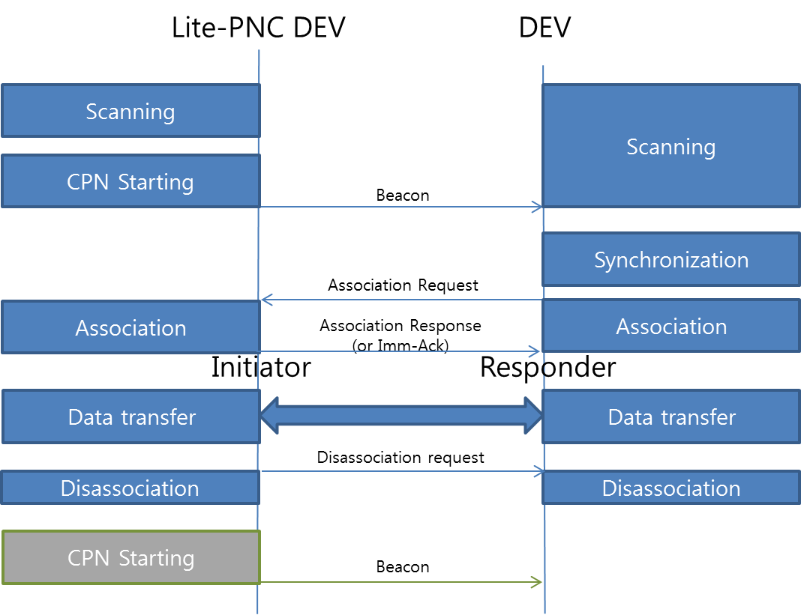
Association and Disassociation
If the lite PNC/DEV role is not designated in advance, a device that transmits beacons first acts as a lite PNC

Slide 11
Association (1/2)
A DEV starts passive scanning first
  Ch2 is the default channel: A DEV only scans Ch2
  A DEV listens to the beacon at least during mMinChannelScan
If a Lite PNC capable device did not receive beacons, then it acts as a lite PNC: It transmits beacons periodically (Starting CPN)
  Otherwise, it acts as a role of a DEV
Synchronization: Upon receiving a beacon, CAP end time, Capabilities, etc are known to the DEV
After synchronization, a DEV transmits Association request
  SrcID of Association request: UnassocID
  ATP which is different from the ATP included in the received beacon may be requested to the lite PNC by including it in the Association request
  Upon receiving Association request, lite PNC allocates DEVID to the DEV and respond with Imm-ACK
    DestID of Imm-ACK is set using the allocated DEVID
    If the lite PNC cannot accept the DEV, then the DestID is set to UnassocID
  After association, a beacon is transmitted which includes information on infinite superframe and infinite CTA for P2P
  No more beacon is transmitted before the DEV is disassociated

Slide 12
Association (2/2)
After receiving Association Response, Association Response is transmitted during the same CAP
    If the superframe duration is set to 0, the duration before disassociation is covered by a single superframe
super frame
super frame
super frame
- No more beacon is transmitted
Before the DEV is disassociated
No CSMA/CA is used
during the data transmission phase
CAP
CAP
Superframe duration = 0
Beacon
Beacon
ACK
Beacon
Lite PNC
DestID = DEVID
Bidirectional CTA
Ass req
DEV
SrcID = UnassocID

Slide 13
Disassociation
Two types of Disassociation
    Disassociation triggered by the request from one of two devices
    Disassociation caused by timeout
      If a DEV moves out of the range of the lite-PNC (e.g, 10 cm), then frames cannot be exchanged and the DEV is disassociated using the timeout mechanism
      The range can be adjusted by the lite-PNC by transmit power control
Beacon is transmitted periodically after disassociation

Slide 14
Touch Action
DEV
DEV measures RSSI of the
received beacon
If measured RSSI >=
expected RSSI value indicated
by the beacon, DEV triggers
connection establishment
If measured RSSI <
expected RSSI value, DEV
waits for the next beacon
- If expected RSSI is set to reserved
value (e.g 0) in the received beacon,
the DEV triggers connection
Lite-PNC indicates expected RSSI value corresponds to the connection establishment trigger boundary in the beacon for touch action
Lite-PNC DEV
Expected RSSI:
Set by Lite-PNC
Expected RSSI value
of the beacon frame
from the viewpoint
of a DEV that will
receive the beacon
at the connection
establishment
trigger boundary
(e.g, 1cm)
The manufacturer of the
Kiosk presets the value
(How to set the value
is out of the scope of
standardization)
Beacon including expected RSSI
Beacon including expected RSSI
Association Request
Association Response (or Imm-Ack)
Connection establishment trigger boundary
for touch action (e.g., 1 cm )
Range of Lite-PNC (e.g, 10 cm)

Slide 15
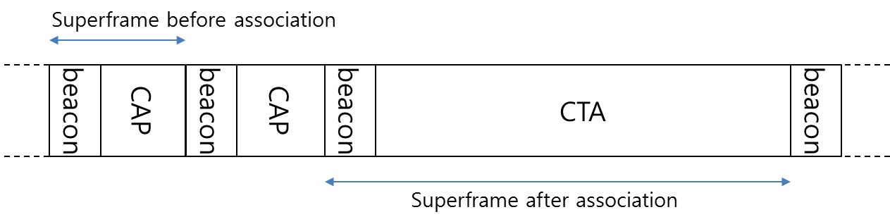
Superframe for 15.3e
Superframe consists of one beacon and a CAP before association
Superframe consists of one beacon and a long CTA after association
One CTA covers duration until disassociation

Slide 16
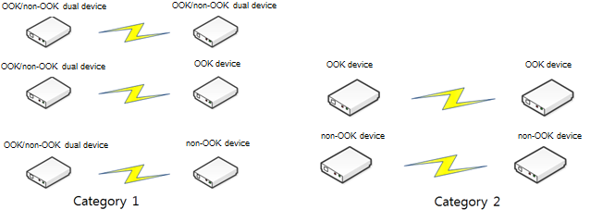
Supporting dual PHY modes (1/2)
Supporting Dual modes (LC & HR PHY)
  Dual modes (Low Complexity SC PHY & High Rate SC PHY) can be supported concurrently in 15.3e
  Example: Dual mode device use cases
    At least one device support dual PHY modes (Category 1)
    Both devices support only one PHY mode (Category 2)
    → Similar use cases with 15.3c

Slide 17
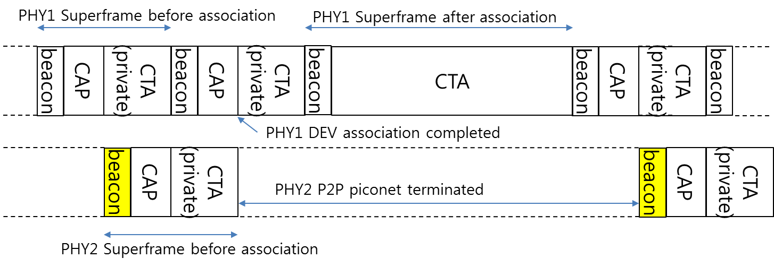
Supporting dual PHY modes (2/2)
Lite PNC transmits beacons using PHY type 1 and PHY type 2 alternately (Low Complexity PHY, High Rate PHY)
Private CTA may be used

Slide 18
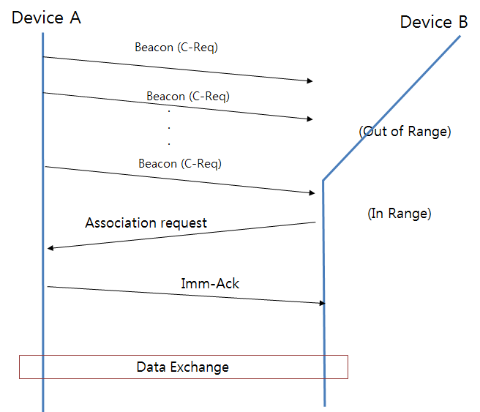
MAC Complexity for dual PHY modes (1/3)
Only possible MAC complexity caused by supporting dual modes: Initial Connection Setup procedure
  After initial connection setup, two devices use one common PHY mode for data exchange: no difference between supporting only one SC PHY mode & dual SC PHY modes after connection
(1) An example of initial connection setup using single PHY mode

Slide 19
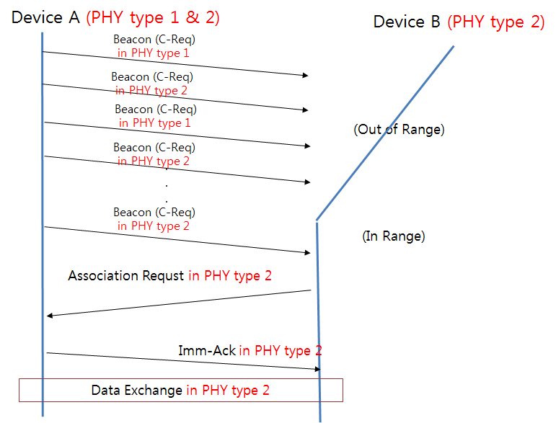
MAC Complexity for dual PHY modes
(2/3)
(2) An example of initial connection setup using dual modes
  If both devices support only one PHY mode: If the supported PHY type by the devices is the same, initial connection setup procedure is similar to (1) (Category 2)
  If at least one device (e.g., Device A) supports dual PHY modes: Beacon is transmitted using PHY type 1 and PHY type 2 alternately (Category 1)

Slide 20
MAC Complexity for dual PHY modes
(3/3)
(2) An example of initial connection setup using dual modes
  From Device B’s point of view, initial connection setup procedure is similar to (1)
  → Complexity is not increased compared with one PHY mode case
  The only difference between (1) and (2) is that Device A transmits Beacon in two modes alternately
  → This is an implementation issue
  . If a device supports both type 1 and type 2, then the device can support the dual mode
  operation naturally, by just transmitting Beacon in two modes alternately
  Additional MAC complexity by supporting two PHY modes is very low !!

Slide 21
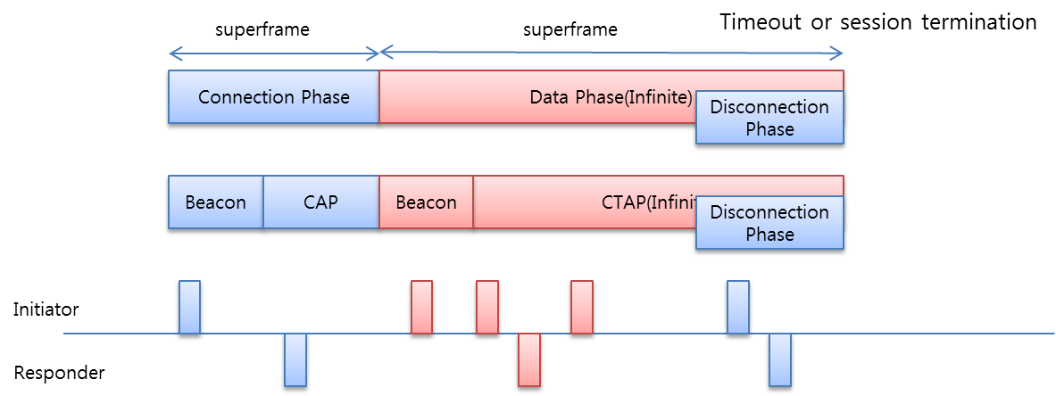
Channel Access
Superframe duration: distinguished by connection phase & data phase
  Connection phase: Beacon and CAP duration for Association
  Data phase: a long CTA allocated by a beacon frame
    Infinite time is allocated
    Session expires by the disassociation command
  During CAP duration, CSMA/CA is used: since more than one DEV may have received the beacon and try to associate with the lite PNC
    No change to legacy CAP Operation
  During Data Phase, priority based channel access is used after initiator/responder role is determined: No CSMA for data transmission
    The role is determined during connection phase

Slide 22
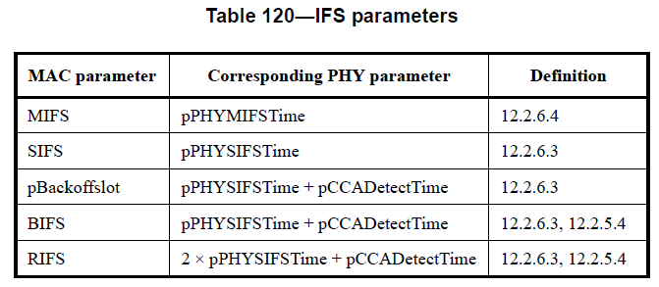
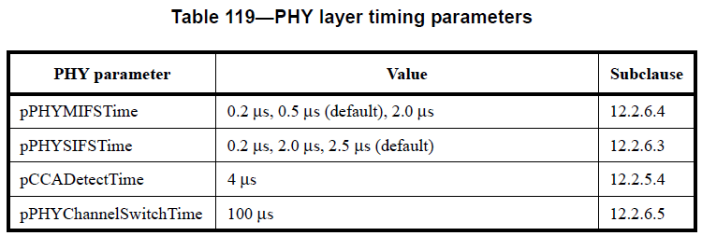
IFS Parameters
Parameters from 15.3c: SC PHY (SC LR PHY, HR PHY)
  MIFS: 0.2 μs, 0.5 μs (default), 2.0 μs
  SIFS: 0.2 μs, 2.0 μs, 2.5 μs (default)
  BIFS: SIFS + CCA(4 μs) (6.5 μs (default))
  RIFS: 2*SIFS + CCA(4 μs) (9 μs (default)) - Retransmission
  Slot time : SIFS + 4 μs (6.5 μs (default))
Additional IFS:
  Initiator IFS : SIFS
  Responder IFS : SIFS + CCA
  Priority based channel access in bi-directional CTA
Corresponding tables in 15.3c spec:

Slide 23
Channel Access in CTAP
CTAP
  Infinite (Static) CTA
    Start time & Infinite duration
  MCTA (Management CTA) is not used
  CTA types
    pseudo-static CTA
Bidirectional CTA (New)
  Infinite static CTA for P2P
  Bidirectional CTA for P2P
  Information exchange during connection phase
  In new Bidirectional CTA, both devices can initiate frame exchange sequences

Slide 24
Bidirectional CTA
Both peer devices can initiate frame sequences
  Initiator DEV: Primary owner
  Responder DEV: Secondary owner
Channel access priority : Primary DEV > Secondary DEV
IFS
  Primary : Initiator IFS (SIFS)
  Secondary : Responder IFS (SIFS + CCA)
  Retransmit IFS is not used
Unidirectional stream index is allocated to both Initiator DEV and Responder DEV respectively, and bidirectional stream is configured

Slide 25
Wide Channel Access
  Ch2 is the default channel (specified in TGD)
  Ch2 and Ch3 are used for 2 channel bonding (specified in TGD)
  Connection Phase
    Use default channel
    Supported channel BW is known by exchanging capability information
  Data phase
    Channel bonding, if available
    PPDU BW is signaled in preamble

Slide 26
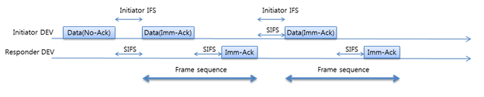
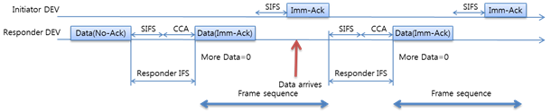
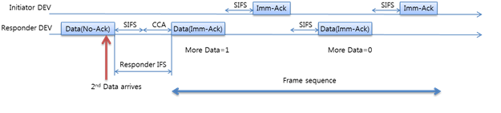
Frame Sequence (2/2)
Initiator initiates transmission regardless of the data arrival timing with SIFS interval if it has data to transmit
  Imm-Ack frame sequence initiated by an Initiator
Responder initiates a new frame sequence when data arrives
  Responder has data to transmit:
  Responder has data to transmit continuously:

Slide 27
Aggregation - Retransmission
DEV
Aggregated (block ack)
Aggregated (block ack)
Aggregation Retransmission
The same method used in non-aggregated frame
After Ack Timeout, retransmission is initiated using Initiator/Responder IFS
DEV
SIFS
CCA
SIFS
SIFS
Empty Data(Block Ack)
= BIFS
= RIFS
DEV
Aggregated (block ack)
Aggregation Retransmission
DEV
SIFS
Empty Data(Block NAck)

Slide 28
Stream Index
Stream Index
  Two initiator/responder DEVs are allocated to one bi-directional CTA for bi-directional stream
  0xF9: allocated to Initiator DEV in PNC
  0xFA: allocated to Responder DEV in PNC
    Bi-directional stream consists of 2 uni-directional stream

Slide 29
Information elements (1/4)
Following Information elements are used
  Most of the fields are inherited from 15.3 and 15.3c
Element ID | Element | Present in beacon | Related clause in IEEE802.15.3
0x00 | CTA | As needed | 7.4.1
0x01 | BSID | As needed | 7.4.2 | Option (may be omitted in PNC)
0x0A | CPN Capability | As needed |  | NEW
0x23 | P2P ATP | As needed |  | NEW

Slide 30
Information elements (2/4)
CTA IE: inherited from 15.3
CTA block: inherited from 15.3
  CTA duration is set to 0 in 15.3e
    Meaning: duration until the end of the Superframe
BSID IE: inherited from 15.3
  BSID can be omitted in 15.3e

Slide 31
Information elements (3/4)
Capability IE: inherited from 15.3 and modified
  PNC Capabilities and CPN capabilities are added to Overall capabilities field
octet: 8 | 1 | 1
Overall capabilities | Length (= 8) | Element IE
octet: 4 | 4
CPN capabilities | PNC capabilities

Slide 32
Information elements (4/4)
PNC capabilities
  Max associated DEVs is set to 1 in 15.3e
  Max CTRqBs is set to 0
  Most of the field of PNC rating field is inherited from 15.3b (Clause 7.4.11)
    PNC Des-mode and PNC capable bit are used in 15.3e and rest of the bits are set to 0

Slide 33
CPN capabilities
CPN capabilities inherits some fields of DEV capabilities in 15.3c and several fields are added for 15.3e
Fields in red colors are newly introduced or modified in 15.3e
b7 | b6 | b5 | b4 | b3 | b2 | b1 | b0
256-QAM Capable | 64-QAM Capable | 16-QAM Capable | 8-PSK Capable | QPSK Capable | SC Spreading | BPSK Capable | OOK Capable
b15 | B14 | b13 | b12 | b11 | B10 | b9 | b8
Always AWAKE | MIMO Capable | Number of Channel Bonding |  | LDPC 2 | LDPC 1 | RS | 1024-QAM Capable
B23 | b22 | b21 | b20 | b19 | B18 | B17 | b16
Sync frame capability | PCES capability | Pilot word capability | STP | CTA relinquish | Blk-ACK | Imp-ACK | Listen to Source
B31 | b30 | b29 | b28 | b27 | B26 | B25 | b24
Reserved |  | Supported Aggregation |  | Supported IFS

Slide 34
P2P Connection parameter IE
P2P Connection parameter IE is added for 15.3e
  Recommended ATP: lite-PNC indicates ATP (Association Timeout Period) using this field
    If the lite-PNC or DEV does not receive any frame from peer node during the recommended ATP, the DEV is disassociated.
  Expected RSSI: See “Touch Action” slide
    Set by a Lite-PNC
    Expected RSSI value of the beacon frame from the viewpoint of a DEV that will receive the beacon at the connection establishment trigger boundary (e.g, 1cm)
    Expected RSSI is expressed in 255 levels (1~255, 0 is reserved to indicated that the DEV may trigger connection establishment regardless of the expected RSSI value)
    The manufacturer of the Kiosk presets the value (How to set the value is out of the scope of standardization)
1 octet | 2 octet | 1 octet | 1 octet
Expected RSSI | Recommend ATP | Length (=5) | Element ID

Slide 35
Beacon (1/3)
  Basic format is inherited from 15.3 baseline document
    Size of the beacon is much smaller than size of the legacy beacon frame since many IEs defined in legacy spec are not required by 15.3e and they may not be present in 15.3e beacon frame
  P2P Connection parameter IE shall be included in the Beacon transmitted before association

Slide 36
Beacon (2/3)
Beacon
  Piconet Synchronization Parameter
    Address of 15.3e device is 6 octets. 2 octets of PNC address field is reserved
    Superframe duration: Setting 0 to this field means that the superframe covers the duration before disassociation
      Value is set between mMinSuperframeDuration and mMaxSuperframeDuration when the beacon is transmitted before association and after a DEV is disassociated
      Otherwise it is set to 0
    CAP end time
      Set to the value equal to Superframe duration before association and after a DEV is disassociated
      Otherwise it is set to end time of the beacon frame
    Other fields are inherited from the baseline

Slide 37
Beacon (3/3)
Beacon
    Piconet Mode
      Inherited from baseline document
      When the beacon is transmitted before association and after a DEV is disassociated, CAP command and CAP associations are set to 1 and other fields are set to 0
      Otherwise, all the fields are set to 0

Slide 38
Command Frames
Following command frames are used in 15.3e
Command type | Commad name | Related clause in IEEE802.15.3
0x0000 | Association request | 7.5.1.1
0x0001 | Association response | 7.5.1.2 | option
0x0002 | Disassociation request | 7.5.1.3

Slide 39
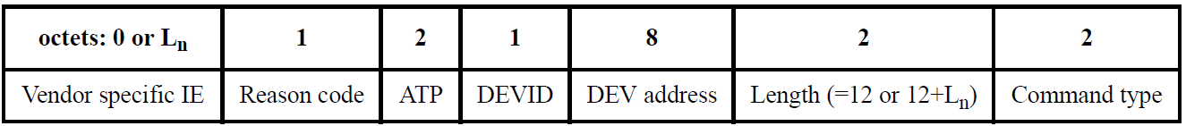
Association Request/Response
Association Request
  Inherited from 15.3 and 15.3c
  DEV utility is set to 0
Association Response
  Inherited from 15.3 and 15.3b
  Association Response can be replaced by Imm-Ack in 15.3e
    Used when the lite-PNC rejects the association request or allocates other ATP value which is different from the ATP value in Association Request
Disassociation Request
  - Inherited from 15.3 and 15.3b

Slide 40
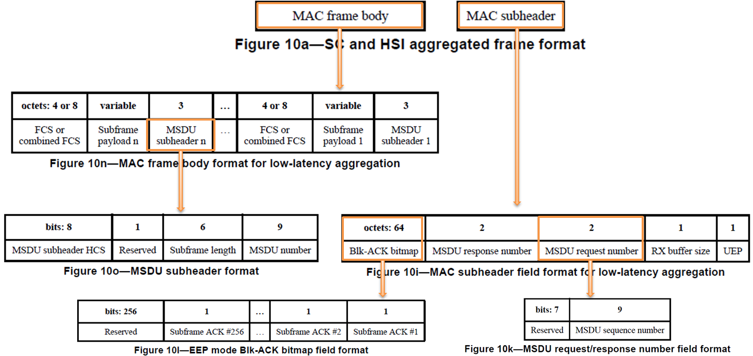
Data Frame
Only low-latency aggregation is used in 15.3e for increased throughput
UEP is not used

Slide 41
Analysis – Link Setup Time (1/6)
Link Setup Time

Slide 42
Analysis – Link Setup Time (2/6)
MAC Frame Length:
Beacon before association
  Piconet synchronization parameters (21B), BSID IE (~34B), Capability IE (9B), P2P Connection parameter IE (5B)
  MAC header 10 octets, MAC frame body ~73 octets
Beacon after association
  Piconet synchronization parameters (21B), BSID IE (~34B), CTA IE (16B)
  MAC header 10 octets, MAC frame body ~75 octets
Association request
  MAC header 10 octets, MAC frame body 26 octets
Imm-Ack
  MAC header 10 octets

Slide 43
Analysis – Link Setup Time (3/6)
- PPDU length calculation using OOK PHY (1 channel, 1 antenna)
 | PHY preamble duration (us) | PHY header length (bit) | MAC header length (bit) | HCS (bit) | RS parity (bit) | Header spreading factor | total Header length (byte) | MAC frame body length (byte) | Body spreading factor | total frame body length (byte) (RS coding) | chip rate (Mchip/s) | PPDU duration (us)
Beacon | 2.04 | 32 | 80 | 16 | 128 | 32 | 1024 | 73 | 1 | 255 | 1760 | 7.85
Ass.Req | 2.04 | 32 | 80 | 16 | 128 | 32 | 1024 | 26 | 1 | 255 | 1760 | 7.85
Imm-Ack | 2.04 | 32 | 80 | 16 | 128 | 32 | 1024 | 0 | 1 | 0 | 1760 | 6.69

Slide 44
Analysis – Link Setup Time (4/6)
IFS: use the same IFS defined in 15.3c
Parameters from 15.3c: SC PHY (SC LR PHY, HR PHY)
  MIFS: 0.2 μs, 0.5 μs (default), 2.0 μs
  SIFS: 0.2 μs, 2.0 μs, 2.5 μs (default)
  BIFS: SIFS + CCA(4 μs) (6.5 μs (default))
  RIFS: 2*SIFS + CCA(4 μs) (9 μs (default)) - Retransmission
  Slot time : SIFS + 4 μs (6.5 μs (default))
Corresponding tables in 15.3c spec are as follows:

Slide 45
Analysis – Link Setup Time (5/6)
Superframe Structure
Superframe before association
- BIFS: 6.50, SIFS: 2.50, SlotTime: 6.50, Modulation: OOK (Chip rate: 1760 Mchip/s, 1 channel)
- Association request/Imm-Ack uses CAP duration
  BIFS + Backoff + Association request + SIFS + Imm-Ack
  6.5us + 4 * 6.5us + 7.85us + 2.5us + 6.69us = 49.54 us
- minimum superframe duration before association
  Beacon + SIFS + minimum CAP duration
  7.85us + 2.5us + 49.54us = 59.89us
*15-14-0612r4 “Proposal to create a new TG 15.3e” proposed that superframe duration before
link setup should be short enough under 200 us. ETRI Proposal satisfies the proposed 200 us.
beacon
CAP
beacon
CAP
beacon
CTA
beacon
Superframe after association

Slide 46
Analysis – Link Setup Time (6/6)
Total link setup time (using OOK, 1 channel, 1 antenna)
  1 superframe duration before association + 1 beacon
  → 59.89us + 7.85us = 67.74 us
Therefore, link setup time is less than 2ms

Slide 47
Analysis – MAC Throughput (OOK)
MAC Throughput for frame sequences
  PPPU duration using OOK PHY (1 channel & 2 channel, No MIMO)
Therefore, link setup time is less than 2ms
 | PHY preamble duration (us) | PHY header length (bit) | MAC header length (bit) | HCS (bit) | RS parity (bit) | Header spreading factor | total Header length (byte) | MAC frame body length (byte) | Body spreading factor | total frame body length (byte) (RS coding) | chip rate (Mchip/s) | PPDU duration (us)
Data (1500B) (1 channel) | 2.04 | 32 | 80 | 16 | 128 | 32 | 1024 | 1500 | 1 | 1785 | 1760 | 14.80
Data (8000B) (1 channel) | 2.04 | 32 | 80 | 16 | 128 | 32 | 1024 | 8000 | 1 | 8670 | 1760 | 46.10
Data (1MB) (1 channel) | 2.04 | 32 | 80 | 16 | 128 | 32 | 1024 | 1048575 | 1 | 1118940 | 1760 | 5092.78
Data (1500B) (2 channel) | 2.04 | 32 | 80 | 16 | 128 | 32 | 1024 | 1500 | 1 | 1785 | 3920 | 7.77
Data (8000B) (2 channel) | 2.04 | 32 | 80 | 16 | 128 | 32 | 1024 | 8000 | 1 | 8670 | 3920 | 21.82
Data (1MB) (2 channel) | 2.04 | 32 | 80 | 16 | 128 | 32 | 1024 | 1048575 | 1 | 1118940 | 3920 | 2287.68
 | MSDU length (Byte) | Data/Ack sequence duration (us) [SIFS+Data+SIFS+Imm-Ack] | MAC SAP throughput (Mbps) | Imp-Ack sequence duration (us) [SIFS + Data] | MAC SAP throughput (Mbps)
1 channel | 1500 | 26.50 | 452.9079 | 17.30 | 693.4594
 | 8000 | 57.79 | 1107.441 | 48.60 | 1316.872
 | 1118940 | 5104.47 | 1753.662 | 5095.28 | 1756.825
2 channel | 1500 | 16.90 | 710.2619 | 10.27 | 1168.564
 | 8000 | 30.95 | 2068.106 | 24.32 | 2631.575
 | 1118940 | 2296.80 | 3897.382 | 2290.18 | 3908.658

Slide 48
Analysis – MAC Throughput (HR PHY)
MAC Throughput for frame sequences (Peak MAC Rate):
  PPPU duration using HR PHY 3~4 channel bonding, 2 Stream, 1024 QAM, LDPC (1440, 1344)
Peak MAC Rate
 | PHY preamble duration (us) | PHY header length (bit) | MAC header length (bit) | HCS (bit) | RS parity (bit) | Header spreading factor | total Header length (byte) | MAC frame body length (byte) | Body spreading factor | total frame body length (byte) (RS coding) | data rate (Mbps) | PPDU duration (us)
Imm-Ack (3 channel, 2 stream)) | 2.62 | 40 | 80 | 16 | 128 | 32 | 1056 | 0 | 1 | 0 | 113493 | 2.69
Data (1MB) (3 channel, 2 stream) | 2.62 | 40 | 80 | 16 | 128 | 32 | 1056 | 1048575 | 1 | 1124640 | 113493 | 81.97
Imm-Ack (4 channel, 2 stream)) | 2.62 | 40 | 80 | 16 | 128 | 32 | 1056 | 0 | 1 | 0 | 153813 | 2.67
Data (1MB) (4 channel, 2 stream) | 2.62 | 40 | 80 | 16 | 128 | 32 | 1056 | 1048575 | 1 | 1124640 | 153813 | 61.17
 | MSDU length (Byte) | Data/Ack sequence duration (us) [SIFS+Data+SIFS+Imm-Ack] | MAC SAP throughput (Mbps) | SIFS + Data sequence duration (us) | MAC SAP throughput (Mbps)
3 channel, 2 stream | 1048575 | 89.66 | 93,560.21 | 84.47 | 99,311.82
4 channel, 2 stream | 1048575 | 68.84 | 121,856.31 | 63.67 | 131,757.44

Slide 49
Technical Requirements
2.1 Functional Requirements
2.1.1 Connection Topology: For the Close Proximity system, the connection is always limited to two devices and the topology is required to be Point-to-Point → Satisfied by MAC Proposal:
- See Slide 6, 11~ 13
2.1.2 Media access mechanism
The close proximity P2P system shall have the following features to achieve its basic requirements:
a. Link setup without any network identifiers → Satisfied by MAC Proposal: No Network identifier is used in the proposal
b. Network topology always limited to two devices → Satisfied by MAC Proposal: See Slide 6, 11~ 13

Slide 50
Technical Requirements
2.1 Functional Requirements
2.1.2 Media access mechanism
c. Link setup time of 2 msec or less, prior to entering active state, to meet application requirements → Satisfied by MAC Proposal: See analysis in Slide 41 ~ 46
d. A means of ensuring spatial division from other systems without beamforming → Satisfied by PHY Proposal: MIMO using polarization is used without beamforming for ensuring spatial division
e. CSMA/CA not required prior to data transmission → Satisfied by MAC Proposal: See analysis in Slide 11, 21. No CSMA/CA is used since CTA is used during data transmission phase

Slide 51
Technical Requirements
2.1 Functional Requirements
2.1.2 Media access mechanism
f. No periodic management frame transmission after connection establishment → Satisfied by MAC Proposal: beacon is not transmitted during the data transmission phase. Beacon is transmitted after a DEV is associated. See slide 11 ~ 12
g. A method to estimate whether a peer device drew apart and a procedure to promptly dissolve connection and change to a standby state when such estimation is made → Satisfied by MAC Proposal: See slide 13. If a DEV moves out of the range of the lite-PNC (e.g, 10 cm), then frames cannot be exchanged and the DEV is disassociated using the timeout mechanism. The range can be adjusted by the lite-PNC by transmit power control. Timeout period can be adjusted by using ATP value

Slide 52
Technical Requirements
2.1 Functional Requirements
2.1.3 QoS
Because of the P2P connectivity, QoS mechanisms are not applicable → No specific mechanisms are specified in the proposal since 2.1.3 does not require QoS mechanisms
2.1.4 Security
Because of the limitation of the transmission range, security mechanisms for the PHY and MAC layers may be omitted for a close proximity P2P system → Security mechanisms are omitted in the proposal since 2.1.4 allows it

Slide 53
Technical Requirements
2.1 Functional Requirements
2.1.5 Power Management
Close proximity P2P communications, where at least one of the two P2P devices in the system will be mobile/handheld, is expected to have extremely short active time. In this regard, the system shall be designed to enable low power consumption in standby state. Furthermore, the system should be designed to have low power consumption in the active state. No additional, special power management schemes are required.
→ No specific power management protocol is proposed, since 2.1.5 does not require new power management protocol should be included in the spec

Slide 54
Technical Requirements
2.2 Performance Requirements
2.2.1 Operation frequency band
The system shall use the 60 GHz unlicensed band. The channel plan is based on that of IEEE802.15.3c. Ch2 is the default channel. Ch2 and Ch3 in this band are designated as unlicensed bands in many countries. Hence the system should support the use of these two channels. Channel bonding or aggregation may be used.
→ Satisfied by PHY Proposal. PHY proposal uses 60 GHz band, and includes channel bonding schemes. See slide 12 ~ 15, 29 and 43

Slide 55
Technical Requirements
2.2 Performance Requirements
2.2.2 Transmission Range
The maximum transmission range will define the close proximity area to allow the touch operation but should be kept to within 100 mm, without any steering or beamforming, when operating at the minimum required rate as defined by each proposal. Likewise, the two P2P devices should disconnect if the separation between the two becomes larger than the close proximity area.
→ Satisfied by MAC Proposal: See slide 13. If a DEV moves out of the range of the lite-PNC (e.g, 10 cm), then frames cannot be exchanged and the DEV is disassociated using the timeout mechanism. The range can be adjusted by the lite-PNC by transmit power control. Timeout period can be adjusted by using ATP value

Slide 56
Technical Requirements
2.2 Performance Requirements
2.2.3 Spectral efficiency
MIMO may be used
→ Satisfied by PHY Proposal: See slide 16 ~ 23 of the PHY Proposal
2.2.4 Data rate
The data rates should be sufficient to support the proposed use cases in conjunction with the operational frequency plan and channel model, operating at PHY rates up to 100 Gbps.
→ Satisfied by PHY Proposal. 100 Gbps can be achieved by using channel bonding, MIMO and 1024 QAM. See slide 53~54 (MCS tables)

Slide 57
Technical Requirements
2.2 Performance Requirements
2.2.5 Link budget
The proposal should include evidence that the system meets the requirement in Section 2.2.2 (Transmission range)
See Link Budget Margin table in the PHY Proposal

Slide 58
Regulatory Requirements
3. Regulatory requirements
The output RF power levels and other regulations for each country which allow the use of the unlicensed 60 GHz band shall be followed
→ RF power levels used in slide 73 are much lower than regulations for each country.
RF power levels and regulation related parameters can be adjusted to meet the requirement by the application or manufacturers.

Slide 59
Evaluation Criteria - PHY
1. Communication distance: Must demonstrate link budget values at a distance of 10 cm based on simulation.
See Link Budget Margin table in the PHY Proposal
2. Frequency: Shall operate within the 60GHz unlicensed band
Satisfied by PHY Proposal.
3. Interference: Shall be able to operate in dense environments without mutual interference among 3e devices
→ Due to the limited range of 3e devices, 3e devices can operate without mutual interference among 3e devices
4. Coexistence: Shall be able to coexist with other systems in the same band when operating without any beamforming technology
→ Due to the limited range of 3e devices, 3e devices can coexist with other systems without beamforming

Slide 60
Evaluation Criteria - PHY
5. Calculated data rate at the PHY SAP: At least one mode shall be capable of achieving 100 Gbps satisfying the common frequency regulations of US, EU, Korea, and Japan
→ Satisfied by PHY Proposal. 3 channels can be bonded in the above countries. Proposed system can provide 100 Gbps Peak PHY rate using channel bonding, MIMO, and 1024 QAM. See slide 53~54 (MCS tables) of the PHY Proposal
6. Antenna form factor: The antenna used for satisfying the other PHY criteria shall be small enough for placement and operation inside a mobile device, including smartphones. → satisfied by PHY Proposal. Maximum 2 antennas are used, the size of an antenna is 3.2 X 3.2 mm². See slide 20 of the PHY Proposal

Slide 61
Evaluation Criteria - MAC
1. Connection setup time: less than 2 ms → Satisfied by MAC Proposal. See analysis described in slide 41 ~ 46
2. Definition of "Connection setup time": time from first successful reception of all necessary information from the management frame(s) to completion of association by both devices → The definition is used when calculating the link setup time
3. P2P: Operation shall be limited to point-to-point connection between two devices only → Satisfied by MAC Proposal:
- See Slide 6, 11~ 13 of the MAC Proposal
4. No identifiers: Connection setup shall be performed without exchanging network identifiers (PNID) for each session → Satisfied by the MAC Proposal: No Network identifier is used in the proposal

Slide 62
Evaluation Criteria - MAC
5. NO CSMA: No Listen before Talk (or CSMA) shall be used prior to transmission → Satisfied by MAC Proposal: See Slide 12, 21. No CSMA/CA is used since CTA is used during data transmission phase
6. Management frames: No periodic management frames shall be transmitted after completion of association → Satisfied by MAC Proposal: beacon is not transmitted during the data transmission phase. Beacon is transmitted after a DEV is associated. See slide 11 ~ 12 of the MAC Proposal
7. Data throughput: Shall be calculated at the MAC SAP → See the calculated MAC throughput in the MAC Proposal (Slide 47 ~ 48)

Slide 63
Evaluation Criteria - MAC
8. Error detection and correction: In the presence of random and burst errors, there shall not be serious throughput degradation nor falling into unstable states → error can be detected using FCS and mechanism. Since Ack and retransmission mechanism is provided at the MAC layer, the system can cope with random and burst errors

Slide 64
Evaluation Criteria – System Criteria
Touch action: Bringing the antennas to within about 1 cm shall trigger the two devices to establish connection. Accurate spatial alignment shall not be required.→ Satisfied by the MAC proposal. See slide 14 of the MAC Proposal (touch action)
2. Disconnection: Shall be able to disconnect promptly when devices draw apart beyond 10 cm → Satisfied by the MAC Proposal: See slide 13. If a DEV moves out of the range of the lite-PNC (e.g, 10 cm), then frames cannot be exchanged and the DEV is disassociated using the timeout mechanism. The range can be adjusted by the lite-PNC by transmit power control. Timeout period can be adjusted by using ATP value

Slide 65
Evaluation Criteria – System Criteria
3. Efficient Design: System shall achieve high throughput and low latency using simple design → Satisfied by MAC and PHY Proposal. The system provides OOK based PHY which is based on the simplest modulation method. Supporting dual PHY modes are straightforward without complex mechanisms. MIMO using polarization is used for high throughput which is very simple to implement
4. Mobile devices should be energy-efficient → Satisfied by PHY Proposal since the proposal includes OOK PHY which is very energy efficient

Slide 66
Summary
Full Proposal for Close Proximity MAC for 15.3e
  Network Architecture is simplified (CPN)
  Simplified & Fast Association procedure
  Simplified Superframe and optimized frames
  Introduced Bidirectional CTA
Inherited baseline document
  Uses existing architecture, frame sequences, and frames as much as possible to avoid reinventing the same features
  15.3e is an amendment to 15.3, 15.3b, and 15.3c
    With as much optimization as possible
    Simplified & Fast Association procedure
Dual PHY modes can be supported
  Supporting dual PHY mode is an implementation issue
  No MAC complexity for supporting dual PHY

Slide 67
References
[1] TG3e Technical Guidance document, May, 2015
[2] TG3e Channel Modeling document, May, 2015
[3] IEEE 802.15.3 – 2003 Specification, September 2003
[4] IEEE 802.15.3b – 2005 Specification, May 2006
[5] IEEE 802.15.3c – 2009 Specification, October 2009
[6] IEEE 802.11 REVmc D4.0, January 2015
[7] 15-14-0612r4 “Proposal to create a new TG 15.3e”, 2014, WNG

Slide 68
Q & A

