Slide 1
Project: IEEE P802.15 Working Group for Wireless Personal Area Networks (WPANs)
Submission Title: Discovery of a device in a PAN by a device in another PAN in TMCTP: Supplementary information for Comments CID 53 and 54 of Letter Ballot #104
Date Submitted: May 22, 2015
Source: Soo-Young Chang (SYCA), Jaebeom Kim (Ajou Univ.), and Jaehwan Kim and Sangsung Choi (ETRI)
Company: SYCA, Ajou Univ. and ETRI
Address:
Voice: +1 530 574 2741, E-Mail: sychang@ecs.csus.edu and kimj@etri.re.kr
Re:
Abstract: To provide supplementary Comment on the draft of TG10 L2R routing for Letter Ballot #104
Purpose: To suggest comment resolution for Letter Ballot #104
Notice: This document has been prepared to assist the IEEE P802.15. It is offered as a basis for discussion and is not binding on the contributing individual(s) or organization(s). The material in this document is subject to change in form and content after further study. The contributor(s) reserve(s) the right to add, amend or withdraw material contained herein.
Release: The contributor acknowledges and accepts that this contribution becomes the property of IEEE and may be made publicly available by P802.15.

Slide 2
Introduction
One question was raised from the floor regarding discovery issue for TMCTP when proposed resolutions for Comment CIDs 53 and 54 of Letter Ballot #104 were presented during Vancouver meeting in May 2015
The question is
How a device in a PAN can be discovered by a device in another PAN?
In this document, this issue is addressed.

Slide 3
In TMCTP
A PAN coordinator uses two channels for scheduling with another PAN
As shown in Figure 34z of 802.15.4m.
In this figure, as an example, the PAN 2 coordinator uses Channels 1 and 2.
Each TMCTP-parent PAN coordinator, including the SPC,
communicates with its TMCTP-child PAN coordinators during the CAP or CFP of the TMCTP-parent PAN coordinator superframe and
receives beacon frames of its TMCTP-child PAN coordinators on a dedicated channel during the dedicated beacon slots (DBS) assigned to them in the BOP, as shown with an asterisk (*) in Figure 2a.
For L2R, information on the above two channels is exchanged in beacon slots so that each device can establish routes with other devices.

Slide 4
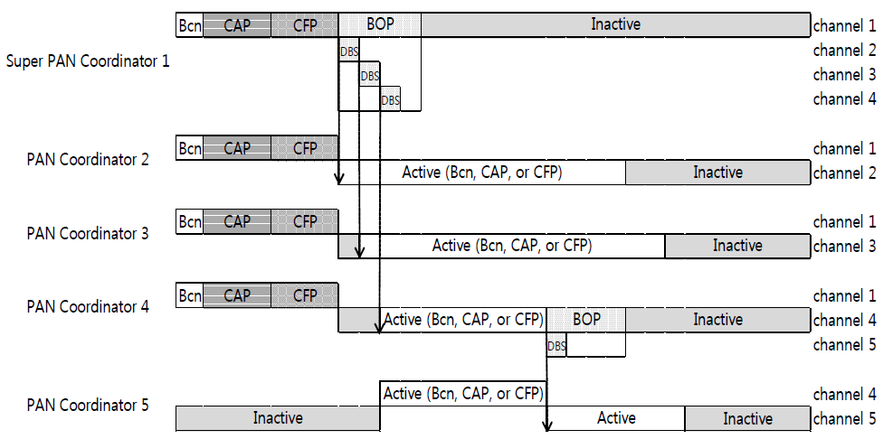
Figure 34z in 802.15.4m Example TMCTP BOP allocation

Slide 5
Discovery of a Device
Channel establishment procedure for discovery
Orphan channel scanning
Join (parent PAN)
Own PAN channel assignment (received from geological DB) and operation

