Slide 1
Project: IEEE P802.15 Working Group for Wireless Personal Area Networks (WPANs)
Submission Title: On the optimization of the random access scheme for PAC
Date Submitted: May, 2015
Source: [Byung-Jae Kwak, Gyung-Chul Sihn, Moon-Sik Lee]¹,
[Junhyuk Kim, Nah-Oak Song, June-Koo Kevin Rhee]²
Affiliation: [ETRI, Korea]¹, [KAIST, Korea]²
Address: [218 Gajeong-ro, Yuseong-gu, Daejeon, Korea]¹, [291 Daehak-ro, Yuseong-gu, Daejeon, Korea]²
Voice: +82-42-860-6618
E-Mail: [bjkwak@etri.re.kr, neuro@etri.re.kr, moonsiklee@etri.re.kr],
[kim.jh@kaist.ac.kr, nsong@kaist.ac.kr, rhee.jk@kaist.edu]
Re:
Abstract: Simulation results for discussion of the optimization issue of scalable random access scheme for fully distributed D2D communications.
Purpose: Discussion
Notice: This document has been prepared to assist the IEEE P802.15. It is offered as a basis for discussion and is not binding on the contributing individual(s) or organization(s). The material in this document is subject to change in form and content after further study. The contributor(s) reserve(s) the right to add, amend or withdraw material contained herein.
Release: The contributor acknowledges and accepts that this contribution becomes the property of IEEE and may be made publicly available by P802.15.

Slide 2
On the Optimization of the Random Access Scheme for PAC
May 2015
Vancouver, BC, CA

Slide 3
Recap 15-14-0687-00-0008 (1/4)
Random access is used in Peering Period and CAP as well as in distributed synchronization.
But the requirements for Peering Period and CAP are different from those for distributed synchronization
Synchronization Signals | Messages
Transmitted by all PDs | Transmitted by PDs with messages
Transmitted always | Transmitted only when needed
Stable | Dynamic
Criterion: Stability, simplicity | Criterion: Adaptability, performance

Slide 4
Recap 15-14-0687-00-0008 (2/4)
Distributed synchronization
  i-EIED (called EIED in 687r0)
  “i-” stands for idle-time
  CW (contention window) is updated using EIED (exponential increase exponential decrease) backoff algorithm
  CW is updated based on the idle-time between packets (i.e., inter-arrival time)
Messages in Peering Period and CAP
  p-EIED (aka adaptive p-persistent in 687r0)
  “p-” stands for persistent
  Instead of CW, use probability of transmission p (≈ 1/CW)
  p is updated based on the idle-time between packets

Slide 5
Recap 15-14-0687-00-0008 (3/4)
Simulation results: Basic access, #PDs: 50 → 200

Slide 6
Recap 15-14-0687-00-0008 (4/4)
Simulation results: RTS/CTS, #PDs: 50 → 200

Slide 7
p-EIED in a Nutshell
p: Probability of packet transmission in the next backoff slot
T_{T}: Target idle-time between packets
T_{M}: Measured idle-time between packets
if (T_{M} < T_{T})
increase p;
else if (T_{M} ≈ T_{T})
no change to p;
else /* T_{M} > T_{T} */
decrease p;

Slide 8
p-EIED Parameters
p: Probability of packet transmission in the next backoff slot
  Updated when hears a packet transmission (as opposed to when backoff counter is expired)
  Large p means aggressive transmission (as opposed to small CW)
T_{T}: Target idle-time between packets
  Large T_{T} means conservative medium access (when cost of collision is large)
  Small T_{T} means aggressive medium access (when cost of collision is small)
  p-EIED is optimized by choosing T_{T}

Slide 9
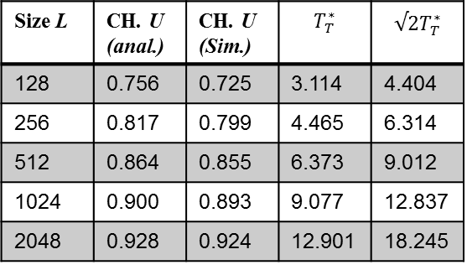
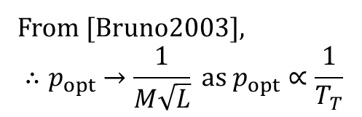
Optimization of p-EIED
Size L | CH. U (anal.) | CH. U (Sim.) | $$T_{T}^{∗}$$ | $$√2T_{T}^{∗}$$
128 | 0.756 | 0.725 | 3.114 | 4.404
256 | 0.817 | 0.799 | 4.465 | 6.314
512 | 0.864 | 0.855 | 6.373 | 9.012
1024 | 0.900 | 0.893 | 9.077 | 12.837
2048 | 0.928 | 0.924 | 12.901 | 18.245
From [Bruno2003],
$$∴p_{opt}→\frac{1}{M\sqrt{L}} as p_{opt}∝\frac{1}{T_{T}}$$
[Bruno2003] R. Bruno, M. Conti, E. Gregori, “Optimal capacity of p-persistent CSMA protocols,”
IEEE Communications Letters, vol. 7, no. 3, pp. 139-141, 2003.

Slide 10
Performance: packet size change (1/4)
Optimized for packet length L₁
Performance evaluated when all packets are of length L₂ ≠ L₁
Schemes compared
  Case 1: p = p_{basic} / sqrt(L₂ / L₁)
  Case 2: p = p_{basic} / (L₂ / L₁)
  Case 3: p = p_{basic}
NOTE: Corresponding scalar also needs to be applied
when T_{M} is estimated.

Slide 11
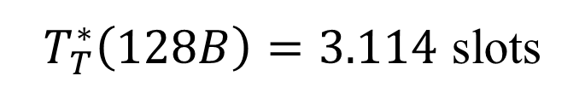
Performance: packet size change (2/4)
Optimized for packet length L₁ = 128B
$T_{T}^{∗}\left(128B\right)=3.114$ slots

Slide 12
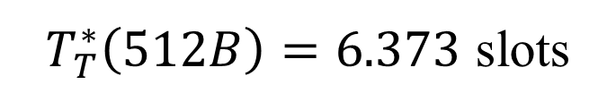
Performance: packet size change (3/4)
Optimized for packet length L₁ = 512B
$T_{T}^{∗}\left(512B\right)=6.373$ slots

Slide 13
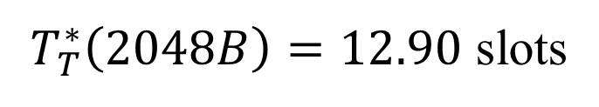
Performance: packet size change (4/4)
Optimized for packet length L₁ = 2048B
$T_{T}^{∗}\left(2048B\right)=12.90$ slots

Slide 14
Performance: mixed packet sizes (1/3)
Optimized for packet length L₁ = 512B
Performance evaluated when
  20 PDs have 256B packets;
  20 PDs have 512B packets;
  20 PDs have 1024B packets.

Slide 15
Performance: mixed packet sizes (2/3)
Schemes compared (same as above)
  Case 1: p = p_{basic} / sqrt(L₂ / L₁)
    Maintain maximum performance & fairness
  Case 2: p = p_{basic} / (L₂ / L₁)
    Maintain maximum channel time fairness
  Case 3: p = p_{basic}
    Maintain maximum channel access fairness
NOTE: Corresponding scalar also needs to be applied
when T_{M} is estimated.

Slide 16
Performance: mixed packet sizes (3/3)
 | Case 1 | Case 2 | Case 3
Ch. Utilization | 0.835465 | 0.812322 | 0.846646
Fairness in Tx chances | 0.928959 | 0.779422 | 0.999649
Fairness in channel time (including coll.) | 0.924825 | 0.999603 | 0.776243
Time Occupancy: * PDs with 256B packets * PDs with 512B packets * PDs with 1024B packets | 11.094 15.622 22.425 | 16.731 16.795 16.870 | 7.017 13.986 28.028

Slide 17
Discussion (1/2)
Optimization is not simple
  Packet length
  Performance vs. fairness
Best overall is case 1 with scaling factor 1/sqrt(L₂/L₁)
  Case 1
    Maintain best performance when packet length changes if all packets are of the same length
    High performance without sacrificing fairness too much in mixed packet length scenario
    Rewards efficient channel use
  Case 2
    Poor performance when packet size changes from the basic length
    Maintain excellent channel time fairness at the cost of throughput in mixed packet size scenario
    Reward efficient channel use
  Case 3
    Poor performance when packet size changes fro the basic length
    Maintain excellent channel access fairness and performance in mixed packet size scenario
    Does not reward efficient channel use

Slide 18
Discussion (2/2)
p-EIED is designed to be used in Peering Period and CAP
Traffic model (average packet length) in Peering Period and CAP are expected to be quite different
  Peering Period → Optimal T_{T} for Peering Period
  CAP → Optimal T_{T} for Peering Period
Frame format, message types, what’s in the packet, etc., need to be determined before optimization of p-EIED.

