Slide 1
        doc.: IEEE 802.15-15-0410-00-007a
Project: IEEE P802.15 Working Group for Wireless Personal Area Networks (WPANs)
Submission Title: Home-page document for LED-ID : LED-ID Related Technical Features and Applications
Date Submitted: May. 13, 2015
Source: Jaesang Cha*, Min-Woo Lee**, JongHyeok Lee**, Hyung-O Kim**, Soo-Young Chang***
Company: Seoul National University of Science & Technology*
Graduate School of NID Fusion Technology, Seoul National University of Science & Technology**
CSUS***
Address:
Voice: FAX: E-Mail: chajs@seoultech.ac.kr
Re:
Abstract: This document is prepared to provide information for TG 15.7r1 home page contents regarding LED-ID.
Purpose: To provide conceptual information on LED-ID to TG 15.7r1 home page.
Notice: This document has been prepared to assist the IEEE P802.15. It is offered as a basis for discussion and is not binding on the contributing individual(s) or organization(s). The material in this document is subject to change in form and content after further study. The contributor(s) reserve(s) the right to add, amend or withdraw material contained herein.
Release: The contributor acknowledges and accepts that this contribution becomes the property of IEEE and may be made publicly available by P802.15.
Slide 1
Jaesang Cha, Seoul National Univ. of Science & Tech.

Slide 2
Home page document for LED-ID
: LED-ID Related Technical Features and Applications
Slide 2
Notes:
doc.: IEEE 802.15-09-0117-00-0007
<month year>

Slide 3
Contents
LED-ID Technology for IEEE802.15.7r1
Concept of LED-ID Technology
Use Cases of LED-ID
Conclusions

Slide 4
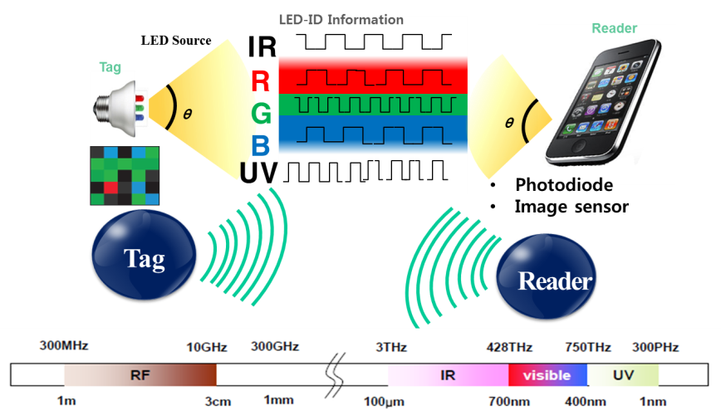
        doc.: IEEE 802.15-15-0410-00-007a
LED-ID Technology for IEEE802.15.7r1
IEEE802.15.7r1 TG OWC (Optical Wireless Communications) consists of three topics as:
  LED-ID: LED-ID is defined as wireless light ID (Identification) system using various LED Light signals
  OCC (Optical Camera Communications)
  LiFi
Concept of LED-ID
  LED-ID is defined as wireless light ID (Identification) system using various LED Light signals.
LED-ID is one of three major topics of OWC while other two are OCC and LiFi.

Slide 5
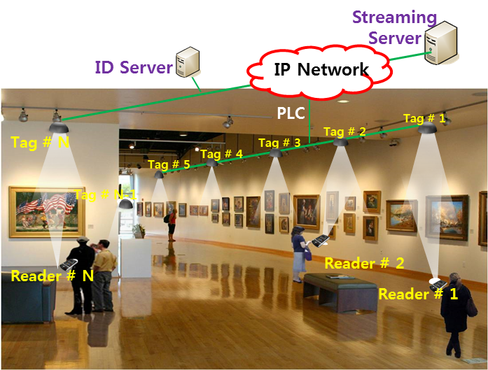
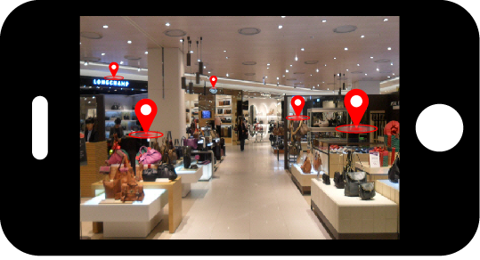
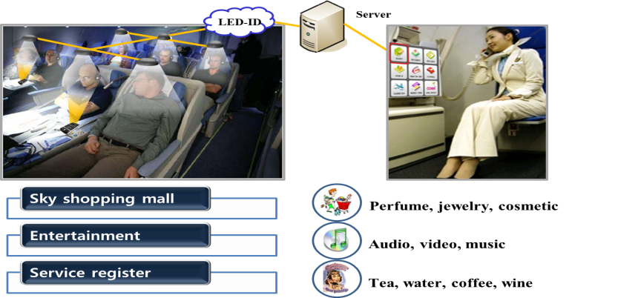
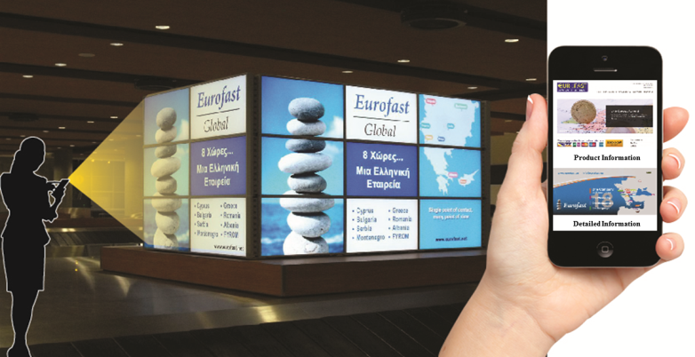
        doc.: IEEE 802.15-15-0410-00-007a
Use Case of LED-ID #1:
Applications of LED-ID Services
Exhibition Service
Indoor Store Service
In-flight Service
Facility Signage/Display
LED-ID signals can be used for data transmission or positioning recognition at exhibition center, indoor store, in-flight and facility signage/display, etc.

Slide 6
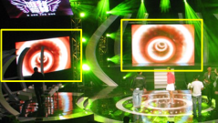

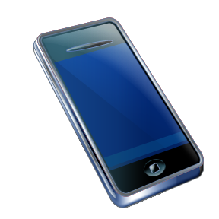
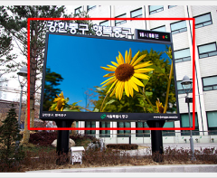


        doc.: IEEE 802.15-15-0410-00-007a
Use Case of LED-ID #2:
LED QR/Color Code
Facility Signage
Color code
QR code
Tag : LED based Bar code (Color code, QR code, etc.)
Reader : Camera Image Sensor of Smart Phone/Pad

Slide 7
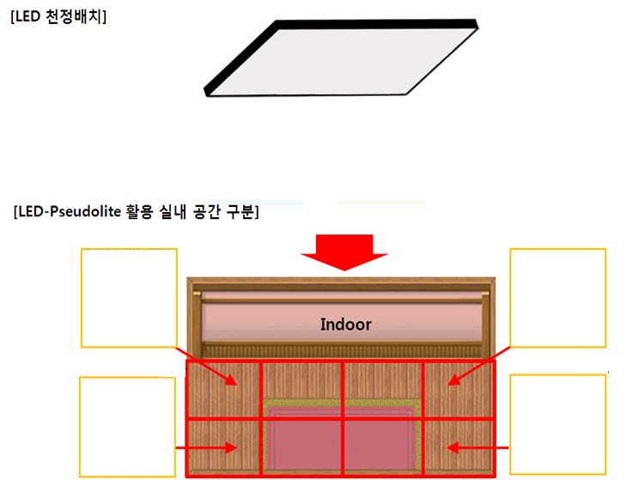
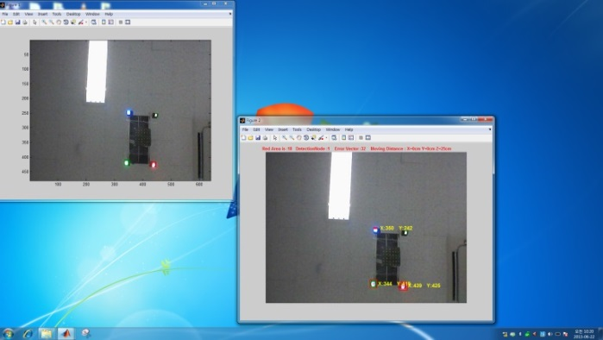

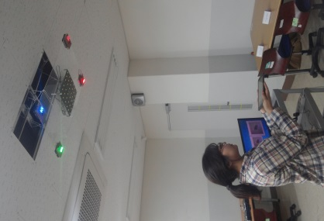
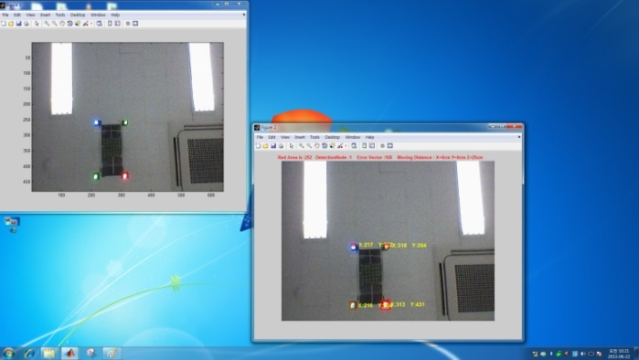
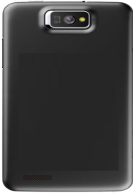
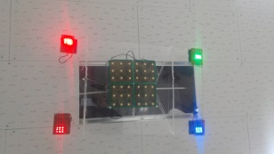
        doc.: IEEE 802.15-15-0410-00-007a
Use Case of LED-ID #3:
Camera Positioning (CamPo)
Smart Phone Camera based indoor Positioning using multiple LED light signals with high resolution is possible.

Slide 8
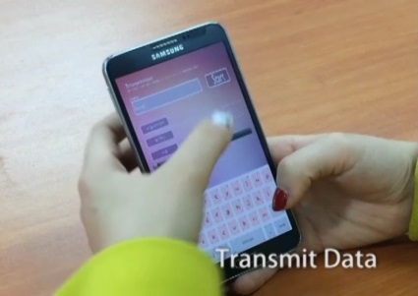
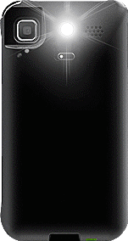
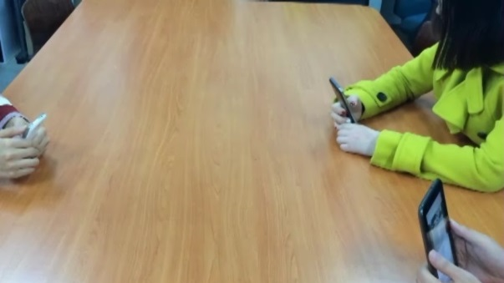
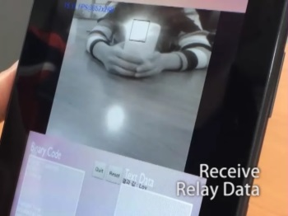
        doc.: IEEE 802.15-15-0410-00-007a
Use Case of LED-ID #4:
P2P (Phone to Phone) Tx/Rx & Relay Application
VLC (OCC)
Tx action
LED Flash Light
Camera
Tx : LED flash light of Smart Device
Rx : Camera module of Smart Device
Rx/Tx (Relay action)
Rx action
Tx: LED flash light of Smart device Rx : Camera of a Smart device.
  LED-ID solutions with smart phone cameras can also be a main OCC& OWC solution.

Slide 9
        doc.: IEEE 802.15-15-0410-00-007a
Conclusions
  LED-ID is defined as wireless light ID (Identification) systems realized using various LED Light signals.
  LED-ID is one of three major topics of OWC; other two are OCC & LiFi.
  Various use cases based on LED-ID can be considered.

Slide 10
        doc.: IEEE 802.15-15-0410-00-007a
Appendix
Slide 10
Notes:
doc.: IEEE 802.15-09-0117-00-0007
<month year>

Slide 11
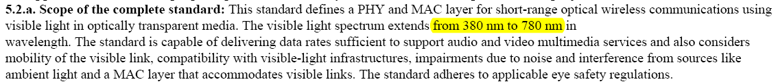
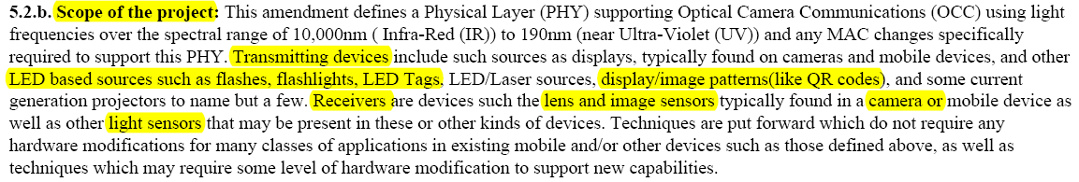
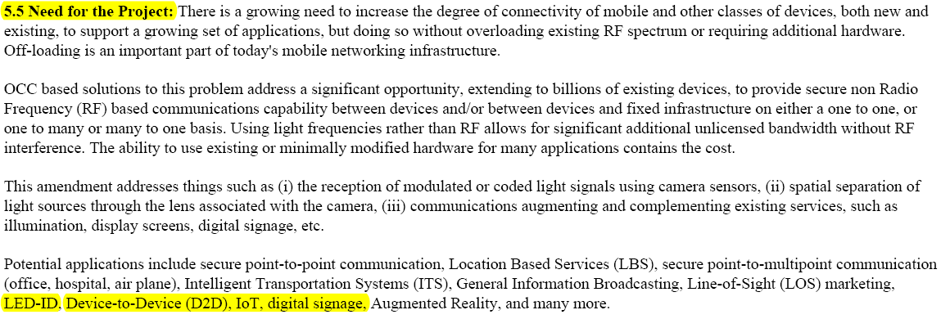
        doc.: IEEE 802.15-15-0410-00-007a
LED-ID Related PAR Components
[ Source : http://ieee802.org/15/par.html ]

Slide 12
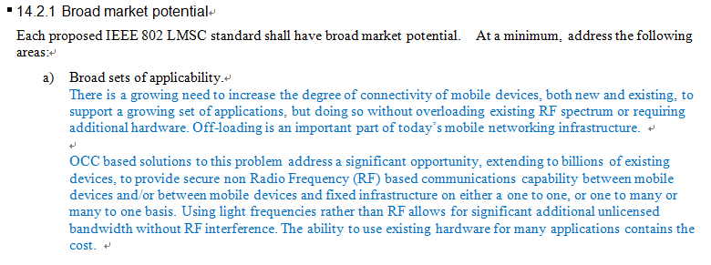

        doc.: IEEE 802.15-15-0410-00-007a
LED-ID Related CSD Components
[ Source : http://ieee802.org/15/par.html ]

