Slide 1
Project: IEEE P802.15 Working Group for Wireless Personal Area Networks (WPANs)
Submission Title: Proposed Resolution for Comment CID 254 from Letter Ballot #104
Date Submitted: May 10, 2015
Source: Soo-Young Chang (SYCA), Jaebeom Kim (Ajou Univ.), and Jaehwan Kim and Sangsung Choi (ETRI)
Company: SYCA, Ajou Univ. and ETRI
Address:
Voice: +1 530 574 2741, E-Mail: sychang@ecs.csus.edu and kimj@etri.re.kr
Re:
Abstract: Proposed comment resolution for a comment on the draft of TG10 L2R routing for Letter Ballot #104
Purpose: To suggest a comment resolution for Letter Ballot #104
Notice: This document has been prepared to assist the IEEE P802.15. It is offered as a basis for discussion and is not binding on the contributing individual(s) or organization(s). The material in this document is subject to change in form and content after further study. The contributor(s) reserve(s) the right to add, amend or withdraw material contained herein.
Release: The contributor acknowledges and accepts that this contribution becomes the property of IEEE and may be made publicly available by P802.15.

Slide 2
Comment CID 254
Commentor
Tero Kivinen
Comment
The figure 17 is bit confusing. Each node should be broadcasting the P2P-RQ IE, but some arrows are not drawn, for example none of the backwards arrows are drawn, but also arrows from J to E, K to F etc are not drawn, or arrows from A to F etc. I assume this was supposed to indicate that those frames are dropped, as those nodes have already forwarded shorter path version out. On the other hand arrow from I to J, and J to K etc are drawn, even when there is shorter paths (D to J and D to K).
Proposed Change
Make sure the figure is correct.

Slide 3
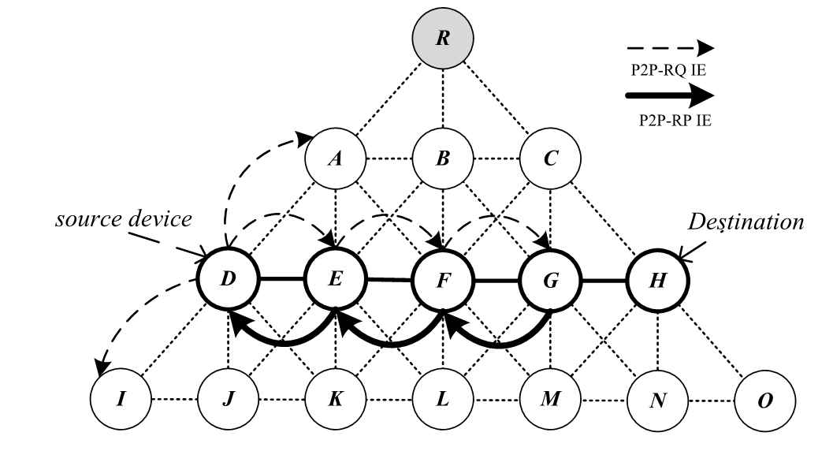
Proposed Resolution (Accept)
Proposed Change
Change Figure 17 as below and by adding a solid arrow from G to H, and three dotted arrows from from H to G, from D to J and from D to K.
Figure 17—P2P route establishment (view from node D, E, F, G, and H)

