Slide 1
Project: IEEE P802.15 Working Group for Wireless Personal Area Networks (WPANs)
Submission Title: Channel Modeling for Visible Light Communications
Date Submitted: May 11, 2015
Source: Murat Uysal and Farshad Miramirkhani, Ozyegin University
Address: Ozyegin University, Nisantepe Mh. Orman Sk. No:34-36 Çekmekoy 34794 Istanbul, Turkey
Voice: +90 (216) 5649329, Fax: +90 (216) 5649450, E-Mail: murat.uysal@ozyegin.edu.tr
Abstract: This document provides an overview of optical channel modeling methods and proposes a flexible and efficient channel modelling approach for visible light communications which overcomes the limitations of previous methods.
Purpose: To introduce a channel modeling method which would be the basis of reference channel model for the evaluation of different PHY proposals.
Notice: This document has been prepared to assist the IEEE P802.15. It is offered as a basis for discussion and is not binding on the contributing individual(s) or organization(s). The material in this document is subject to change in form and content after further study. The contributor(s) reserve(s) the right to add, amend or withdraw material contained herein.
Release: The contributor acknowledges and accepts that this contribution becomes the property of IEEE and may be made publicly available by P802.15.

Slide 2
Channel Modeling For Visible Light Communications

Slide 3
Outline
  Motivation
  Overview of Optical Channel Modeling Methods
  Existing Works on VLC Channel Modeling
  Proposed Methodology for VLC Channel Modeling
  Channel Impulse Response Results
  CIR Results (Purely Diffuse)
  CIR Results (Mostly Specular )
  CIR Results (Mixed)
  Comparison with existing results
Conclusions

Slide 4
Motivation
Growing literature on VLC
Due to lack of proper channel models, infrared (IR) channel models are commonly used for the performance evaluation of VLC systems
VL and IR bands exhibit different characteristics
  An IR source can be approximated as a monochromatic emitter
  A white light LED source is inherently wideband (380-780nm). This calls for the inclusion of wavelength-dependent channel in VLC channel modeling.
  In IR band, the reflectance of materials is modeled as a constant.
  The reflectance of materials in the visible spectrum should be taken into consideration due to the wideband nature of VLC link.
This necessitates the development of dedicated VLC channel models.

Slide 5
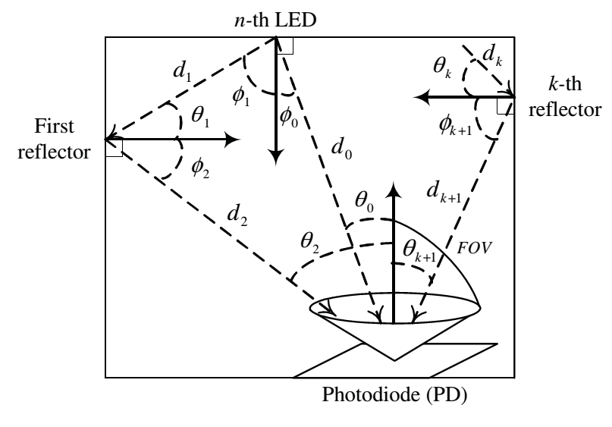
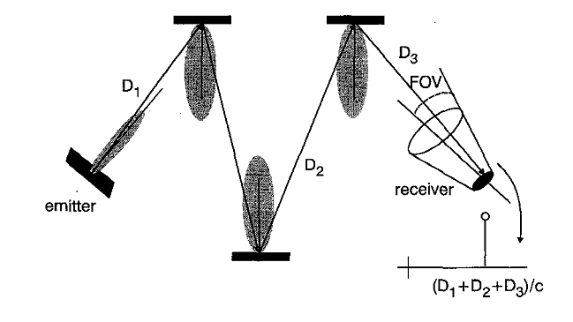
Overview of Channel Modeling Methods
Recursive Methods
Monte Carlo Ray Tracing
Other Approaches

Slide 6
Recursive Methods
Barry’s Method [1]
  Discretize room surfaces (i.e., walls, floor, ceiling) into small cells
  Emit single ray from the source and track the ray’s bounces until it reaches detector
  For each reflection, calculate the power and delay (i.e., CIR for that specific reflection)
  Overall CIR obtained as an infinite summation of CIRs for all reflections (in practice, truncated to a finite value)
  Underlying assumption: Empty Room
DUSTIN Algorithm [2]
  Modified recursive method for faster computation of CIR
Iterative Site-Based Method [3]
  Modified recursive method for a complex environment (i.e., with objects)
  [1] J. R. Barry, J. M. Kahn, W. J. Krause, E. A. Lee, and D. G. Messerschmitt, “Simulation of multipath impulse response for wireless optical channels,” IEEE J. Sel. Areas Commun., 11, 367–379, 1993.
  [2] F. J. Lopez-Hermandez, and M. J. Betancor, “DUSTIN: Algorithm for calculation of impulse response on IR wireless indoor channels,” IEEE Electronics Lett., vol. 33, no. 21, pp. 1804,1806, Oct 1997.
  [3] J.B. Carruthers, and P. Kannan, “Iterative site-based modeling for wireless infrared channels,” IEEE Trans. Antennas Propag., vol. 50, no. 5, pp. 759,765, May 2002.

Slide 7
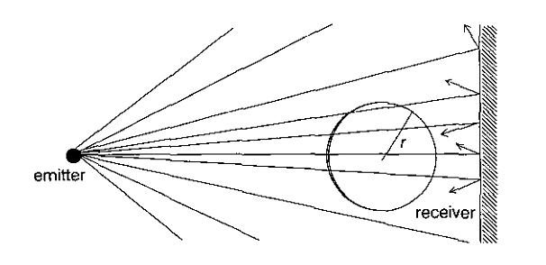
Monte Carlo Ray Tracing
Monte Carlo Ray Tracing [4], [5], [6] methods involve
  Discretization of room surfaces (i.e., walls, floors, ceiling) into small cells
  Ray generation based on a given statistical distribution (distribution type depends on the source)
  Track each ray until it reaches detector and calculate the detected power and associated delay
  [4] F.J. Lopez-Hernandez, R. Perez-Jimeniz, and A. Santamaria, “Monte Carlo calculation of impulse response on diffuse IR wireless indoor channels,” IEEE Electronics Lett., vol. 34, no. 12, pp. 1260,1262, Jun 1998.
  [5] F.J. Lopez-Hernandez, R. Perez-Jimenez, and A. Santamaria, “Modified Monte Carlo scheme for high-efficiency simulation of the impulse response on diffuse IR wireless indoor channels,” IEEE Electronics Lett., vol. 34, no. 19, pp. 1819,1820, Sep 1998.
  [6] F.J. Lopez-Hernandez, R. Perez-Jimenez, A. Santamaria, “Ray tracing algorithms for fast calculation of the channel impulse response on diffuse IR wireless indoor channels,” Opt. Eng. 39(10), 2775-2780, Oct 2000.

Slide 8
Other Approaches
Ceiling Bounce Model [7]
  Underlying assumptions: Source towards the ceiling and co-located with the detector
  Closed form for path loss and RMS delay spread
  Closed form expression for CIR
  [7] J. B. Carruthers, and J. M. Kahn, “Modelling of non-directed wireless infrared channels,” IEEE Trans. Commun., 45, 1260–1268, 1997.
Curve Fitting [8], [9]
  Curve fitting on measurement data
  Closed form expressions for RMS delay spread and mean excess delay spread
  [8] R. Perez-Jimenez, J. Berges, and M.J. Betancor, “Statistical model for the impulse response on infrared indoor diffuse channels,” IEEE Electronics Lett., vol. 33, no. 15, pp. 1298,1300, Jul 1997.
  [9] R. Perez-Jimenez, V.M. Melian, and M.J. Betancor, “Analysis of multipath impulse response of diffuse and quasi-diffuse optical links for IR-WLAN,” Proceedings of the Fourteenth Annual Joint Conference of the IEEE Computer and Communications Societies, vol. 2, pp. 924,930, Apr 1995.

Slide 9
Existing Works on VLC Channel Modeling
 | Method | Modeling of Reflectance | Number of Reflections | Assumptions
[10] | Monte Carlo Ray Tracing | Fixed Reflectance | Third Order | Purely Lambertian Reflections Empty Room
[11] | Recursive (Barry’s Method) | Fixed Reflectance | First Order | Purely Lambertian Reflections Empty Room
[12] | Recursive (Barry’s Method) | Fixed Reflectance | First Order | Purely Lambertian Reflections Empty Room
[13] | Recursive (Iterative Site-Based) | Averaged Reflectance | Fourth Order | Purely Lambertian Reflections With Objects
[14] | Recursive (Barry’s Method) | Wavelength Dependent | Third Order | Purely Lambertian Reflections Empty Room
  [10] H. Chun, C. Chiang, and D. O’Brien, “Visible light communication using OLEDs: illumination and channel modeling,” in Int. Workshop Opt. Wireless Commun., pp. 1–3, Oct. 2012.
  [11] H. Q. Nguyen, et al., “A MATLAB-Based simulation program for indoor visible light communication system,” CSNDSP 2010, pp. 537-540, July 2010.
  [12] T. Komine, and M. Nakagawa, “Performance evaluation on visible-light wireless communication system using white LED lightings,” in Proc. Ninth IEEE Symposium on Computers and Communications, vol. 1, pp. 258-263, 2004.
  [13] S. Long, M. A. Khalighi, M. Wolf, S. Bourennane, Z. Ghassemlooy, “Channel characterization for indoor visible light communications,” Optical Wireless Communications (IWOW), pp.75-79, Sept. 2014.
  [14] K. Lee, H. Park, and J. R. Barry, “Indoor channel characteristics for visible light communications,” IEEE Commun. Lett., vol. 15, no. 2, Feb 2011.

Slide 10
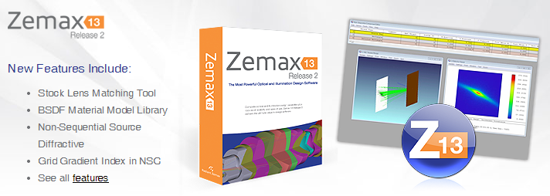
Proposed Methodology for Channel Modeling
CAD Objects (Furniture, etc)
3D Indoor Environment Modeling
(Zemax)
Channel DC Gain
Light Source Specifications
Non-Sequential Ray-Tracing
(Zemax)
Channel Impulse Response
(Matlab)
Mean Excess Delay Spread
Characterization
Detector Specifications
Coherence Bandwidth
Material Reflectance Values
RMS Delay Spread
E. Sarbazi, M. Uysal, M. Abdallah and K. Qaraqe, “Indoor Channel Modelling and Characterization for Visible Light Communications”, 16th International Conference on Transparent Optical Networks (ICTON), Graz, Austria, July 2014.
F. Miramirkhani, M. Uysal, and E. Panayirci, “Novel Channel Models For Visible Light Communications”, SPIE Photonics West, San Francisco, California, United States, February 2015.

Slide 11
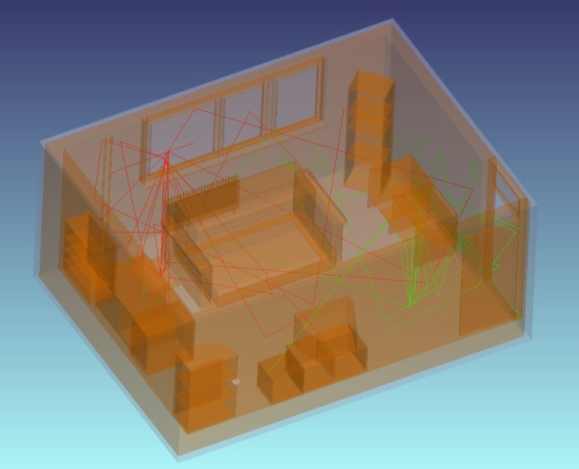
3D Indoor Environment Modeling
  Creation of 3D indoor environment in Zemax involves the selection of
    Room size and shape
    CAD objects within the environment (furniture etc)
    Position and type of transmitters and receivers
    Type and properties of materials (walls, floor, ceiling, objects etc)

Slide 12
Reflectance of Materials: IR vs VL
  Reflectance is highly dependent on wavelenght in VL band.
  “Table coating” feature in Zemax allows defining the wavelength dependent reflectance of surface coating for each material.
  [14] K. Lee, H. Park, and J. R. Barry, “Indoor channel characteristics for visible light communications,” IEEE Commun. Lett., vol. 15, no. 2, Feb 2011.
  [15] “ASTER Spectral Library - Version 2.0,” [Online]. Available at: http://speclib.jpl.nasa.gov.

Slide 13
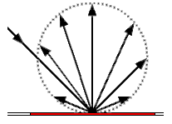
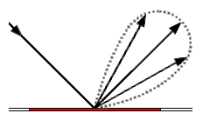
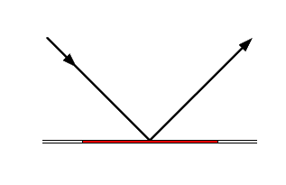
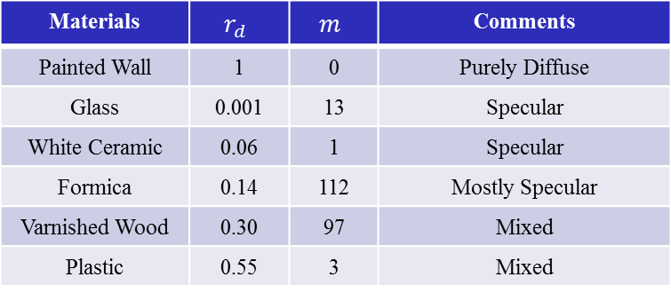
Specular vs. Diffuse Reflections
Painted Wall
Glass
Plastic
θ_{i} =45º m=0 r_{d} =1
Purely Diffuse Reflections
θ_{i} =45º m=13 r_{d} =0.001
Specular Reflections
θ_{i} =45º m=3 r_{d} =0.55
Mixed Reflections
Phong’s Equation
Materials | $$r_{d}$$ | $$m$$ | Comments
Painted Wall | 1 | 0 | Purely Diffuse
Glass | 0.001 | 13 | Specular
White Ceramic | 0.06 | 1 | Specular
Formica | 0.14 | 112 | Mostly Specular
Varnished Wood | 0.30 | 97 | Mixed
Plastic | 0.55 | 3 | Mixed
θ_{i} : Incident angle
θ₀ : Observation angle
m : Directivity of specular components
r_{d} : Percentage of diffuse reflections (Defined as «scatter fraction» in Zemax)

Slide 14
Specular vs. Diffuse Reflections
θ_{i} =0º
θ_{i} =45º
  The specular reflections depend on the incident angle (θ_{i}) while the diffuse reflections are independent from incident angle.
  Proper choice of “scatter fraction (SF)” and “number of rays for diffuse reflections (NR)” allows the definition of the specular/diffuse property of material in Zemax.

Slide 15
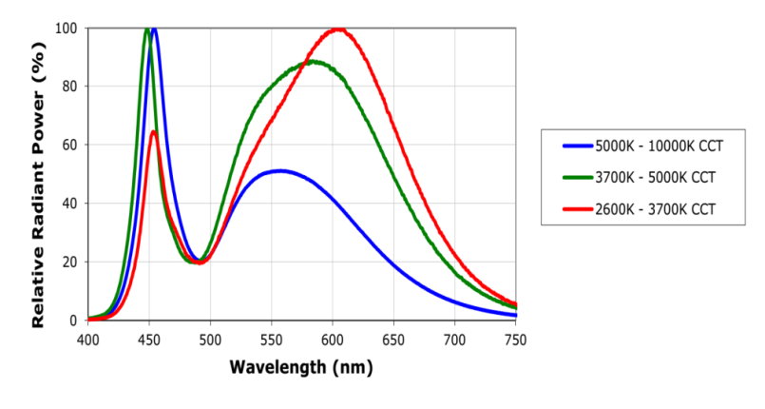
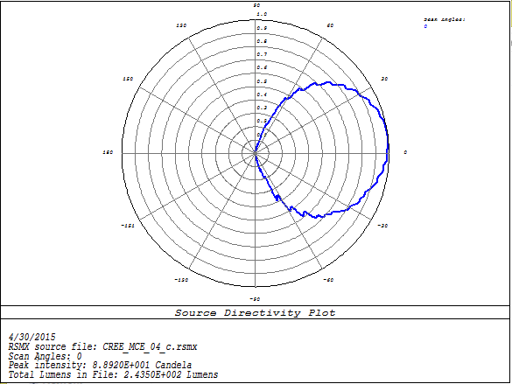
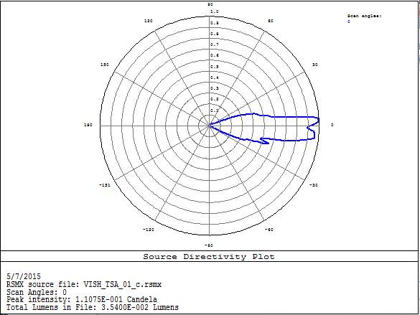
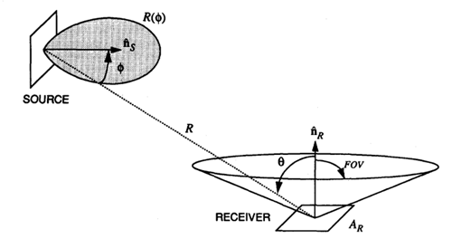
Sources and Detectors
  We can select commercially available source brands in Zemax
    Cree Inc., OSRAM AG, OPTO Diode Corp., Philips Lighting, Vishay Intertechnology, Panasonic Corporation, StockerYale
Relative Radiant Power of Source
Emission Pattern of Source
MC-E Cree Inc.
TSA Vishay Intertechnology
  Detector Rectangle: Records and displays the power of each ray that reaches to the detector.

Slide 16
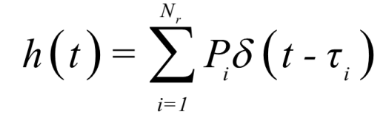
Ray Tracing in Zemax
  Based on Monte Carlo Ray Tracing
  Sobol sampling is used for speeding up ray tracing
  The Zemax non-sequential ray-tracing tool generates an output file, which includes all the data about rays such as the detected power and path lengths for each ray.
  The data from Zemax output file is imported to MATLAB and using these information, the CIR is expressed as
P_{i} = the power of the ith ray
τ_{i} = the propagation time of the ith ray
δ(t) = the Dirac delta function
N_{r} = the number of rays received at the detector

Slide 17
Characterization of CIR
Channel Parameters | Definition
Channel DC Gain
Mean Excess Delay Spread
RMS Delay Spread
Frequency Correlation Function
Coherence Bandwidth (Correlation level of 0.9)
Channel Transfer Function

Slide 18
Simulation Parameters
Size of room | 5 m × 5 m × 3 m
Time resolution ( ) | 0.2 ns
Number of lighting | 4
Number of chips per each lighting | 100
Power of each chip | 0.45 W
Lighting positions | (1.5,1.5,3) (1.5,3.5,3) (3.5,1.5,3) (3.5,3.5,3)
PD position | (0.5, 1, 0)
View angle of lighting | 120°
FOV of PD | 85°
Area of PD | 1 cm²
Materials | Plaster (Walls) + Floor + Ceiling (see p13 for reflectance values) A: Purely Diffuse Reflections SF=1 NR=7 B: Mostly Specular Reflections SF=0.2 NR=7 C: Mixed Reflections SF=0.5 NR=7

Slide 19
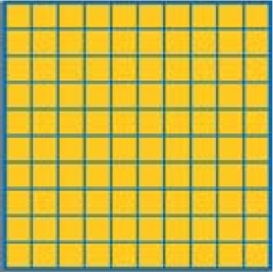
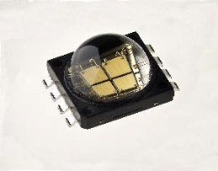
3D Environment
10×10 LED Chips
S2
S3
LED Chip
MC-E Cree Inc.
S1
S4
0.6 m
0.6 m
Emission Pattern of Source
3 m
5 m
OWC terminal
5 m

Slide 20
CIR Results (Scenario A: Purely Diffuse)
  Assumption: Purely Diffuse Reflections → SF=1
  In this figure, three peaks exist which are related to 4 LED lightings. The largest one corresponds to the nearest LED (S2) and the second one is related to two LEDs (S1 and S3) which are at the same distance from the photodetector and the last one is related to the farther LED (S4).

Slide 21

Effect of Higher Order Reflections -1
  First order reflections contribute to increase the amplitude of zero order reflections.
  The delay spread also increases by first order reflections.

Slide 22
Effect of Higher Order Reflections -2
  Second order reflections slightly increases the amplitude of zero order reflections but effectively increases the delay spread of CIR.

Slide 23
Comparison with Recursive Method
OWC terminal
  The CIR is nearly the same as recursive method [14] for purely diffuse reflections and Lambertian source.
  Unlike [14], our method works for any type of source
  For other environments (specular, mixed) where [14] does not work, we can efficiently obtain CIRs
  [14] K. Lee, H. Park, and J. R. Barry, “Indoor channel characteristics for visible light communications,” IEEE Commun. Lett., vol. 15, no. 2, Feb 2011.
Notes:
The only difference of two CIRs in the tail is because of realistic source modeling in Zemax. The sources in Zemax are measured source while the ideal pattern is considered for the sources in [14].

Slide 24
Channel Characteristics (Purely Diffuse)
 | (ns) | (ns)
0 | 12.58 | 2.10 | 4.825×10⁻⁵
1 | 13.53 | 3.33 | 6.030×10⁻⁵
2 | 15.59 | 6.60 | 7.068×10⁻⁵
3 | 17.26 | 8.95 | 7.673×10⁻⁵
4 | 17.42 | 9.25 | 7.714×10⁻⁵
5 | 17.42 | 9.25 | 7.714×10⁻⁵
6 | 17.42 | 9.26 | 7.714×10⁻⁵
7 | 17.42 | 9.26 | 7.714×10⁻⁵
8 | 17.42 | 9.26 | 7.714×10⁻⁵
Mean Excess Delay vs. Number of Reflections
RMS Delay vs. Number of Reflections
Channel DC Gain vs. Number of Reflections
  The RMS delay, mean excess delay and channel DC gain saturate after 4 reflections.

Slide 25
CIR Results (Scenario B: Mostly Specular)
  Assumption: Mostly Specular Reflections → SF=0.2
OWC terminal
  The CIR for mostly specular case obviously differs from the CIR obtained for diffuse case.

Slide 26
Channel Characteristics (Mostly Specular)
 | (ns) | (ns)
0 | 12.365 | 1.945 | 4.190×10⁻⁵
1 | 13.854 | 3.454 | 7.406×10⁻⁵
2 | 15.241 | 5.376 | 8.602×10⁻⁵
3 | 16.469 | 7.124 | 9.198×10⁻⁵
4 | 17.079 | 8.077 | 9.433×10⁻⁵
5 | 17.444 | 8.783 | 9.538×10⁻⁵
6 | 17.643 | 9.227 | 9.585×10⁻⁵
7 | 17.744 | 9.491 | 9.605×10⁻⁵
8 | 17.792 | 9.638 | 9.612×10⁻⁵
9 | 17.816 | 9.721 | 9.616×10⁻⁵
10 | 17.818 | 9.733 | 9.616×10⁻⁵
11 | 17.821 | 9.744 | 9.616×10⁻⁵
12 | 17.821 | 9.744 | 9.616×10⁻⁵
13 | 17.821 | 9.745 | 9.616×10⁻⁵
14 | 17.821 | 9.745 | 9.616×10⁻⁵
Mean Excess Delay vs. Number of Reflections
RMS Delay vs. Number of Reflections
OWC terminal
Channel DC Gain vs. Number of Reflections
  The RMS delay, mean excess delay and channel DC gain saturate after 7 reflections.
  The saturation level of “mostly specular” scenario is higher than the “purely diffuse”

Slide 27
CIR Results (Scenario C: Mixed)
  Assumption: Mixed Reflections → SF=0.5
  The CIR for mixed case differs from the CIR obtained for diffuse case. In comparison to the mostly specular case, it exhibits more smooth characteristics.

Slide 28
Channel Characteristics (Mixed)
 | (ns) | (ns)
0 | 12.44 | 1.98 | 4.534×10⁻⁵
1 | 13.88 | 3.52 | 7.387×10⁻⁵
2 | 14.76 | 4.93 | 8.063×10⁻⁵
3 | 15.05 | 5.49 | 8.193×10⁻⁵
4 | 15.11 | 5.61 | 8.209×10⁻⁵
5 | 15.11 | 5.61 | 8.210×10⁻⁵
6 | 15.11 | 5.61 | 8.210×10⁻⁵
Mean Excess Delay vs. Number of Reflections
RMS Delay vs. Number of Reflections
OWC terminal
Channel DC Gain vs. Number of Reflections
  The RMS delay, mean excess delay and channel DC gain saturate after 4 reflections.

Slide 29
Conclusions
  Provided an overview of optical channel modeling approaches
  Proposed a flexible and efficient method for realistic VLC channel modeling
    Wavelength dependency
    Realistic sources
    Effect of objects and materials
  Presented some initial results for a room size of 5m x 5m x 3m assuming diffuse, mostly specular and mixed conditions
    For diffuse case, we are able to reproduce the existing results in [14] using the same assumption of Lambertian source
    Unlike [14], our method works for any type of source
    For other environments (specular, mixed) where [14] does not work, we can efficiently obtain CIRs

Slide 30
Future Plan
  Based on the TG recommendations, we plan to obtain CIRs for the specified environments and make available as .m files for public use

Slide 31
Acknowledgments
  This work is supported in part by the EU COST Action IC1101 OPTICWISE.

