Slide 1
Project: IEEE P802.15 Working Group for Wireless Personal Area Networks (WPANs)
Submission Title: Secret key agreement protocol for IEEE 802.15.8 PAC
Date Submitted: May 2015
Source: [Byung-Jae Kwak, Gyung-Chul Sihn, Moon-Sik Lee]¹,
[Sangseok Yun, Sanghun Im, Jeongseok Ha]²
Company [ETRI, Daejeon, Korea]¹, [KAIST]²
Address [218 Gajeong-ro, Yuseong-gu, Daejeon, Korea]¹, [291 Daehak-ro, Yuseong-gu, Daejeon, Korea]²
Voice: [+82-42-860-6618]¹, [+82-42-350-7524]²
E-Mail: [bjkwak@etri.re.kr]¹, [ssyun@kaist.ac.kr]²
Re: P802.15.8 Draft D0.10.0
Abstract: Discussion of the secret key agreement protocol for IEEE 802.15.8 PAC from physical layer point of view.
Purpose: Discussion
Notice: This document has been prepared to assist the IEEE P802.15. It is offered as a basis for discussion and is not binding on the contributing individual(s) or organization(s). The material in this document is subject to change in form and content after further study. The contributor(s) reserve(s) the right to add, amend or withdraw material contained herein.
Release: The contributor acknowledges and accepts that this contribution becomes the property of IEEE and may be made publicly available by P802.15.

Slide 2
Secret key agreement protocol for
IEEE 802.15.8 PAC
May 2015

Slide 3
Introduction
This document presents a secret key agreement protocol using physical layer features
This document proposes a secret key distribution protocol using channel impulse responses
By taking advantage of channel reciprocity and sequential key distillation, a pair of legitimate users can remotely share a secret key without resorting to a key management infrastructure
We have verified feasibility of the proposed protocol with hardware-based experiments

Slide 4
Introduction
Fundamental problems in cryptography
  Sharing a secret key between two legitimate parties, Alice and Bob, in the presence of an adversary Eve
  This problem can be solved by applying public key cryptography
    Key management infrastructure is required
    Assume that Eve’s computing power is limited
Existing public key cryptography-based secret key distribution protocols are not applicable to fully distributed PAC

Slide 5
General Secret Key Agreement Protocol
Maurer[1] proposed a new approach to generate a random sequence achieving the perfect security
  The process of generating a shared secret key consists of 3 phases
Randomness Sharing
Information Reconciliation
Privacy Amplification
Share the common randomness between Alice and Bob
Alice & Bob agree on an identical random sequence
Hash function provides the perfect secrecy
Channel response between Alice & Bob can be seen as the common randomness

Slide 6
Randomness Sharing
The reciprocity of the propagation channel [2]
  Used as a source of common randomness
Spatial de-correlation assumption
  The channel response is location-specific
  Secret key is extracted by exploiting random fluctuation of the wireless channel

Slide 7
Randomness Sharing
Channel impulse response
  In time domain, the channel gains for the dominant paths can be utilized as shared randomness

Slide 8




Secret Key Agreement Protocol
Alice (PD1)
Channel Probing
Bob (PD2)
Channel Estimation
Channel Estimation
Randomness Sharing Protocol
Quantizer
Quantizer
$n$-bits
$n$-bits
Reconciliation
Syndrome
Reconciliation
Agree/Disagree
Post Processing Protocol For Key Extraction
$k$-bits
$k$-bits
Privacy Amplification
Privacy Amplification
Secret key, $K_{A}$
Secret key, $K_{B}$
Randomness Test

Slide 9
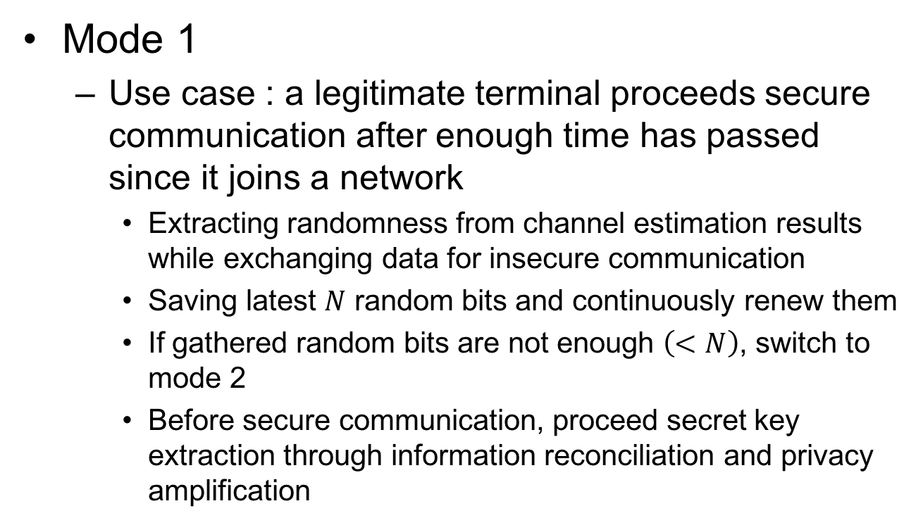
Randomness Sharing Protocol
Mode 1
  Use case : a legitimate terminal proceeds secure communication after enough time has passed since it joins a network
    Extracting randomness from channel estimation results while exchanging data for insecure communication
    Saving latest $N$ random bits and continuously renew them
    If gathered random bits are not enough $\left(<N\right)$, switch to mode 2
    Before secure communication, proceed secret key extraction through information reconciliation and privacy amplification

Slide 10












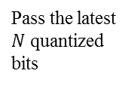





Randomness Sharing Protocol
Alice
Bob
Mode 1
RTS ($i$)
process
process
CTS ($i$)
Channel estimation
$$\left\{{\hat{H}}_{b,1}, {\hat{H}}_{b,2}, …, {\hat{H}}_{b,m}\right\}$$
Channel estimation
$$\left\{{\hat{H}}_{a,1}, {\hat{H}}_{a,2}, …, {\hat{H}}_{a,m}\right\}$$
Data Transmission
Extract distinctive feature
(freq. $→$ time domain)
$$\left\{{\hat{h}}_{a,1},{\hat{h}}_{a,2}, …,{\hat{h}}_{a,p}\right\}$$
Extract distinctive feature
(freq. $→$ time domain)
$$\left\{{\hat{h}}_{a,1},{\hat{h}}_{a,2}, …,{\hat{h}}_{a,p}\right\}$$
$$⋯$$
Quantization
$$\left\{b_{1},b_{2},…, b_{n_{i}}\right\}$$
Quantization
$$\left\{a_{1},a_{2},…, a_{n_{i}}\right\}$$
RTS ($j$)
$$⋯$$
$$⋯$$
CTS ($j$)
process
process
$$\left\{b_{1},b_{2},…, b_{n_{j}}\right\}$$
$$\left\{a_{1},a_{2},…, a_{n_{j}}\right\}$$
Data Transmission
Pass the latest $N$ quantized bits
Pass the latest $N$ quantized bits
Post
processing
$\left\{k_{0},k_{1},…, k_{S}\right\}$ : secret key

Slide 11
Randomness Sharing Protocol
Mode 2
  Use case : a legitimate terminal proceeds secure communication immediately to join network
    Continuously exchange only probe requests/responses for randomness sharing
    If enough random bits are gathered, perform secret key extraction through the post processing, i.e. information reconciliation and privacy amplification

Slide 12













Randomness Sharing Protocol
Mode 2
Alice
Bob
Probe Request (1)
process
process
Probe Response (1)
$$b_{1}=\left[b_{1}, b_{2},…, b_{n_{1}}\right]$$
$$a_{1}=\left[a_{1}, a_{2},…, a_{n_{1}}\right]$$
$$⋯$$
process
Probe Request $\left(j\right)$
process
$$a_{j}=\left[a_{1}, a_{2},…, a_{n_{j}}\right]$$
Probe Response $\left(j\right)$
$$b_{j}=\left[b_{1}, b_{2},…, b_{n_{j}}\right]$$
Stop probing if $N≤\sum_{i=1}^{j}{n_{i}}$
Gathering Enough $N$-bits
Gathering Enough $N$-bits
$$\left\{a_{1},…, a_{N}\right\}$$
Post
processing
$$\left\{b_{1},…, b_{N}\right\}$$
$\left\{k_{0},k_{1},…, k_{S}\right\}$ : secret key

Slide 13
Secret Key Agreement Protocol
Alice (PD1)
Channel Probing
Bob (PD1)
Channel Estimation
Channel Estimation
Randomness Sharing Protocol
Quantizer
Quantizer
$n$-bits
$n$-bits
Reconciliation
Syndrome
Reconciliation
Agree/Disagree
Post Processing Protocol For Key Extraction
$k$-bits
$k$-bits
Privacy Amplification
Privacy Amplification
Secret key, $K_{A}$
Secret key, $K_{B}$
Randomness Test

Slide 14
Common Key Extraction Protocol
Information reconciliation
  Random bit sequence for extracting secret key is obtained from channel impulse responses with quantization
  In the quantization process, the random bit sequences at legitimate parities may have discrepancy
  Such discrepancy can be removed by performing the information reconciliation [3, 4]

Slide 15
Common Key Extraction Protocol
Privacy amplification
  Since the public discussions in the information reconciliation are also open to the eavesdropper, there must be an additional procedure aiming to extract secret key of which the eavesdropper is totally ignorant
  Privacy amplification using hash functions removes revealed information about the shared randomness during the information reconciliation and produces a secret key [5, 6]

Slide 16
Common Key Extraction Protocol
Randomness test
  It is necessary to check whether a secret key follows almost pure random distribution for verifying suitability to use secret key
  Such test can be carried out by following a procedure proposed by U.S. Bureau of Standards [7]

Slide 17
Feasibility of the Proposed Protocol
Experimental results based on
off-the-shelf hardware devices

Slide 18
Experimental Environment
Experiment setup
  802.11a ad-hoc mode
  Atheros wireless module
    Antenna gain : 1
    Transmit signal strength : 14 dBm
  Frequency range
    Carrier frequency : 5.2 GHz
    Signal bandwidth : 20 MHz
  Measuring RSSI for randomness sharing
    Alice-Bob, Alice-Eve, Bob-Eve

Slide 19
Experimental Layout
Experimental Layout 1
  Bob and Eve were stationary while Alice moved along fixed trajectory with speed of 3.6km/h
Experimental Layout 2
  All Stations were stationary
  NLOS channel between Alice and the other stations due to partition

Slide 20
Feasibility of proposed protocol
Secret key extraction rate
  Mobile case
  Static case
Duration of experiments | 2225 sec
Quantization level | 3-bits
Probability of key mismatch | 0
Secret key rate | 1.64 bits/sec
Duration of experiments | 2861 sec
Quantization level | 1-bits
Probability of key mismatch | 0
Secret key rate | 0.65 bits/sec

Slide 21
Other works for the proof of concepts
WINLAB [Mathur08]
  It uses the amplitude of the maximum peak of the CIR (channel impulse response) recorded over time in a 802.11a LAN environment
  Level crossing algorithm is used for key generation
  Achieve about 1 bit/s in a real, indoor environments

Slide 22
Conclusion
It is possible for legitimate terminals to share a secret key in fully distributed network by exploiting the channel reciprocity and the post processing
Using off-the-shelf 802.11a network interface cards, we show that the secret key using RSSI can be successfully generated at rates of 1.64 bits/sec and 0.65 bits/sec in mobile and static environments.
It is expected that secret key extraction rate can be further significantly increased when we exploit channel impulse response (CIR) as a source of secret key

Slide 23
References
[1] U. Maurer, “Secret key agreement by public discussion from common information,” IEEE Tans. Information Theory, vol. 39, pp. 733-742, May 1993.
[2] G. S. Smith, “A direct derivation of a single-antenna reciprocity relation for the time-domain,” IEEE Trans. Antennas Propagate., vol. 52, no. 6, pp. 1568-1577, Jun. 2004.
[3] C. H. Bennett, E. Bessette, G. Brassard, L. Salvail and J. Smolin, “Experimental quantum cryptography,” Journal of Cryptography, vol. 5, no. 1, pp. 3-28, 1992.
[4] G. Brassard and L. Savail, “Secret-key reconciliation by public discussion,” In Advances in cryptology EUROCRYPT ‘93, Lecture Notes in Computer Science, vol. 765, pp. 410-423, Springer-Verlag, New York, 1994.
[5] G. H. Bennett, G. Brasard, C. Crrpeau and U. M. Maurer, “Generalized privacy amplification,” IEEE Trans. Information Theory, vol. 41, pp. 1915-1923, Nov. 1995.
[6] C. H. Bennett, G. Brassard and J.-M. Robert, “Privacy amplification by public discussion,” SIAM Journal on Computing, vol. 17, pp. 201-229, April 1988.
[7] A. Rukhin et al., “A Statistical Test Suite for Random and Pseudorandom Number Generators for Cryptographic Applications,” NIST Special Publication 800-22, National Institute of Standards and Technology, Gaithersburg, MD, July 2000.

