Slide 1
Project: IEEE P802.15 Working Group for Wireless Personal Area Networks (WPANs)
Submission Title: [A Review of IG Activities after the March 2015 Plenary Session]
Date Submitted: [7 May, 2015]
Source: [Junhyeong Kim, Bing Hui, Hee-Sang Chung, JunHwan Lee] Company [ETRI]
Address [218 Gajeong-ro, Yuseong-gu, Daejeon, 305-700, KOREA]
Voice:[+82-42-860-6239], FAX: [+82-42-860-6732], E-Mail:[jhkim41jf@etri.re.kr]
Abstract: [A Review of Email Discussions after Plenary meeting in Berlin]
Purpose: [For discussion]
Notice: This document has been prepared to assist the IEEE P802.15. It is offered as a basis for discussion and is not binding on the contributing individual(s) or organization(s). The material in this document is subject to change in form and content after further study. The contributor(s) reserve(s) the right to add, amend or withdraw material contained herein.
Release: The contributor acknowledges and accepts that this contribution becomes the property of IEEE and may be made publicly available by P802.15.

Slide 2
Email Discussions
Prof. Ke Guan
An Associate Professor of
State Key Lab of Rail Traffic Control and Safety, Beijing Jiaotong University (北京交通大学)
An expert in
Propagation and channel measurements and simulations in various railway scenarios
Joint research with Prof. Thomas Kuerner (TU Brauschweig), who introduced the IG HRRC to Prof. Ke Guan

Slide 3
Email Discussions
Prof. Guan plans to attend the upcoming meeting, probably in September
Currently he and his colleagues are very interested in
mmWave or sub-mmWave used for railway
Some contributions will be submitted
Propagation and channel characteristics of mm-wave bands for railway
Channel modeling and simulations

Slide 4
Email Discussions
Research experiences of his lab
Various railway communication systems
such as GSM-R and LTE-R
Three ray-tracing simulators that have been validated by corresponding measurements:
A ray-tracing simulator exclusive for channels inside arbitrary tunnels, i.e., various cross sections, straight or curved, etc., at sub-6 GHz.
A ray-tracing simulator for dual-mobile channels, such as V2V, T2T, and so on, validated by measurements up to 15 GHz.
An indoor mmWave static channel ray-tracing simulator validated by frequencies up to 300 GHz in various indoor environments.

Slide 5
Email Discussions
Dr. Hui provided detailed information that Prof. Guan requested and will discuss further via the reflector
Some scenarios for HRRC
Candidate frequency bands
30 GHz, one of candidate frequencies for HRRC considered by ETRI
Other frequency (e.g., 18 GHz and 90 GHz etc.)
Simulation comparison & further discussion
 | Scenario | Remarks
Scenario 1 | Subway | 100km/h
Scenario 2 | High-speed train | Up to 500km/h, but including normal-speed train
Scenario 3 | High-speed bus | High way environment
Scenario 4 | Normal vehicles | General environment

Slide 6
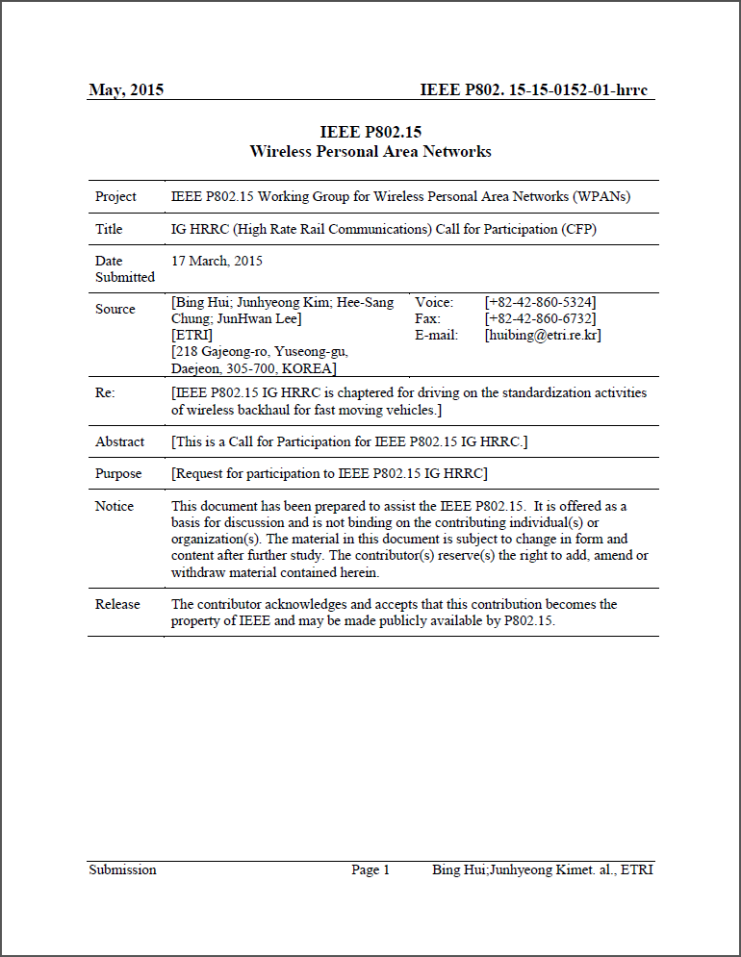
Email Discussions
Call for Participation (CFP)
Modified based on comments from Plenary meeting in Berlin
Additional comments from Email reflector (ETRI)
Add “How to Participate” and contact point to the CFP
CFP will be finalized and distributed after the Vancouver meeting
15 WG reflector and IG HRRC reflector
Document number : IEEE P802.15-15-0152-01-hrrc
Link : https://mentor.ieee.org/802.15/dcn/15/15-15-0152-01-hrrc-draft-ig-hrrc-call-for-participation.docx

Slide 7
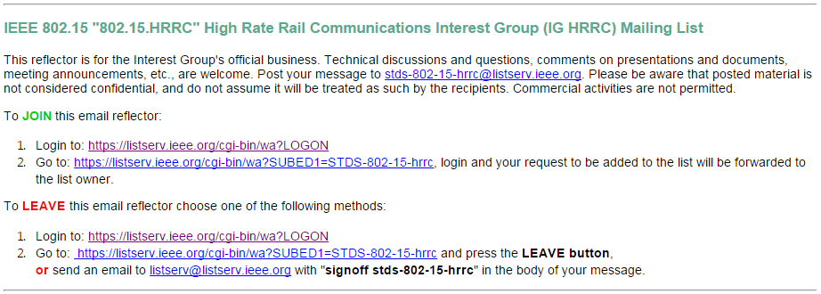
Email Reflector for IG HRRC
An Email reflector for IG HRRC is available for you to join now
Subscription link : http://grouper.ieee.org/groups/802/15/pub/Subscribe.html

Slide 8
Other Collaboration Activities for IG
NICT & Hitachi
Millimeter-wave (mmWave)-based mobile wireless backhaul is being considered as one of candidate technologies for HRRC
An ongoing research : mmWave backhaul technology for high-speed vehicles
Realization of hand-over-free transmission with high throughput
Convergence of mmWave and Radio over Fiber (RoF)
90GHz
Discussion of future cooperation for HRRC standardization

Slide 9
Other Collaboration Activities for IG
Rail Companies
Plan to contact the person in charge, mentioned during the March Plenary meeting
Discussion on HRRC standardization issues

Slide 10
Future Plan
Plan to attend Train Communications Systems 2015 Conference, held in June (10th and 11th), in London, and organized by BWCS
The WiFi on train conference : directly focusing on the problems and opportunities of putting WiFi services onto trains
To learn about the current state of communications to moving trains and the solutions of various vendors to meet growing demand

