Slide 1
Project: IEEE P802.15 Working Group for Wireless Personal Area Networks (WPANs)
Submission Title: [PAC Authentication Procedure]
Date Submitted: [March 10th, 2015]
Source: [Woongsoo Na and Sungrae Cho]
Company: [Chung-Ang University, Korea]
E-Mail: [wsna@uclab.re.kr srcho@cau.ac.kr]
Re: [This is the original document]
Abstract: [Authentication procedure for IEEE 802.15.8 TG]
Purpose: [Material for discussion in 802.15.8 TG]
Notice: This document has been prepared to assist the IEEE P802.15. It is offered as a basis for discussion and is not binding on the contributing individual(s) or organization(s). The material in this document is subject to change in form and content after further study. The contributor(s) reserve(s) the right to add, amend or withdraw material contained herein.
Release: The contributor acknowledges and accepts that this contribution becomes the property of IEEE and may be made publicly available by P802.15.

Slide 2
MAC security for IEEE 802.15.8 PAC
Woongsoo Na,
Sungrae Cho
Chung-Ang University

Slide 3
Security Parameters
Entity | Size
PAC_ADDR | xxx bits
AUTH_KEY | $≥$160 bits
ENC_KEY | $≥$128 bits
GENC_KEY | $≥$128 bits
RAND | $≥$128 bits
PAC_ADDR: PAC device address (unique for each device)
AUTH_KEY: used for authentication purposes
ENC_KEY: encryption key (for secure unicast)
GENC_KEY: group encryption key
RAND: frequently changing random or pseudo-random number made by the PAC device itself

Slide 4
Key Derivation
Device A
Device B
PIN
PIN
During
peering
PRF
PRF
Authentication
AUTH_KEY_{AB}
AUTH_KEY_{AB}
PRF
PRF
Encryption
ENC_KEY
ENC_KEY
Slide 4

Slide 5
Authentication
Process of verifying ‘who’ is at the other end of the link
Performed for devices (PAC_ADDR)
Authentication is achieved based on the stored authentication key (AUTH_KEY) or by peering procedure (entering a PIN).
Slide 5

Slide 6
Flow Chart for Authentication
Authentication start
Already authenticated
yes
no
Link key (AUTH_KEY) available
yes
no
no
Peering allowed
yes
fail
Peering
ok
Authentication fail
Authentication OK

Slide 7
Infrastructureless Architecture
Authentication between PDs is done using PIN, or certificate issued by the third party
Cf) Bluetooth pairing
PIN establishment issue
(1) offline establishment
(2) online establishment
→ It is not secure against the man-in-the-middle attack and replay attack.
Slide 7

Slide 8
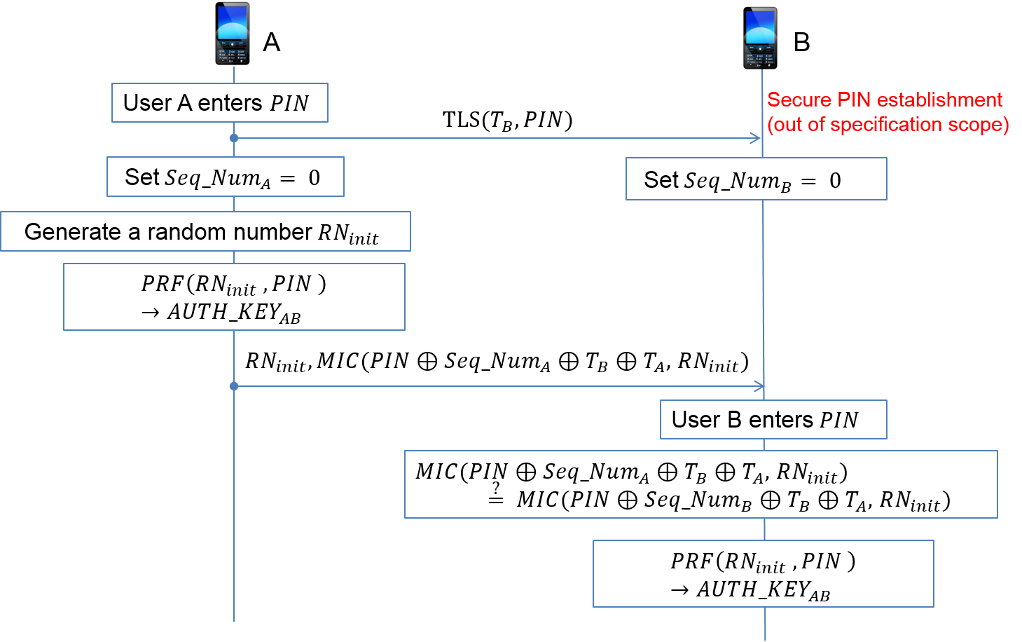
Authentication between PDs

Slide 9
Authentication without Infrastructure
Function and parameter
$T_{B}$: A information of device B
$Seq_Num$: A sequence number
$RN_{init}$: 128-bit random number
$MIC$: Message integrity code

Slide 10
Conclusion
Offline PIN establishment is not suitable for IEEE 802.15.8 PAC model due to scalability.
PIN is distributed to each PD securely using the application level protocol (TLS, etc…)
Since PIN is securely shared, proposed security technique can successfully eliminate MITM attack.
Since sequential number is used for MIC, proposed security technique is secure against the replay attack.
Slide 10

