Slide 1
Project: IEEE P802.15 Working Group for Wireless Personal Area Networks (WPANs)
Submission Title: [ Channel access: CFP text]
Date Submitted: [ April 6th, 2015 ]
Source: [Marco Hernandez, Huan-Bang Li, Igor Dotlić, Ryu Miura ]
Company: [NICT]
Address: [3-4 Hikarino-oka, Yokosuka, 239-0847, Japan]
Voice:[+81 46-847-5439] Fax: [+81 46-847-5431] E-Mail:[]
Re: [In response to call for technical contributions TG8]
Abstract: [ ]
Purpose: [Material for discussion in 802.15.8 TG]
Notice: This document has been prepared to assist the IEEE P802.15. It is offered as a basis for discussion and is not binding on the contributing individual(s) or organization(s). The material in this document is subject to change in form and content after further study. The contributor(s) reserve(s) the right to add, amend or withdraw material contained herein.
Release: The contributor acknowledges and accepts that this contribution becomes the property of IEEE and may be made publicly available by P802.15.

Slide 2
Channel access: CFP text
5.1.1.1.2 Contention-free period (CFP)
  The CFP shall start on a slot boundary immediately following the CAP, and it shall complete before the end of the active portion of the superframe. If aAny allocated GTReS† have been allocated by the PAN coordinator, they shall be located within the CFP and occupy contiguous ReSs. The CFP shall therefore grow or shrink depending on the total length of all of the combined GTReSs.
  No transmissions within the CFP shall use a CSMA-CA contention mechanism to access the channel. A device PD transmitting in the CFP shall ensure that its transmissions are complete within one IFS period, as described in 5.1.1.3, before the end of its GTReS.
ReS† (Resource Slot) ← GTS (Guarantee Time Slot)
    A ReS is either a time-frequency slot or time slot.

Slide 3
Channel access: CFP text
5.1.1.3 Interframe spacing (IFS)
  The MAC sublayer needs a finite amount of time to process data received by the PHY. To allow for this, two successive frames transmitted from a device PD shall be separated by at least an IFS period; if the first transmission requires an acknowledgment, the separation between the acknowledgment frame and the second transmission shall be at least an IFS period. The length of the IFS period is dependent on the size of the frame that has just been transmitted. Frames (i.e., MPDUs) of up to aMaxSIFSFrameSize shall be followed by a short interframe space (SIFS) period of a duration of at least macSIFSPeriod. Frames (i.e., MPDUs) with lengths greater than aMaxSIFSFrameSize shall be followed by a long interframe spacing (LIFS) period of a duration of at least macLIFSPeriod. These concepts are illustrated in Figure 10.

Slide 4
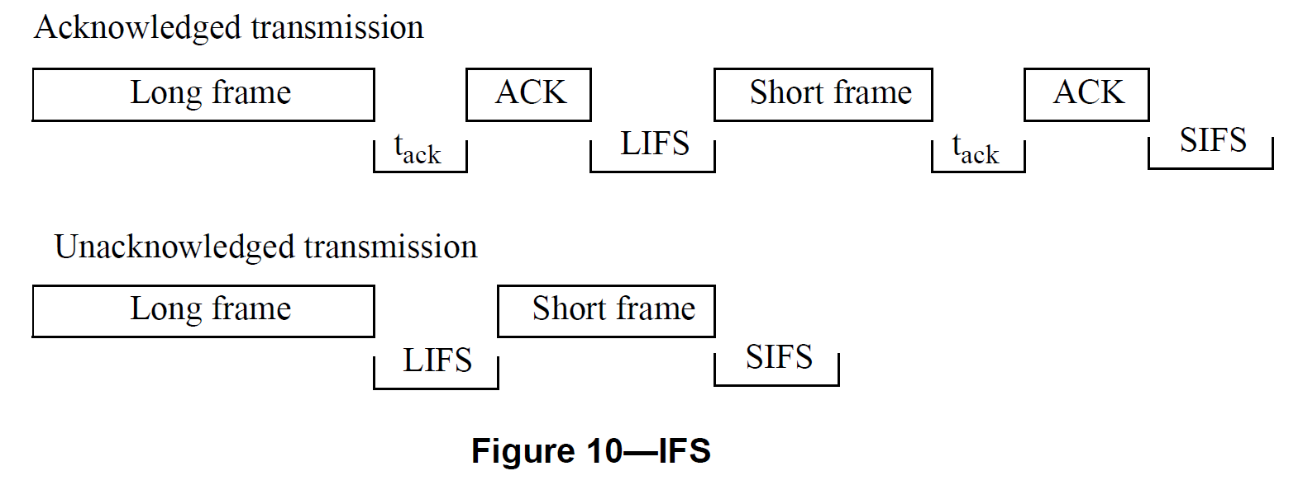
Reference

