Slide 1
Project: IEEE P802.15 Working Group for Wireless Personal Area Networks (WPANs)
Submission Title: Introduction to 802.11 Association Procedure
Date Submitted: March 2015.
Source: Jae Seung Lee, Byung-Jae Kwak, Moon-Sik Lee
Company: ETRI
Address: 218 Gajeong-ro, Yuseong-gu, Daejeon, 305-700, Korea
Voice: +82-42-860-1326
FAX:
E-Mail: [jasonlee@etri.re.kr, bjkwak@etri.re.kr, moonsiklee@etri.re.kr]
Re: P802.15.8 Draft D0.8
Abstract: Introduction material about 802.11 Association Procedure.
Purpose: Informational.
Notice: This document has been prepared to assist the IEEE P802.15. It is offered as a basis for discussion and is not binding on the contributing individual(s) or organization(s). The material in this document is subject to change in form and content after further study. The contributor(s) reserve(s) the right to add, amend or withdraw material contained herein.
Release: The contributor acknowledges and accepts that this contribution becomes the property of IEEE and may be made publicly available by P802.15.

Slide 2
Introduction to 802.11 Association Procedure
March 2015

Slide 3
Introduction
Efficient association procedure should be defined for PAC
This document introduces association procedures of 802.11 to help design PAC association procedures

Slide 4
802.11 Initial Link Setup Overview
Initial link setup includes all operations required to enable packets exchange:
Network & BSS discovery
Authentication & association
Higher layer setup (such as IP address configuration)
 | BSS Discovery* | Network Discovery | Authentication & Association* | Higher Layer Setup* (DHCP / IP)

Slide 5
BSS Discovery (1/2)
A station becomes aware of the existence of a BSS
through scanning
passively seeking Beacon transmissions or
actively probing for the existence of an AP through a Probe
Request /Response exchange
Passive Scanning
The AP in an infrastructure BSS periodically broadcasts Beacon frames
The Beacon frame carries regulatory information, capability information and information for managing the BSS

Slide 6
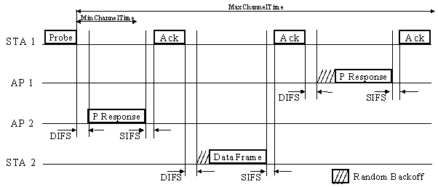
BSS Discovery (2/2)
Active Scanning
A STA actively probes for the existence of an AP through
a Probe Request /Response exchange
An AP that receives a broadcast Probe Request sends
a Probe Response to the station making the request

Slide 7
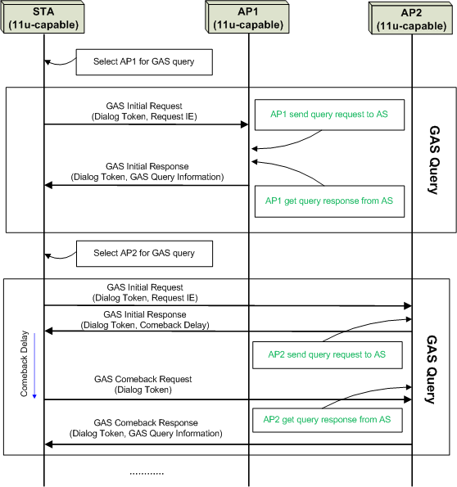
Network Discovery
802.11u has been developed to provide network selection and Generic Advertising Service (GAS)
802.11u defines protocols for network selection, including the 802.21 protocol, multiple SSID query for faster scanning, and network type identification
Discovery of suitable networks is possible through the advertisement of access network type, roaming consortium and venue information, via management frames
Source: IEEE 802.11 11-11-1499r0

Slide 8
Association
Before a STA is allowed to send data via an AP it must become associated with the AP
Association provides a mapping between the STA and AP that allows messages within the DS to reach the AP with which the STA is associated and ultimately to the station itself
Association is initiated by the STA with the STA sending an Association Request to the AP
If the STA is admitted, the AP responds with an Association Response
The STA and AP exchange capability information (support for optional features) and the AP informs the STA of specific operating parameters within the BSS

Slide 9
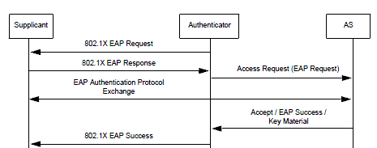
Authentication
Open System authentication admits any STA to the DS
RSNA supports authentication based on IEEE Std 802.1X-2004 after Open System authentication
IEEE 802.1X authentication utilizes the EAP to authenticate STAs and the Authentication Server with one another

Slide 10
Higher Layer Setup
Higher Layer Setup is required to establish IP layer connectivity
DHCP is used for IP configuration
Outside the scope of IEEE 802.11

Slide 11
Initial Link Setup Procedure
STA
AP
AAA Server
BSS Discovery
(Passive Scanning or Active Scanning)
Beacon with 802.11u Interworking IE
Probe Request
Probe Response
GAS Initial Request
GAS Initial Response
- Network Discovery (Defined by 11u)
ANQP provides Network Information
STA selects network using the information
GAS Comeback Request
GAS Comeback Response
Open Authentication
Authentication (null)
Authentication Response
Association Request/
Response
Association Request (SSID)
Association Response (AID)
802.1X (EAPOL-Start)
802.1x EAP Authentication
802.1X (EAP-Identity Request)
802.1X (EAP-Identity Response)
4-way handshake
(Pairwise and Group Key establishment)
802.1X (EAP-Auth. Exchange)
RADIUS (EAP-Auth. Exchange)
RADIUS (Access-Accept)
802.1X (EAP-Success)
4-Way Handshake (PTK, GTK)

Slide 12
802.11ai (FILS) Overview
TGai focuses on reducing the time spent in any phase of the initial link set-up
FILS focuses on an environment where mobile users are
constantly entering and leaving the coverage area
of an existing extended service set (ESS)
Every time the mobile device enters an ESS, the mobile
device has to do an initial link set-up.
This requires efficient mechanisms that:
(a) scale with a high number of users simultaneously entering an ESS
(b) minimize the time spent within the initial link set-up phase
(c) securely provide initial authentication

Slide 13
11ai Scanning Enhancement
More control to scanning procedures:
Terminating the on-going scanning
More reporting options of the scanning result
Immediate reporting
Reporting after a channel is scanned
Legacy: reporting after scanning is completed
Announcing one or more neighbor BSS or channel
information in Beacon, Probe Response and
Fast Discovery (FD) frame
Reduce chances of scanning channels with no AP
BSSID of neighbor AP enables more precise active scanning
More information on neighbor BSSs may be provided
Source: IEEE 802.11-13/1325r5

Slide 14
11ai Active Scanning Enhancement (1/2)
More control to scanning procedures:
One Probe Response may contain information of
multiple APs
The total number of Probe Request and Probe Responses is
reduced
Ch 1
Ch 6
Cn 1
Ch 6
AP1
AP2
AP3
AP1
AP2
AP3
Probe Response + Neighbor List
Probe
Request
Contains information of itself (AP 2), as well as AP 1 and AP 3 of Channel 1 and
Channel 6
Request for
information of other BSSs
STA 1
STA 1
Source: IEEE 802.11-13/1325r5

Slide 15
11ai Active Scanning Enhancement (2/2)
Probe Request contains criteria to responding Probe
Response from the AP
Response is transmitted by the AP only if the criteria is met to reduce unnecessary Probe Responses
Criteria include:
STA’s preference on AP’s capability (E.g, STA prefers only HT or VHT Aps)
Reception power
AP’s channel access delay, STA’s QoS requirement, etc
AP1
AP2
AP3
AP1
AP2
AP3
Probe Request
Probe
Response
Specify criteria on responding Probe
Response
to APs
Probe
response
is transmitted
if all the criteria are met
STA 1
STA 1
Source: IEEE 802.11-13/1325r5

Slide 16
11ai Passive Scanning Enhancement
FILS Discovery (FD) frame: short beacon frame for fast discovery of APs
FD frame is transmitted between Beacon frames for a fast AP/Network discovery
FD frame may be transmitted as a non-HT duplicate PPDU, enabling a larger channel than 20MHz
Example #1
Beacon
FD frame
Primary
channel of the transmitter
T1
time
Preamble
Payload of FD Frame
Preamble
Payload of FD Frame
Example #2
T2
time
Preamble
Payload of FD Frame
Preamble
Payload of FD Frame
Example #3
T3
time
Source: IEEE 802.11-13/1325r5

Slide 17
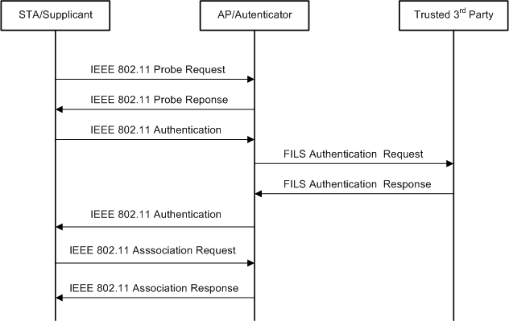
Concurrent Higher Layer Setup
Significant reduction in setup signaling
Authentication, 4-way handshake, Association, Higher layer setup
(including IP address assignment) completed in 2 roundtrip
signaling messages
Fast authentication & FILS IP address assignment speeds up the
authentication & IP Address assignment procedure

Slide 18
Reduced Overhead by piggy back
Piggy-backing info along FILS authentication protocol:
Higher-layer setup, including IP address assignment
Authorization functionality, subscription credentials, etc.
STA
AP
TTP
Services
Beacon/Probe Resp.
Authentication Request
Authentication help
Key
Establishment
Authentication Response
IP address assignment
Association Request
Authorization
+ piggy-backed info request
Configuration help
Key
Confirmation
Association Request
Subscription
credentials
+ piggy-backed info response
Source: IEEE 802.11-13/1325r5

Slide 19
Brief Overview of WiFi P2P (1/4)
Wi-Fi Direct is a P2P technology defined by the Wi-Fi Alliance
aimed at enhancing direct device to device communications in Wi-Fi
builds upon the IEEE 802.11 infrastructure mode
inherits QoS, power saving, and security mechanism from 802.11 infrastructure mode
Devices negotiate who will take over the AP-like functionalities
legacy Wi-Fi devices may seamlessly connect to Wi-Fi Direct devices

Slide 20
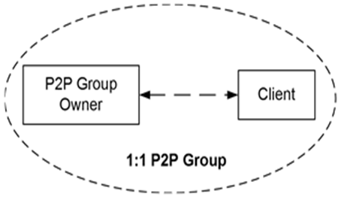
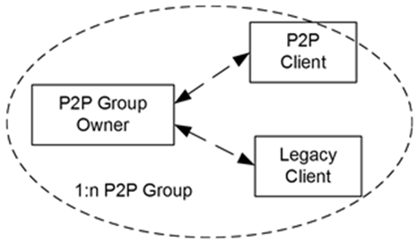
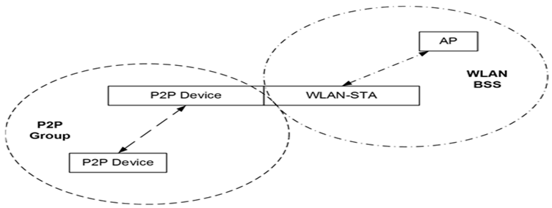
Brief Overview of WiFi P2P (2/4)
P2P Group is similar to an infrastructure BSS with a P2P Group Owner assuming the role of the AP and a P2P Client assuming
the role of the STA
A legacy device may also join as a STA
A P2P Device supports both Group Owner and Client roles
Topology [6]:
1:1 | 1:n | Concurrent Operation
 | .

Slide 21
Brief Overview of WiFi P2P (3/4)
When two P2P devices discover each other, they negotiate their roles to establish a P2P Group
P2P Client, P2P GO (Group Owner)
Once the P2P Group is established, other P2P Clients can join the group as in a traditional Wi-Fi network
Legacy clients can also communicate with the P2P GO
Legacy 802.11 STAs see the P2P GO as a traditional AP

Slide 22
Brief Overview of WiFi P2P (4/4)
P2P GO
announces itself through beacons
runs a DHCP server to provide P2P Clients with IP addresses
Only the P2P GO is allowed to cross-connect the devices in its P2P Group to an external network
e.g., a 3G network, infrastructure WLAN
Wi-Fi Direct does not allow transferring the role of P2P GO within a P2P Group
If the P2P GO leaves the P2P Group, then the group is torn down, and has to be reestablished

Slide 23
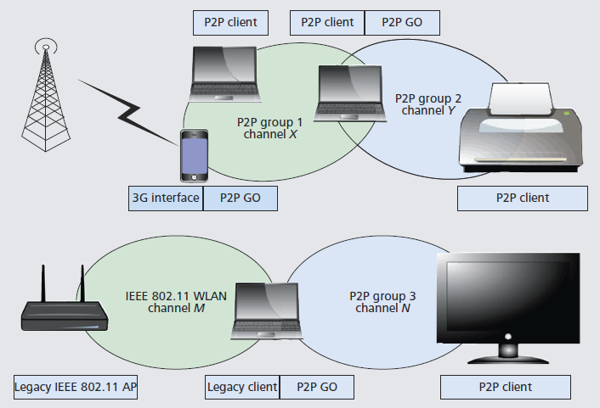
Example of Wi-Fi Direct topologies
Source: [7]

Slide 24
Initial Link Setup Procedure for WiFi P2P
P2P Standard Group formation [7]
WPS Provisioning

Slide 25
Standard Group Formation
Discovery Phase
P2P devices discover each other
First, 802.11 Scanning is used to discover existing P2P Groups
Next, performing probe request/probe response for device discovery
GAS query can be used
GO Negotiation Phase
negotiate which device will act as P2P GO, and on the channel where the group will operate on
P2P devices send a GO Intent value
the device declaring the highest value becomes the P2P GO

Slide 26
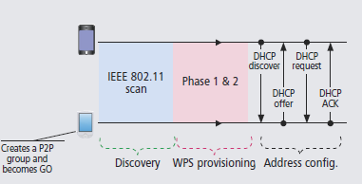
Autonomous Group Formation
P2P Autonomous Group formation [7]
A P2P Device becomes the P2P GO, by starting to transmit beacons
Other devices discover the group using scanning
Discovery phase is simplified
No GO Negotiation phase

Slide 27
Persistent Group Formation (1/2)
P2P Persistent Group formation [7]
P2P devices can declare a group as persistent
The devices forming the group store network credentials
The assigned P2P GO and Client roles for subsequent re-instantiations of the P2P group

Slide 28
Persistent Group Formation (2/2)
After the Discovery phase, if a P2P Device recognizes to have formed a persistent group with the corresponding peer in the past, any of the two P2P devices can use the Invitation Procedure to quickly re-instantiate the group.
GO Negotiation phase is replaced by the invitation exchange
the WPS Provisioning phase is significantly reduced because the stored network credentials can be reused

Slide 29
Security
Wi-Fi Direct devices uses WPS (Wi-Fi Protected Setup)
Based on WPA-2
supports a secure connection with minimal user intervention
WPS allows to add a new device to the network for secure connection by
a PIN in the P2P Client, or
pushing a button in the two P2P Devices
NFC, USB flash drive, etc.
Phase 1: GO generates and issues the security keys
Phase 2: P2P Client disassociates and reconnects using its new authentication credentials
If two devices already have the required network credentials (Persistent group formation), there is no need to trigger the first phase

Slide 30
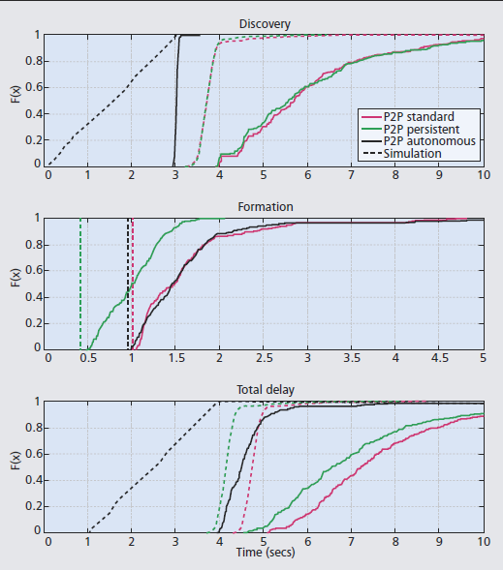
Delay in WiFi P2P Initial Link Setup
Discovery Delay
Formation Delay
Time required for GO Negotiation, WPS Provisioning, and Address configuration
Source: [7]

Slide 31
Other 802.11 D2D Technologies
802.11 ad hoc mode operation (IBSS):
Never became widely deployed in the market
lack of efficient power saving support or extended QoS capabilities
No support for group communication
Being replaced by Wi-Fi Direct
802.11z (Tunneled Direct Link Setup (TDLS))
enables direct device to device communication
requires stations to be associated with the same AP

Slide 32
References
[1] IEEE P802.11-REVmc/D4.0, January 2015
[2] IEEE P802.11ai /D4.0, February 2015
[3] Improving WLAN System Performance, 11-13-1325r5, Nov 11, 2013
[4] TGai Experimental Test Report of FILS, 11-13-0323r2, 2013.
[5] GAS Query Optimization in 11ai, 11-11-1499r0, Oct 24, 2011.
[6] P2P Technical Specification Proposal Overview, WFA, May 15 2009.
[7] Device-to-Device Communication with WIFI-Direct: Overview and Experimentation, Daniel Camps-mur, et.al., IEEE Wireless Communications June 2013

Slide 33
Q & A

