Slide 1
Project: IEEE P802.15 Working Group for Wireless Personal Area Networks (WPANs)
Submission Title: [Joining procedure of group for PAC]
Date Submitted: [March 10th, 2015]
Source: [Woongsoo Na and Sungrae Cho]
Company: [Chung-Ang University, Korea]
E-Mail: [wsna@uclab.re.kr srcho@cau.ac.kr]
Re: [This is the original document]
Abstract: [Joining procedure of group for PAC]
Purpose: [To introduce proposed joining procedure for PAC]
Notice: This document has been prepared to assist the IEEE P802.15. It is offered as a basis for discussion and is not binding on the contributing individual(s) or organization(s). The material in this document is subject to change in form and content after further study. The contributor(s) reserve(s) the right to add, amend or withdraw material contained herein.
Release: The contributor acknowledges and accepts that this contribution becomes the property of IEEE and may be made publicly available by P802.15.

Slide 2
Joining Procedure of Group for PAC

Slide 3
Finding/Joining Group (1/12)
A group consists of two or more PDs with the same application type ID, application specific ID, application specific group ID, and device group ID.
A group can be formed only if two or more PDs can recognize themselves.
Before a PD joins a group, it has to find the group within K-hop coverage.
  If the PD cannot find the group, then it finds the group periodically.
  In order to find a multicast group, a PD broadcasts an Advertisement Command Frame (ACF) after random timer T_{j} where the maximum TTL is set to K. Range of T_{j} is [0, T_{jmax} ].

Slide 4
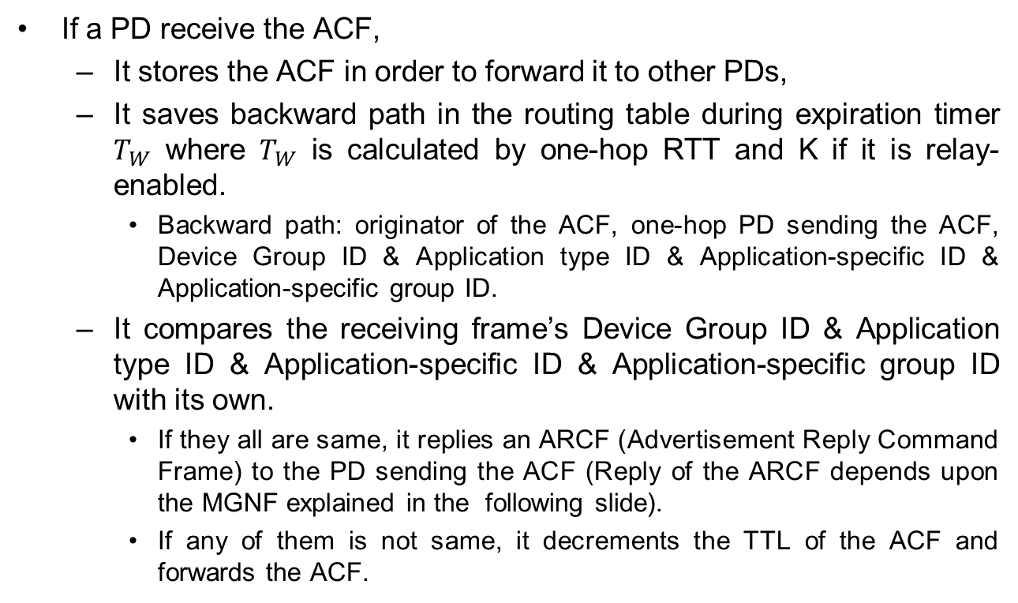
Finding/Joining Group (2/12)
If a PD receive the ACF,
  It stores the ACF in order to forward it to other PDs,
  It saves backward path in the routing table during expiration timer $T_{W}$ where $T_{W}$ is calculated by one-hop RTT and K if it is relay-enabled.
    Backward path: originator of the ACF, one-hop PD sending the ACF, Device Group ID & Application type ID & Application-specific ID & Application-specific group ID.
  It compares the receiving frame’s Device Group ID & Application type ID & Application-specific ID & Application-specific group ID with its own.
    If they all are same, it replies an ARCF (Advertisement Reply Command Frame) to the PD sending the ACF (Reply of the ARCF depends upon the MGNF explained in the following slide).
    If any of them is not same, it decrements the TTL of the ACF and forwards the ACF.

Slide 5
Finding/Joining Group (3/12)
In order to limit the duplicate ARCF, PDs replying the ARCF multicast a Multicast Group Notification Frame (MGNF) after random time. (MGNF is explained detail in later section)
Then, the PD multicasting the MGNF replies source PD with an ARCF by using backward path.
A PD receiving both ACF and MGNF does not reply an ARCF.
A PD receiving the ARCF whose destination is not itself saves the route information of
      ID of the source PD sending the ARCF, ID of the one-hop PD sending the ARCF, Device Group ID, Application type ID, Application-specific ID, Application-specific group ID.
      Then, this PD is referred to as “FORWARDING PD.”
A PD receiving the ARCF whose destination is itself saves the route information same as FORWARDING PD.
  Then, this PD is referred to as “JOINED MULTICAST GROUP MEMBER.”

Slide 6
Finding/Joining Group (4/12)
Assume the following topology.
  There is a multicast group consisting PDs B, D, F, and G.
G
: Member PD
F
: Candidate PD
1-hop
1-hop
: Non-member PD
D
B
E
C
1-hop
1-hop
1-hop
A
1-hop

Slide 7
Finding/Joining Group (5/12)
If PD A want to join the group, it broadcasts an ACF (assume K=4 hops).
G
: Member PD
F
: Candidate PD
: Non-member PD
D
B
E
C
A
: Adv Command Frame

Slide 8
Finding/Joining Group (6/12)
PD C is not in the group. Therefore, it saves the route information and forwards to the others (e.g., F and E).
PD D already received the ACF and PD F now receives the ACF.
Then, there will be a duplicate ARCF from both of D and F to A.
In order to limit the duplicate ARCF, PD D multicasts a MGNF notifying that D will send an ARCF instead of F.
G
: Member PD
F
: Candidate PD
: Non-member PD
D
B
E
E
C
C
A
: Adv Command Frame
: Multicast Group Notification Frame

Slide 9
Finding/Joining Group (7/12)
E forwards the ACF to B and G.
D replies with ARCF to A.
D may send KEKs(key encryption keys) to A after authentication for secure multicast if needed.
D may send rekeying messages to update an existing group key for backward secrecy.
F does not transmit an ARCF to A.
G
: Member PD
F
: Candidate PD
D
B
: Non-member PD
E
C
A
: Adv Command Frame
: Adv Reply Command Frame

Slide 10
Finding/Joining Group (8/12)
When PD A receives the ARCF, A joins D’s group.
Also, PD B receives the ACF from PD E.
Then, B multicasts a MGNF to limit a duplicate ARCF from G.
G
: Member PD
F
: Non-member PD
D
B
E
C
A
: Adv Command Frame
: Adv Reply Command Frame
: Multicast Group Notification Frame

Slide 11
Finding/Joining Group (9/12)
PD B replies with an ARCF to A through E.
B may send KEKs(key encryption keys) to A after authentication for secure multicast if needed.
B may send rekeying messages to update an existing group key for backward secrecy.
G does not transmit an ARCF to A since the PD G already received the MGNF from B.
G
: Member PD
F
: Non-member PD
D
B
E
C
A
: Adv Command Frame
: Adv Reply Command Frame

Slide 12
Finding/Joining Group (10/12)
E forwards the ARCF to PD C.
G
: Member PD
F
: Non-member PD
D
B
E
C
A
: Adv Command Frame
: Adv Reply Command Frame

Slide 13
Finding/Joining Group (11/12)
C forwards the ARCF to PD A.
G
: Member PD
F
: Non-member PD
D
B
E
C
A
: Adv Command Frame
: Adv Reply Command Frame

Slide 14
Finding/Joining Group (12/12)
PD A is aware of route between PD A and PD B.
Now, PD A joins PD B’s multicast group.
Although group of B and G are not aware of group of D and F currently, multicasting service still works by simply forwarding multicast data frames.
G
: Member PD
F
: Non-member PD
D
B
E
C
A
: Adv Command Frame
: Adv Reply Command Frame

Slide 15
Flow Chart - Join Scenario
PD 1
Group1
PD 2
Group1
PD 3
Group Join Request (Send ACF)
Group Join Request (Send ACF)
Send MGNF (Type = 0)
Group Join Reply (Send ARCF)
Group Join Complete

