Slide 1
Project: IEEE P802.15 Working Group for Wireless Personal Area Networks (WPANs)
Submission Title: Addressing TG4q (ULP) use cases via ULP-PHYs
Date Submitted: Mar. 10, 2015
Source: [Kiran Bynam], [Chandrashekhar Thejaswi PS], [Jinesh Nair]
[Henk de Ruijter]
[Chunhui Allan Zhu]
[Youngsoo Kim], [Chiu Ngo]
Abstract: This presentation presents several target applications of 802.15.4q. It describes the benefits of the two ULP-PHYs and how they can address those applications.
Purpose: This presentation is to provide an analysis of the current TG4q PAR against its applications.
Notice: This document has been prepared to assist the IEEE P802.15. It is offered as a basis for discussion and is not binding on the contributing individual(s) or organization(s). The material in this document is subject to change in form and content after further study. The contributor(s) reserve(s) the right to add, amend or withdraw material contained herein.
Release: The contributor acknowledges and accepts that this contribution becomes the property of IEEE and may be made publicly available by P802.15.

Slide 2
Re-Cap: Gilb’s proposed PAR modification in January 2015 (DCN: 15-14-0572r0)
TG4q PAR Parameters | Existing PAR | Gilb’s proposed PAR modification | Remarks
Data Rate | Upto 1Mbps | 100 Kbps
Range | 10m (typical) | 100m
Desirable peak power consumption for PHY | <15mW (typical) | 5mW
Energy/bit | - | < 5 nJ/bit
Frequency Band | 2.4GHz & Sub 1 GHz | -

Slide 3
Re-cap: Application Analysis (15/13-478r0)
Wireless Sensor Market Analysis
Market Sector | Big Network? | Sensor Size Matters? | Battery Life Matters?
Smart Energy/Smart Grid | H | L | L
Smart Utility (Gas/Water) | H | L | H
Building Automation | H | M | H
Home Automation | M | M | M
Wireless Control | L | L | M
Medical / Health Care | L | H | H
Retail Service | H | M | H
Telecom Service | L | H | H
Industrial Monitoring (e.g. bridges, pipe lines) | H | L | H
Environment Monitoring | H | L | H
Shelf Label / Inventory Tracking | H | H | H
Energy-Harvesting Sensor | L | M | HH
H: highly true; M: often true; L: least true

Slide 4
Application Requirements
Market Sector | Data Rate (Kbps) | Range (m) | Number of Nodes | Reliability | Form Factor | Duty Cycle | Payload Size | Mobility | Battery Life
Smart Utility (Gas/Water) | 100 | 30 | 1000s | High | -- | Low | Small | No | Years
Building Automation | 1000 | 30 | 100s | High | S, M | Mid | Mid | No | Years
Medical / Health Care | 1000 | 10 | 10s | High | Small | High | Small-Mid | Yes | Days-Mos
Retail Service | 100 | 30 | 100s | High | Small | Mid-High | Mid-Large | Yes | Years
Telecom Service | 1000 | 10 | 10s | High | Small | High | Mid-Large | Yes | Days
Industrial Monitoring | 100 | 100 | 100s | High | -- | Mid-High | Small-Mid | No | Years
Environment Monitoring | 100 | 100 | 100s | High | -- | Low | Small | No | Years
Energy-Harvesting Sensor | 100 | 10 | 10s | Low | -- | Low | Small | -- | Years
Smart Active Label | 100 | 30 | 1000s | High | Small | Low | Small | Yes | Days-Mos
Shelf Label/ Inventory Tracking | 1000 | 30 | 1000s | High | Small | Low | Mid-Large | - | Months-years

Slide 5
ULP-TASK PHY Energy Efficiency

Slide 6
Power Consumption
Tx Component | Power (µW) @ -5 dBm
Baseband | 1000
VCO | 322
Power Amplifier | 2982
PLL + Freq Synthesizer | 1000
Total | 5304
Rx Component | Power (µW)
LNA+SRO | 638
ED+VGA | 33
ADC (8 bit) | 7.5
Baseband | 1500
PLL + Freq Synthesizer | 1000
Total | 3178.5
Total Power consumption less than 5 mW for Receiver
Total Power consumption of transmitter less than 7 mW @ -5 dBm EIRP

Slide 7
Benefits of ULP-TASK modulation
Best suited for non-coherent mode of operation
- enables low power implementation at the receivers.
- decodable simultaneously at the coherent receiver also.
2. Spreading to enable robustness, data rate scalability and low-complex designs.
3. Spreading sequences with good correlation properties:
- sequences with good correlation properties both in coherent (with ternary alphabet)
and non-coherent (unipolar binary) modes.
- performance similar to the best-known sequences in the respective domains.
( W-H codes in coherent mode and OOC in non-coherent mode)
Benefits at the transmitter:
Low power consumption due to duty-cycling
Low complexity implementation.
Benefits at the receiver:
Non-coherent receiver
- based on Super-regenerative reception (SRR) principle
- eliminates need of mixers, and the demodulation is based on simple
envelope detection.
2. Reduction in power consumption due to duty-cycling.

Slide 8
Some examples ULP TASK Rx design
A 2.4GHz ULP OOK Single-Chip Transceiver for Healthcare Applications” By Vidojkovic et al. (IMEC) http://ieeexplore.ieee.org/stamp/stamp.jsp?tp=&arnumber=5746396

Slide 9
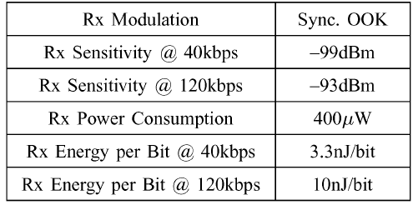
Some examples ULP TASK Rx design
“ A 350 $μW$ CMOS MSK Transmitter and 400 $μW$ OOK Super-Regenerative Receiver for Medical Implant Communications” By Bohorquez, Chandrakasan etal. (UC Berkeley)
http://ieeexplore.ieee.org/stamp/stamp.jsp?tp=&arnumber=4804969

Slide 10
ULP-GFSK PHY Energy Reduction

Slide 11
Benefits of ULP-GFSK PHY
ULP-GFSK is FSK based:
FSK is constant envelop → high efficiency PA (non-linear)
Low complexity TX and RX → power efficient
BTLE transceivers are reported using less than 5mW in continuous receive. [1]
Power consumption requirements in PAR can already be achieved using existing standards.
Make higher data rates (up to 1Mbps) available in sub-GHz bands and supporting mesh and star topology
BTLE uses 2.4GHz only and has no mesh currently
Highest data rate in 15.4 (FSK based) = 400kbps (JP band)
Further reduction of energy use:
Asymmetric Link Networks
Improved PSDU efficiency
Seamless Rate Switching and Transmit Power Control
Wide Band Digital Modulation
[1] A 3.7mW-RX 4.4mW-TX Fully Integrated Bluetooth Low-Energy/IEEE802.15.4/Proprietary SoC with an
ADPLL-Based Fast Frequency Offset Compensation in 40nm CMOS. ISSCC-2015 paper 13.2

Slide 12
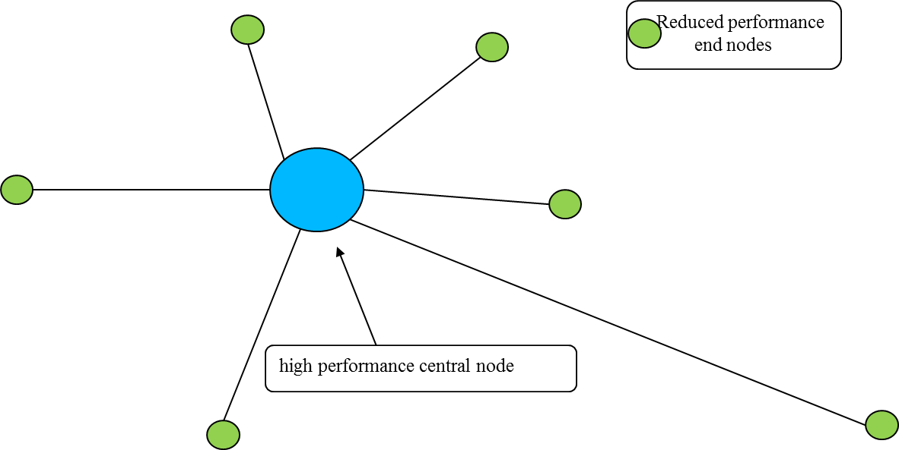
Asymmetric Link Networks (ALN):
ALN may be deployed in star network topologies
Provisions in ULP-GFSK PHY to support ALN:
GMSK with differential encoding and FEC
Central node: coherent RX with FEC decoding
Allows for sensitivity improvements of ~6dB
Low complexity convolutional encoding → suitable for low power end nodes
GFSK without FEC encoding
End nodes: low complexity non-coherent RX without FEC decoding

Slide 13
Asymmetric Link Networks
Reduced performance in the end nodes is compensated by high performance in the central node
Central node having higher receive sensitivity and higher transmit power
The reduced performance requirements in the end nodes allows to reduce their energy consumption
Higher noise figure requirement translate into lower power consumption
Reduced transmit power also contributes to that
Link budget example of Asymmetric Link Network
 |  | uplink | downlink
TX | Over-the-air data rate [kSymbols/s] | 1000 | 500
 | Distance [m] | 30 | 30
 | TX antenna gain [dBi] | -5 | 0
 | Center frequency [MHz] | 868 | 868
 | Transmit power [dBm] | -5 | +5
Channel | Path loss [dB] (PL exponent 2.7) | 71 | 71
RX | RX antenna gain [dBi] | 0 | -5
 | Received signal strength [dBm] | -86 | -71
 | Receiver noise figure [dB] | 5 | 10
 | Min. Eb/N0 @1% PER [dB] | 3.2 | 12.1
 | Implementation loss [dB] | 2 | 2
 | RX sensitivity [dBm] | -103.8 | -92.9
 | Link margin [dB] | 22.8 | 21.9
Uplink: end node to central node
Downlink: central node to end node

Slide 14
Seamless Rate Switch
PSDU can be transmitted in 2-GFSK or 4-GFSK
When link budget margin is low → PDSU transmit use 2-GFSK
Link budget with high margin → PSDU may be transmitted in 4-GFSK
Rate Switch is signalled in the PHY header
Rate Switch is seamless (does not need a resynchronization)
Allows for short on-times in both transmission and receiver when signal quality is sufficient.
Improved PDSU efficiency
Minimal preamble length in ULP-GFSK is 16 bits
Other 15.4 FSK based PHY require at least 32 bits
Minimal PHY header length is 8 bits
Transmit Power Control
When link budget margin is high → TX power may be reduced
When link budget margin is low→ TX power may be increased
Saves power when link budget is sufficient

Slide 15
Addressing Use Case Scenarios

Slide 16
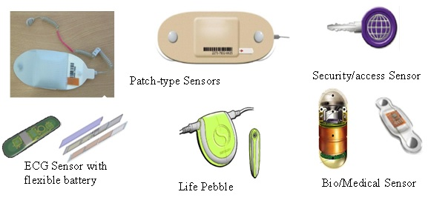
Mobile Health Care
Energy consumption analysis for inventory tracking
Parameter | 15.4q Mobile Heathcare (net datarate of 500Kbps) |  | 15.4 Legacy
 | Humidity, Temperature, Battery | ECG | Humidity, Temperature, Battery | ECG
Tx Power (in mW) | 7 | 7 | 7 | 7
Rx Power (in mW) | 4 | 4 | 15 | 15
Beacon Length(for 30 Bytes) (in $μs$) | 2368 | 2368 | 1392 | 1392
Packet Length (in $μs$) | 704 | 2480 | 704 | 4256
Number of packets | 2 | 4 | 2 | 4
ACK Length (in $μs$) | 765 | 765 | 352 | 352
AP→Node Rx energy consumption (in $μJ$) | 16 | 22 | 42 | 42
AP→Node Tx energy consumption (in $μJ$) | 27 | 38 | 19.6 | 19.6
Node→AP Rx energy consumption (in $μJ$) | 6 | 40 | 21 | 255
Node→AP Tx energy consumption (in $μJ$) | 10 | 69 | 10 | 120
Energy comsumption in sleep mode (in $μJ$) | 3 | 3 | 3 | 3
Total energy consumed in one sec (in $μJ$) | 62 | 172 | 96 | 437
Traffic characteristics
Node | Apps | Packet Size (Byte) | Packets per sec | Data Rate (Kbps) | Mode
1 | ECG | 127 | 4 | 4.064 | CFP
2 | Humidity | 16 | 2 | 0.256 | CAP
3 node ECG with coordinator as part of smart watch considered
Observed over 100 % improvement in battery life time of smart watch

Slide 17
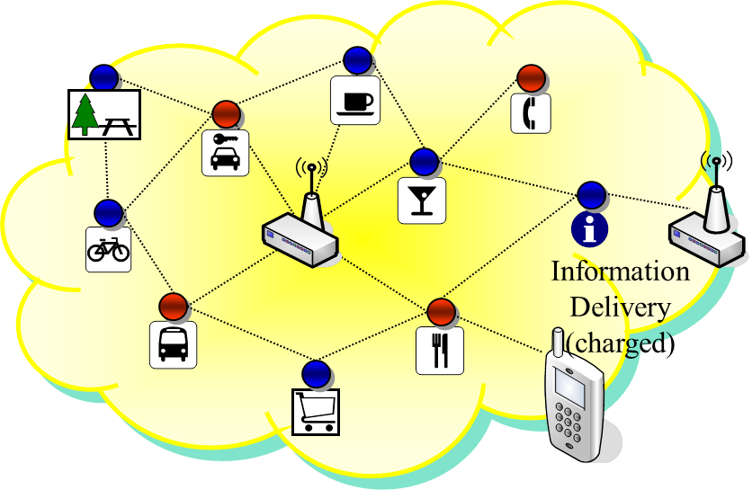
Telecom Service
Energy consumption analysis for telecom services
Energy consumption analysis for telecom services
Parameter | 15.4q (net data rate of 500 kbps) | 15.4 Legacy
Transmitter power (5 dBm) | 7 mW | 7 mW
Rx Power (4q) | 4 mW | 15 mW
Beacon Length(30 Bytes) | 2368 usec | 1152 usec
Packet Length (127 bytes including MAC overhead) | 2448 usec | 4292 usec
Ack Lenth | 528 usec | 352 usec
Energy consumed in Rx | 86.240 uJ | 369 uJ
Energy consumed in Tx | 104 uJ | 164 uJ
Sleep energy (1 uA current) | 3 uJ | 3 uJ
Total energy consumed in one sec | 193.24 uJ | 546 uJ
Relatively high duty cycle application
Energy efficiency of 300 % is achieved
Battery Life extension of 3 times
Assumptions on traffic pattern
Packet size | Number of packets per second | Upload traffic | Download traffic
127 bytes | 5 uplink, 5 downlink | 5 kbps | 5 kbps

Slide 18
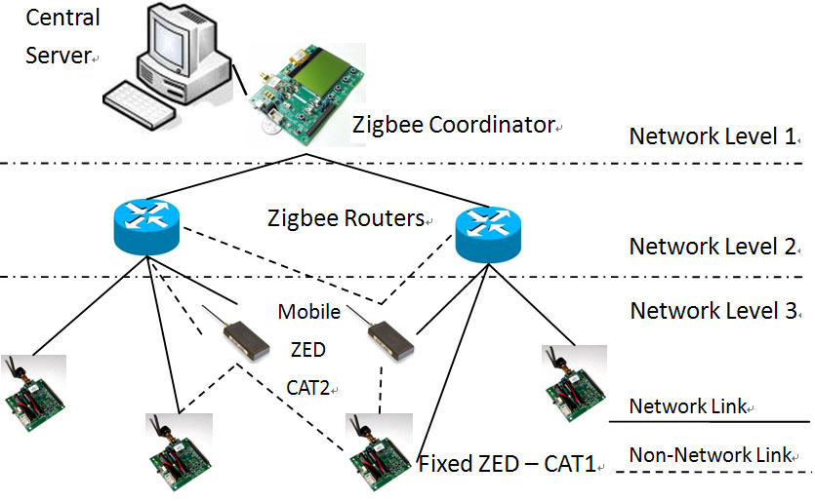
Inventory Tracking
Network architecture for inventory tracking
Energy consumption analysis for inventory tracking
Parameter | 15.4q (net data rate of 500 kbps) | 15.4 Legacy
Transmitter power | 7 mW | 7 mW
Rx Power (4q) | 4 mW | 15 mW
Beacon Length(30 Bytes) | 2368 usec | 1152 usec
Packet Length (25 bytes including MAC overhead) | 848 | 992 usec
Ack Lenth | 528 usec | 352 usec
Energy consumed in Rx | 11.584 uJ | 22.56 uJ
Energy consumed in Tx | 5.936 uJ | 6.94 uJ
Sleep energy | 3 uJ | 3 uJ
Total energy consumed in one sec | 20.52 uJ | 32.5 uJ
Hierarchical Scheme of Inventory tracking mechanism considered
To achieve energy efficiency at end nodes
End node range requirement is below 10 m.
Energy efficiency improvement of 30 % achieved

Slide 19
Shelf Labeling
Receive Beacon from central node (PSDU = 30 Octets)
If there is data announced the shelf label send data request command frame to central node (PSDU = 11 Octets)
Central node responds with ACK (PSDU = 5 Octets)
Central node sends secured data frame with new pricing. (PSDU = 30 Octets)
Shelf label responds with ACK (PSDU = 5 Octets)
Set device to sleep state
For the battery life estimation the following values have been assumed:
A 240 mAh CR2032 coin cell battery with approx. 100 nA self-discharge current
ULP-GFSK end devices using ALN: NF = 12dB, I_RX = 4 mA, P_TX = -5 dBm, I_TX = 6 mA
Other 15.4 end devices: NF = 8dB, I_RX = 6 mA, P_TX = 0 dBm, I_TX = 7 mA
0.7 µA current consumption in sleep state
Table: Battery Life Estimation
Amendment | Beacon interval [s] | Data rate [kpbs] | Data interval [s] | Battery lifetime [years]
15.4 (OQPSK-DSSS) | 0.5 | 250 | 3600 | 1.9
15.4f (MSK) | 0.5 | 250 | 3600 | 1.8
15.4g (MR-FSK) | 0.5 | 200 | 3600 | 1.4
15.4q (ULP-GFSK) | 0.5 | 1000 | 3600 | 8.0

Slide 20
- End -

