Slide 1
Project: IEEE P802.15 Working Group for Wireless Personal Area Networks (WPANs)
Submission Title: Fraunhofer HHI Response to 15.7r1 CFA
Date Submitted: March 10, 2015
Source: Volker Jungnickel Company: Fraunhofer Heinrich Hertz Institute (HHI)
Address:
Voice: E-Mail: volker.jungnickel@hhi.fraunhofer.de
Re: IEEE802.15.7a CFA
Abstract: CFA Response
Purpose: CFA Response
Notice: This document has been prepared to assist the IEEE P802.15. It is offered as a basis for discussion and is not binding on the contributing individual(s) or organization(s). The material in this document is subject to change in form and content after further study. The contributor(s) reserve(s) the right to add, amend or withdraw material contained herein.
Release: The contributor acknowledges and accepts that this contribution becomes the property of IEEE and may be made publicly available by P802.15.

Slide 2
High-Speed OWC Applications
Fraunhofer HHI

Slide 3
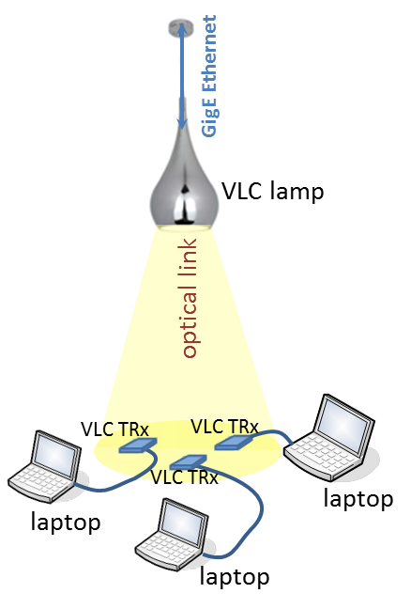
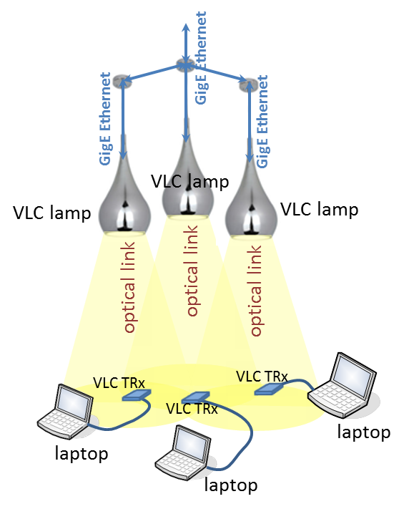
Use Case: Multipoint-to-multipoint
  High data rate coverage in large areas
  Multiuser support
  Mobility support: Handover
  Interference coordination
  Challenges:
    Reduce complexity
    Keep the performance high
  Include multipoint-to-multipoint support in OWC system

Slide 4
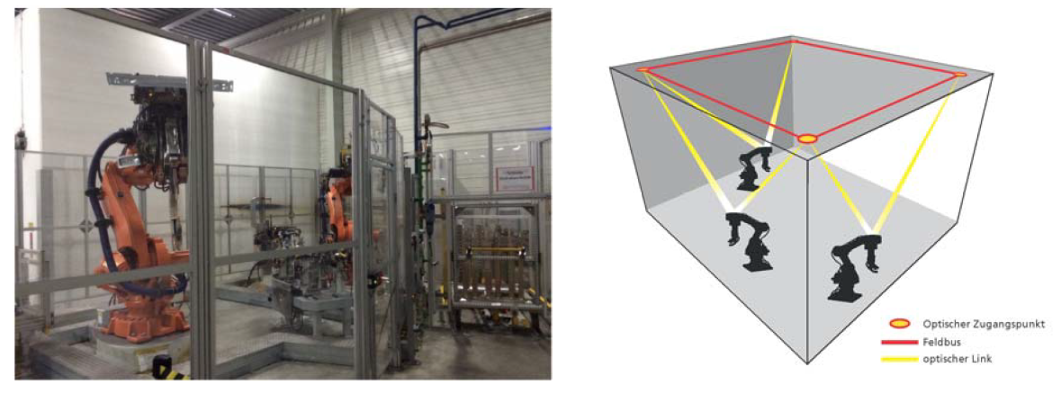
Use Case: Personalized Manufacturing Cells
Increasingly personalized production needs more flexibility
Mobile communication for robots
    WiFi is only useful technology so far, but interference and jamming are harmful
    Challenges for OWC:
      high speed (>1 Gbit/s), low latency (<1 ms), reliable connections (MIMO)
    Design the OWC system according to industrial communications demands

Slide 5
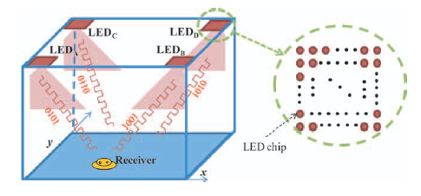
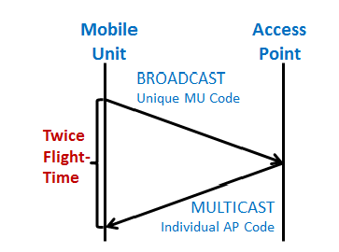
Use Case: Precise Indoor Positioning
S.Y. Jung et al., „Optical wireless indoor positioning system using light emitting diode ceiling lights,“Microwave and Optical Technology Letters, Vol. 54, No. 7, pp. 1622–1626,
July 2012.
  Exploit wide modulation bandwidth of LED lighting
  Transmitters are identified with high-speed sequences
  Mobiles respond with own sequence (“Ranging”)
  Bidirectional time-of-flight measurements
  <5 cm spatial resolution was demonstrated so far
  Include means for positioning into bidirectional OWC system

Slide 6
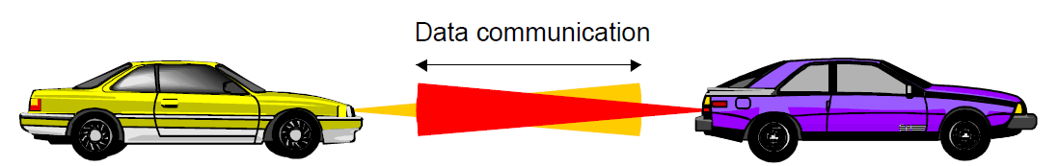
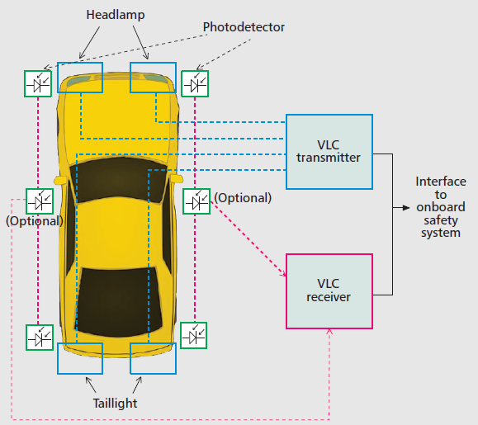
Use Case: Car-to-Car Communications
Optical TRx in head and tail lights
High-speed OWC + Positioning
Enhanced vehicular safety
Movies from camera in preceding car(s)
Challenges: Ultra-low latency, Quick adaptation to the channel
Design OWC PHY and MAC according to C2C requirements
K.D. Langer, J. Grubor, ICTON 2007, Tu.D3.1
Yu et al., IEEE Comm. Mag. Dec. 2013

Slide 7
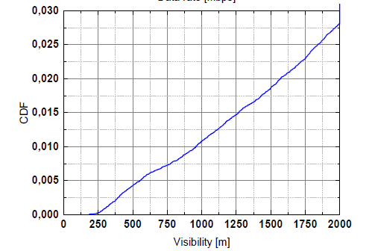
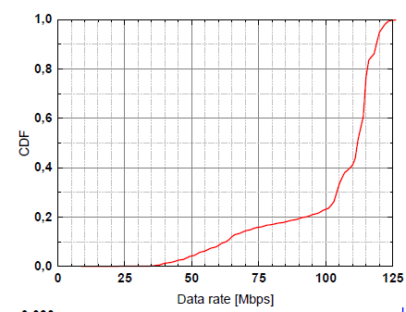
Use Case: Backhaul for small cells
Small cells need a low-cost backhaul
Rate-adaptive OWC PHY is needed
Environmental cond. (fog, sunlight)
2-months field trial in Berlin
Visibility always better than 200 m
>100 Mbit/s over 100 m with single LED, potential for 1 Gbit/s is there
10 Gbit/s 200 m using lasers
Data rates up to 10 Gbit/s in OWC

Slide 8
Asking for in the standard …
A bidirectional OWC PHY + MAC that supports
  high data rates up to 10 Gbit/s, at least in the downlink
  MIMO to achieve reliability and high data rates, according to the channel
  multipoint-to-multipoint (MP2MP) operation to resolve interference and to achieve low latency in case of congestion
  means for precise positioning using “ranging” measurements, also for handover and interference coordination
A higher-layer interface that supports handover and joint signal processing with negligible impact on latency (industrial requirement, C2C)

