Slide 1
Project: IEEE P802.15 Working Group for Wireless Personal Area Networks (WPANs)
Submission Title: [Additional TG4s use case and consideration of SRM information]
Date Submitted: [9 March, 2015]
Source: [Shoichi Kitazawa, Masayuki Ariyoshi] Company [ATR]
Address [Hikaridai, Seika, Kyoto JAPAN]
Voice:[+81-774-95-1565], FAX: [], E-Mail:[kitazawa@atr.jp]
Re: []
Abstract: [Description of document contents.]
Purpose: [For discussion.]
Notice: This document has been prepared to assist the IEEE P802.15. It is offered as a basis for discussion and is not binding on the contributing individual(s) or organization(s). The material in this document is subject to change in form and content after further study. The contributor(s) reserve(s) the right to add, amend or withdraw material contained herein.
Release: The contributor acknowledges and accepts that this contribution becomes the property of IEEE and may be made publicly available by P802.15.

Slide 2
Additional TG4s use case and consideration of SRM information
Authors:

Slide 3
Use Case: Cluster Tree
Each PAN Coordinator collect SRM information from device.
  RFD should forward SRM information
The SRM information should include PAN ID.
PAN ID 4
PAN ID 2
PAN ID 1
PAN ID 3
SRME:SRM Entity
RFD: Reduced-function device
802.15.4 Coordinator
SRM Information Request
802.15.4 Device
SRM Information Response

Slide 4
SRM PIB
The SRM enabled PIB should be add in MAC PIB, for the collection of SRM information.
Table 133—General MAC PIB attributes for functional organization
Attribute | Type | Range | Description | Default
macSRMEnabled | Boolean | TRUE, FALSE | If TRUE, the device is using functionality specific to SRM | —

Slide 5
SRM information consideration
Last meeting the group review “SRMM requirement table”
The group need to discuss this issue.
 | Items | Detailed Items | Primitives
Measurement | Channel Load | ED (Passive)
 |  | CCA (Passive)
 |  | Active Scan
 |  | CCA value histgram
 |  | CA count
 |  | Noise?
 | Link Statistics | LQI value
 |  | LQI Histogram (History)
 | Interference measurement | What is different from ED ?
 |  | Fluctuation of floor ?
 |  | Deviation to fluctuation of floor ?
 |  | Same as media sensing Histogram ?
 | Node Statistics | Frame Error Count
 |  | Time out Occurance Count
 |  | Retry Count
 | Channel Ocupancy Statistics | Frame Air Time
 | Wakeup statistics | Average interval
 |  | Min./Max. interval
 |  | Aperiodic wakeup count
 |  | Average awake duration
 |  | Min./Max. awake duration
 | Time synch. Error | Corrected error value
 |  | Drift rate
 | Items | Detailed Items | Primitives
Management Report | Beacon Report
 | Slotframe Report
 | Anormaly Detection
 | Data/Ack Report
 | Hopping Channel Report
 | Noise & Interference Histogram
 | Node Statistics Report
 | Media Sensing Histogram
 | Channel Ocupancy Statistics
 | PANID list
 | Misuse detection Report | Channel usage violation
Spectrum Resource Measurement and Management requirement table (15-15-089)

Slide 6
Existing MAC Metrics
Existing MAC Metrics are defined MAC Metrics IE and MAC PIB.
  MAC Metrics IE(Sub-ID 0x1f) defined in 7.4.3.7 MAC Metrics IE in draft document P802.15.4-REVc-DF3.
Table 133—General MAC PIB attributes for functional organization
Attribute | Type | Range | Description | Default
macMetricsEnabled | Boolean | TRUE, FALSE | If TRUE, the device is providing additional MAC Metrics | —
If macMetricsEnabled is TRUE, the MAC shall collect the metrics listed in Table 143.
One idea is adding SRM related metrics in this Table.
Source: P802.15.4-REVc-DF3

Slide 7
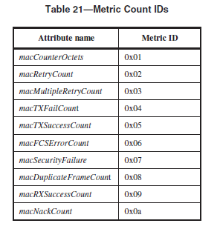
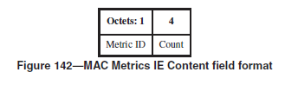
MAC Metrics IE
Source: P802.15.4-REVc-DF3

Slide 8
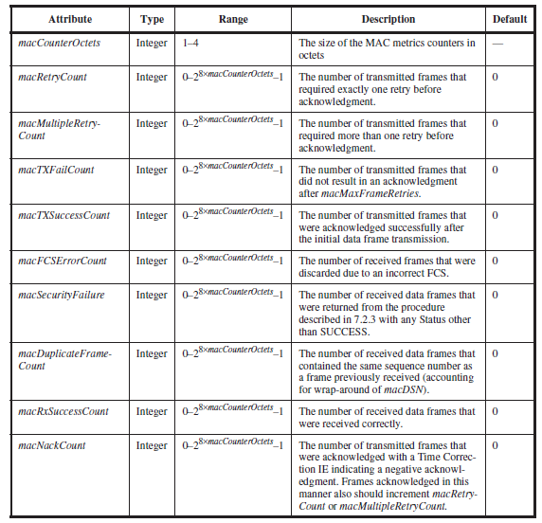
Table 143—Metrics-specific MAC PIB attributes
Source: P802.15.4-REVc-DF3

