Slide 1
        doc.: IEEE 802.15-15-0196-00-007a
Project: IEEE P802.15 Working Group for Wireless Personal Area Networks (WPANs)
Submission Title: Introduction of LED-ID and Smart Device Camera based Applications
: for Short-Range Optical Wireless Communications Tutorial
Date Submitted: Mar. 8, 2015
Source: Jaesang Cha
Company: Seoul National University of Science & Technology
Address:
Voice: FAX: E-Mail: chajs@seoultech.ac.kr
Re:
Abstract: Presentation document for for Short-Range Optical Wireless Communications Tutorial to be presentted in Mar. 9, 2015
Purpose: Tutorial presentation for the IEEE802 plenary
Notice: This document has been prepared to assist the IEEE P802.15. It is offered as a basis for discussion and is not binding on the contributing individual(s) or organization(s). The material in this document is subject to change in form and content after further study. The contributor(s) reserve(s) the right to add, amend or withdraw material contained herein.
Release: The contributor acknowledges and accepts that this contribution becomes the property of IEEE and may be made publicly available by P802.15.
Slide 1
Jaesang Cha, Seoul National Univ. of Science & Tech.

Slide 2
Introduction of LED-ID and Smart Device Camera based Applications
Slide 2
Notes:
doc.: IEEE 802.15-09-0117-00-0007
<month year>

Slide 3
Contents
LED-ID Technology for IEEE802.15.7r1
Use Cases of LED-ID
Conclusions

Slide 4
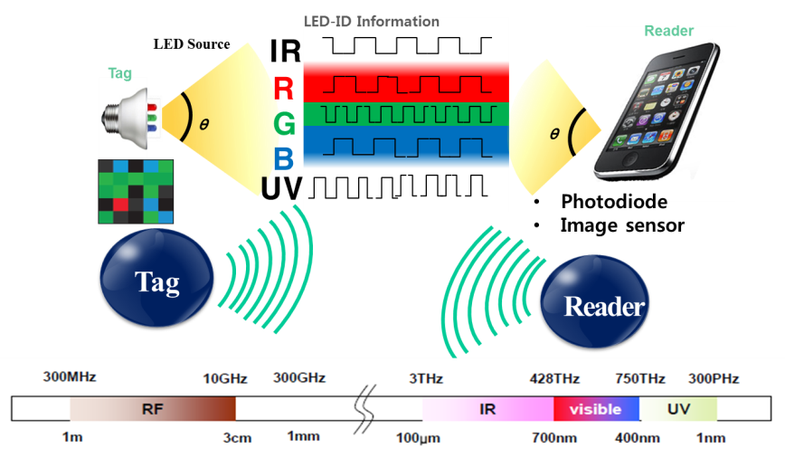
        doc.: IEEE 802.15-15-0196-00-007a
LED-ID Technology for IEEE802.15.7r1
IEEE802.15.7r1 TG OWC (Optical Wireless Communications) consists of three topics as:
  LED-ID: LED-ID is defined as wireless light ID (Identification) system using various LED Light signals
  OCC (Optical Camera Communications)
  Li-Fi
Concept of LED-ID
  LED-ID is defined as wireless light ID (Identification) system using various LED Light signals.
LED-ID is one of main topics of OWC with OCC a nd Li-Fi.

Slide 5
        doc.: IEEE 802.15-15-0196-00-007a
Concept of LED-ID Technology
(Comparison between LED-ID & RF-ID)
Tech item |  | LED-ID | RF-ID
Difference | Source | LED lights | RF
 | Security | High | Low
 | Harmful | X | O (Due to Electromagnetic)
 | Promotional in market | High | Low
 | Dedicated Reader | Unnecessary (using smart devices) | Necessary
Common | Configuration | LED Tag & Smart device | RF-ID Tag and Reader
 | Directivity | LED-ID Tag to Smart device | RF-ID Tag to RF-ID Reader

Slide 6
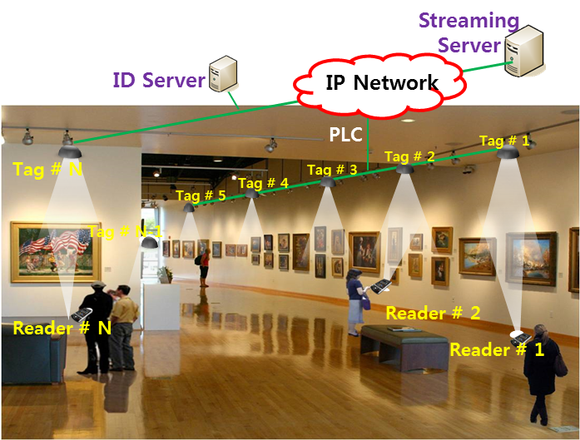
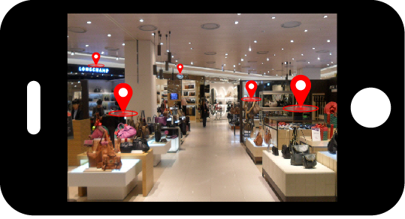
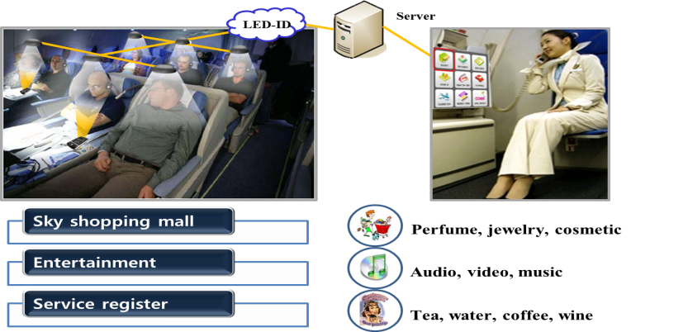
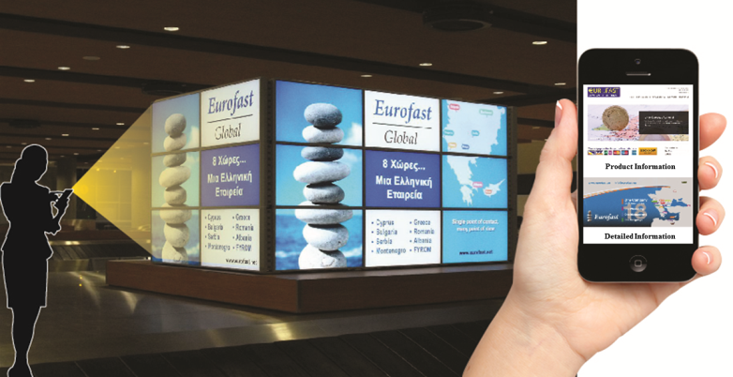
        doc.: IEEE 802.15-15-0196-00-007a
Use Case of LED-ID #1:
Applications of LED-ID Services
Exhibition Service
Indoor Store Service
In-flight Service
Facility Signage/Display
LED-ID signals can be used for data transmission or positioning recognition at exhibition center, indoor store, in-flight and facility signage/display, etc.

Slide 7
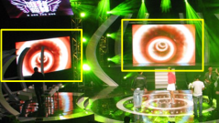


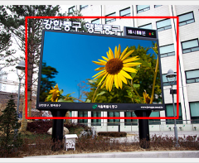


        doc.: IEEE 802.15-15-0196-00-007a
Use Case of LED-ID #2:
LED QR/Color Code
Facility Signage
Color code
QR code
Tag : LED based Bar code (Color code, QR code, etc.)
Reader : Camera Image Sensor of Smart Phone/Pad

Slide 8
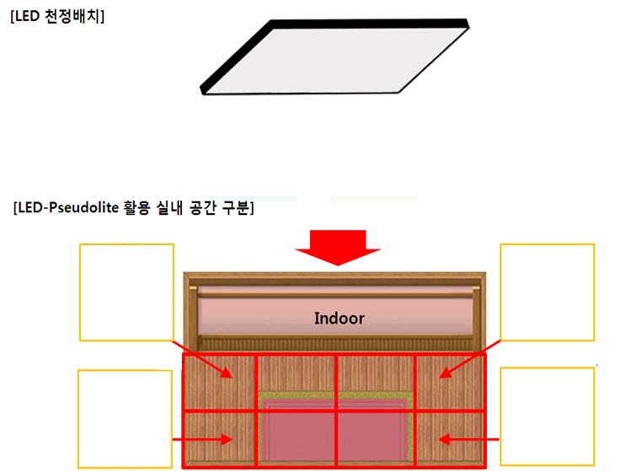
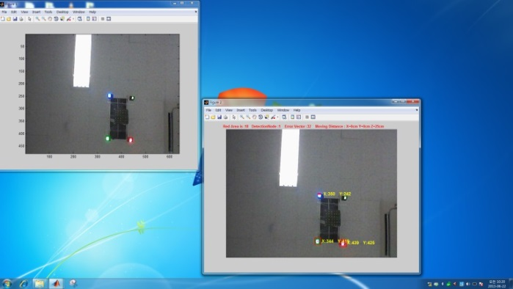

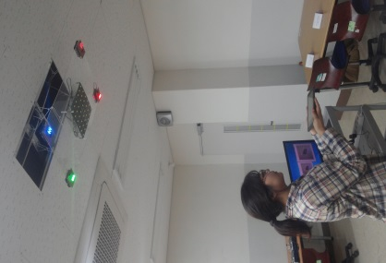
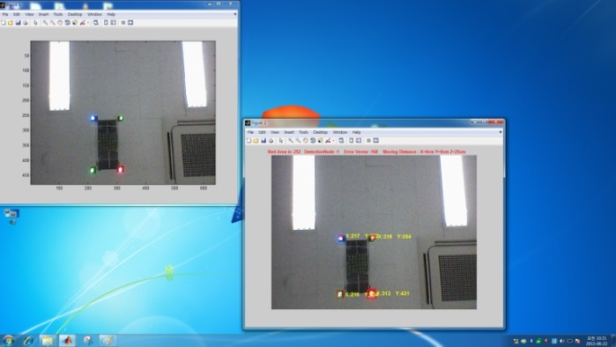
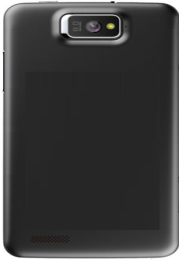
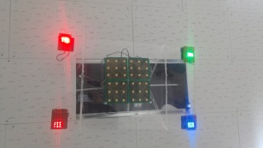
        doc.: IEEE 802.15-15-0196-00-007a
Use Case of LED-ID #3:
Camera Positioning (CamPo)
Smart Phone Camera based indoor Positioning using multiple LED light signals with high resolution is possible.

Slide 9
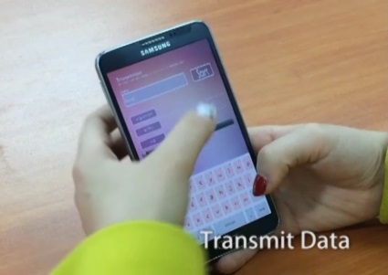
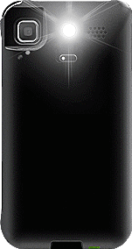
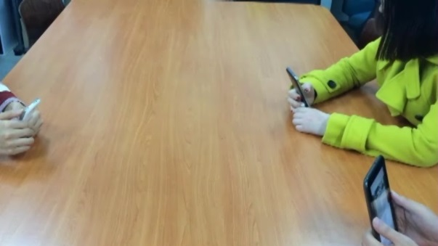
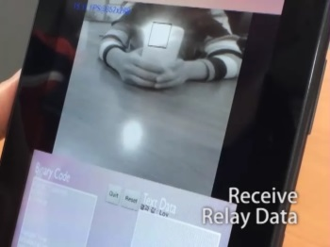
        doc.: IEEE 802.15-15-0196-00-007a
Use Case of LED-ID #4:
P2P (Phone to Phone) Tx/Rx & Relay Application
VLC (OCC)
Tx action
LED Flash Light
Camera
Tx : LED flash light of Smart Device
Rx : Camera module of Smart Device
Rx/Tx (Relay action)
Rx action
Tx: LED flash light of Smart device Rx : Camera of a Smart device
  LED-ID solutions with smart phone cameras can also be a main OCC& OWC solution.

Slide 10
        doc.: IEEE 802.15-15-0196-00-007a
Conclusions
  LED-ID is defined as wireless light ID (Identification) system using various LED Light signals.
  LED-ID is one of main topics of OWC with OCC & Li-Fi.
  Existing light source infrastructure can be used for LED-ID technology applications.
  Camera Image Sensor could be used for LED-ID receivers.
  Smart phone based CamPo (Camera Positioning) & P2P (Phone to Phone) services are possible.
  LED-ID solutions with smart phone cameras can also be a main OCC& OWC solution.
  Various use cases based on LED-ID are considerable.

