Slide 1
Project: IEEE P802.15 Working Group for Wireless Personal Area Networks (WPANs)
Submission Title: Next Generation Gbit/s Optical Wireless Communications and Introduction of OPTICWISE Scientific Network
Date Submitted: 09 March, 2015
Source: Murat Uysal, Ozyegin University, Volker Jungnickel, Fraunhofer Heinrich Hertz Institute Berlin
Addresses
Murat Uysal: Nisantepe Mh. Orman Sk. No:34-36 Çekmekoy 34794 Istanbul, Turkey
Voice: +90 (216) 5649329, FAX: +90 (216) 5649450, E-Mail: murat.uysal@ozyegin.edu.tr
Volker Jungnickel: Fraunhofer HHI, Einsteinufer 37, 10587 Berlin, Germany
Voice: +49 30 31002 768, FAX: +40 30 31002 250, E-Mail: volker.jungnickel@hhi.fraunhofer.de
Abstract: This document summarizes use cases, requirements, research results and key technical solutions for a Gbit/s optical wireless PHY. It is relevant to the potential revision of the IEEE 802.15.7 standard.
Purpose: To introduce the state of the art and to show a main new direction for future standardization
Notice: This document has been prepared to assist the IEEE P802.15. It is offered as a basis for discussion and is not binding on the contributing individual(s) or organization(s). The material in this document is subject to change in form and content after further study. The contributor(s) reserve(s) the right to add, amend or withdraw material contained herein.
Release: The contributor acknowledges and accepts that this contribution becomes the property of IEEE and may be made publicly available by P802.15.

Slide 2
Outline
Introduction
  History and Advantages
  Use Cases and Main Requirements
Research Results and Key Technical Features
Demonstrations
Introduction of COST 1101 Action OPTICWISE
Summary

Slide 3
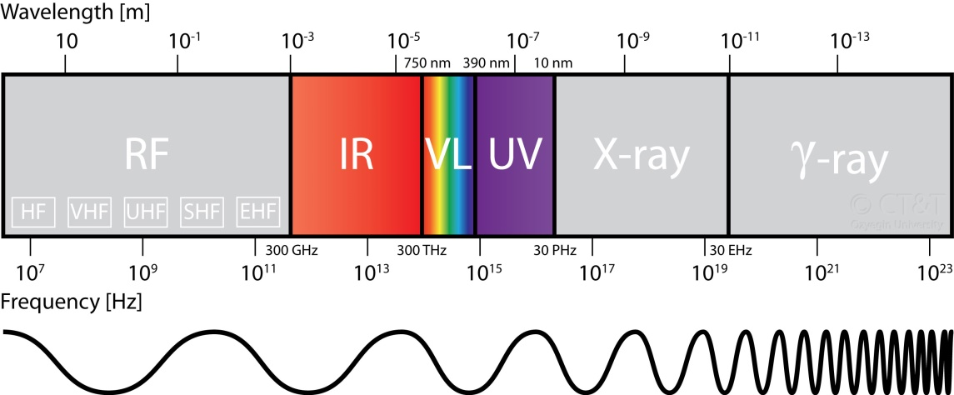
Introduction
Optical Wireless Communications (OWC)
OWC: Wireless (unguided) transmission through the deployment of optical frequencies
  Infrared (IR)
  Visible (VL)
  Ultraviolet (UV)

Slide 4

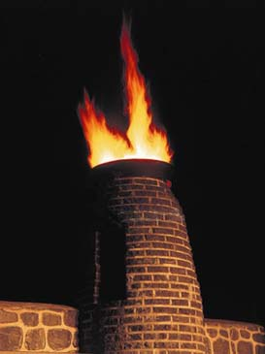
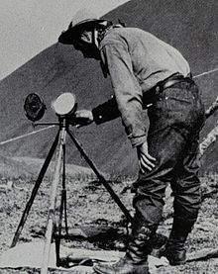
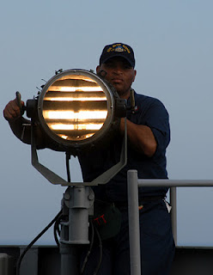
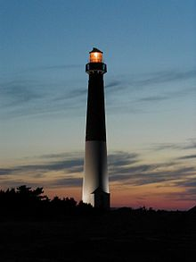
OWC History
The use of sunlight
  Heliograph (Information delivery using mirror reflection of sunlight)
The use of fire or lamp
  Beacon fire
  Lighthouse
  Signal lamp for ship-to-ship communication

Slide 5
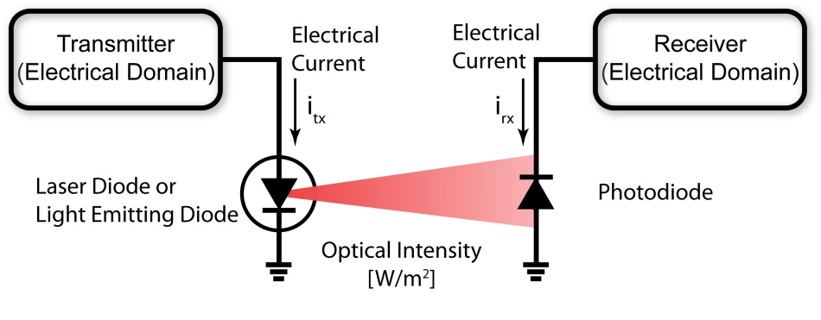
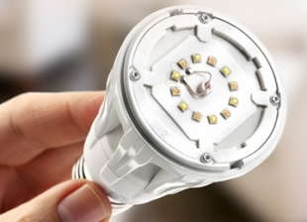
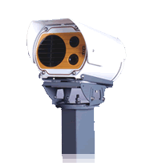
OWC Basics
Transmitter
  Baseband processing in electrical domain
  E/O Conversion
    Laser (small FoV and restricted to LOS)
    LED (large FoV and LOS/NLOS)
Amplitude constraints
  Non-negativity of the signal
  Eye-safety regulations for laser
Receiver
  O/E Conversion (Photodetector, Image sensor)
  Baseband processing in electrical domain

Slide 6

OWC - Advantages
  Large bandwidth capacity
  Unregulated spectrum
  High degree of spatial confinement
    High reuse factor
    Inherent security
    Robustness to EMI
      Can be safely used in RF restricted areas (hospitals, airplanes, spacecrafts, industrial areas etc)

Slide 7

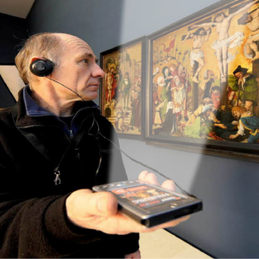
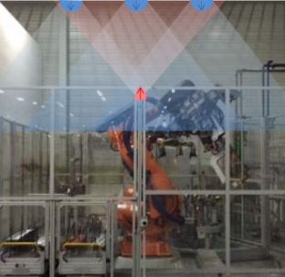



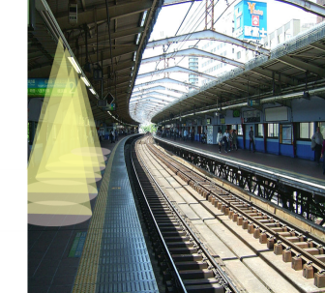


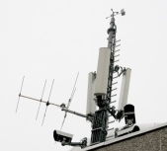
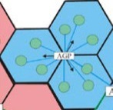
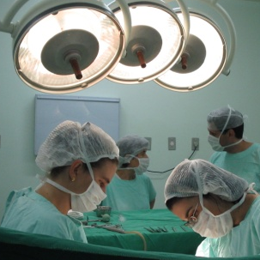
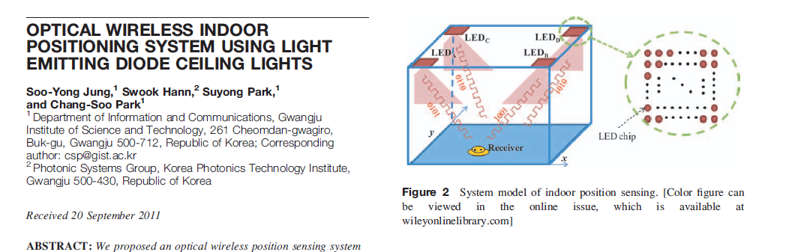

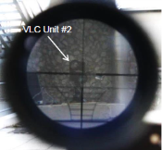
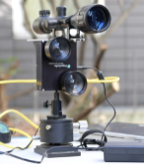
OWC Gbit/s Use Cases
IoT: Flexible Manufacturing
Conference Rooms
Private Households
In-flight Entertainment
Mass transportation
IoT: Car2Car, Car2Infra
Opt. Backhaul for
small cells in 5G
Augmented reality, hospitals, support for disabled people
Precise Indoor Positioning
Secure Wireless

Slide 8

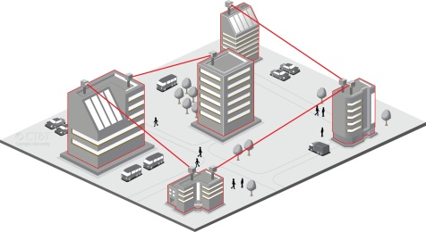
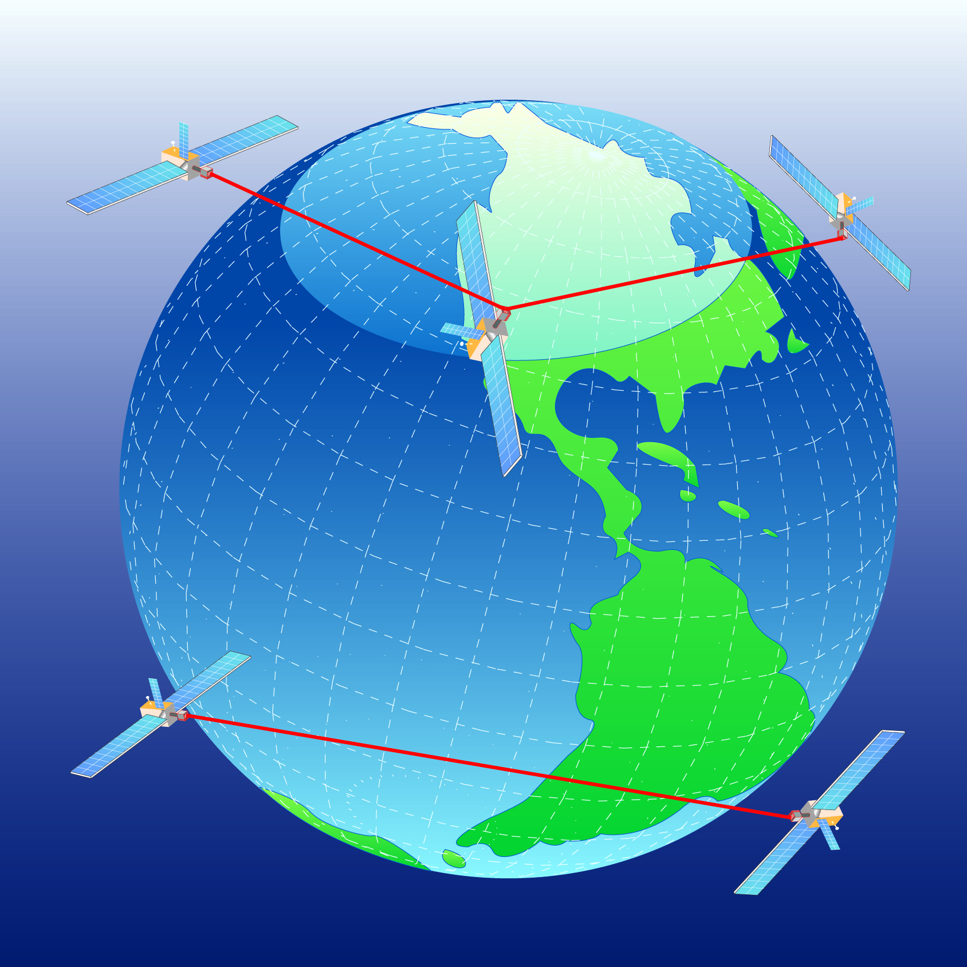
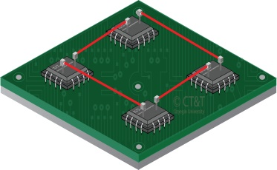
OWC - Domains
Depending on the intended application, variations of OWC (UV, IR, VL) can serve as a powerful alternative, complementary or supportive technology to the existing ones
  Ultra-short range (e.g., optical circuit interconnects)
  Short range (e.g., WBAN, WPAN)
  Medium range (e.g., WLAN, VANET)
  Long range (e.g., inter-building connections)
  Ultra-long range (e.g., satellite links)
~mm
m
km
>10,000 km

Slide 9

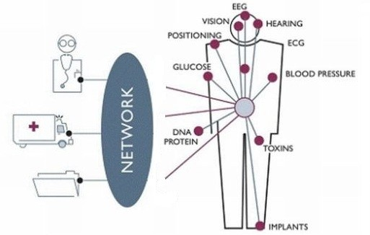
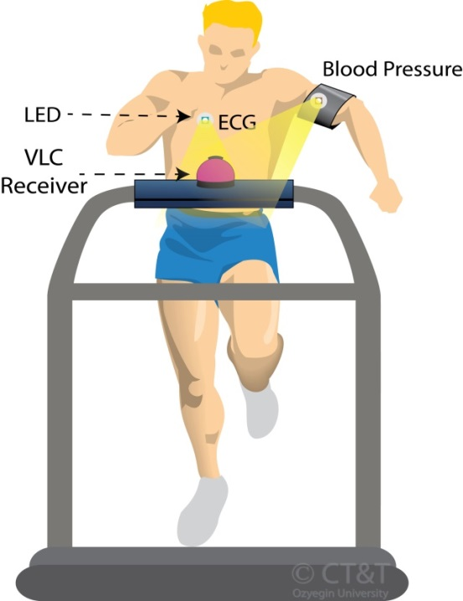
Optical Wireless BAN
Body-area networks
Retrieval of physical and bio-chemical information of the individual through the use of wearable computing devices

Slide 10
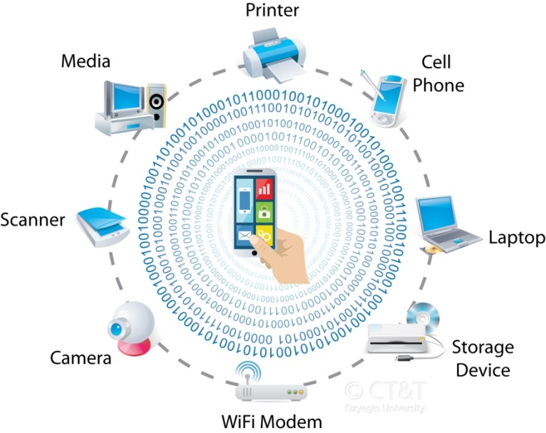

Optical Wireless PAN
Personal area networks: “Last meter” connectivity for interconnecting devices centered around an individual person's workspace
Giga-IR ~ 1.25 Gb/s (limited mobility)
10Gb/s IR under development
IEEE 802.15.7: Enhanced mobility but limited data rate
Smart phone communication using visible light (phone-to-phone, phone-to-TV, phone-to-vending machine, phone-to-POS machine, phone-to-ATM etc)

Slide 11


Optical Wireless LAN
In line with governmental plans worldwide to phase out incandescent bulbs and fluorescent lights, it is predicted that LEDs will be the ultimate light source in the near future.
  Visible light communications (VLC) a.k.a Li-Fi
    Dual use of lightning for illumination and communication
Start-up companies on VLC
  PureVLC (UK)
  OLEDCOMM (France)
  Visilink (Japan)
  LVX (US)

Slide 12
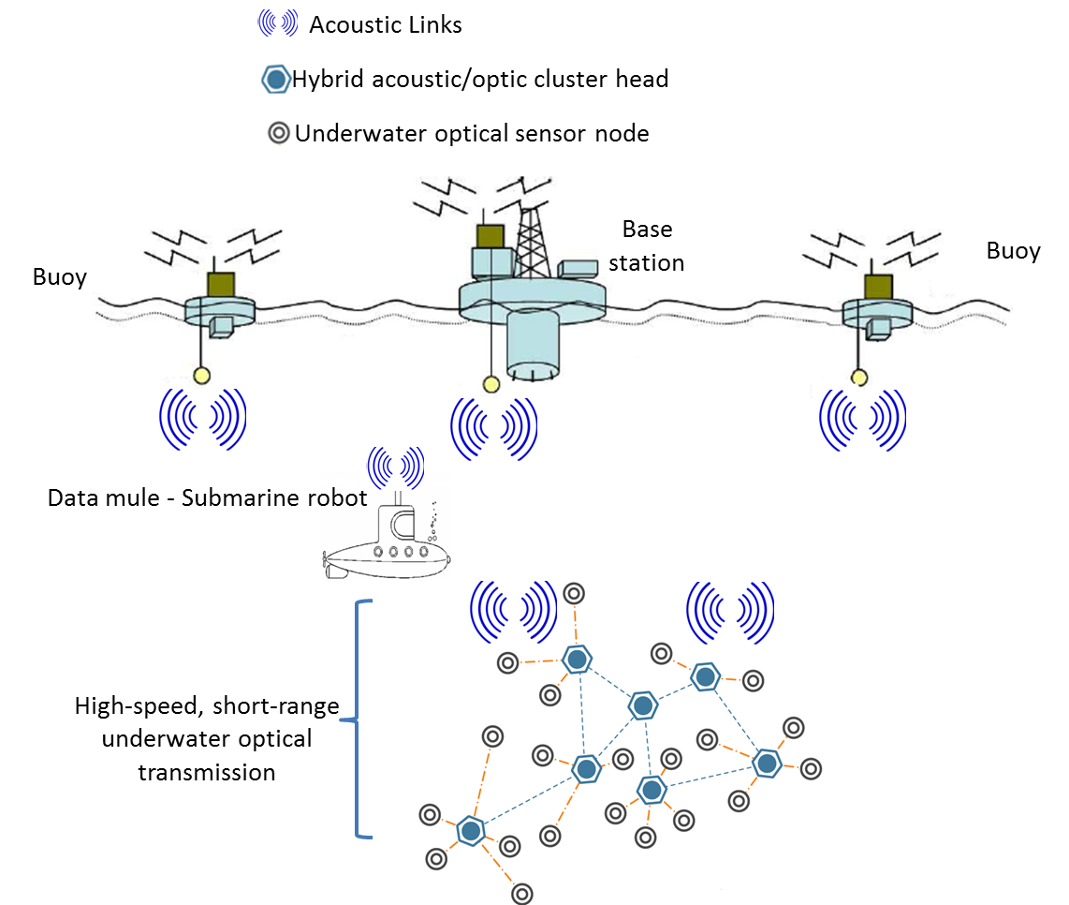
Optical Wireless Underwater
                Typical choice for underwater transmission is acoustic → kbps @ km’s
                Complimentary to long range underwater acoustic systems
                Visible light band (380 nm - 760 nm) useful for short links
                Envisioned hybrid acoustic/optical underwater sensor network

Slide 13
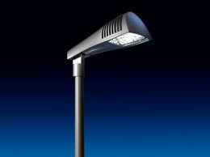
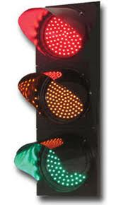
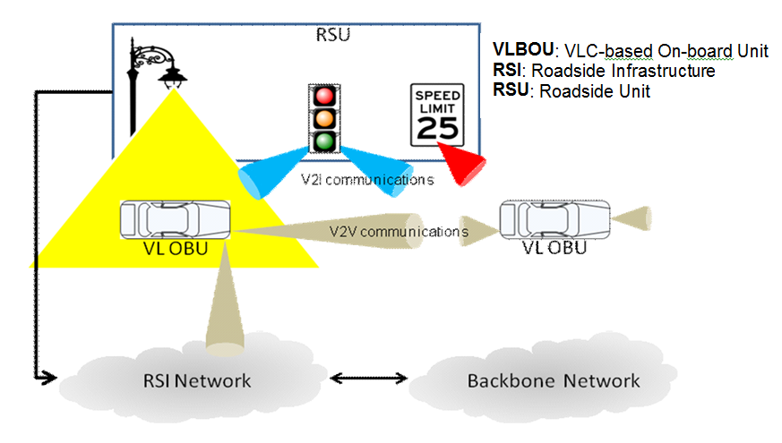

Optical Wireless VANET
Vehicle-to-vehicle communication (V2V)
Vehicle-to-infrastructure communication (V2I)

Slide 14
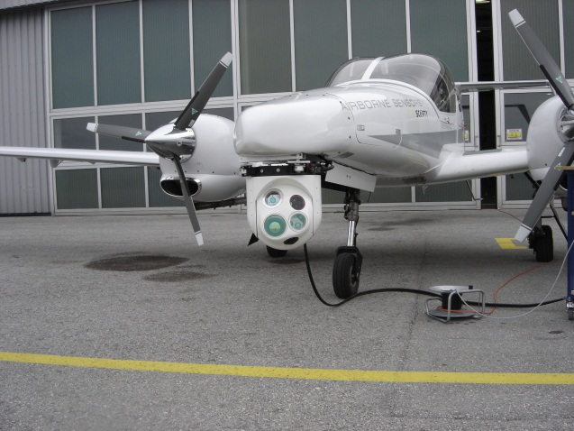
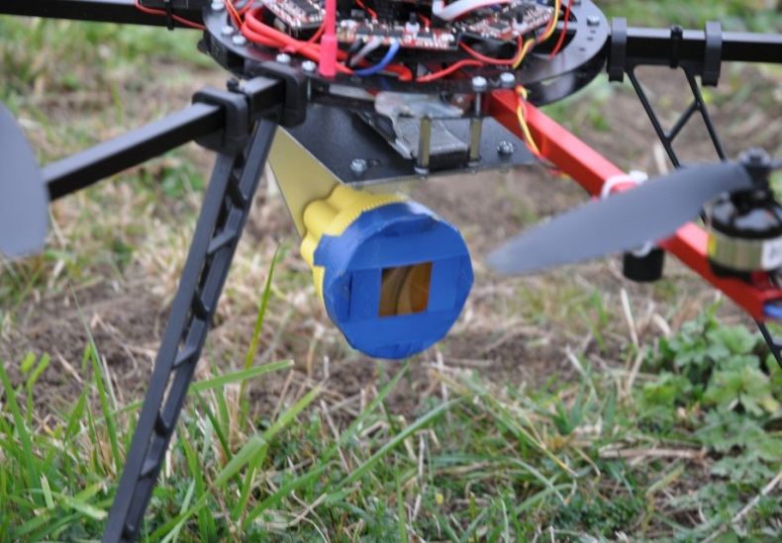
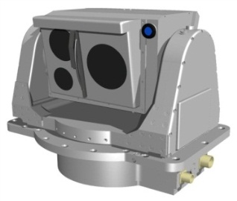
Optical Wireless for Airborne
  Aircraft-to-aircraft
  Aircraft-to-ground
  Aircraft-to-satellite
  Aircraft-to-HAP
  Drones
OWC terminal
Corner Cube reflector
Ground station @ 4 km

Slide 15
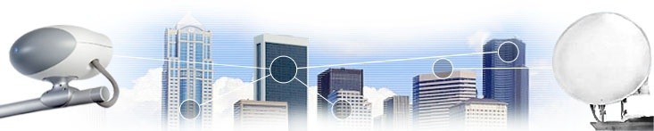

Terrestrial Optical Wireless
Atmospheric line-of-sight (LOS) infrared communication using lasers/LEDs, a.k.a. free-space optical (FSO) communications
  metropolitan area network (MAN) extension
  enterprise/campus connectivity
  optical fiber back-up
  backhaul for small cells and coverage extension
  temporary links for disaster recovery & emergency response
  adaptation to environmental conditions is important (fog, sunlight)

Slide 16
Main Requirements
High speed: > 1 Gb/s per link
    Ultra-dense wireless scenarios, Short- to medium range (1 m diffuse to100 m directed)
Mobility and adaptation to the channel
    Seamless mobility support for heterogeneous wireless environments
Robustness: < 0.1 % outage in coverage area
    Multipoint multiuser support → low latency, horizontal and vertical handover to Wi-Fi
Low latency: < 1ms
    Short response times for the Industrial Internet
Precise positioning: < 10 cm
    Enhanced security support: Wireless data only near the user location

Slide 17

Research results
  Focus will be on short range
  Using infrared (IR) and visible light communications (VLC)
  Optical personal small cells
  10 Mbit/s … few Gbit/s per link
  Low-cost: LEDs, photodiodes, digital signal processing

Slide 18
Scenarios
  Wide beams → coverage, robustness, mobility
  Directed LOS
  Non-directed LOS
  Switched-beam LOS
  LOS + NLOS
  Non-directed NLOS
  Multi-spot NLOS

Slide 19
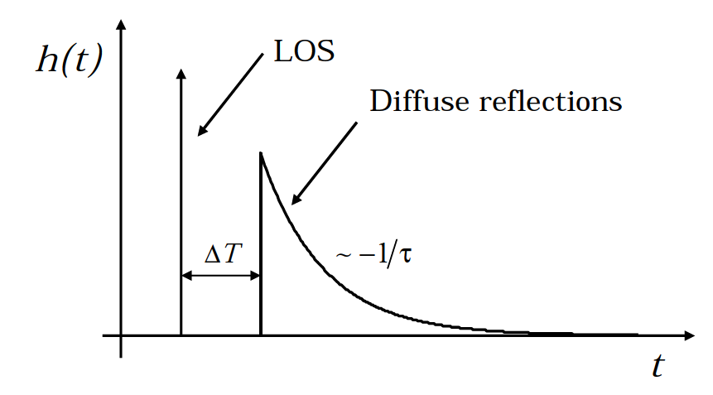
Channel Properties
  Line-of-sight (LOS)
    direct path → high power
    narrow field-of-view
    → blocking is critical
    → mobility needs tracking
    no multipath → huge bandwidth
  Non-line-of-sight (NLOS)
    Diffuse reflections → less power
    wide field-of-view
    → blocking is less relevant
    → inherent mobility support
    multipath → reduced bandwidth

Slide 20
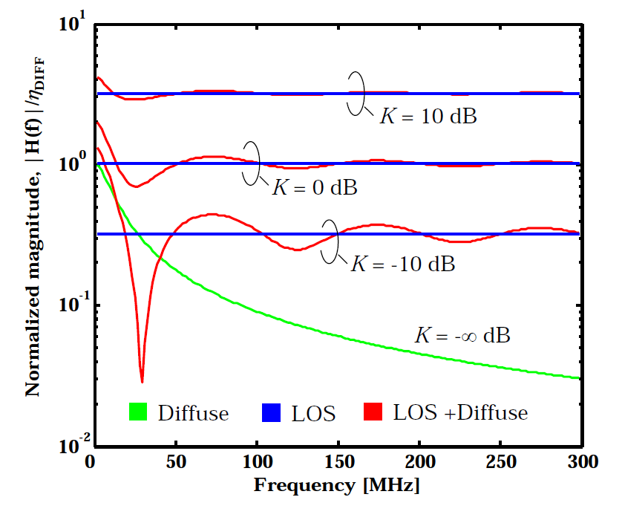
Superimposed LOS and NLOS
  Typical case
  Channel impulse response depends on
    K-factor (Rice)
    delay DT between LOS and NLOS
  Frequency-selective channel
    there can be “optical fading” at the edges of the room
    where photocurrents of LOS and NLOS contributions have similar amplitude but opposite phase

Slide 21
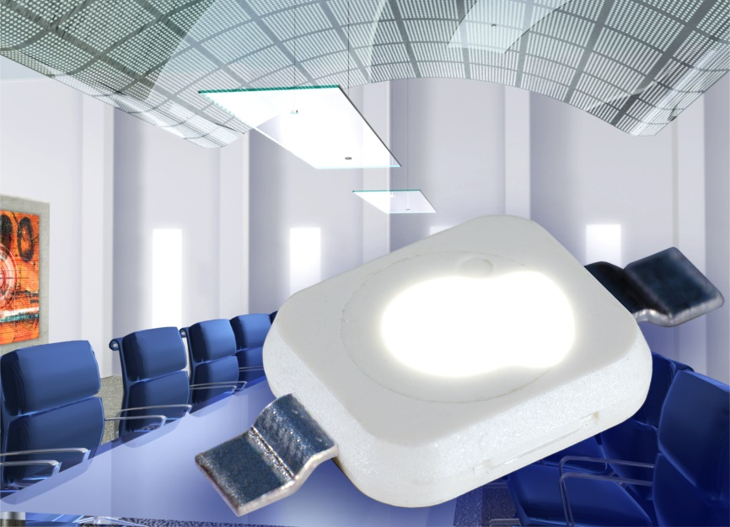
LED as Transmitter
  Optical wireless was limited for a long time due to insufficient power
  Recently, low-cost high-power LEDs became available using infrared and visible light
  For data transmission, LED can be modulated at high speed
  Flicker is not visible for human eye

Slide 22
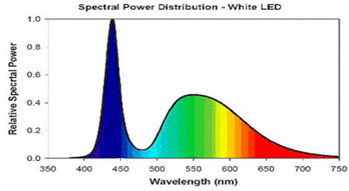
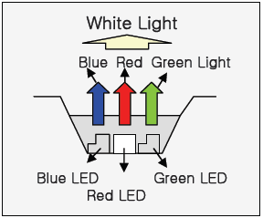
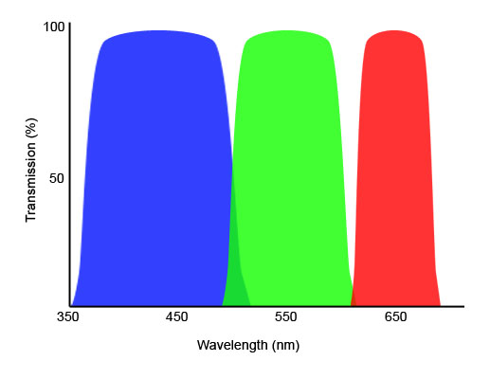
LED design and bandwidth
Blue LED + phosphor
    Blue LED is fast (~20 MHz)
    Phosphor is slow (~2 MHz)
    Low-cost, simple driving
R+G+B type
  Enables wavelength-division multiplex (WDM)
  ~15 MHz per LED chip
  Higher cost

Slide 23
The Potential of high-power LEDs
  5 x 5 x 3 m room
  4 LED arrays, 400-800 lux
  Very high SNR (60-70 dB)
  High spectral efficiency: 12-16 bps/Hz
  Using only blue part of phosphor-type LEDs to have ~20MHz bandwidth
  400-800 Mbit/s with phosphor-LED
  > 1 Gbit/s with RGB
1.65 m
3 m
A
5 m

Slide 24
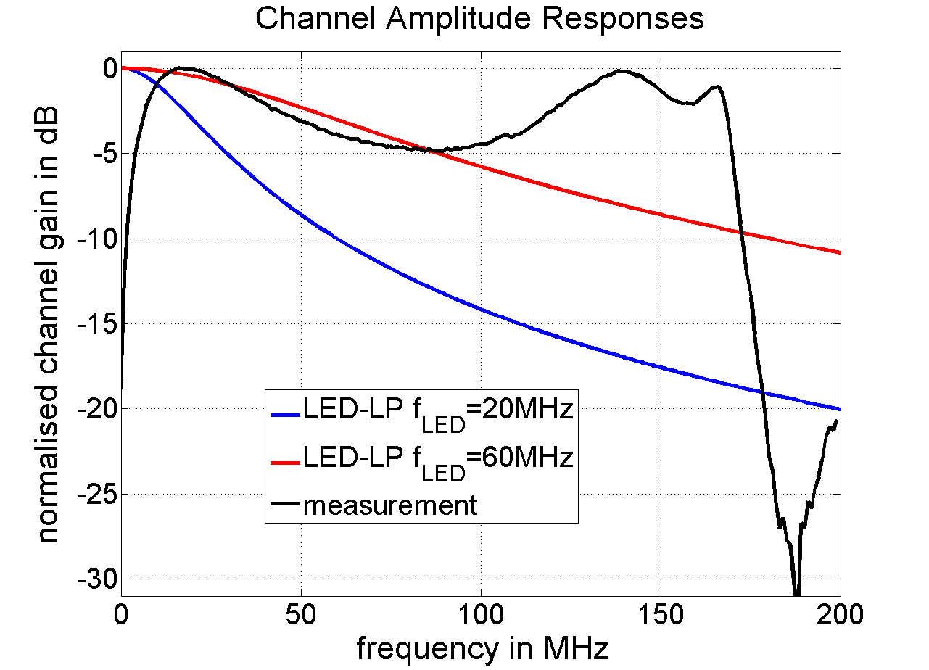
LED Driver
  Conversion efficiency is < 1W/A
  P=R*I² → with 50 Ω: 1 W optical power → 50 W RF for modulation
  RF leakage can be stronger than the received signal over the optical path
  Impedance matching is mandatory for high bandwidth and energy efficiency
  Best recent results
    >100 MHz modulation bandwidth
    30% more energy than for lightning

Slide 25
Photodetectors
  PIN photodiode
    low cost, large area
    limited sensitivity
  Avalanche photodiode (APD):
    higher sensitivity, smaller area
    high reverse bias → significantly higher cost
  Image sensors:
    CCD type: low cost due to high volumes, slow due to serial read-out
    Array type: pixels are operated like parallel photodiodes → fast but high price currently

Slide 26
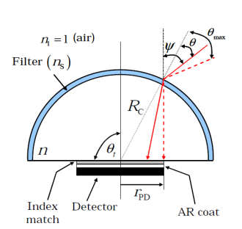
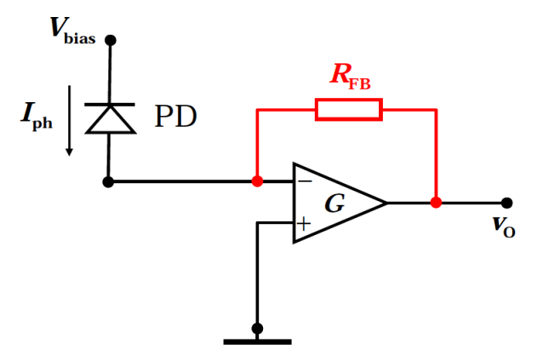
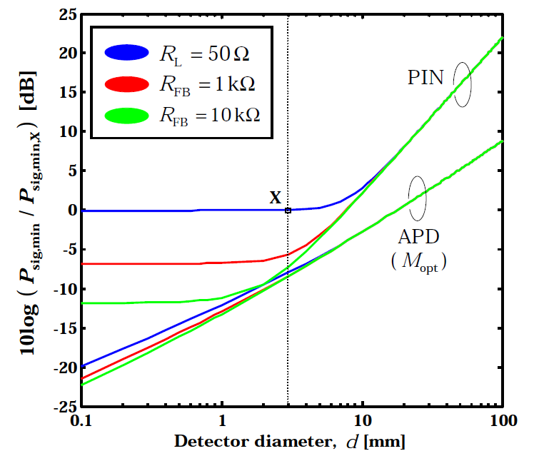
Receiver Design
  Wide aperture → optical concentrator
  Antireflection and color filter are possible
  Impedance matching is critical
  PD can have 10 dB higher sensitivity using trans-impedance amplifier (TIA) compared to 50 Ω design
  APD gain can be small

Slide 27
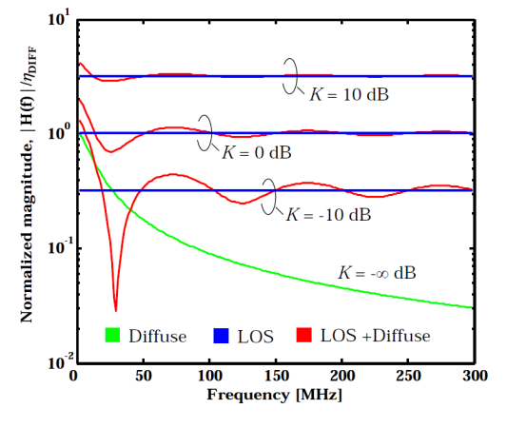
Rate-adaptive system concept
  We want to be mobile, while channel is frequency-selective and time variant
  Rate-adaptive system concept based on feedback over the reverse link
  Complex dispersion effects are not avoidable
    Orthogonal frequency-division multiplex (OFDM)
    Adaptive modulation and coding
Channel quality information
Ambient light
Tx
OW channel
Rx
Data in
Data out

Slide 28
IM/DD Capacity bound
R. You and J. Kahn, „Upper-bounding the capacity of optical IM/DD Channels with multiple-subcarrier modulation and fixed bias using trigonometric moment space method“, IEEE Trans. Inf. Theory, Vol. 48, No. 2, Feb. 2002
  You and Kahn provided an upper bound on the channel capacity of intensity-modulation with direct detection (IM/DD), based on multiple-subcarrier modulation
  Based on this result, a practical formula including a frequency-selective channel characteristics H_{n} can be derived (Jelena Vucic, Ph.D. thesis, TU Berlin 2009)
effective SNR
B_{SC} subcarrier bandwidth
optimal no. of carriers
P_{O} optical power
η optical path gain
N_{D} detector noise

Slide 29
How many sub-carriers are useful?
  Depending on the channel, maximize the bound of You and Kahn
  Number of used suncarriers is important
  For NLOS, low-frequency subcarriers are used, while all are used with LOS
C/B_{SC} [bit/s/Hz]
Number of used subchannels
(best channels out of 63)

Slide 30
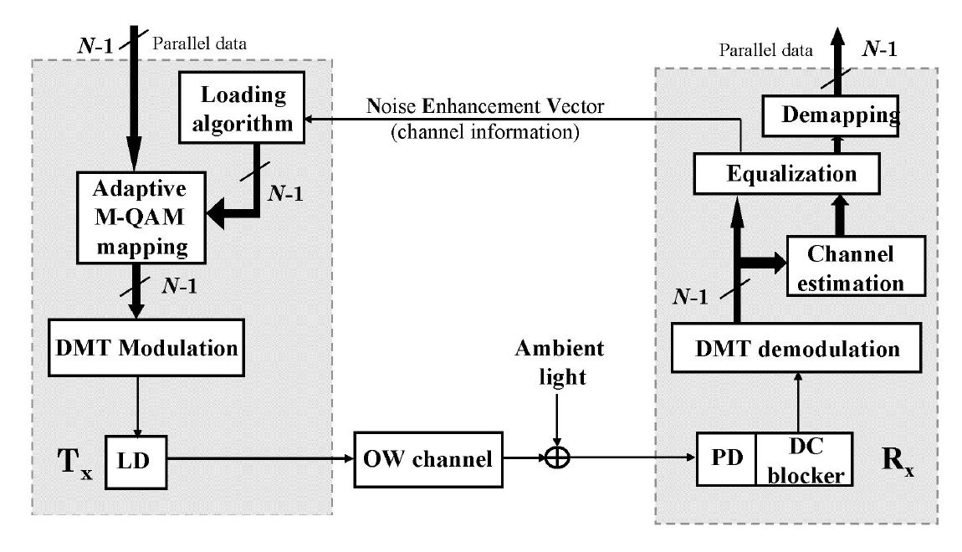
Implementation using adaptive DMT
  Now we consider a practical optical wireless link
  Use discrete multi-tone (DMT) with adaptive bit and power loading
J. Grubor, V. Jungnickel, K.-D. Langer, and C. von Helmolt, “Dynamic data-rate adaptive signal processing method in a wireless infra-red data transfer system,” Patent EP1897252 B1, 24 June 2005.
J. Grubor, V. Jungnickel, K.-D. Langer, „Capacity Analysis in Wireless Infrared Communication using Adaptive Multiple Subcarrier Transmission, ICTON We C2.7, 2005.

Slide 31
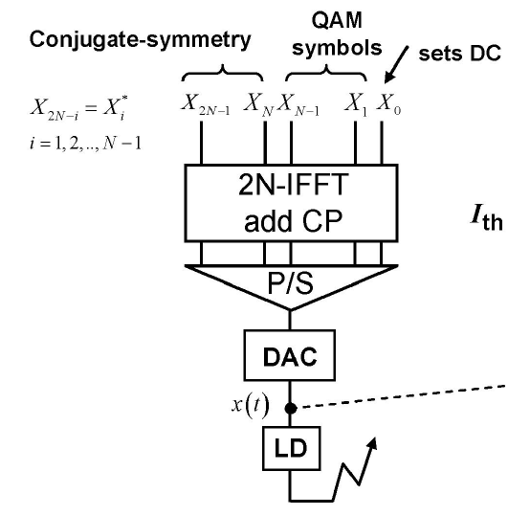
Discrete Multi-tone (DMT)
  OFDM yields a complex-valued waveform
    Use double-sized IFFT
    Subcarriers in the upper side-band are complex conjugated and used again in the lower sideband
  Yields a real-valued waveform
  Complex-valued symbol-constellations with variable spectral efficiency can be used on each subcarrier (QPSK, 16-QAM, 64-QAM, …)

Slide 32
Asymmetric Clipping
J. Armstrong, B.J.C. Schmidt, „Comparison of assymetrically clipped
optical OFDM and DC-biased OFDM in AWGN, IEEE Commun. Lett.,
Vol. 12, No. 5, May 2008
  Based on DMT
    Main observation: If odd carriers are modulated
    only, the clipping noise is only on the even carriers!
  Asymmetric clipping
    Use even sub-carriers only for DMT
    Clip the negative part of the waveform
    Increase the modulation index
  Trade-off between power and spectral efficiency
    Suitable for low and medium SNR
DC-
OFDM
ACO-
OFDM

Slide 33
Adaptive Bit- and Power Loading
  Depending on the channel, sub-carriers are loaded with suitable modulation
  Power is modified to adapt the SNR to the switching thresholds between the modulation schemes
  Loading: Hughes-Hartogs, Chow-Cioffi-Bingham, Fischer-Huber, Krongold
  Krongold is optimal, has low complexity
6
4
2
16QAM
64QAM
QPSK
B.S. Krongold et al.,“Computationally Efficient Optimal Power Allocation Algorithms for Multicarrier Communication Systems,“ IEEE Trans. Commun., Vol. 48, No. 1, 2000

Slide 34
Controlled Clipping
  At high SNR typical for VLC, DC-biased DMT is used, clipping is tolerated
  Resulting errors are corrected
    Needs powerful forward error correction (FEC)
    Retransmissions (HARQ)
  DMT Samples are clipped in the digital domain
  Link adaptation with controlled clipping
    Inner loop: Bit and power loading using a fixed modulation power
    Outer-loop: Adapt the modulation power until a desired error rate is reached
Graph: Nokia
CS IFFT
CL
G_{CP}
LD

Slide 35
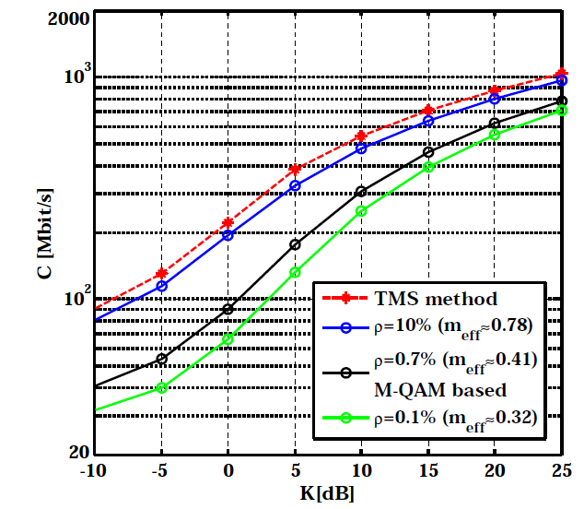
Results at High SNR
J. Vucic, Ph.D. thesis, 2009
  Red is the upper bound of capacity
  Blue: 10% clipping probability yields gap ~2 dB to upper bound
  Green: Clipping is nearly avoided
  Gaussian input distribution and waterfilling for all curves (not for red)
  For further work, see
X. Li, J. Vucic, V. Jungnickel, J. Armstrong „On the capacity of intensity-modulated direct detection systems and the information rate od ACO-OFDM for indoor optical wireless applications, IEEE Trans. Comm.,2012
P_{opt}=400 mW, η=1A/W, B=100 MHz, N=64

Slide 36
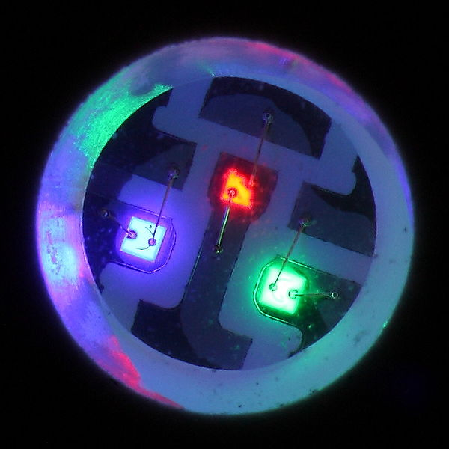
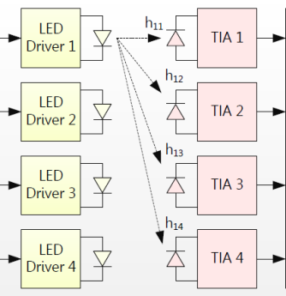
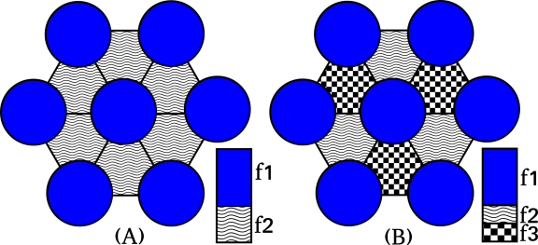
Further Technical Features
  Wavelength-division multiplex (WDM) to multiply data rates, e.g. RGBY LED
  MIMO, angular diversity transmitters and receivers, also in combination with WDM
  Cell-specific pilots for positioning, handover and inter-cell interference coordination
36

Slide 37
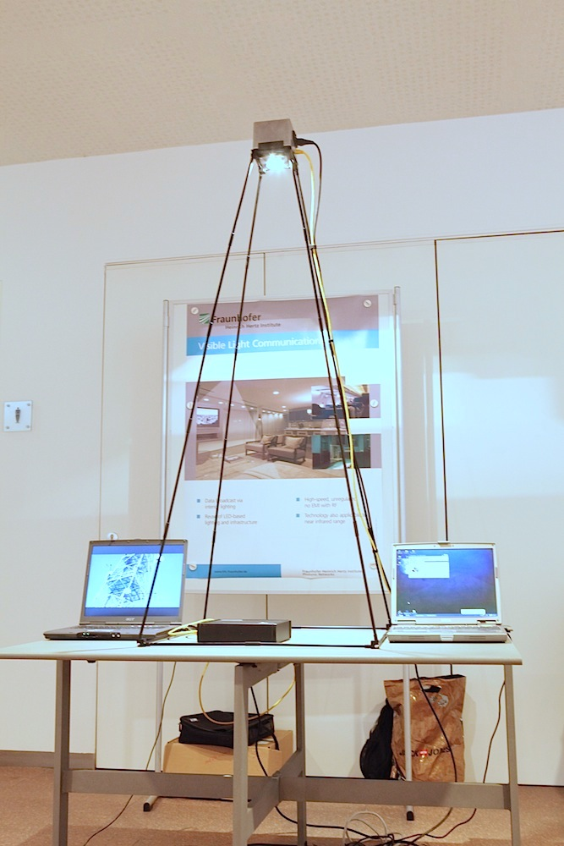
1st Demo: Transparent Link
LED driver
Rx AMP
10BaseT
10BaseT
LED
VLC / IR
channel
Photo-
detector
Lighting /
Power supply
Bidirectional link: White-LED (downlink) and infrared LED (uplink)
LED drivers and receivers are optimized, but
  bandwidth is not fully exploited, no rate adaptation, limited spectral efficiency of the Manchester code

Slide 38
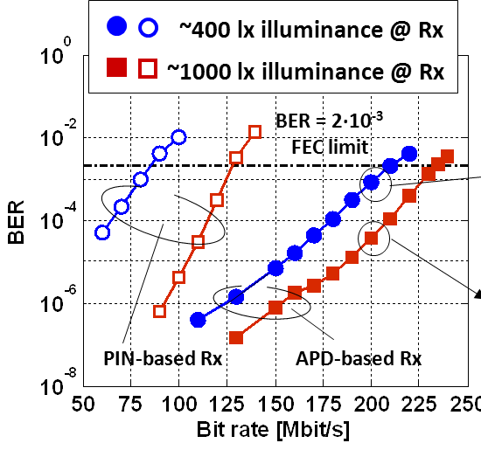

On-Off Keying
Error counter
PRBS
generator
LPF
„blue“
filter
dc
white
LED
VLC channel
AMP
AMP
Tx
PD
lens
Rx
Phosphor-type white LED: Blue is filtered out
Coverage is limited by color filter
125 Mbit/s with PIN, 230 Mbit/s with APD
J. Vucic, C. Kottke, S. Nerreter, K. Habel, A. Buettner, K.D. Langer, J. W. Walewski, „125 Mbit/s over 5 m wireless distance by use of OOK-modulated phosphorescent white LEDs,“ ECOC 2009.

Slide 39
First DMT Experiments
AWG
PC
OSC
LPF
Phosphor LED
APD Rx
35 MHz 3-dB bandwidth
128 subcarriers 100 MHz bandw.
513 Mbit/s
EOE channel
lens
dc
VLC channel
AMP
AMP
white
LED
APD
Tx
„blue“
filter
Rx
Measurements
(R=513 Mbit/s)
Simulations
(R=604 Mbit/s)
upper bound
(C=757 Mbit/s)
J. Vucic, C. Kottke, S. Nerreter, K. Langer, and J. Walewski, "513 Mbit/s Visible Light Communications Link Based on DMT-Modulation of a White LED," J. Lightwave Technol. 28, 3512-3518 (2010).

Slide 40
The Potential of WDM
AWG
PC
OSC
Figure shows red channel of the LED under test
out 2
out 1
RGB
luminary
LPF
dc
AMP
R/G/B
WDM
filter
R
AMP
dc
AMP: amplifier
AWG: arbitrary wave generator
OSC: oscilloscope
LPF: low-pass filter
G
AMP
coupler
dc
VLC channel
1000 lx
APD
B
lens
Commercially available RGB-type white LED (3 WDM channels)
Commercially available WDM band-pass filters

Slide 41
Bit- and Power loading for WDM
Bit- and power-loading using uncoded BER ≤ 2∙10⁻³
~293+ Mbit/s (R), ~223+ Mbit/s (G), ~286+ Mbit/s (B)
WDM almost triples the throughput: 803 Mbit/s
1.25 Gbit/s at ECOC 2012
C. Kottke, J. Hilt, K. Habel, J. Vucic, and K. Langer, "1.25 Gbit/s Visible Light WDM Link based on DMT Modulation of a Single RGB LED Luminary," in Proc. ECOC 2012, We.3.B.4.

Slide 42

Recent Records
Beyond 1 Gbit/s possible
  using WDM and DMT
  5.6 Gbit/s is latest record
G. Cossu et al., “5.6 Gbit/s Downlink and 1.5 Gbit/s Uplink Optical Wireless Transmission at Indoor Distances, ECOC 2014, We.3.6.4
10 Gbit/s is next target
  higher bandwidth per color
D. Tsonev et al. “3-Gb/s Single-LED OFDM-based Wireless VLC Link Using a Gallium Nitride μLED", PTL, Jan. 2014
  MIMO, enhanced WDM, using lasers
Potential of WDM and MIMO is currently exploited

Slide 43



Realtime Implementations
K.D. Langer, J. Vučić, „Optical Wireless Indoor Networks: Recent Implementation Efforts,” ECOC 2010, WE.6.B.1
Real-time is mandatory for mobility: OMEGA project 2007-2010
PHY: Synch. over the air, DMT with FEC and 100BaseT network interface
System running at 125 Mb/s (gross), 100 Mb/s (net), realtime video demo

Slide 44





Reduced form factor
500 Mbit/s realtime VLC link with bidirectional DMT
1 Gbit/s with 1 ms latency (FOE 2015, HHI)
Entirely based on off-the-shelf components: Small volumes production

Slide 45




Realtime measured results
Throughput versus distance
  Variable optics for different scenarios
  2’’ lens at Tx: 200 Mb/s over 15 m
  1’’ lenses: same over 2 m
  Diffusely reflected NLOS works!
  NLOS configuration
LOS is no longer needed for high speed
K.D. Langer et al. „Rate-adaptive visible light communication at 500Mb/s arrives at plug and play,” SPIE Newsroom, Nov. 2013

Slide 46



EU COST Action (2011-2015)
http://opticwise.uop.gr/
OPTICWISE is a European Scientific Network funded by the European Science Foundation (ESF). It currently includes
100+ researchers
35 institutions
23 European countries
6 international partners
OPTICWISE Member

Slide 47

Research Scope
Research scope of OPTICWISE covers all means of optical wireless communication in infrared, visible and ultraviolet frequencies.
Depending on the intended application, variations of OWC can serve as a powerful alternative, complementary or supportive technology to the existing ones
  Ultra-short range (e.g., optical circuit interconnects)
  Short range (e.g., WBAN, WPAN)
  Medium range (e.g., WLAN, VANET)
  Long range (e.g., inter-building connections)
  Ultra-long range (e.g., satellite links)

Slide 48
Objectives
OPTICWISE recognizes the great potential of OWC and aims to establish and consolidate OWC as a mainstream technology.
Specific objectives include
  Make significant contributions to the scientific understanding and technical knowledge of the OWC field
  Develop OWC solutions as powerful alternatives and/or complements to existing technologies, and thereby help increase OWC market penetration
  Increase awareness of OWC in the scientific community and the general public
  Influence decision makers at national and international levels
  Attract and train graduate students and early stage researchers for OWC field.

Slide 49
Working Groups
Propagation Modeling and Channel Characterization
Physical Layer Algorithm Design & Verification
Networking Protocols
Advanced Photonic Components
WG1
WG2
WG3
WG4

Slide 50
Work Items
WG1 (Propagation Modeling and Channel Characterization): Development, evaluation and validation of statistical and empirical channel models for OWC applications and optical bands under consideration.
WG2 (Physical Layer Algorithm Design and Verification) : Establishment of information-theoretic framework for OWC and investigation of practical algorithms and techniques to approach these ultimate performance boundaries.
WG3 (Networking Protocols): Design and analysis of upper layer protocol stacks and investigation of co-existence and interoperability of OWC with other communication networks.
WG4 (Advanced Photonic Components): Efficient design, characterization, fabrication and test of state-of-the-art opto-electronic/photonic components and sub-systems for OWC systems

Slide 51
Highlights from OPTICWISE
More than 100 Action participants working on complementary aspects of OWC who produced a total of
  50 input documents and 400+ publications
  60+ publications as joint work
The current research funding comes from
  14 EC projects
  49 national projects
Associate Member of 5G Public Private Partnership (PPP)

Slide 52
OPTICWISE’s View on 802.15.7
The current version of IEEE 802.15.7 supports up to 96 Mb/s and we think that it is somewhat outdated at this point.
In the light of recent advancements in this area, we think that a high-rate VLC standard (supporting multi-Gb/s up to 10Gb/s) is required to cope with the increasing demand of wireless data.
We are very glad to hear that a revision was initiated to broaden the scope from camera communication to OWC.
We have a dedicated Special Interest Group (SIG) on VLC who can actively contribute to the preparation of revised standard.
  Murat Uysal, Ozyegin University
  Volker Jungnickel, Fraunhofer HHI
  Harald Haas, University of Edinburgh
  Víctor P. Gil, University Carlos III de Madrid
  Stanislav Zvanovec, Czech Technical University
  Paul Anthony Haigh, University of Bristol
  Fary Ghassemlooy, Northumbria University
  Ernesto Ciaramella, Scuola S. Sant'Anna
  Mike Wolf, Ilmenau Univ. of Technology
  Roger Green, University of Warwick

Slide 53
Related Achievements
Realistic VLC channel modeling and characterization (OzU)
OFDM PHY was thoroughly implemented and tested (UEdin)
Further performance improvements on OFDM VLC through cooperation and MIMO techniques (OzU, UEDin)
As an alternative to OFDM, SC-FDE was investigated (IUT)
Real-time closed-loop link adaptation was demonstrated (HHI)
Capability of NLOS and robustness against multipath (HHI, UEDin)
Development of MAC layer (HHI)
World record → 5 Gb/s over 2 m based on WDM+OFDM (Sant'Anna)
Several dedicated testbeds at participating institutions and on-site real-time demos from HHI, UEDIN, Sant’Anna

Slide 54
Summary
Gbit/s optical wireless has many useful applications in WPAN and WLAN
  Car-to-X, machine-to-machine, WiFi backhaul, conference rooms
  Augmented reality, indoor positioning, vertical and horizontal handover
  High-power LEDs and large-area silicon photodiodes are available at low cost
  High SNR, high spectral efficiency, >100 MHz bandwidth → Gbit data rates
Adaptive DMT PHY is mature, other options are SC/FDE and M-CAP
  Robust transmission in multipath and NLOS channels was demonstrated
  Up to 5 Gbit/s and some 100 Mbit/s were demonstrated over several meters using free LOS and diffuse reflections (NLOS), respectively
  Real-time demo with small form factor is available
  COST OPTICWISE is ready to support the standardization work

Slide 55











Supporters

