Slide 1
Project: IEEE P802.15 Working Group for Wireless Personal Area Networks (WPANs)
Submission Title: Fully Distributed Synchronization Scheme for PAC with Additional Simulations
Date Submitted: March 2015
Source: [Byung-Jae Kwak, Moon-Sik Lee]¹,
[Junhyuk Kim, Kyounghye Kim, Nah-Oak Song, June-Koo Kevin Rhee] ²
Company: [ETRI, Korea] ¹, [KAIST, Korea]²
Address:
E-Mail: [bjkwak@etri.re.kr, moonsiklee@etri.re.kr] ¹,
[kim.jh@kaist.ac.kr, khye.kim@kaist.ac.kr, nsong@kaist.ac.kr, rhee.jk@kaist.edu]²
Re: P802.15.8 Draft D0.8
Abstract: Presents additional simulation result of the proposed fully distributed synchronization scheme for PAC to address comments from Jan. 2015 meeting..
Purpose: Approval.
Notice: This document has been prepared to assist the IEEE P802.15. It is offered as a basis for discussion and is not binding on the contributing individual(s) or organization(s). The material in this document is subject to change in form and content after further study. The contributor(s) reserve(s) the right to add, amend or withdraw material contained herein.
Release: The contributor acknowledges and accepts that this contribution becomes the property of IEEE and may be made publicly available by P802.15.

Slide 2
Fully Distributed Synchronization Scheme for PAC with Additional Simulations
March. 2015

Slide 3
Introduction
P802.15.8/D0.8 still has an incomplete description of fully distributed synchronization scheme (e.g., phase update rule)
Proposal 15-15-0053-02-000 was not accepted during Jan 2015 meeting
  “No evidence that 180º rule is optimum.”
  More comparison needed: e.g., 90º rule, 270º rule, etc.
  See minutes for more info.: 15-15-0099-00-0008

Slide 4
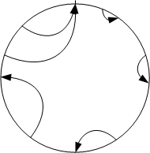
A Brief Recap of Phase Update Rules
Convex curve
  Used in the original firefly sync. scheme
  Two parameters
    b: convexity (the larger, the stronger)
    ε: coupling

Slide 5
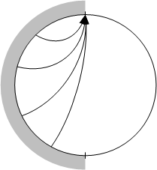
A Brief Recap of Phase Update Rules
  180º rule
    Simple
    No parameters to optimize
    Rationale behind 180º rule
      Mimic the convex curve
      with exaggerated behavioral change
      to make it work for PAC (random access transmission of sync signals)

Slide 6
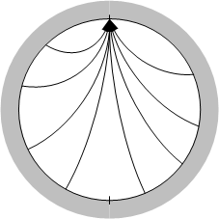
A Brief Recap of Phase Update Rules
  360º rule
    Only natural to ask:
    “Why not 360º rule?”
    Also
      Simple
      No parameters to optimize
    See simulation results

Slide 7
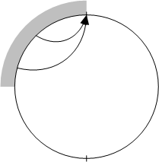
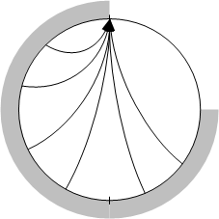
A Brief Recap of Phase Update Rules
  90º rule & 270º rule
    How do you know 180º is the best?
    More variations of the same concept
90º rule
270º rule

Slide 8
A Brief Recap of Phase Update Rules
  Do we have to test all possible degrees?
    No!
    See the discussion in the following slides

Slide 9
Simulation Results: Initial Sync. (1/3)
Comparison of 5 rules for updating oscillator phase
  Convex curve [Mirollo 1990]
  90º rule
  180º rule
  270º rule
  360º rule
[Mirollo 1990] R. E. Mirollo, S. H. Strogatz, “Synchronization of pulse-coupled biological oscillators,”
SIAM J. Appl. Math., vol. 50, no. 6, pp. 1645-1662, Dec. 1990.

Slide 10
Simulation Results: Initial Sync. (2/3)
Convex curve simulation results (Source: 15-15-0053-0x-0008)
  1000 PDs in 500m x 500m area (random clustered drop)
  Average of 30 independent runs
  Discussion
    Small coupling (ε=0.05~0.1) gives better performance in multi-hop networks (end-to-end: about 10 hops)
    But, in small networks, large coupling gives better performance [Tyrrell 2009]
    Need to be optimized for a particular scenario
Table: Mean #frame to synchrony
 | ε=0.01 | ε=0.03 | ε=0.05 | ε=0.1 | ε=0.3 | ε=0.5 | ε=0.7
b=1 | 162.6 | 133.7 | 95.4 | 88.3 | 130.7 | 430.4 | 517.8
b=1.2 | 182.9 | 97.7 | 88.2 | - | - | - | -
b=4 | - | - | - | 192.6 | 535.7 | 1085.2 | 1380.5
b=7 | - | - | - | 184.2 | 1030.2 | 1629.1 | 1337.2
[Tyrrell 2009] Alexander Tyrrel, “Firefly Synchronization in Wireless Networks,” Ph.D. Thesis,
Department of Engineering Science, University of Klagenfurt, Austria, July 2009.

Slide 11
Simulation Results: Initial Sync. (3/3)
90º rule, 180º rule, 270º rule, & 360º rule
  1000 PDs in 500m x 500m area (random clustered drop)
  Average of 100 independent runs
# frames to synchrony | 90º rule | 180º rule | 270 º rule | 360º rule
Mean | 153.65 | 51.68 | 2816.59 | 6428.91
Std. deviation | 400.04 | 28.76 | 3672.88 | 6712.29
Converged? | Yes | Yes | 99 out of 100 | 96 out of 100
Min | 33 | 20 | 22 | 455
Max | 3917 | 178 | 26073 | 29106

Slide 12
Simulation Results: Network Merge (1/5)
Definitions
  A PAC network is a set of PDs, any two PDs of which can exchange data or control messages with each other either directly or through a multi-hop relay route.
  Two networks “meet” when one or more PDs in one network can communicate with one or more PDs in another network directly or through a multi-hop relay route.
    Two networks can meet each other when the networks move, or any obstacle separating the two networks is removed.
    In general, when two networks meet, the reference timing of the two networks are different and they will interferer with each other.
  When two PAC networks meet, the two networks are merged or synchronized by making the PDs in the two networks have the same reference timing.

Slide 13
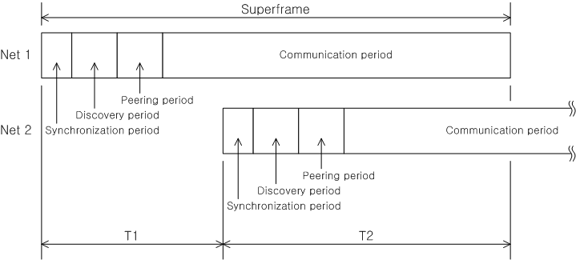
Simulation Results: Network Merge (2/5)
Network merge scheme
  Detection: PDs in Net 1 & Net 2 detect Net 2 & Net 1
  Indication: PDs indicate the “detection” in the synchronization signal (to wake up PDs in sleep mode)
  Move (consistent with 180º rule):
    If T1 < T2, PDs in Net 2 move to Net 1: 180º rule
    If 3*T1 < T2, PDs in Net 2 move to Net 1: 90º rule
    If T1 < T2*3, PDs in Net 2 move to Net 1: 270º rule
  Complete
    After all PDs move

Slide 14
Simulation Results: Network Merge (3/5)
The scenario
  2 PAC networks: blue: 100 PDs in 50m radius; red: 1000 PDs in 250m radius
  Average of 100 independent runs: (10 drops) x (10 runs / drop)
Random relative phase between two networks
Clustered random drop
Edge distance: 30m
Tx range: 56m

Slide 15
Simulation Results: Network Merge (4/5)
90º rule, 180º rule, 270º rule, & 360º rule
  1000 PDs in 500m x 500m area (random clustered drop)
  Average of 100 independent runs
# frames to synchrony | 90º rule | 180º rule | 270º rule | 360º rule
Mean | 11.44¹⁾ | 12.22²⁾ | 368.07 | 859.17
[Min, Max] | [1, 26] | [2, 26] | [2, 9445] | [19, 10983]
Std. deviation | 7.50 | 7.99 | 1354 | 1932
1) Only 47 out of 100 merged successfully. (20: Net 1 → Net 2, 27: Net 1 ← Net 2)
2) 49: Net 1 → Net 2, 51: Net 1 ← Net 2
Note: If convex curve was used, mean = 248.867 and Std. deviation = 10.373

Slide 16
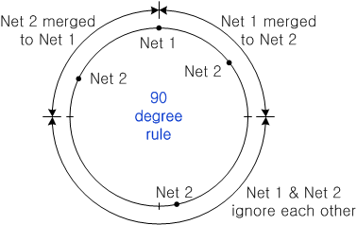
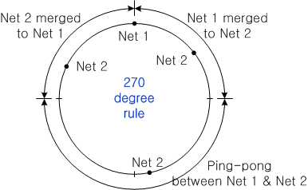
Simulation Results: Network Merge (5/5)
What’s up with 90º rule & 360º rule?
  90º rule
    Did not work half of time (53 out of 100)
    If the phase difference between the two networks is 90º ~ 270º, they ignore each other.
    The similar situation is true for other angles smaller than 180º
  270º rule: suffer from Ping-Pong effect as 360º rule does

Slide 17
Review of the Proposed Text

Slide 18
Motion
“Move to accept the text proposal included in 15-15-0191-02-0008 to be accepted into P802.15.8 Draft Std. D0.8.”
Mover: BJ
Second:
Result: Yes/No/Abstain =

