Slide 1
Project: IEEE P802.15 Working Group for Wireless Personal Area Networks (WPANs)
Submission Title: [Use case Proposal for Technical Guidance Document]
Date Submitted: [7 Mar, 2015]
Source: [Hidetoshi Yokota] Company [Landis&Gyr]
Address [1-2-9 Nishi Shimbashi Minato-ku, Tokyo 105-0003, Japan]
Voice:[+81 3-5532-7455], FAX: [+81 3-5532-7519], E-Mail:[hidetoshi.yokota@landisgyr.com]
Re: [“TG4s Technical Guidance Document”, IEEE 802.15-14-0555-03-004s]
Abstract: [This contribution proposes a use case and application for Spectrum Resource Management in the field of AMI (Advanced Metering Infrastructure) and related functional requirements that should be considered in the Technical Guidance Document.]
Purpose: [Discussion and approval]
Notice: This document has been prepared to assist the IEEE P802.15. It is offered as a basis for discussion and is not binding on the contributing individual(s) or organization(s). The material in this document is subject to change in form and content after further study. The contributor(s) reserve(s) the right to add, amend or withdraw material contained herein.
Release: The contributor acknowledges and accepts that this contribution becomes the property of IEEE and may be made publicly available by P802.15.

Slide 2
Use case Proposal for Technical Guidance Document
Authors:

Slide 3
Use case (Section 4.4.x)
Use case #X: Resource management for Neighborhood Area Network (NAN)
  Large-scale NAN is composed of multiple PANs
    When a new smart meter (end point) is installed, it will join one of those PANs in their footprints
    Selection and reselection of the PAN to be joined is determined with certain criteria
    Structure of RF mesh changes from time to time
  Stable performance among multiple PANs is desired
    Well-balanced SRU (Spectrum Resource Usage) is desired for each end point to show as much the same performance as possible regardless of the available PANs
    Instantaneous QoS fluctuation should not affect the behavior of those end points

Slide 4
SRU-aware PAN coordination
Network Manager
(Head End System)
Aggregate SRU
Aggregate SRU
Ctl/mgmt info
Aggregate SRU
PNC#1
(Concentrator)
Ctl/mgmt info
PNC#1
(Concentrator)
Ctl/mgmt info
PNC#1
(Concentrator)
Local/aggr. SRU
Local/
Aggr. SRU
Router
Router
Router
Router
Router
Router
Local SRU
Local SRU
Re-selection
Router
Selection
Leaf
Leaf
Re-selection
Leaf
Leaf
Leaf
Leaf
Leaf

Slide 5
Functional requirements (Section 5.x)
Type and form of metrics to be provided (metric calculation)
  Performance metrics (PER, throughput, latency, etc.) per layer of EPs in the PAN
  Aggregate SRU on both uplink and downlink
  Global and local views of SRU
Collection and distribution of SRU information
  Centralized and decentralized ways of acquiring and controlling SRU
  Each node may process or pass through SRU before sending upward or downward

Slide 6
SRM information flow
[SRM Request]
Timing: On demand
Metrics to be reported:
(e.g., latency, PER, Tput)
[SRM Report]
Timing: in response to SRM
request, periodical or event-driven
Metric to report: {Individual/aggregate}
- Latency: additive
- PER: multiplicative
- Throughput: maximum
PNC#1
(Concentrator)
Layer 0
[SRM Information]
Aggregate metrics: global view
Layered metrics: per-layer view
Individual metrics: local view
Router
Router
Layer 1
Router
Router
Leaf
Layer 2

Slide 7
Applications (Appendix)
A.x Advanced Metering Infrastructure (AMI)
  A number of smart meters construct Neighborhood Area Network (NAN) in the form of RF mesh in order to send meter reading data for billing or event data for management as well as to receive commands for energy and device control
  Requirements
    Stable network performance under
    dynamic mesh structure change
    Centralized and distributed resource
    usage control mechanism
    Assured QoS provision as a commercial
    communication infrastructure

Slide 8

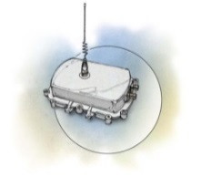
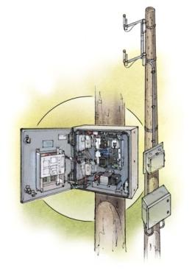
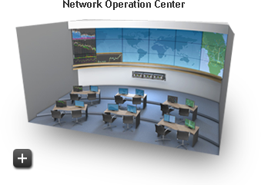
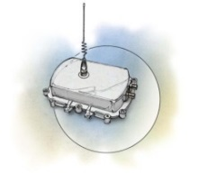
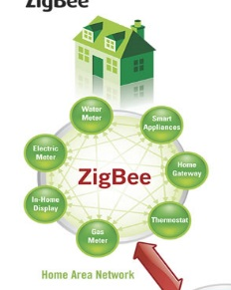

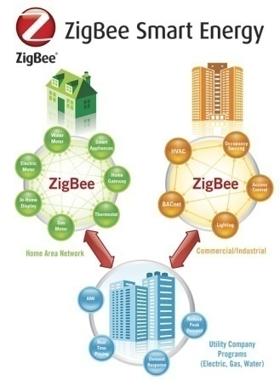

Applications (Appendix, cont’d)
IPv6 Neighborhood Area Network (NAN)
Wide Area Network (WAN)
Head End System (HES)
IP based backhaul
RF Collector
Home Area Network(HAN)
Citation: Bill Lichtensteiger “Interoperable NANs - A Global Perspective”, Wireless Japan 2014, 2014

