Slide 1
Project: IEEE P802.15 Working Group for Wireless Personal Area Networks (WPANs)
Submission Title: Discussion for a method how to revise numbering a document
Date Submitted: March 9, 2015
Source: Gyung-Chul Sihn, Hoo-Sung Lee, Ik-Jae Chun, Seok-Jin Lee, Moon-Sik Lee, Byung-Jae
Company: ETRI
Address: 218 Gajeong-ro, Yuseong-gu, Daejeon 305-700, South Korea
Voice:+82-42-860-6354, FAX: +82-42-860-6732, E-Mail: neuro@etri.re.kr
Abstract: On numbering scheme of official documents
Purpose: Discussion on revision numbering a method
Notice: This document has been prepared to assist the IEEE P802.15. It is offered as a basis for discussion and is not binding on the contributing individual(s) or organization(s). The material in this document is subject to change in form and content after further study. The contributor(s) reserve(s) the right to add, amend or withdraw material contained herein.
Release: The contributor acknowledges and accepts that this contribution becomes the property of IEEE and may be made publicly available by P802.15.

Slide 2
A method how to revise numbering a document
IEEE 802.15.3e
March 2015

Slide 3
Background
Even if a document was agreed with attendees, there exist a lot of colored editorial memos and change tracking by several contributors.
  Difficult to read : various colored sentences, deleted and inserted phrases/paragraphs
  Which is(/are) contributing sentence(s)? : difficult to discriminate against old and latest sentence(s)
The revision number of an official document should be incremented with consensus
  Contributors with new text should get a new document number
  New text will be accepted with discussion and consensus

Slide 4
Principles
Maintain two types of documents
  Clean version
    Draft or only contains text reviewed by the members
    No change tracking marks
    May contain memos (problems yet to be addressed, reminders, etc.)
  Merged version (with change tracking marks)
    Last clean version + new text since last clean version
    Contains change tracking to show new texts
  2. Contributors
  New text should be based on the last clean version of the official document
  New text should be added with change tracking marks
  3. Editor/TG
  Create a new merged version to collect all approved documents with new text
  The merged version is reviewed and approved → Clean version

Slide 5
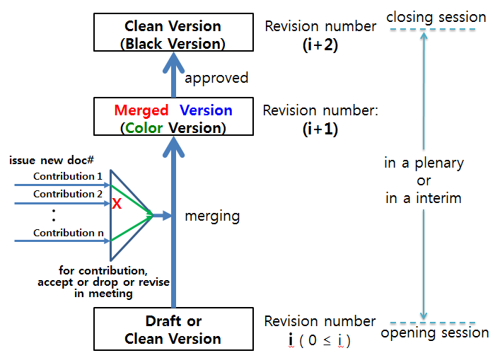
A method on Revision Numbering

Slide 6
Request to Study Group
Discussion on revision numbering method for consistency
Discuss a principle that ETRI suggests

