Slide 1
Project: IEEE P802.15 Working Group for Wireless Personal Area Networks (WPANs)
Submission Title: Measuring the Terahertz Intra-Device Propagation Channel
Date Submitted: 09 March 2015
Source: Alexander Fricke, Thomas Kürner, TU Braunschweig
Address Schleinitzstr. 22, D-38092 Braunschweig, Germany
Voice:+495313912416, FAX: +495313915192, E-Mail: fricke@ifn.ing.tu-bs.de/t.kuerner@tu-bs.de
Re: n/a
Abstract: In this contribution, a measurement approach for the THz intra-device channel is presented. Based on the preconditions of simple modulation schemes and static antenna positioning, the application of vector network analysis is discussed. By means of an example scenario, the peculiarities of the THz intra-device channel are carved out.
Purpose: Contribution towards developing an intra-device channel model for use in TG 3d
Notice: This document has been prepared to assist the IEEE P802.15. It is offered as a basis for discussion and is not binding on the contributing individual(s) or organization(s). The material in this document is subject to change in form and content after further study. The contributor(s) reserve(s) the right to add, amend or withdraw material contained herein.
Release: The contributor acknowledges and accepts that this contribution becomes the property of IEEE and may be made publicly available by P802.15.

Slide 2
Measuring the Terahertz
Intra-Device Propagation Channel
Alexander Fricke, Thomas Kürner
TU Braunschweig

Slide 3
Outline
Motivation
Measurement Approach
Example Scenario
Observations
Conclusion & Outlook

Slide 4
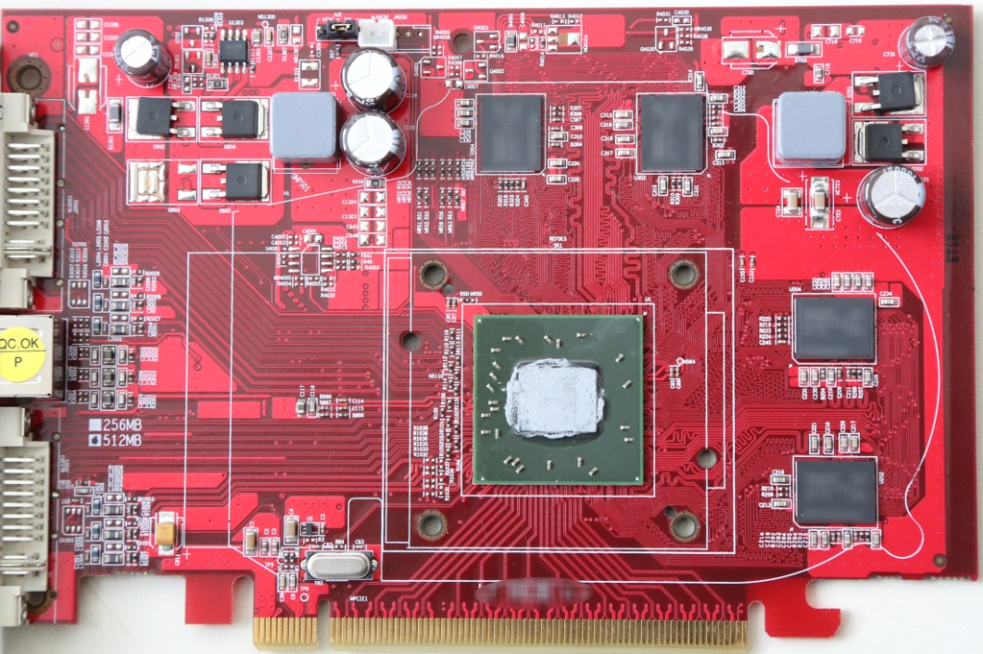
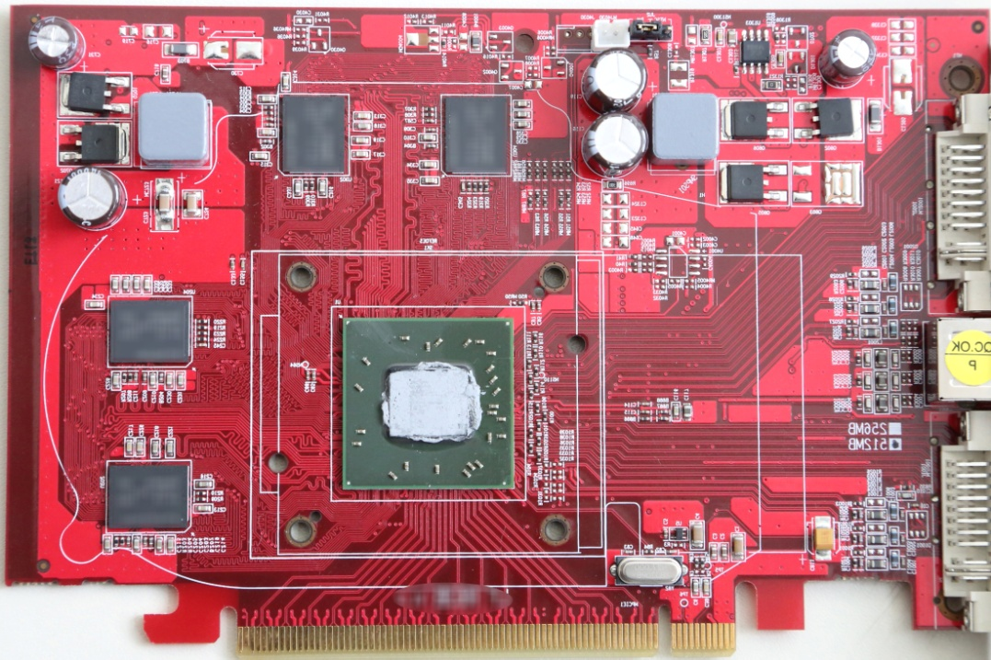
Motivation (1/2) -
Intra-Device Communication at THz Frequencies
    Ever increasing demand for higher wireless data rates, 100 Gbit/s estimated for 2020.
    Huge available bandwidths above 300 GHz can provide these data rates.
    Short wave lengths of several millimeters and less enable intra device communications from chip to chip with integrated antennas.
    Need to investigate the propagation characteristics with typical structures and materials for intra device links

Slide 5
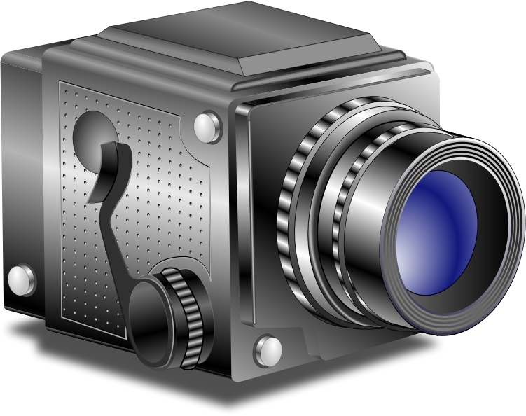
Motivation (2/2) -
Channel Measurements Inside a Mock-Up
  Several propagation mechanisms relevant for intra-device propagation have been investigated
  However, in order to develop a model for the intra-device propagation channel, an idea of the complete channel behavior is necessary
  The straightforward approach is thus the measurement of several well-defined propagation scenarios

Slide 6
Measurement Approach (Setup)
  Targeted PHY data rate of 100 Gbps with low-complexity modulation schemes
  Frequency Division / Spatial Division Multiplexing
  Point-to-point communications between static antennas with known positions allow for simple MAC layer implementation
  To fully characterize the channel, frequency domain measurements using a vector network analyzer with frequency extensions are performed
  The channel transfer function (CTF) is measured over a bandwidth of e.g. 50 GHz and is then evaluated in terms of channel impulse responses (CIR) for frequency bands of e.g. 10 GHz bandwidth

Slide 7
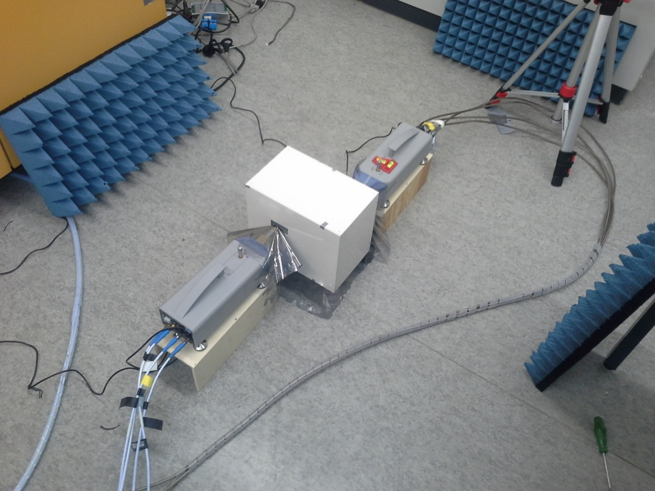
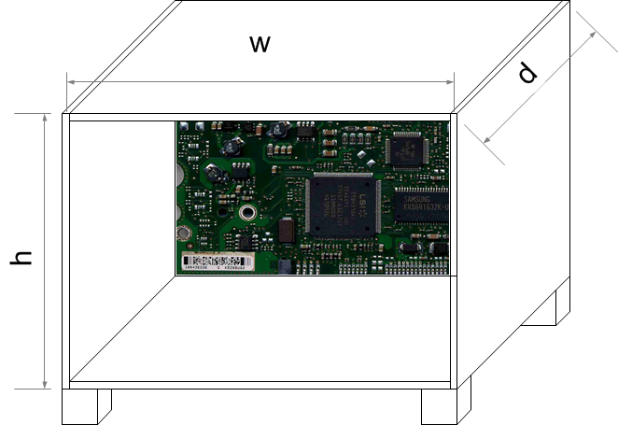
Measurement Approach (Procedure)
  Absorbers
  Rohde & Schwarz ZVA50 with
  Frequency Extensions
  Mock-Up:
  Standard Gain
  Horns
  Absorbing Foil

Slide 8
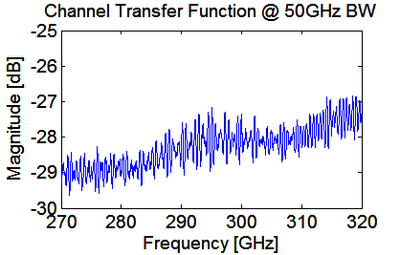
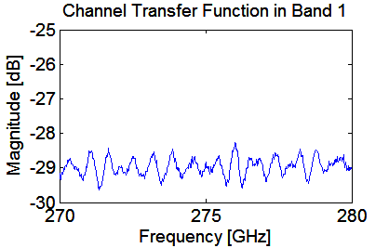
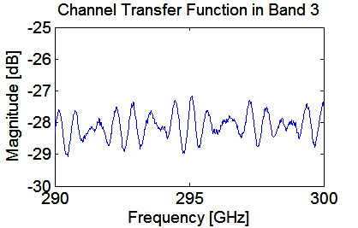
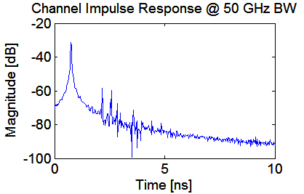
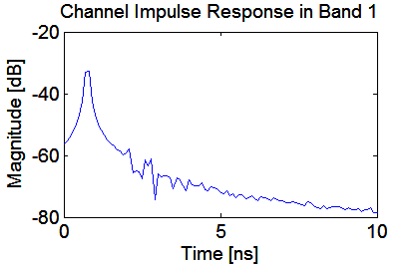
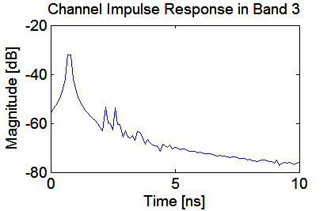
Measurement Approach (Evaluation)
Varying Echos
FFT Leakage
  Due to the large total bandwidth of 50GHz, the CIR of the sub-bands varies
  The impact of FFT leakage must be compensated, e.g. using appropriate filter functions

Slide 9
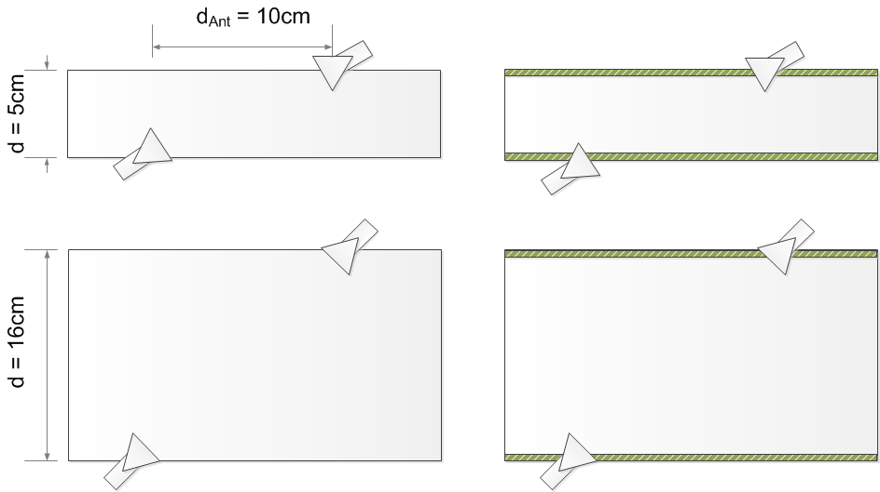
Example Scenario: Direct Transmission
  As a first example, the case of board-to-board communication with no obstructions between the antennas has been measured
  As seen below, four configurations with diagonal antenna positioning have been measured featuring both varying box size and number of printed circuit boards
  Further scenarios must be defined to create a comprehensive channel model
PCBs

Slide 10
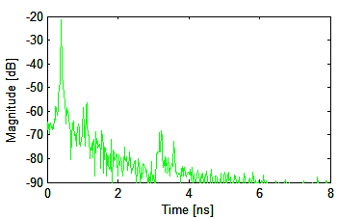
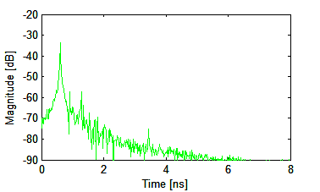
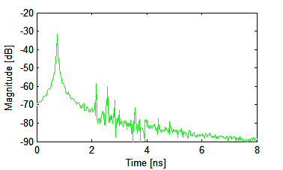
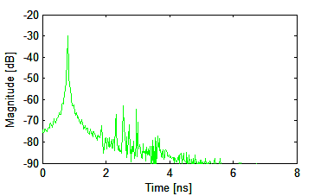
Observations for Direct Transmission: Full BW
 | ABS Walls | PCB Walls
Small Box d = 5cm
Large Box d = 16cm

Slide 11
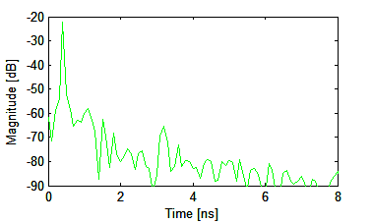
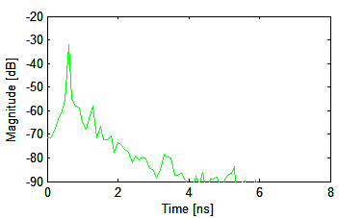
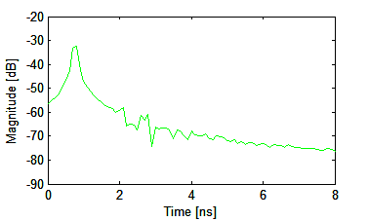
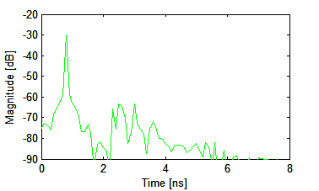
Observations for Direct Transmission: Band 1
 | ABS Walls | PCB Walls
Small Box d = 5cm
Large Box d = 16cm

Slide 12
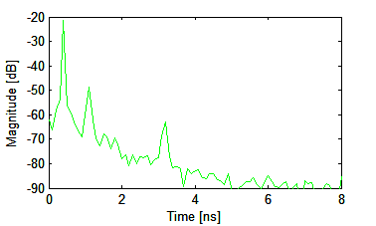
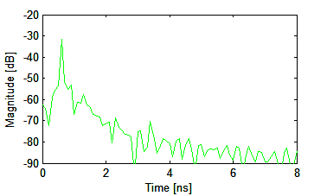
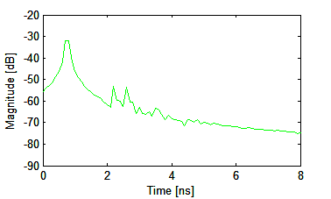
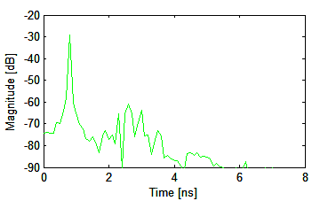
Observations for Direct Transmission: Band 3
 | ABS Walls | PCB Walls
Small Box d = 5cm
Large Box d = 16cm

Slide 13
Observations for Direct Transmission
  Generally, one dominant path corresponding to the direct link between Tx and Rx
  Several distinct reflected propagation paths following the main peak
  All reflected paths are generally more than 20dB weaker than the main signal
  The amplitude of reflected paths varies significantly between sub-bands
  For narrower environments, the multipath richness of the CIR is reduced
  Signal degradation can be observed if the line of sight is obstructed in the small box
Notes:
… However, no significant additional MPCs arised from the presence in this scenario - this will change however if we start thinking about directed NLOS communication scenarios

Slide 14
Conclusion & Outlook
  Channel characterization in frequency domain is necessary to account for possible multiple sub-bands as well as frequency dispersion
  FFT Leakage must possibly be supressed using filter techniques
  The effects of both the plastic casing and the PCB building parts play a significant role for intra-device propagation modelling
  The behavior of the sub-bands may vary significantly
  Additional scenario definitions need to be developed for the complete channel model, e.g. chip-to-chip communication

Slide 15
Thank You for Your Attention

