Slide 1
Project: IEEE P802.15 Working Group for Wireless Personal Area Networks (WPANs)
Submission Title: LB100 Comment Resolutions.
Date Submitted: 21 January, 2014
Source: Chandrashekhar Thejaswi PS, Kiran Bynam and Jinesh Nair
E-Mail: c.thejaswi@samsung.com
Abstract: Comment resolutions.
Purpose: Response to the letter ballot comments.
Notice: This document has been prepared to assist the IEEE P802.15. It is offered as a basis for discussion and is not binding on the contributing individual(s) or organization(s). The material in this document is subject to change in form and content after further study. The contributor(s) reserve(s) the right to add, amend or withdraw material contained herein.
Release: The contributor acknowledges and accepts that this contribution becomes the property of IEEE and may be made publicly available by P802.15.

Slide 2
Uniqueness, ULP capability
CID | Reviewer | Pg.No | Clause | Ln. No. | Comment | Suggested Change | Mandatory
2059, 2071, 2118 | B. Verso J. Gilb M. McLaughlin | 12 | 30 | 1 | The draft does not meet the 5C requirement of uniqueness. There are already low power PHYs defined in 802.15.4, the O-QPSK PHY, LRP UWB and BPSK PHY all enable power usuage at or below the proposed TASK PHY. The TASK PHY does not take advantage of ASK modulation (it requires phase coherency in the transmitter) nor a constant envelope modulation (e.g., FSK) and so the resulting designs will end up even higher power than the currently defined PHYs. | Delete Clause 30 and references to the ULP TASK PHY. | Yes

Slide 3
Resolution: Rejected
Meets the requirements of PAR, which are unique:
  Support of multiple data rates in the specified bands up to 1Mbps
  Power consumption <15 mW (as per PAR)
Support in the design of ultra low power receivers, like SRR based receivers etc.
  Receiver complexity and power consumption of OOK/ASK receivers are quite
  low when compared to the receivers for other modulation types.
Support for both coherent and non-coherent receivers, due to the employment of
spreading based on ternary sequences.
ULP capability of TASK:
  Supports ULP receivers.
  Advanced transmitter designs are available which can ensure ultralow
  power consumption.

Slide 4
Employing FECs and interleaving
CID | Reviewer | Pg. No. | Clause | Ln. No. | Comment | Suggested Change | Mandatory
2073, 2120 | James Gilb M. McLaughlin | 18 | 30.4.1.1 | 5 | There is no need to define a new FEC as there are already many defined in 802.15.4. The new FEC does not enable lower power than the existing FECs | Replace the BCH and SiPC with a single FEC from the base standard. | Yes
2090 | James Gilb | 19 | 30.5.1.1.4 | 10 | Bit interleaving is useless for this PHY as the bands used are typically interference limited, hence errors are correlated in time, rather than being uncorrelated. The response “Here, bit-level interleaving is used on the coded symbols, specifically, to reduce the bit errors in the event of symbol errors. It yields 1-2dB gain compared to the case without interleaving.” is incorrect as it assumes uncorrelated errors and hence there is no gain. | Delete bit interleaving as it adds complexity but no increase in performance in real-world situations. | Yes
Resolution : Rejected
BCH FEC is used in some of the recent 802.15 standards, like 15.4g and 15.6.
Reason for using BCH is explained in 15-14-0664-05-004q-choice-of-bch-codes-for-tg4q.pptx
Also the current version has only one FEC (BCH) in the mandatory mode.
The bit-level interleaving performed here is different from the conventional interleaving.
Unlike in the conventional interleaving, our interleaving is not channel dependent, hence channel memory (or lack of it)
has no effect on its performance. This interleaving exploits the power of FECs to reduce the bit errors due to symbol errors.

Slide 5
CID | Reviewer | Pg. No. | Clause | Ln. No. | Comment | Suggested Change | Mandatory
2027 | Kiran Bynam | 21 | 30.4.1.1.4 | 7 | The sentence " ….. d = M, from . " is incomplete | Please rectify the sentence appropriately. | YES
Resolution: Revised
Replace the sentence in Pg. 21, Ln. 7 with
“ For the given MCS, with the modulation order M, choose the initial interleaving depth, d = M.”

Slide 6
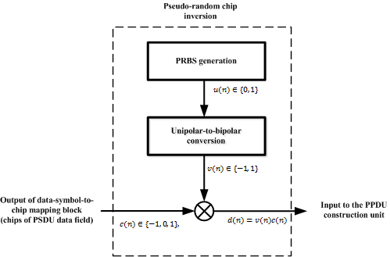
CID | Reviewer | Pg. No. | Clause | Ln. No. | Comment | Suggested Change | Mandatory
2029 | Kiran Bynam | 25 | 30.4.3 | 2 to 13 | Be consistent with notation stick to c_n, u_n or c(n), u(n)…Please modify Figs 15 and 16 also appropriately | Incoporate the change | YES
Resolution: Revised
In page 25, 30.4.3, replace Figure 15 with the following figure:

Slide 7
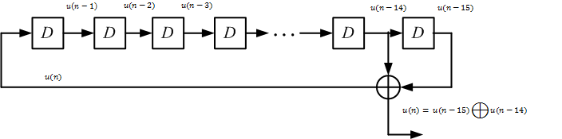

In page 26, 30.4.3.1, replace Figure 16 with the following figure:
In page 26, 30.4.3.1, in Line 6, replace the equation with the following one:
$$u(n)=u(n−14) ⊕u(n−15), n=0, 1, 2,…$$
In page 26, 30.4.3.1, in Line 7, replace the equation with the following one:
$$u_{init}=\left[u\left(−15\right), u\left(−14\right), …, u\left(−1\right)\right]$$

Slide 8
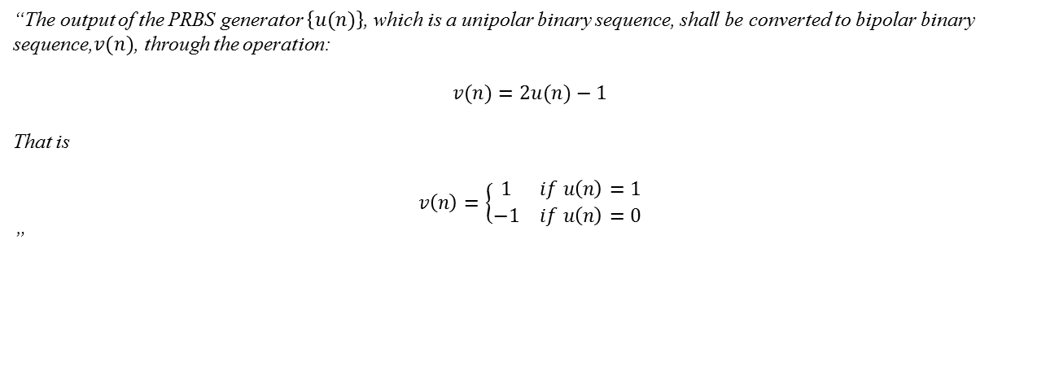
In page 26, replace the paragraph in 30.4.3.2 with the following text:
“The output of the PRBS generator $\left\{u(n)\right\}$, which is a unipolar binary sequence, shall be converted to bipolar binary sequence,$v(n)$, through the operation:
$$v(n)=2u(n)−1$$
That is
$$v\left(n\right)=\left\{\begin{matrix}1 & if u\left(n\right)=1 \\ −1 & if u\left(n\right)=0\end{matrix}\right.$$
”
In page 26, 30.4.3.3, Line 14, replace the equation with the following one:
$$d(n)=v(n)c(n), c(n)∈\{−1, 0, 1\}, n=0, 1, 2,…$$

Slide 9
CID | Reviewer | Pg. No. | Clause | Ln. No. | Comment | Suggested Change | Mandatory
2034 | Kiran Bynam | 30 | 30 |  | Add CCA in clause 30 | Add " The ULP-TASK PHY shall use the one of the CCA modes as described in 8.2.7" under new sub-clause. | YES
Resolution: Revised
In page 28, following 30.8.10, add a new sub-clause 30.8.11 as follows:
“ 30.8.11 Clear channel assessment (CCA)
The ULP-TASK PHY shall use one of the CCA modes as described in 8.2.7. ”

Slide 10
CID | Reviewer | Pg. No. | Clause | Ln. No. | Comment | Suggested Change | Mandatory
2037 | Kiran Bynam | 13 | 30.2.1.1.3 | Table 5 | Modify the table with the mapping [1 0 -1 0 0 -1 0 1] for bit=1 [0 -1 0 1 1 0 -1 0] for bit=0 | Incoporate the change | YES
2038 | Kiran Bynam | 14 | 30.2.1.1.5 | Table 7 | Modify the table with the mapping [1 0 -1 0 0 -1 0 1] for bit=1 [0 -1 0 1 1 0 -1 0] for bit=0 | Incoporate the change | YES
Resolution: Revised
Replace Table 5 with the following table
SFD bit | Bit –to-sequence mapping
0 | [0 -1 0 1 1 0 -1 0]
1 | [1 0 -1 0 0 -1 0 1]
Replace Table 7 with the following table
PHR bit | Bit –to-sequence mapping
0 | [0 -1 0 1 1 0 -1 0]
1 | [1 0 -1 0 0 -1 0 1]

Slide 11
CID | Reviewer | Pg. No. | Clause | Ln. No. | Comment | Suggested Change | Mandatory
2040 | Kiran Bynam | 16 | 30 | Data rate field of tables 7,8,9 | Compute datarates appropriately and mdoify the tables if needed. Some data rates seems to be wrong. | Incoporate the change | YES
Resolution: Revised
In page 15, 30.3.2, replace the values in the “Data rate” column of Table 8 with the following column:
Data rate (kbps)
809.52
404.76
303.57
126.48
719.57
359.78
269.84
112.43

Slide 12
In page 15, 30.3.3, replace the values in the “Data rate” column of Table 9 with the following column:
Data rate (kbps)
485.71
242.85
182.14
75.89
431.74
215.87
161.90
67.46

Slide 13
In page 16, 30.3.4, replace the values in the “Data rate” column of Table 10 with the following column:
Data rate (kbps)
202.38
101.19
75.89
31.62
179.89
89.94
67.46
28.10

Slide 14
CID | Reviewer | Pg. No. | Clause | Ln. No. | Comment | Suggested Change | Mandatory
2042 | Kiran Bynam | -- | 30 | -- | in several places, while mentioning about BCH with interleaving, stick to one terminology consistenty: either "BCH" or "BCH+interleaving" | Incoporate the change | YES
Resolution: Revised
In page 16-17, Figure 8, 9 and 10 replace the “Coding format” columns with the following column:
Coding format
BCH
BCH with interleaving
BCH with interleaving
BCH with interleaving
BCH+SiPC
BCH+SiPC
BCH+SiPC
BCH+SiPC

Slide 15
CID | Reviewer | Pg. No. | Clause | Ln. No. | Comment | Suggested Change | Mandatory
2088 | James Gilb | 17 | 30.4 | 9 | This figure should map into Figure 9, but the name doesn't match. Figure 9 needs to be the reference modulator. If you are going to break out a block in Figure 9 in another figure, then you need to clearly identify it with the same name. | Change Figure 9 to be the Reference Modulator so that it matches the current revision draft. Ensure that each block in Figure 9 is named uniquely to match the subclauses and figures elsewhere in the draft that describe its functionality. | Yes
Resolution: Revised
In page 15, Line 10, sub-clause 30.2.2: Replace the sentence with the following text
“The reference modulator diagram for generating a PPDU signal for ULP-TASK PHY is as depicted in Figure 9.”

Slide 16
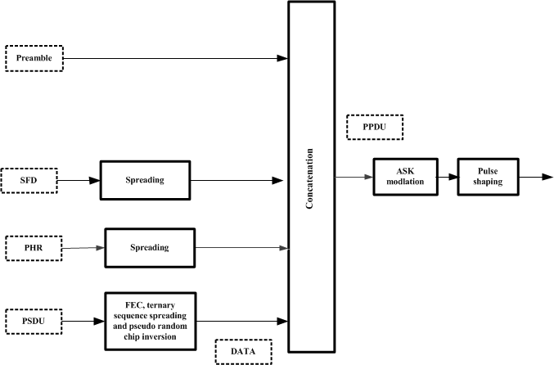
In page 15, sub-clause 30.2.2: Replace Figure 9 with the following figure
In page 15, sub-clause 30.2.2: Change the caption of Figure 9 to:
Figure 9—Reference modulator diagram: Generation of PPDU signal

Slide 17
In page 17, sub-clause 30.4, Ln. 2: Change the title to:
FEC, ternary sequence spreading and pseudo-random chip inversion for the PSDU
In page 17, sub-clause 30.4, Figure 10, change the caption to :
Figure 10—FEC, ternary sequence spreading and pseudo-random chip inversion : mandatory mode
In page 18, sub-clause 30.4, Figure 11, change the caption to :
Figure 11—FEC, ternary sequence spreading and pseudo-random chip inversion : optional mode

Slide 18


CID | Reviewer | Pg. No. | Clause | Ln. No. | Comment | Suggested Change | Mandatory
2089 | James Gilb | 12 | 30.2.1.21 | 10 | Figure 7 does not follow the 802.15.4 style, it should have two rows, the top is Bits: 0-6, 7, 8-10, 11, 12-15. The term “Reserved” is used exclusively, not “Res”. |  | Yes
Resolution: Revised
In page 13, Replace the Figure 7 with the following figure:
In page 13, Table 6, heading of the first column: replace (PHR₈, PHR₉, PHR₁₀) by (b₈, b₉, b₁₀)
In page 14, Line 8: replace “$PHR_{0}−PHR_{11}$” by “ $b_{0}−b_{11}$”
In page 14, Line 9: replace “$PHR_{12}$” by “$b_{12}$”

Slide 19
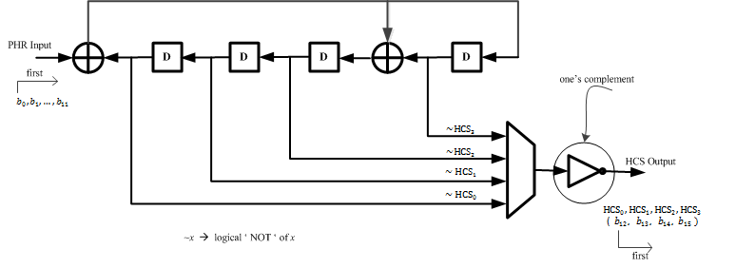
In page 14, Replace the Figure 8 with the following figure:

Slide 20
CID | Reviewer | Pg. No. | Clause | Ln. No. | Comment | Suggested Change | Mandatory
2117 | Tero Kivinen | 28 | 30.8.2 | 17 | While processing 802.15.4 maintenance version we had long discussion how this text should be formatted, so this text should be aligned with the same format that was used in the latest 802.15.4 maintenance draft to make it easier to import it to the future drafts. | See examples from P802.15.4-REVc section 12.3.4, 13.3.4, 14.4.4 etc. | n
Resolution: Revised
In page 28, Line 17-18, sub-clause 30.8.2: Replace the paragraph with the following text
“ Under the conditions specified in 8.1.7, a compliant device shall be capable of achieving a receiver sensitivity of –85 dBm or better for the modulation format corresponding to the lowest data rate in the given operating band.”

Slide 21
TBD

Slide 22
About the “ULP” qualifier
CID | Reviewer | Pg. No. | Clause | Ln. No. | Comment | Suggested Change | Mandatory
2050 | Mike McInnis | 12 | 30 |  | Many of the PHYs within the IEEE 802.15.4 Standard may be implemented in a Ultra Low Power applications not just the ULP Draft standard PHYs ULP-TASK and ULP-GFSK | Eliminate the ULP prefix to the PHY names ULP-GFSK and ULP-TASK | YES
2052 | Mike McInnis | 38 | Annex A |  | Many of the PHYs within the IEEE 802.15.4 Standard may be implemented in a Ultra Low Power applications not just the ULP Draft standard PHYs ULP-TASK and ULP-GFSK | Eliminate the ULP prefix to the PHY names ULP-GFSK and ULP-TASK | YES
2061 | Billy Verso | 1 |  |  | The term "ultra low power" seems to be marketing driven. | Globally replace “Ultra Low Power” and "ULP" with more suitable name and acronym relating to the technical uniqueness of the modudulation. | Yes

Slide 23
About annexure
CID | Reviewer | Pg. No. | Clause | Ln. No. | Comment | Suggested Change | Mandatory
2097 | James Gilb | 38 | Annex A | 1 | This annex does not contain any useful information for implementing the standard. | Delete Annex A. Replace it with a bibliographic entry that points to a document on mentor that contains the information. | Yes

