Slide 1
Project: IEEE P802.15 Working Group for Wireless Personal Area Networks (WPANs)
Submission Title: LiFi use-cases and High Level Concepts
Date Submitted: 20 January, 2015
Source: Dr. Nikola Serafimovski Company: pureLiFi Ltd.
Address: pureLiFi Ltd. ETTC, Max Born Crescent, Edinburgh, EH9 3BF, UK
Voice: +44-131-472-4704, E-Mail: nikola.serafimovski@purelifi.com
Re:
Abstract: High level description of the LiFi use-cases along with requirement parameters for market deployment
Purpose: Provide an overview of the use-cases for LiFi deployment, the commercial deployment and some of the general constraints required for the successful use of the technology.
Notice: This document has been prepared to assist the IEEE P802.15. It is offered as a basis for discussion and is not binding on the contributing individual(s) or organization(s). The material in this document is subject to change in form and content after further study. The contributor(s) reserve(s) the right to add, amend or withdraw material contained herein.
Release: The contributor acknowledges and accepts that this contribution becomes the property of IEEE and may be made publicly available by P802.15.

Slide 2
LiFi Use-Cases
Current State and High Level Concepts

Slide 3
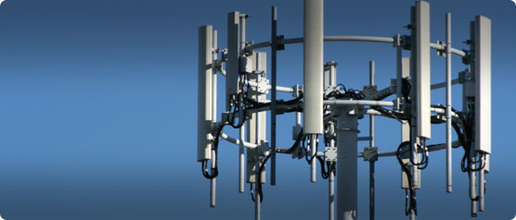
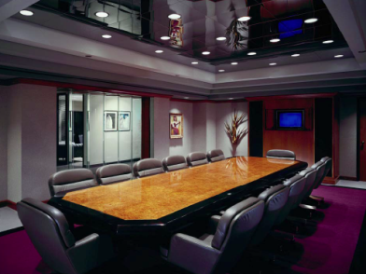
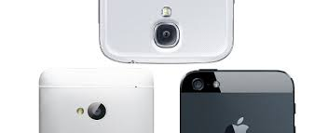
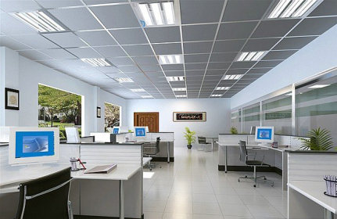
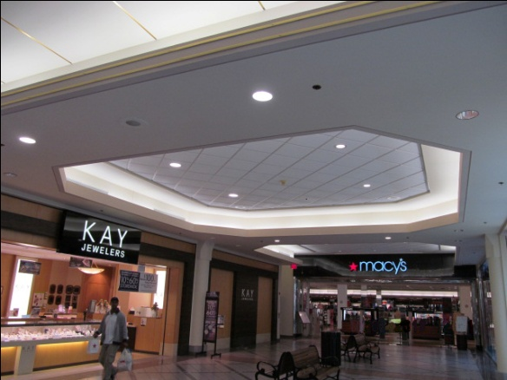
Use-Cases

Slide 4
802.15.7r1
Flexibility to deploy a range of more efficient PHY systems
Improved dimming support
Enhanced MAC
Support for greater security

Slide 5
Proof of Concept
Li-1st (http://vimeo.com/90128750)
point-to-point, high speed, bidirectional, off-the-shelf lights
Li-Flame (http://youtu.be/TIAS8BxGe_8)
high speed, bidirectional, networked and mobile wireless communications using light

Slide 6
Technical Principles
Optical OFDM
ACO-OFDM
DCO-OFDM
U-OFDM
…..

Slide 7
High Level Concepts
High speed
efficient use of Optical Bandwidth
Bidirectional
to alleviate spectrum
Networked & Mobile
user expectations of wireless technology
Secure & Safe
Privacy, Cybersecurity and EMI concerns

