Slide 1
Project: IEEE P802.15 Working Group for Wireless Personal Area Networks (WPANs)
Submission Title: Multi-hop peering procedure
Date Submitted: Jan. 2015
Source: [Woongsoo Na, Sungrae Cho]
Company: [Chung-Ang University, Korea]
Address:
E-Mail: [wsna@uclab.re.kr, srcho@uclab.re.kr)
Re: P802.15.8 Draft D0.6
Abstract: Multi-hop peering procedure.
Purpose: Approval.
Notice: This document has been prepared to assist the IEEE P802.15. It is offered as a basis for discussion and is not binding on the contributing individual(s) or organization(s). The material in this document is subject to change in form and content after further study. The contributor(s) reserve(s) the right to add, amend or withdraw material contained herein.
Release: The contributor acknowledges and accepts that this contribution becomes the property of IEEE and may be made publicly available by P802.15.

Slide 2
Multi-hop peering procedure
Jan. 2015

Slide 3
Multi-hop peering
The Peering Request and Peering Response should be relayed by a relay PD.
The relay PD should forward the Peering Requests and Peering Response.

Slide 4
Peering Request Frame
In peering request frame, the following fields should be included
Application type ID
Application specific ID
Application specific group ID
Device group ID

Slide 5
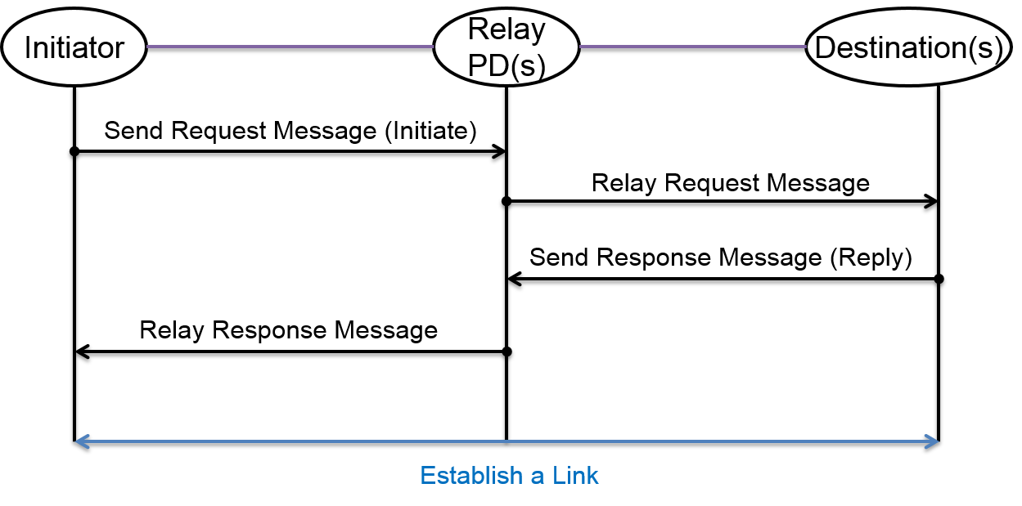
Flowchart of multi-hop peering

Slide 6
Multi-hop re-peering procedure
Re-peering procedure is similar to peering procedure.
The main differences are:
1) some of the previous peering information may not be included in request and response messages;
2) the PD receiving the request validates peering information before making a decision to accept the re-peering request

Slide 7
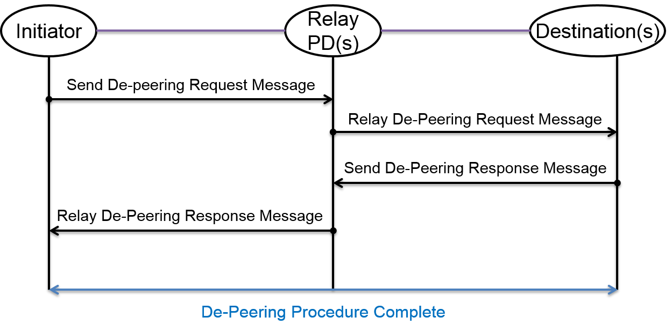
Multi-hop de-peering procedure
De-peering procedure starts with a de-peering request, which is replied by a de-peering response message.

