Slide 1
Project: IEEE P802.15 Working Group for Wireless Personal Area Networks (WPANs)
Submission Title: [LB97 PICS Scrub]
Date Submitted: [14 January2015]
Source: [Mike McInnis] Company [The Boeing Company]
Address [Seattle area, WA, USA]
Voice], E-Mail:[michael.d.mcinnis@boeing.com]
Re: [LB97 PICS Scrub]
Abstract: [LB97 PICS Scrub]
Purpose: []
Notice: This document has been prepared to assist the IEEE P802.15. It is offered as a basis for discussion and is not binding on the contributing individual(s) or organization(s). The material in this document is subject to change in form and content after further study. The contributor(s) reserve(s) the right to add, amend or withdraw material contained herein.
Release: The contributor acknowledges and accepts that this contribution becomes the property of IEEE and may be made publicly available by P802.15.

Slide 2
Annex D
Protocol implementation conformance statement (PICS) proforma
Tables Status
D.1 Functional Device Types Reviewed
D.2 PHY Functions Reviewed
D.3 PHY Packet Reviewed
D.4 Radio Frequency (RF) Reviewed
D.5 HRP UWB Elements Reviewed
D.6 MAC Sublayer Function Reviewed
D.7 MAC Frames Reviewed
D.8 MAC IEs Reviewed
Slide 2
Notes:
January 15
Page 2

Slide 3
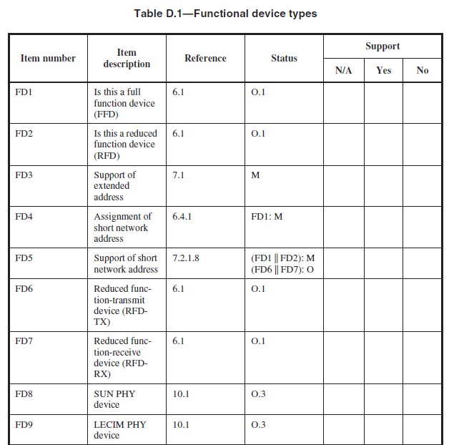
OK
OK
OK
6.1
6.1
OK
OK
Device defined in text?
? For device ref
Device defined in text?
? For device ref

Slide 4
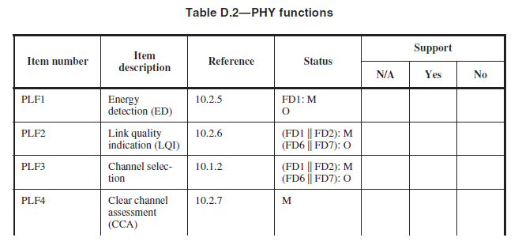
7.4.3.20
Device defined in text?
? For device ref
OK
OK
OK
OK

Slide 5
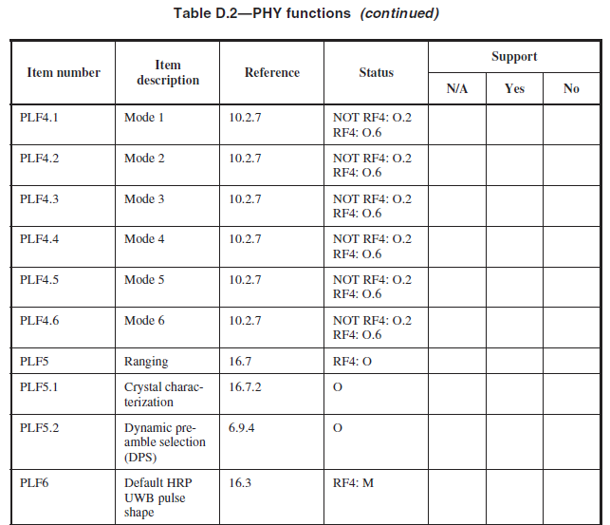
CCA
CCA
CCA
CCA
CCA
CCA
OK
OK
PLF5:O
OK
RF4:O
16.4.5

Slide 6
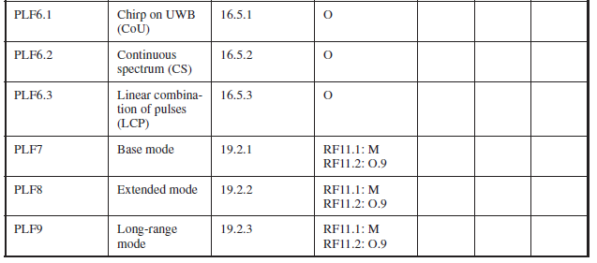
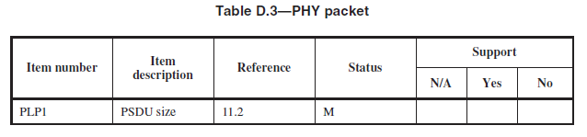
OK
RF4:O
OK
RF4:O
OK
RF4:O
LRP UWB
OK
LRP UWB
OK
LRP UWB
OK

Slide 7
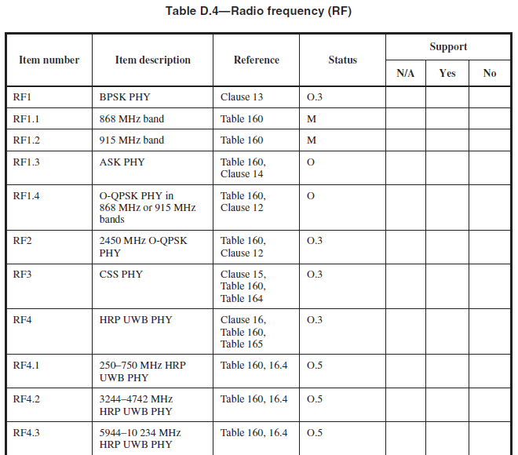
, RF1.3:M, RF1.4:M
RF1:M
RF1:M
RF4:O.5
RF4:O.5
RF4:O.5

Slide 8
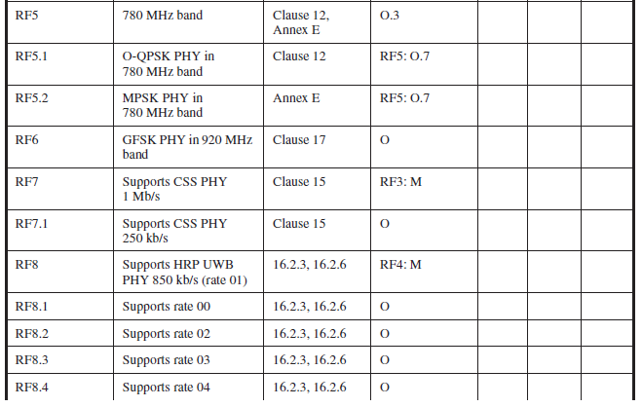
RF5
O.3
RF5A
O.3
O.3
Move to RF3
Move to RF3
RF3:O
Move to RF4
RF4:O
RF4:O
RF4:O
RF4:O

Slide 9
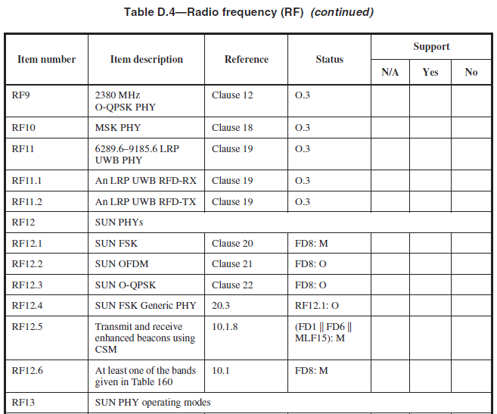
JAMES FIX RF11:O
Replace FD8 with RF12 globally
FD1and RF12 and MLF26:M

Slide 10
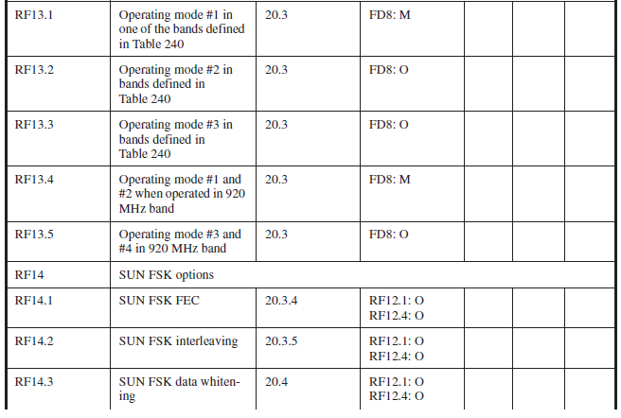

Slide 11
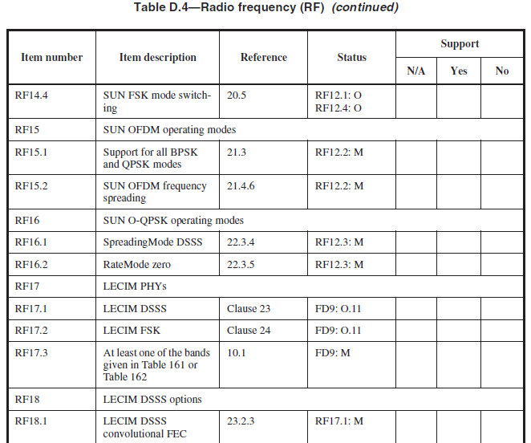
RF17 is now O.3 globally replace FD9 with RF17

Slide 12
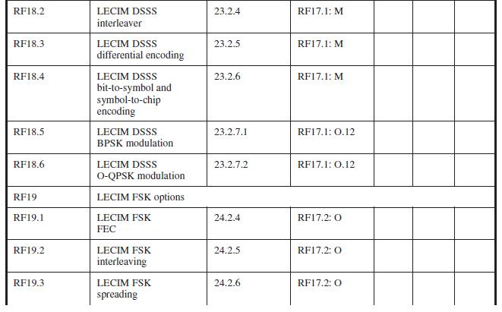

Slide 13
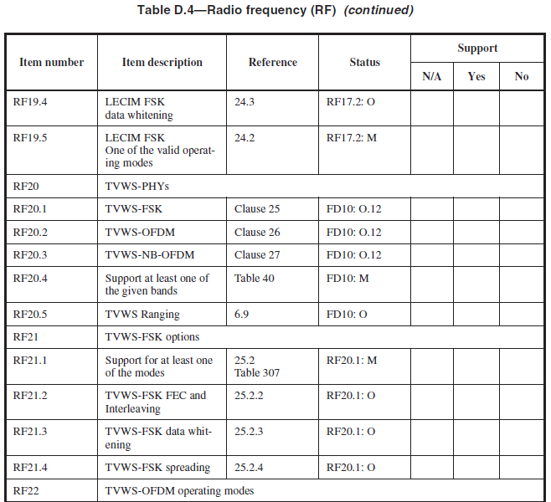
FD10 becomes RF20 globally and RF20 is 0.3

Slide 14
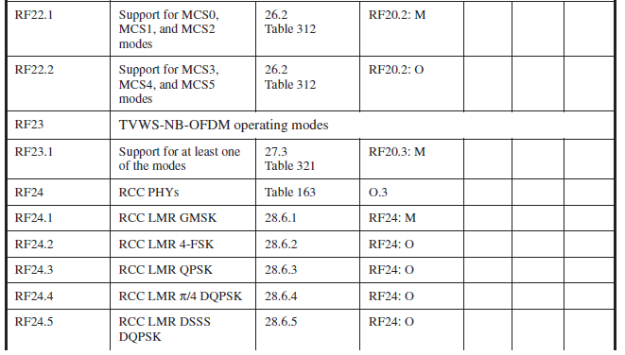

Slide 15
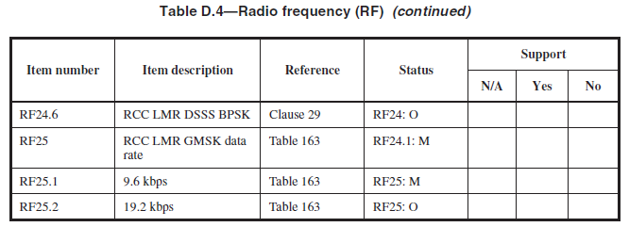

Slide 16
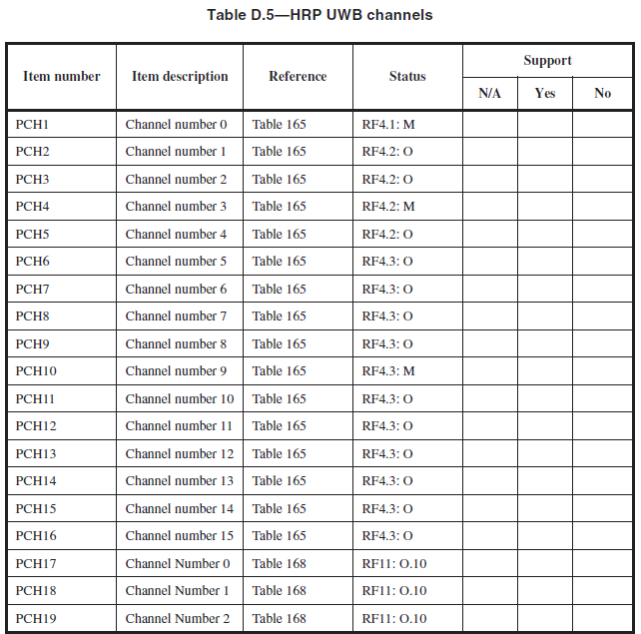
LRP UWB Channels Another table needed

Slide 17
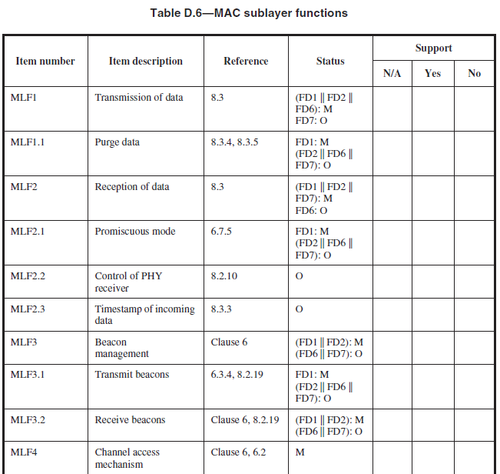
Copy MLF1 here
Check cross
references to 8.3
Copy of MLF2

Slide 18
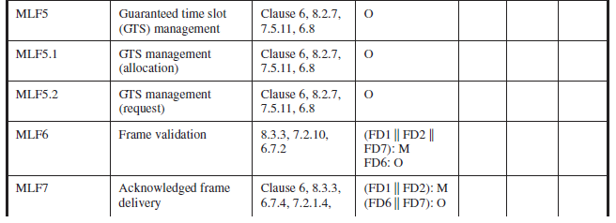
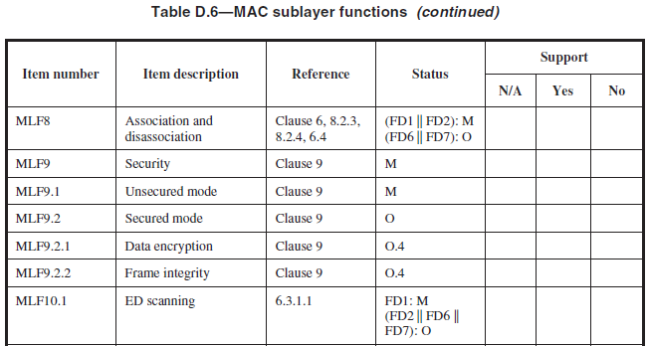
MLF9.2:O
MLF9.2:M
FD1 or FD2 or FD7:M

Slide 19
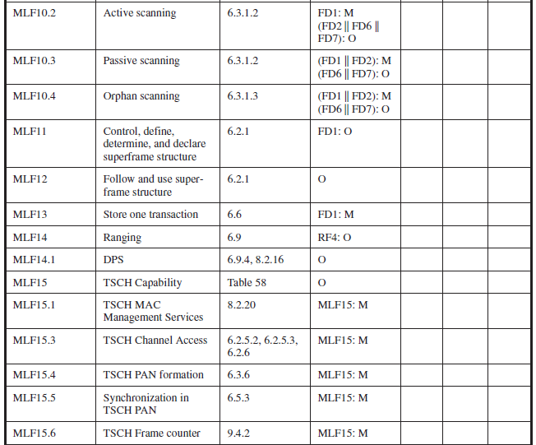
RF4:O
FD1:O

Slide 20
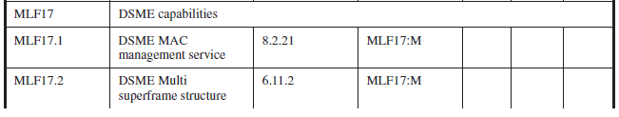
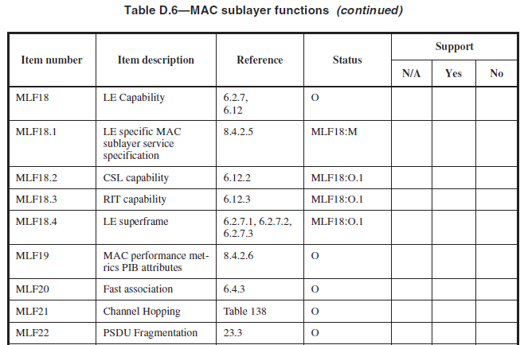
O
Check semantics of O.x
Last item reviewed during Wednesday meeting on this document. These edits prior to and including MLF22 were made in Framemaker on Thursday by James.
?
Mandatory for LECIM DSSS

Slide 21
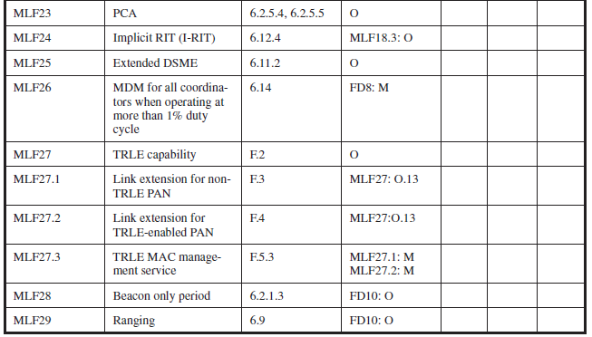
James Gilb began directly modifying the Framemaker version during the Wed and Thur meetings here .
Thus no modifications are shown in this document past this point.

Slide 22
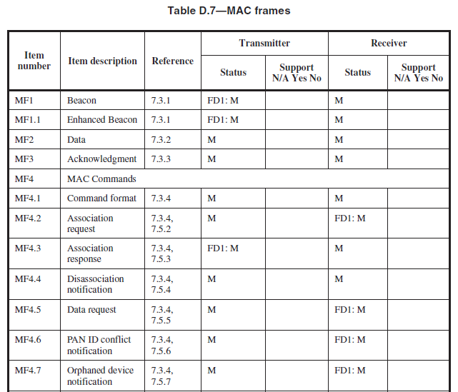
Thursday PM1 start

Slide 23
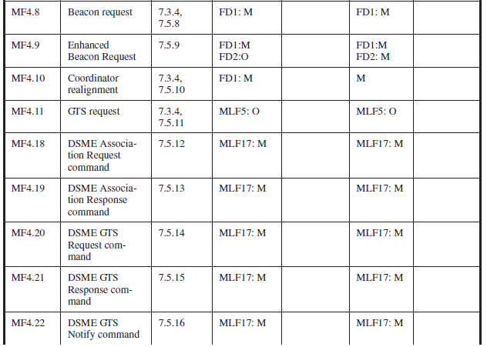

Slide 24
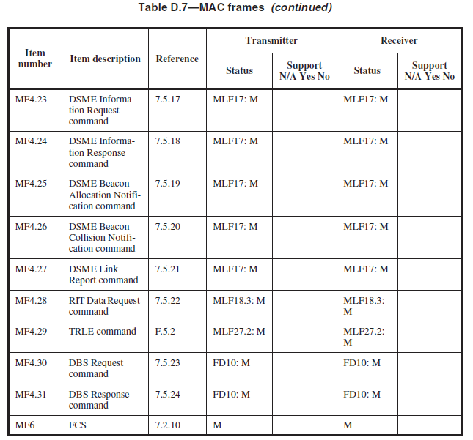

Slide 25
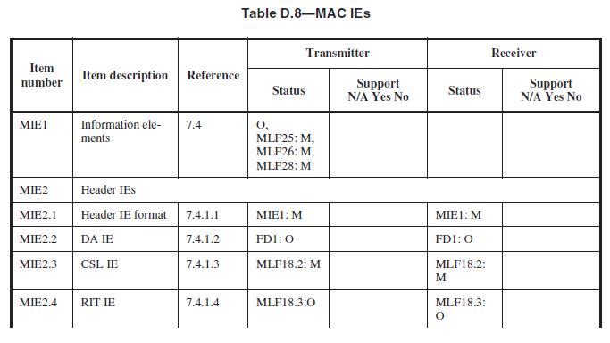

Slide 26
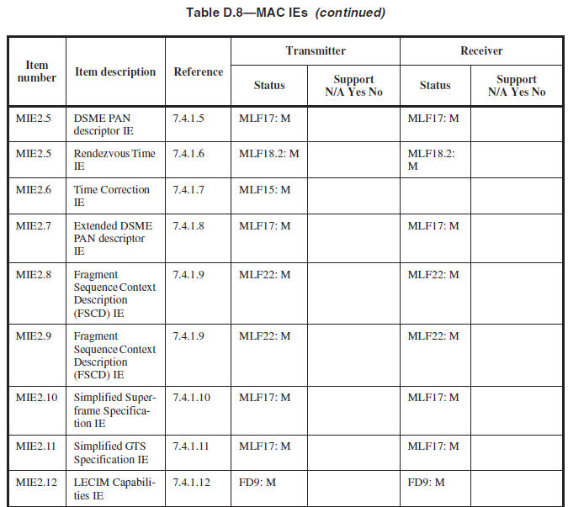

Slide 27
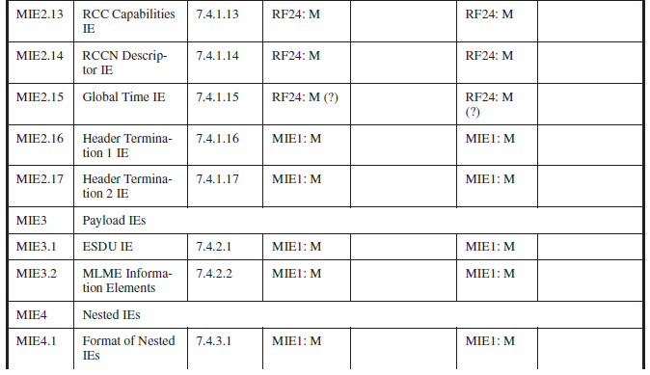

Slide 28
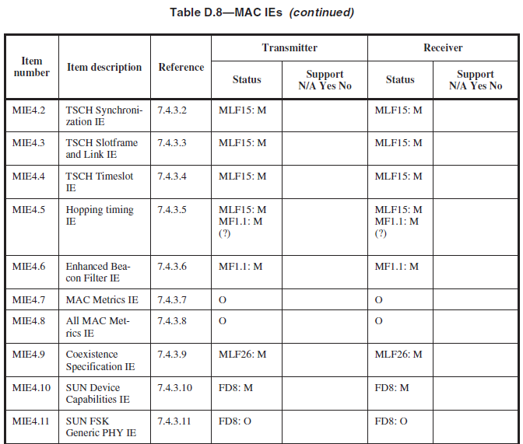

Slide 29
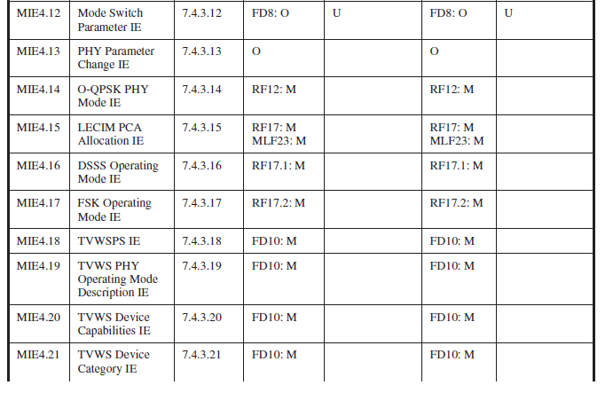

Slide 30
