Slide 1
Project: IEEE P802.15 Working Group for Wireless Personal Area Networks (WPANs)
Submission Title: [LB97 PICS Scrub]
Date Submitted: [13 January2015]
Source: [Mike McInnis] Company [The Boeing Company]
Address [Seattle area, WA, USA]
Voice], E-Mail:[michael.d.mcinnis@boeing.com]
Re: [LB97 PICS Scrub]
Abstract: [LB97 PICS Scrub]
Purpose: []
Notice: This document has been prepared to assist the IEEE P802.15. It is offered as a basis for discussion and is not binding on the contributing individual(s) or organization(s). The material in this document is subject to change in form and content after further study. The contributor(s) reserve(s) the right to add, amend or withdraw material contained herein.
Release: The contributor acknowledges and accepts that this contribution becomes the property of IEEE and may be made publicly available by P802.15.

Slide 2
Annex D
Protocol implementation conformance statement (PICS) proforma
Tables Status
D.1 Functional Device Types Reviewed
D.2 PHY Functions Reviewed
D.3 PHY Packet Reviewed
D.4 Radio Frequency (RF) Needs Extensive Work
D.5 HRP UWB Elements Not Started
D.6 MAC Sublayer Function Not Started
D.7 MAC Frames Not Started
D.8 MAC Ies Not Started
Slide 2
Notes:
January 15
Page 2

Slide 3
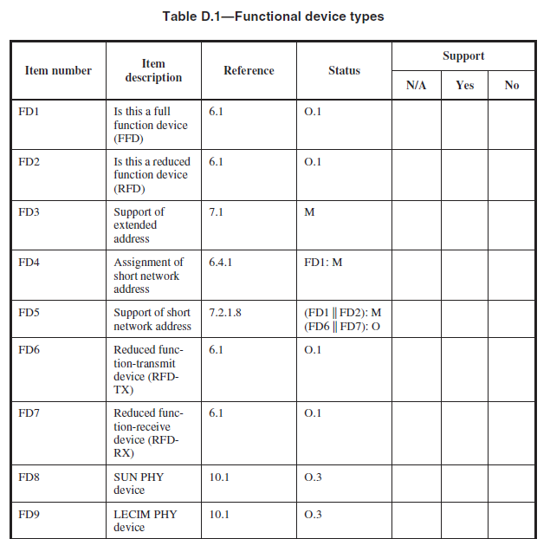
OK
OK
OK
6.1
6.1
OK
OK
5.2
LECIM device not mentioned

Slide 4
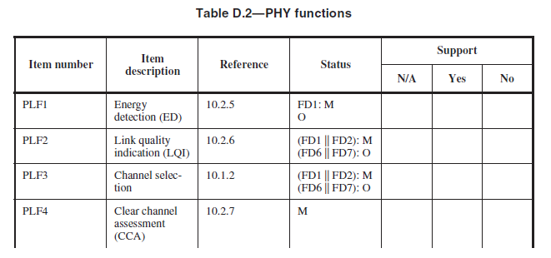
7.4.3.20
OK
OK
OK
OK

Slide 5
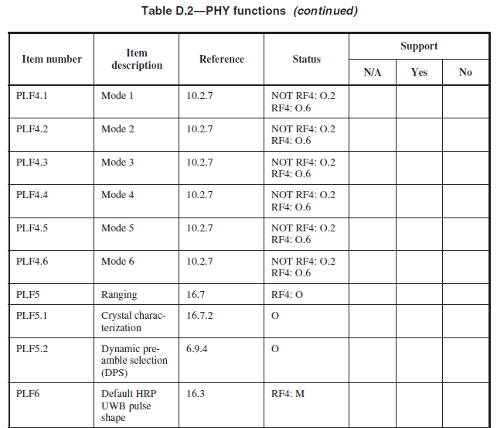
CCA
OK
CCA
OK
CCA
OK
CCA
OK
CCA
OK
CCA
OK
OK
OK
OK
16.4.5

Slide 6
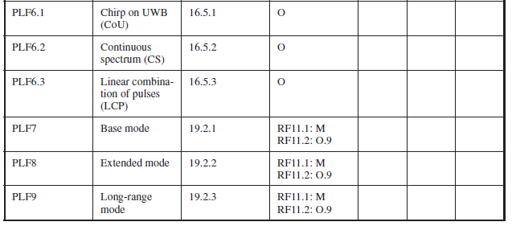
OK
OK
OK
LRP UWB
OK
LRP UWB
OK
LRP UWB
OK
OK

Slide 7
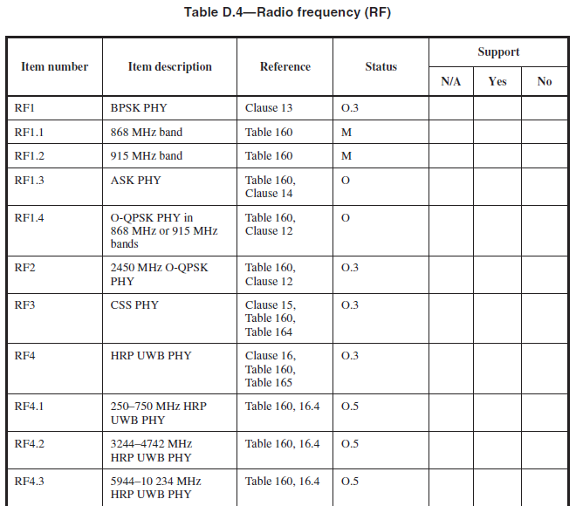
PICs RF list order does not match the order of PHY listings in the Table of Contents beginning with Clause 12, O-QPSK PHY
OK

Slide 8
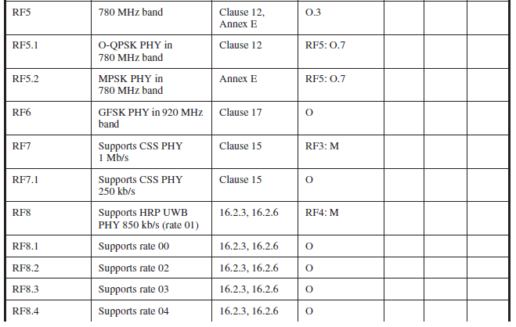

Slide 9
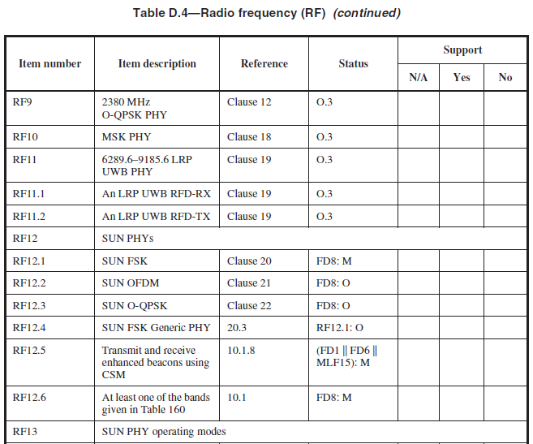

Slide 10
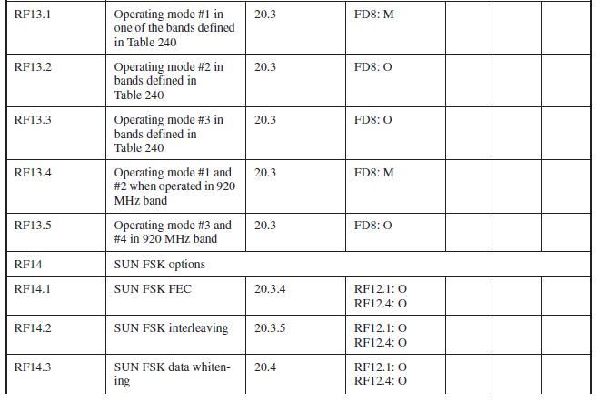

Slide 11
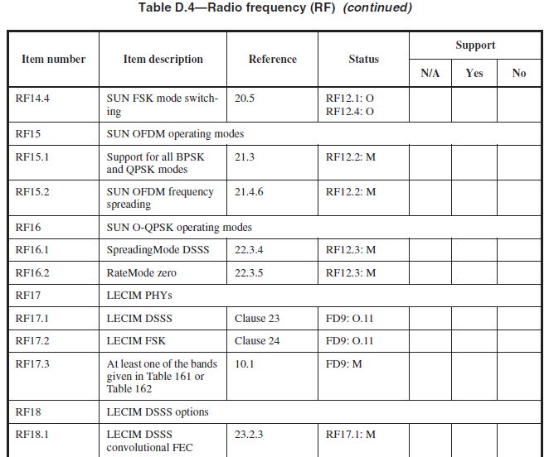

Slide 12
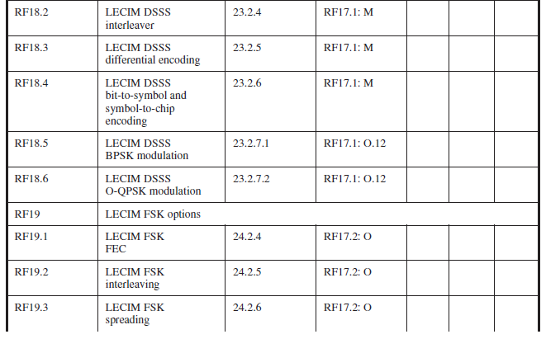

Slide 13
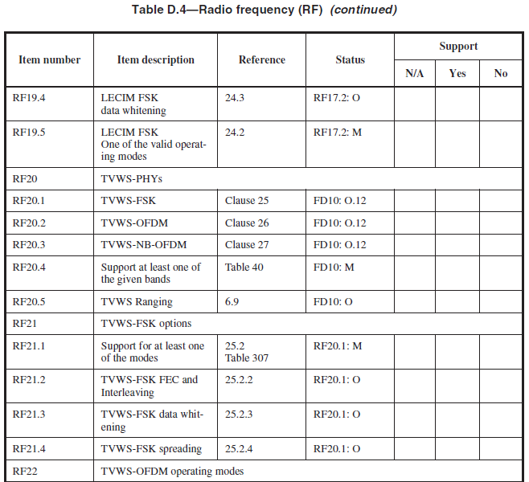

Slide 14
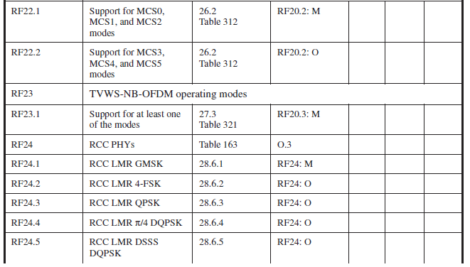

Slide 15
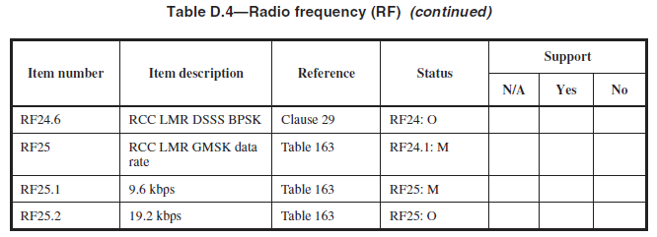

Slide 16
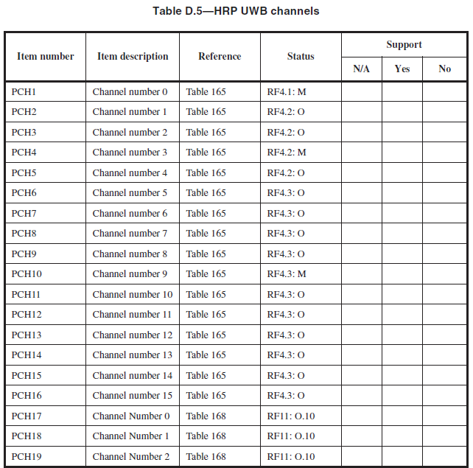

Slide 17
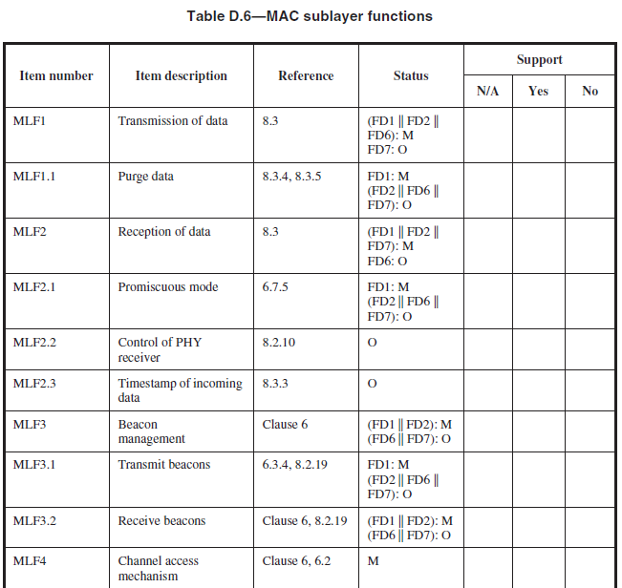

Slide 18
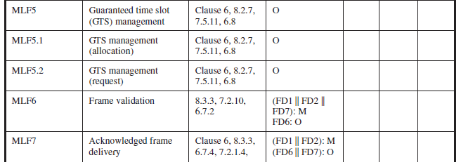
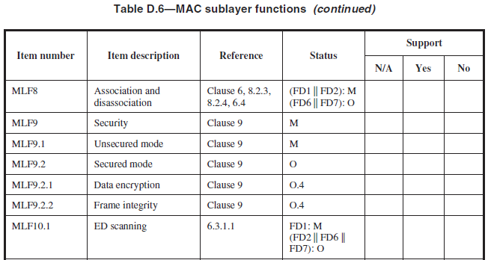

Slide 19
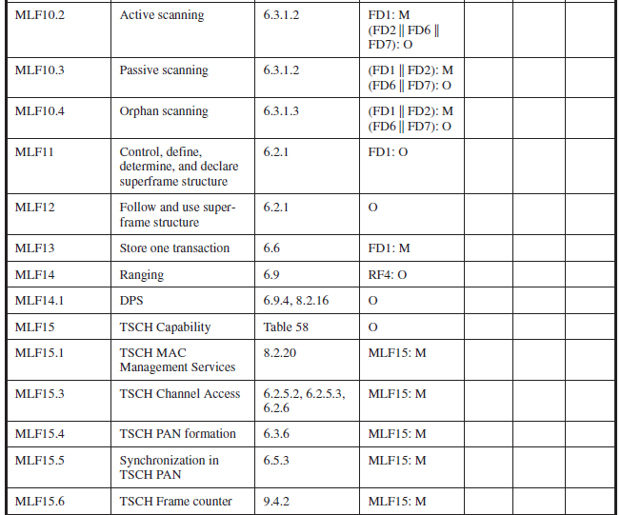

Slide 20
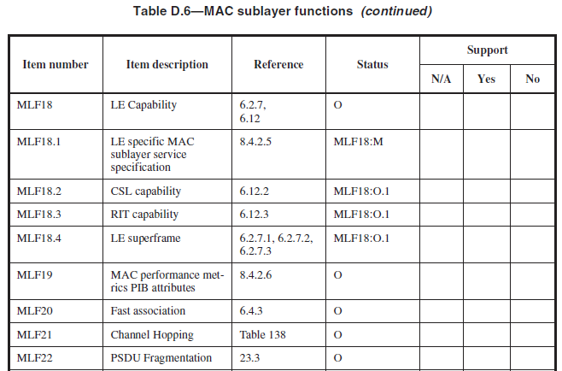

Slide 21
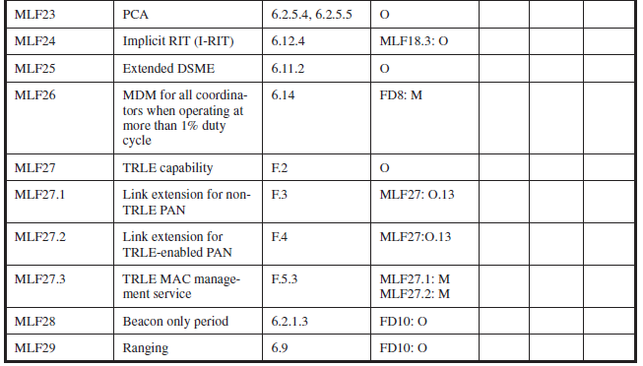

Slide 22
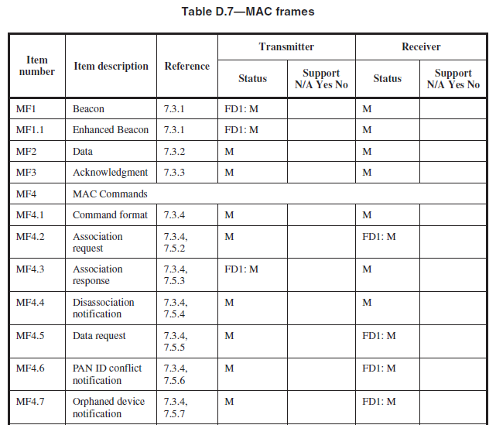

Slide 23
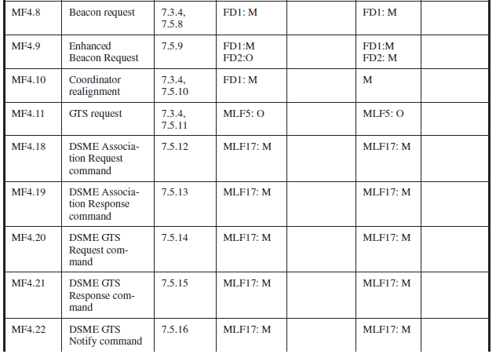

Slide 24
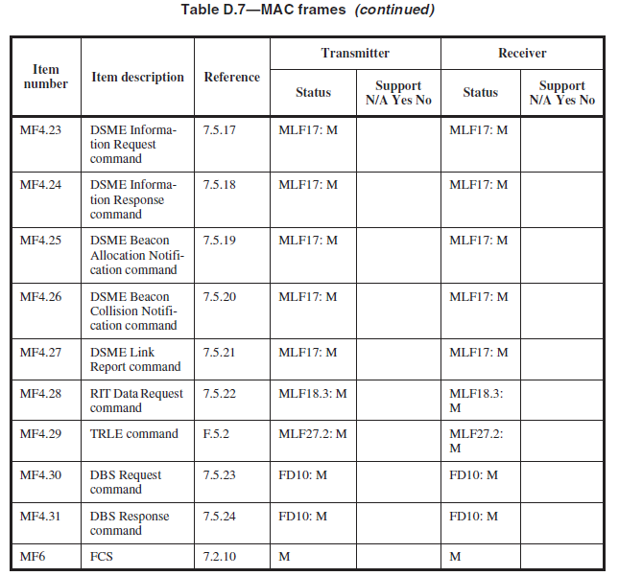

Slide 25
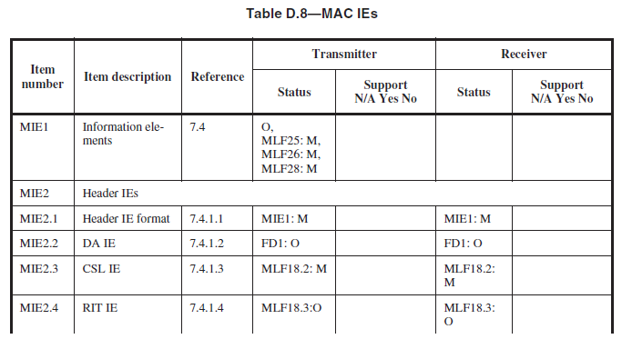

Slide 26
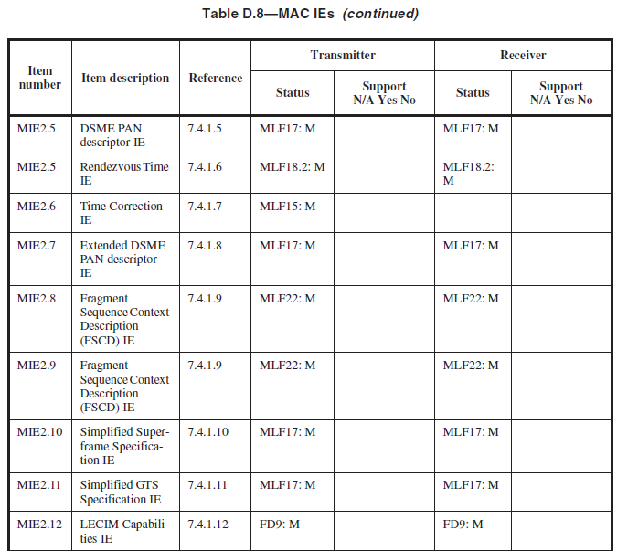

Slide 27
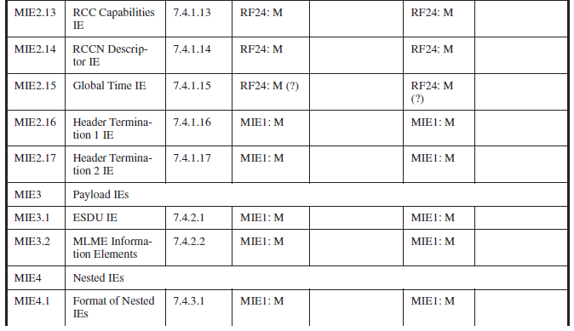

Slide 28
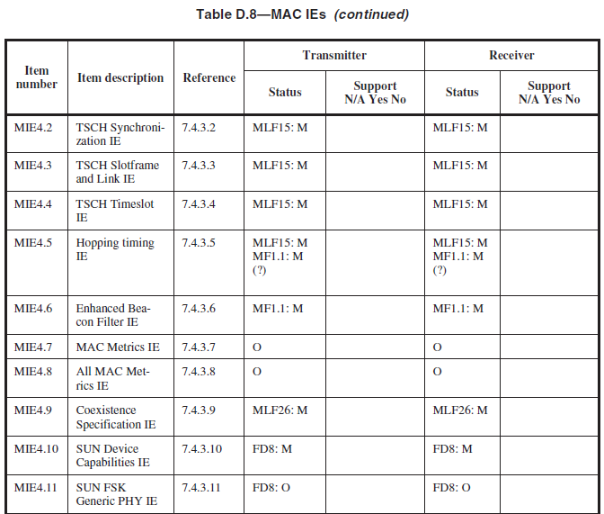

Slide 29
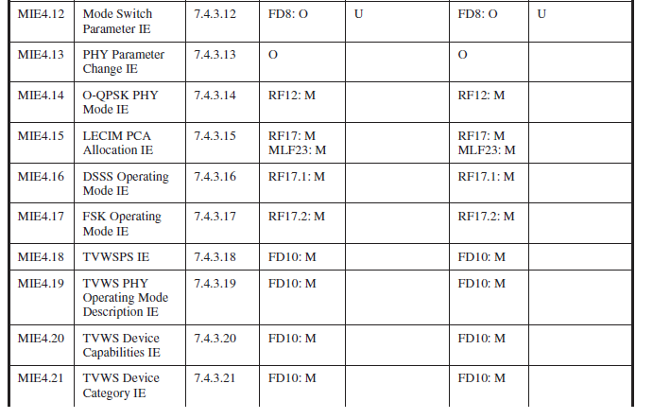

Slide 30
