Slide 1
Project: IEEE P802.15 Working Group for Wireless Personal Area Networks (WPANs)
Submission Title: OPTICWISE: A European Scientific Network on Optical Wireless Communication
Date Submitted: 13 January, 2015
Source: Murat Uysal, Ozyegin University
Address Nisantepe Mh. Orman Sk. No:34-36 Çekmekoy 34794 Istanbul, Turkey
Voice: +90 (216) 5649329, FAX: +90 (216) 5649450, E-Mail: murat.uysal@ozyegin.edu.tr
Re:
Abstract: This document summarizes the overall research scope of OPTICWISE and introduces its research activities on high-rate visible light communication relevant to the potential revision of the IEEE 802.15.7 standard.
Purpose: To introduce the research scope and activities of OPTICWISE
Notice: This document has been prepared to assist the IEEE P802.15. It is offered as a basis for discussion and is not binding on the contributing individual(s) or organization(s). The material in this document is subject to change in form and content after further study. The contributor(s) reserve(s) the right to add, amend or withdraw material contained herein.
Release: The contributor acknowledges and accepts that this contribution becomes the property of IEEE and may be made publicly available by P802.15.

Slide 2
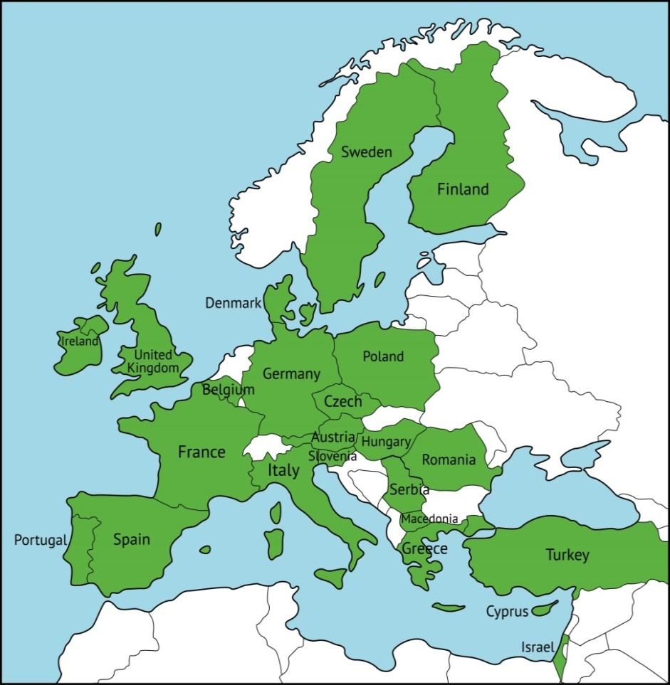
EU COST Action
(2011-2015)
http://opticwise.uop.gr/
OPTICWISE is a European Scientific Network funded by the European Science Foundation (ESF). It currently includes
100+ researchers
35 institutions
23 European countries
6 international partners
OPTICWISE Member

Slide 3
Research Scope
Research scope of OPTICWISE covers all means of optical wireless communication in infrared, visible and ultraviolet frequencies.
Depending on the intended application, variations of OWC can serve as a powerful alternative, complementary or supportive technology to the existing ones
Ultra-short range (e.g., optical circuit interconnects)
Short range (e.g., WBAN, WPAN)
Medium range (e.g., WLAN, VANET)
Long range (e.g., inter-building connections)
Ultra-long range (e.g., satellite links)

Slide 4
Objectives
OPTICWISE recognizes the great potential of OWC and aims to establish and consolidate OWC as a mainstream technology.
Specific objectives include
Make significant contributions to the scientific understanding and technical knowledge of the OWC field
Develop OWC solutions as powerful alternatives and/or complements to existing technologies, and thereby help increase OWC market penetration
Increase awareness of OWC in the scientific community and the general public
Influence decision makers at national and international levels
Attract and train graduate students and early stage researchers for OWC field.

Slide 5
Working Groups
Propagation Modeling and Channel Characterization
Physical Layer Algorithm Design & Verification
Networking Protocols
Advanced Photonic Components
WG1
WG2
WG3
WG4

Slide 6
Working Groups
WG1 (Propagation Modeling and Channel Characterization): Development, evaluation and validation of statistical and empirical channel models for OWC applications and optical bands under consideration.
WG2 (Physical Layer Algorithm Design and Verification) : Establishment of information-theoretic framework for OWC and investigation of practical algorithms and techniques to approach these ultimate performance boundaries.
WG3 (Networking Protocols): Design and analysis of upper layer protocol stacks and investigation of co-existence and interoperability of OWC with other communication networks.
WG4 (Advanced Photonic Components): Efficient design, characterization, fabrication and test of state-of-the-art opto-electronic/photonic components and sub-systems for OWC systems

Slide 7
Highlights from OPTICWISE
More than 100 Action participants working on complementary aspects of OWC who produced a total of
50 input documents and 400+ publications
60+ publications as joint work
The current research funding comes from
14 EC projects
49 national projects
Associate Member of 5G PPP (pending final approval)

Slide 8
OPTICWISE’s View on 802.15.7
The current version of IEEE 802.15.7 supports up to 96 Mb/s and we think that it is somewhat outdated at this point.
In the light of recent advancements in this area, we think that a high-rate VLC standard (supporting multi-Gb/s up to 10Gb/s) is required to cope with the increasing demand of wireless data.
We are very glad to hear that a revision was initiated to broaden the scope from camera communication to OWC.
We have a dedicated Special Interest Group (SIG) on VLC who can actively contribute to the preparation of revised standard.
Murat Uysal, Ozyegin University
Volker Jungnickel, Fraunhofer HHI
Harald Haas, University of Edinburgh
Víctor P. Gil, University Carlos III de Madrid
Stanislav Zvanovec, Czech Technical University
Paul Anthony Haigh, University of Bristol
Fary Ghassemlooy, Northumbria University
Ernesto Ciaramella, Scuola S. Sant'Anna
Mike Wolf, Ilmenau Univ. of Technology
Roger Green, University of Warwick

Slide 9
Related Research Achievements
Realistic VLC channel modeling and characterization (OzU)
OFDM PHY was thoroughly implemented and tested (UEdin)
Further performance improvements on OFDM VLC through cooperation and MIMO techniques (OzU, UEDin)
As an alternative to OFDM, SC-FDE was investigated (IUT)
Real-time closed-loop link adaptation was demonstrated (HHI)
Capability of NLOS and robustness against multipath (HHI, UEDin)
Development of MAC layer (HHI)
World record → 5 Gb/s over 2 m based on WDM+OFDM (Sant'Anna)
Several dedicated testbeds at participating institutions and on-site real-time demos from HHI, UEDIN, Sant’Anna

