Slide 1
Project: IEEE P802.15 Working Group for Wireless Personal Area Networks (WPANs)
Submission Title: [Need of New PHY for HRCP Application]
Date Submitted: [13 January 2015]
Source: [Itaru Maekawa, Andrew Estrada, Keiji Akiyama, Hiroyuki Matsumura, Ko Togashi, Kiyoshi Toshimitsu]
Company: JRC, Sony and Toshiba
Address [5-1-1, Shimorenjaku , Mitaka, Tokyo, Japan]
Voice:[+81-422-45-9228], FAX: [], E-Mail:[maekawa.itaru@jrc.co.jp]
Re: []
Abstract: [Limitation of legacy mm-wave PHY]
Purpose: [Discussion about New PHY for 802.15.3e application]
Notice: This document has been prepared to assist the IEEE P802.15. It is offered as a basis for discussion and is not binding on the contributing individual(s) or organization(s). The material in this document is subject to change in form and content after further study. The contributor(s) reserve(s) the right to add, amend or withdraw material contained herein.
Release: The contributor acknowledges and accepts that this contribution becomes the property of IEEE and may be made publicly available by P802.15.
Itaru Maekawa, JRC

Slide 2
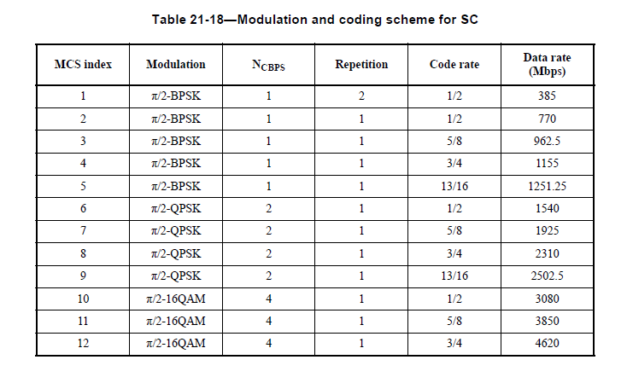
802.11ad SC PHY
Modulation: 64QAM or Higher rate modulation is not defined
Code Rate: ¾ is maximum (poor efficiency)
Itaru Maekawa, JRC

Slide 3
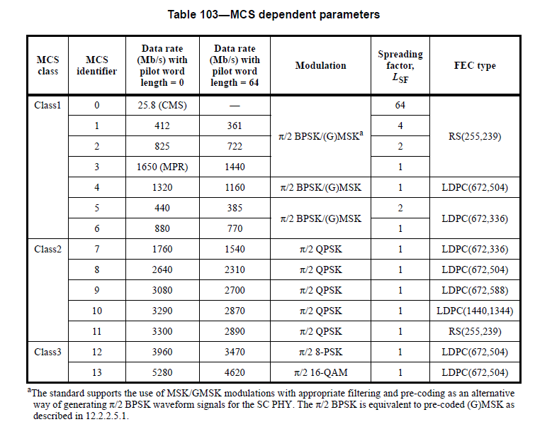
January 2015
802.15.3c SC PHY
Modulation: 64QAM or Higher rate modulation is not defined
Code Rate: better efficiency than 802.11ad, however both RS & LDPC is required . (RS is mandatory for CMS)
Itaru Maekawa, JRC

