Slide 1
Project: IEEE P802.15 Working Group for Wireless Personal Area Networks (WPANs)
Submission Title: Updated Proposal on Fully Distributed Synchronization Scheme for PAC
Date Submitted: Jan. 2015
Source: [Byung-Jae Kwak, Kapseok Chang, Moon-Sik Lee]¹,
[Junhyuk Kim, Kyounghye Kim, Nah-Oak Song, June-Koo Kevin Rhee] ²
Company: [ETRI, Korea] ¹, [KAIST, Korea]²
Address:
E-Mail: [bjkwak@etri.re.kr, kschang@etri.re.kr, moonsiklee@etri.re.kr] ¹,
[kim.jh@kaist.ac.kr, khye.kim@kaist.ac.kr, nsong@kaist.ac.kr, rhee.jk@kaist.edu]²
Re: P802.15.8 Draft D0.6
Abstract: Updated proposal on fully distributed synchronization scheme for PAC.
Purpose: Approval.
Notice: This document has been prepared to assist the IEEE P802.15. It is offered as a basis for discussion and is not binding on the contributing individual(s) or organization(s). The material in this document is subject to change in form and content after further study. The contributor(s) reserve(s) the right to add, amend or withdraw material contained herein.
Release: The contributor acknowledges and accepts that this contribution becomes the property of IEEE and may be made publicly available by P802.15.

Slide 2
Updated Proposal on Fully Distributed Synchronization Scheme for PAC
Jan. 2015

Slide 3
Contents
Updated simulation results for initial synchronization scheme
New simulation results for merging two networks with different reference timing
Review of proposed text
Discussion and decision

Slide 4
Simulation Results: Initial Sync. (1/5)
Comparison of 3 rules for updating oscillator phase
  Convex curve [Mirollo 1990]
  180º rule
  360º rule
[Mirollo 1990] R. E. Mirollo, S. H. Strogatz, “Synchronization of pulse-coupled biological oscillators,”
SIAM J. Appl. Math., vol. 50, no. 6, pp. 1645-1662, Dec. 1990.

Slide 5
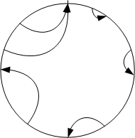
Simulation Results: Initial Sync. (2/5)
Convex curve
  Used in the original firefly sync. scheme
  Two parameters
    b: convexity (the larger, the stronger)
    ε: coupling

Slide 6
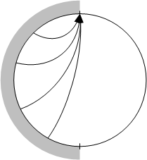
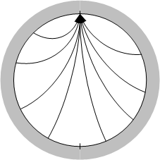
Simulation Results: Initial Sync. (3/5)
  180º rule
    Simple & no parameters
  360º rule
    Simple & no parameters

Slide 7
Simulation Results: Initial Sync. (4/5)
Convex curve simulation results
  1000 PDs in 500m x 500m area (random clustered drop)
  Average of 30 independent runs
  Discussion
    Small coupling (ε=0.05~0.1) gives better performance in multi-hop networks (end-to-end: about 10 hops)
    But, in small networks, large coupling gives better performance [Tyrrell 2009]
    Need to be optimized for a particular scenario
Table: Mean #frame to synchrony
 | ε=0.01 | ε=0.03 | ε=0.05 | ε=0.1 | ε=0.3 | ε=0.5 | ε=0.7
b=1 | 162.6 | 133.7 | 95.4 | 88.3 | 130.7 | 430.4 | 517.8
b=1.2 | 182.9 | 97.7 | 88.2 | - | - | - | -
b=4 | - | - | - | 192.6 | 535.7 | 1085.2 | 1380.5
b=7 | - | - | - | 184.2 | 1030.2 | 1629.1 | 1337.2
[Tyrrell 2009] Alexander Tyrrel, “Firefly Synchronization in Wireless Networks,” Ph.D. Thesis,
Department of Engineering Science, University of Klagenfurt, Austria, July 2009.

Slide 8
Simulation Results: Initial Sync. (5/5)
180º rule & 360º rule simulation results
  1000 PDs in 500m x 500m area (random clustered drop)
  Average of 30 independent runs
  Discussion
    180º rule outperforms the best result with convex curve (53 vs. 88)
    No parameter optimization required with 180º rule
    Simple to implement
    Consistent with other parts of synchronization
Table: Mean #frame to synchrony
 | 180º rule | 360º rule
Mean # frames to synchrony | 52.733 | 599.600
Standard deviation | 32.522 | 497.602

Slide 9
Merging Two Networks (1/4)
Definitions
  A PAC network is a set of PDs, any two PDs of which can exchange data or control messages with each other either directly or through a multi-hop relay route.
  Two networks “meet” when one or more PDs in one network can communicate with one or more PDs in another network directly or through a multi-hop relay route.
    Two networks can meet each other when the networks move, or any obstacle separating the two networks is removed.
    In general, when two networks meet, the reference timing of the two networks are different and they will interferer with each other.
  When two PAC networks meet, the two networks are merged or synchronized by making the PDs in the two networks have the same reference timing.

Slide 10
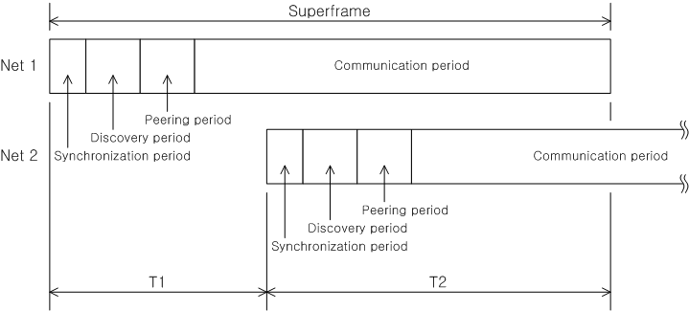
Merging Two Networks (2/4)
Network merge scheme
  Detection: PDs in Net 1 & Net 2 detect Net 2 & Net 1
  Indication: PDs indicate “detection” the detection in the synchronization signal (to wake up PDs in sleep mode)
  Move (consistent with 180º rule)
    If T1 < T2, PDs in Net 2 move to Net 1
    If T1 > T2, PDs in Net 2 move to Net 2
  Merge is complete after all PDs move

Slide 11
Merging Two Networks (3/4)
The scenario
  2 PAC networks: blue: 100 PDs in 50m radius; red: 1000 PDs in 250m radius
  Average of 100 independent runs: (10 drops) x (10 runs / drop)
Random relative phase between two networks
Clustered random drop
Edge distance: 30m
Tx range: 56m

Slide 12
Merging Two Networks (4/4)
Simulation results
  On average, it take about 13 frames to merge two networks using 180º rule
  It takes longer when the larger of the two is merged into the smaller
  180º rule outperforms convex curve with less interruption during the merge.
  Network merge is much faster than initial synchronization
 | 180º rule (Net1 ← Net2 (54%) / Net1 → Net2 (46%)) | Convex curve¹
Mean #frames to synchrony | 13.810 (20.148 / 6.370) | 248.867
Standard deviation | 8.505 (4.109 / 5.870) | 10.373
¹ b = 1.2, ε=0.05

Slide 13
Review of the Proposed Text

