Slide 1
Project: IEEE P802.15 Working Group for Wireless Personal Area Networks (WPANs)
Submission Title: [Frequency channel selection text to put into draft]
Date Submitted: [January, 2015]
Source: [Huan-Bang Li, Marco Hernandez, Igor Dotlic, and Ryu Miura] Company [NICT]
Address [3-4 Hikarino-oka, Yokosuka, Kanagawa, Japan]
Voice:[+81 468475104], FAX: [:[+81 468475431], E-Mail:[lee@nict.go.jp]
Re: [Proposed text for drafting 15.8 PAC]
Abstract: [Text of frequency channel selection to be put into 15.8 draft]
Purpose: [This document is to provide PHY process]
Notice: This document has been prepared to assist the IEEE P802.15. It is offered as a basis for discussion and is not binding on the contributing individual(s) or organization(s). The material in this document is subject to change in form and content after further study. The contributor(s) reserve(s) the right to add, amend or withdraw material contained herein.
Release: The contributor acknowledges and accepts that this contribution becomes the property of IEEE and may be made publicly available by P802.15.

Slide 2
Frequency Channel Selection Text to Put Into Draft
Huan-Bang Li, Marco Hernandez,
Igor Dotlic, and Ryu Miura
January, 2015

Slide 3
Purposes
In November meeting@San Antonio, contents of frequency channel selection were adopted, which were given in PPT format.
(See 15-14-0679-01-0008)
To put the approved contents into the draft, editorial modification is needed to transfer the text into WORD format.
Moreover, it needs to be decided where the text should be added in.

Slide 4
Modification To Do
Use the approved contents as it is as possible.
Delete redundant description.
Add particle or adposition if necessary to smooth the text.

Slide 5
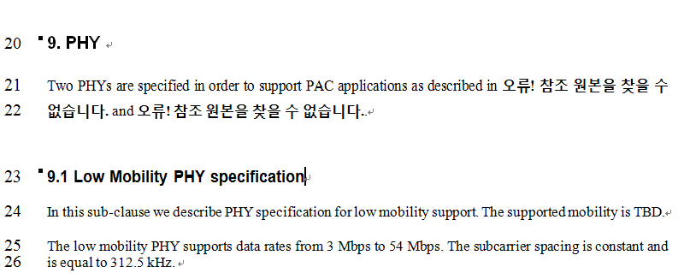
Suggest Position in D0.6
Here
… …
… …

Slide 6
Agreed Text (1)
The frequency channel selection shall be performed by higher layers in cooperation with MAC and PHY. Frequency channel selection methodologies may include the following.
Frequency channel selection could be pre-assigned.
Contention based frequency channel selection with CCA. CCA might use energy detection (ED), carrier sensing, or other techniques used for channel measurements and detections.
Text to be in draft (1)
The frequency channel selection shall be performed by higher layers in cooperation with MAC and PHY. Frequency channel selection methodologies may be either pre-assigned or contention based with CCA. CCA might use energy detection (ED), carrier sensing, or other techniques used for channel measurements and detections.
Notes:
Clause, item

Slide 7
Agreed Text (2)
The information of selected frequency channel for peering shall be shared among the PDs involved in peering prior to the peering.
The information of selected frequency channel for communication shall be shared among the PDs involved in communication prior to the communication.
Text to be in draft (2)
The information of selected frequency channel for peering shall be shared among the PDs involved in peering prior to the peering. And, the information of selected frequency channel for communication shall be shared among the PDs involved in communication prior to the communication.

Slide 8
Agreed Text (3)
To minimize discovery latency, the channel to start discovery procedure may be pre-specified when contention based channel selection is performed. Discovery and emergency message are given the highest priority to use this channel (naming of the channel is TBD: i.e. TBD channel).
To minimize discovery latency, it may specify the order of candidate channel list for discovery if the TBD channel is not available, e.g. reaching its accommodation capacity or failing the required QoS, etc.
Text to be in draft (3)
To minimize discovery latency, the channel to start discovery procedure may be pre-specified when contention based channel selection is performed. Discovery and emergency message are given the highest priority to use this channel (naming of the channel is TBD). Moreover, it may specify the order of candidate channel list for discovery if the TBD channel is not available, e.g. reaching its accommodation capacity or failing the required QoS, etc.

Slide 9
Agreed Text (4)
Channel hopping shall be enabled for coexistence or other purposes. The manner of channel hopping is TBD.
Text to be in draft (4)
Channel hopping shall be enabled for coexistence or other purposes. The manner of channel hopping is TBD.

Slide 10
Motion
Motion: To approve “TG agreed text for frequency channel selection” (DCN: 15-0046-00-0008) and include it in the Standard Draft v0.6.
Moved: Huan-Bang Li
Second:
Yes:
No:
Abstain:

