Slide 1
Project: IEEE P802.15 Working Group for Wireless Personal Area Networks (WPANs)
Submission Title: [mmWave Wireless Backhauling for High Rate Mobile Hotspot Network]
Date Submitted: [13 January, 2015]
Source: [Bing Hui, Junhyeong Kim, Hee-Sang Chung, and Il Gyu Kim] Company [ETRI]
Address [218 Gajeong-ro, Yuseong-gu, Daejeon, 305-700, KOREA]
Voice:[+82-42-860-5324], FAX: [+82-42-860-6732], E-Mail:[huibing@etri.re.kr]
Abstract: [mmWave Wireless Backhauling for High Rate Mobile Hotspot Network]
Purpose: [To introduce a concept of mobile wireless backhaul for MHN]
Notice: This document has been prepared to assist the IEEE P802.15. It is offered as a basis for discussion and is not binding on the contributing individual(s) or organization(s). The material in this document is subject to change in form and content after further study. The contributor(s) reserve(s) the right to add, amend or withdraw material contained herein.
Release: The contributor acknowledges and accepts that this contribution becomes the property of IEEE and may be made publicly available by P802.15.

Slide 2
mmWave Wireless Backhauling for High Rate Mobile Hotspot Network

Slide 3
Outline
Background
Objectives
MHN RTT
Technical Challenges

Slide 4
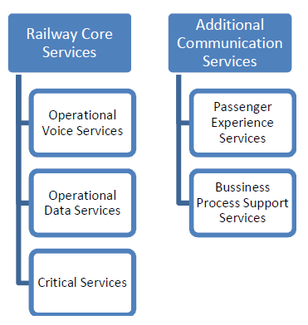
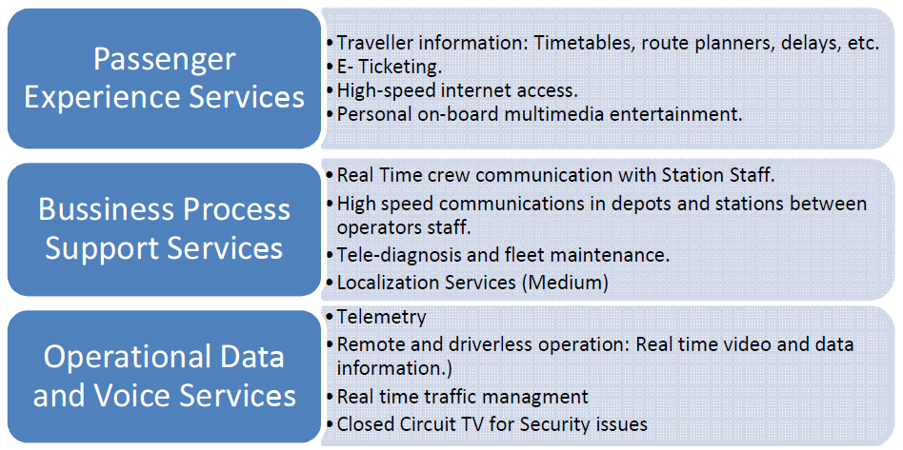
Background (1/2)
Classification of Railway Services^{[ETSIT]}
S. Amundsen, “Future Rail Communication Implementation Scenarios for LTE”, a master thesis submitted to Department of Telematics, Norwegian University of Science and Technology, 2013.06.

Slide 5
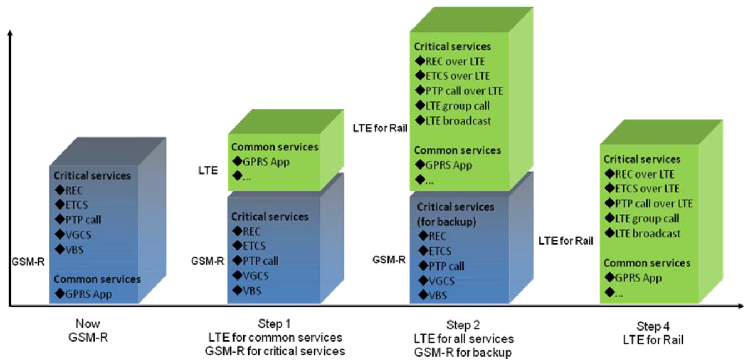
Background (2/2)
GSM-R to LTE-R^{[Huawei]}
REC: Railway Emergency Call
ETCS: European Train Control System
PTP Call: Point-to-point call
VGCS: Voice group call service
VBS: Voice broadcast service
GPRS: General packet radio service
Wenhua, “Huawei LTE for rail”, Huawei technical white paper, 2014.08.

Slide 6
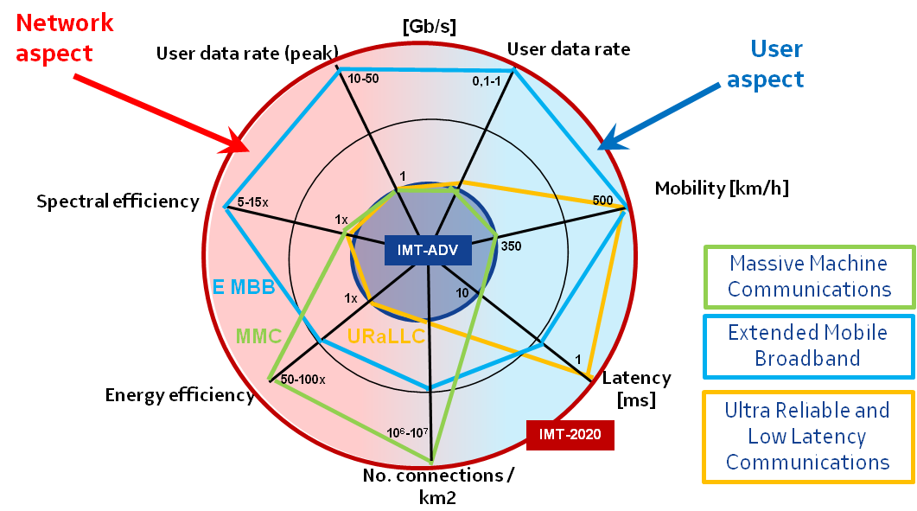
Objectives (1/3)
Key Capabilities of Future IMT^{[Nokia & NSN]}
IMT Vision – “Framework and overall objectives of the future development of IMT for 2020 and beyond”, ITU Recommendation Study Groups, 2014.10.

Slide 7
Objectives (2/3)
RAT for High-mobility Regions
‘Home’ and ‘Vehicle’ are the most preferred places to use mobile Internet
89.6
81.3
Where?
Mobile
Internet
62.1
62.0
52.6
34.0
28.0
Home
Vehicle
Streets
Outdoor
(Coffee shops)
Work
Public
space
School
※ Survey 2012 for Mobile Internet Usage by Korea Internet & Security Agency
Wireless Internet use
Low Medium High mobility
(above 100km/h)

Slide 8
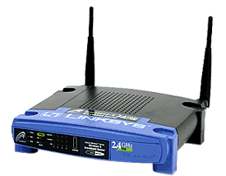
Objectives (3/3)
Backhaul & Access Link
GW : Gateway
DU : Digital Unit
RU : Radio Unit
TE : Terminal Equipment
Access Link
(inside vehicle)
Backhaul Link
mmWave
Backhaul Link
mmWave
TE
RU
RU
DU
Public Internet
GW

Slide 9
MHN RTT (1/7)
Features
New RAT for Mobile Wireless Backhaul
Wireless Backhaul Link (Outside Vehicle) | OFDM based on mmWave
Data throughput (DL) | 1 Gbps using 250-MHz bandwidth
Spectral efficiency | 4 bps/Hz
Mobility | 400 km/h
User Access Link (Inside Vehicle) | Small Cell (WiFi or Femto)

Slide 10
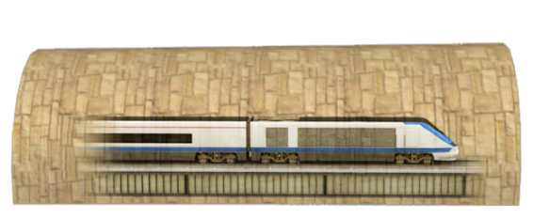
MHN RTT (2/7)
MHN Network Components
mTE : Located on train (w. RF) | mRU: BS RF (w. antennas)
mDU : BS digital unit | mGW (w. SW)
Baseband model of mTE | L2/L3 SW for mTE
Baseband model of mDU | L2/L3 SW mDU
1
5
2
6
3
7
4
8
mTE
1
3
7
5
mRU
2
4
8
mRU
Public Internet
mGW
mDU
6
mGW: MHN Gateway, mDU : MHN Digital Unit, mRU: MHN Radio Unit, mTE: MHN Terminal Equipment

Slide 11
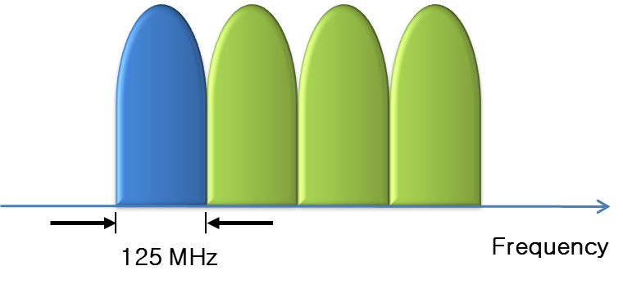
MHN RTT (3/7)
Wide Spectrum over Millimeter Waves
Considerations for frequency resources and implementation
Primary bandwidth : 125 MHz
Carrier aggregation up to 500 MHz
Table. Freq. candidates in Korea
Range | Bandwidth
12.75 ~ 13.25GHz | 500 MHz
13.4 ~ 14GHz | 600 MHz
18.1 ~ 18.6GHz | 500 MHz
18.935 ~ 19.185GHz | 250 MHz
26.5 ~ 27 GHz | 500 MHz
31.5 ~ 33.5 GHz | 2 GHz

Slide 12
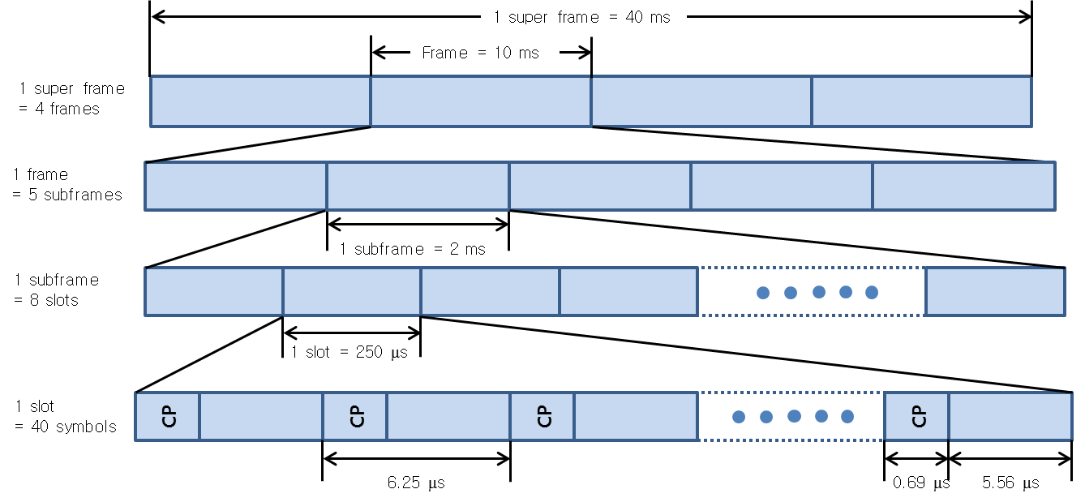
MHN RTT (4/7)
Frame Structure

Slide 13
MHN RTT (5/7)
Downlink Resource Grid

Slide 14
MHN RTT (6/7)
OFDM Parameters Comparison btw. MHN & LTE
 | MHN | LTE/LTE-A
Carrier frequency | 20 ~ 40 GHz | Sub-6 GHz
Frequency bandwidth | 125 MHz x 4 | 20 MHz x 5
Subcarrier spacing | 180 kHz | 15 kHz
OFDM symbol duration | 5.56 us | 66.7 us
CP length | 0.69 us (12.5%) | 4.69 us (7%)
TTI | 250 us | 1 ms

Slide 15
MHN RTT (7/7)
MHN Transmitter Structure
Modulation format: QPSK, 16QAM, 64QAM
Layer: 1 or 2
Precoding: Single antenna or TX diversity
layers
antenna ports
Layer
mapper
Precoding
RE
mapper
OFDM signal
generation
Scrambling
Modulation mapper
RE
mapper
OFDM signal generation

Slide 16
Technical Challenges (1/2)
Coverage Improvement
Path loss and atmospheric attenuation of millimeter-wave
Synchronization
Accurate Freq. & time sync.
Doppler Effect
Large amount of Doppler shift

Slide 17
Technical Challenges (2/2)
High-speed Handover
Massive HO
Frequent HO
Outage/failure rate
Tunnel Environment
Dedicated channel environment
Block of LoS link

