Slide 1
Project: IEEE P802.15 Working Group for Wireless Personal Area Networks (WPANs)
Submission Title: [Overview of TG4s Spectrum Resource Usage]
Date Submitted: [14 January, 2015]
Source: [Shoichi Kitazawa] Company [ATR]
Address [Hikaridai, Seika, Kyoto JAPAN]
Voice:[+81-774-95-1565], FAX: [], E-Mail:[kitazawa@atr.jp]
Re: []
Abstract: [This contribution summarizes TG4s current activity and future plan.]
Purpose: [Promote TG4s activities to the WG15 members.]
Notice: This document has been prepared to assist the IEEE P802.15. It is offered as a basis for discussion and is not binding on the contributing individual(s) or organization(s). The material in this document is subject to change in form and content after further study. The contributor(s) reserve(s) the right to add, amend or withdraw material contained herein.
Release: The contributor acknowledges and accepts that this contribution becomes the property of IEEE and may be made publicly available by P802.15.

Slide 2
Overview of
TG4s Spectrum Resource Usage
Shoichi Kitazawa

Slide 3
Abstract
Objective
Provide TG4s scope and future plan.
Outline
Problem statement
History of the group
Scope
Proposed applications
Timeline

Slide 4
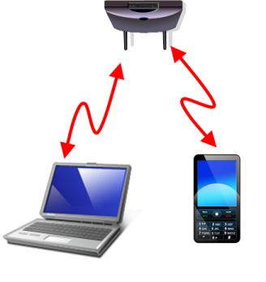

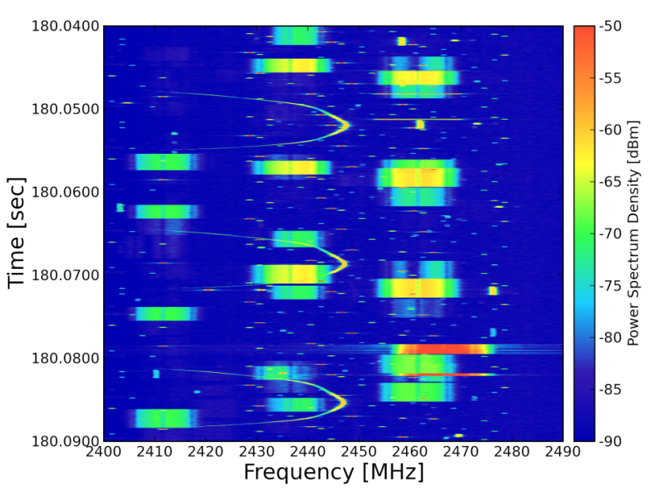
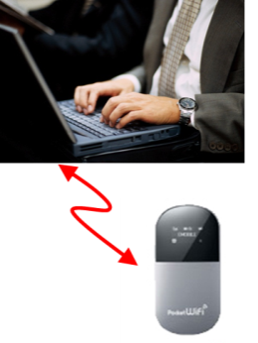

Problem statement
Many WPAN, WLAN systems use unlicensed frequency bands including 2.4GHz and 915MHz bands
  Heavy interference occurs among these systems and/or other disparate systems
Such heavy congestion in these conditions needs to be solved
TG4s aims for efficient use of the spectrum resource
50 ms
WLAN
Bluetooth
WLAN

Slide 5
History
IG SRU formed November 2010
  Measurement and simulation results of 2.4GHz congestion situation has been discussed.
  The group agree to form a SG for developing mechanisms of Radio Resource Measurement and Management (RRMM) for WPANs.
SG SRU formed September 2013
  The group decided to standardization of Spectrum Resource Measurement to enable spectrum resource management for 15.4.
TG4s started September 2014

Slide 6
Scope of the Project
This amendment to IEEE Std 802.15.4 defines MAC related functions to enable spectrum resource management.
It specifies,
spectrum resource measurements and network performance metrics, such as packet error ratio, delay, etc,
information elements and data structures to capture these measurements,
procedures for collecting and exchanging spectrum resource measurement information with higher layers or other devices.

Slide 7
Scope of the TG4s (cont’d)
Need for the Project:
As various wireless systems are deployed in the shared and license exempt frequency bands including 2.4GHz and 915MHz bands, heavy interference has limited performance of the wireless systems. In order for these wireless systems to operate more effectively, a standardized set of spectrum resource measurements is needed that will facilitate management functions in these networks.
Stakeholders for the Standard:
The stakeholders include manufacturers and users of telecom, medical, environmental, energy, and consumer electronics equipment and manufacturers and users of equipment involving the use of wireless sensor and control networks.

Slide 8
Spectrum Resource Measurement
Next Higher Layers
Spectrum Resource Usage (SRU) information is collected using existing PIBs
MLME and PLME exchanges the SRU information through existing SAPs
MLME may send the SRU information to Next Higher Layer by IE
MCPS SAP
MLME SAP
MAC
MAC Command
part sublayer
MLME
MAC PIB
PD SAP
PLME SAP
PHY
PLME
MCPS:MAC Common Part Sublayer
MLME:MAC Layer Management Entity
PD: PHY Data
PLME: Physical Layer Management Entity
PIB: PAN information base
PHY PIB
RF SAP

Slide 9
A Possible Enhancement for Spectrum Resource Measurement and Management
The Network Manager (NM) requests the measurement of the SRU information to Pico Net Controllers (PNC).
Each PNC collects the SRU information from attached Devices and report them to the NM.
Based on the collected SRU information, the NM may perform network management (including a management for efficient spectrum resource usage).
Network Manager
PNC1
PNC2
PNCn
Devices
Devices
Device

Slide 10
Network Manager
TG4s aims at building a standard to specify MAC framework for exchanging information on SRU.
The Network Manager
controls PHY/MAC parameter based on spectrum resource usage.
Detecting spectrum resource usage and notifies to the Network Manager.
802.15.4
Coordinator
802.15.4
Coordinator
802.15.4
Coordinator
Radio resource contention will be occur
between different piconet

Slide 11
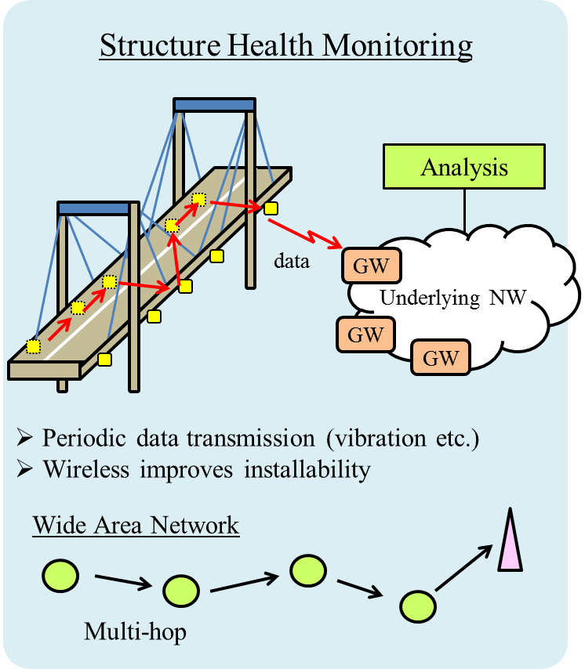
Applications
Hospital/Medical/Healthcare
Infrastructure Monitoring
Industrial Automation

Slide 12
Timeline
Year |  | 2014 |  |  |  |  |  | 2015 |  |  |  |  |  | 2016 |  |  |  |  |  | 2017
Month |  | 1 | 3 | 5 | 7 | 9 | 11 | 1 | 3 | 5 | 7 | 9 | 11 | 1 | 3 | 5 | 7 | 9 | 11 | 1 | 3 | 5 | 7 | 9 | 11
SG | PAR & CSD development
TG Work Items | Start TG
 | Use Cases & TGD
 | Editing Draft
 | Letter Ballot
 | LB Comment Resolution
 | Initial Sponsor Ballot
 | SB Comment Resolution
 | Submission to RevCom

Slide 13
Meetings of This Week
Monday 12 January AM2
  Heard 2 presentations
  Reviewed the Technical Guidance Document (TGD)
Tuesday 13 January PM2
  Heard presentation and worked on the TGD
  Reviewed WNG meeting slide
Thursday 15January PM2
  Continue to Work on revise the TGD
  Plan for March meeting and Teleconference

