Slide 1
Project: IEEE P802.15 Working Group for Wireless Personal Area Networks (WPANs)
Submission Title: [Introduction to mobile Internet service in fast moving vehicles]
Date Submitted: [7 January, 2014]
Source: [Junhyeong Kim, Bing Hui, Hee-Sang Chung and Il Gyu Kim] Company [ETRI]
Address [218 Gajeong-ro, Yuseong-gu, Daejeon, 305-700, KOREA]
Voice:[+82-10-4818-8166], FAX: [+82-42-860-6732], E-Mail:[jhkim41jf@etri.re.kr]
Abstract: [Introduction to mobile Internet service in fast moving vehicles]
Purpose: [For discussion]
Notice: This document has been prepared to assist the IEEE P802.15. It is offered as a basis for discussion and is not binding on the contributing individual(s) or organization(s). The material in this document is subject to change in form and content after further study. The contributor(s) reserve(s) the right to add, amend or withdraw material contained herein.
Release: The contributor acknowledges and accepts that this contribution becomes the property of IEEE and may be made publicly available by P802.15.

Slide 2
Introduction to Mobile Internet Service in Fast Moving Vehicles

Slide 3
Outline
Background
Mobile Internet Service In Fast Moving Vehicles
Objective

Slide 4

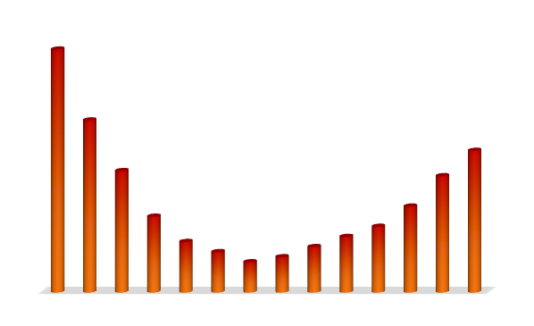
Background
IMT Vision : “Framework and overall objectives of the future development of IMT for 2020 and beyond” ^{[1]}
  Increasing demands of traffic will be expected even in high-speed vehicular environments
IMT-Advanced (4G) mobility support ^{[2]}
Peak data rate | 10 ~ 50 Gbps
User experienced data rate | 100 Mbps ~ 1 Gbps
Mobility | 500 km/h (Performance at high mobility should maintain high quality)
Mobile Internet Use
Freedom of two hands !
Low Medium High mobility
(above 100km/h )
Mobility classes | Velocities | Performance
Stationary | 0 km/h | Optimized
Pedestrian | > 0 km/h to 10 km/h
Vehicular | 10 to 120 km/h | Marginal degradation (support with high performance)
High speed vehicular | 120 to 350 km/h | System should be able to maintain connection

Slide 5

Background
High mobility environments are getting important
  People enjoy mobile internet services at low or high mobility
  About 10 billions of passengers yearly in Korea
    Bus, subway, and KTX (high-speed train)
‘Home’ and ‘Vehicle’ are the most preferred places to use mobile Internet
89.6
81.3
62.1
62.0
52.6
Where?
Mobile
Internet
34.0
28.0
Home
Vehicle
Streets
Outdoor
(Coffee shops)
Work
Public
space
School
※ Survey 2012 for Mobile Internet Usage by Korea Internet & Security Agency

Slide 6
Mobile Internet Service In Fast Moving Vehicles
Wi-Fi service based on WiBro/LTE for fast moving vehicles in Korea, provided by major mobile operators, SKT, KT
  WiBro : also known as mobile WiMAX or 802.16e
    Subway, bus, etc.
    In the Seoul subway, WiBro antennas are spread out at 300- to 400-meter intervals in the tunnels and at the stations
  LTE
    KTX bullet train

Slide 7

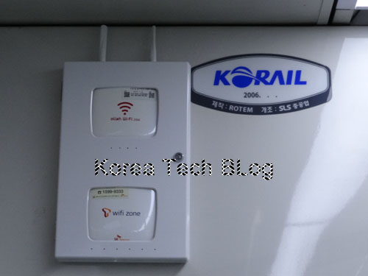
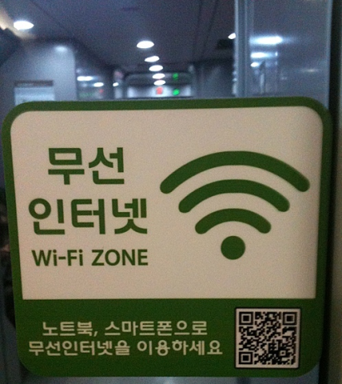
KTX bullet train in Korea
Wi-Fi service in KTX bullet train
  KTX (Korea Train eXpress) is South Korea’s high-speed rail system, operated by Korail
    Top speed for trains in regular service is currently 305 km/h
  Wi-Fi service based on LTE
<Wi-Fi service in KTX bullet train>

Slide 8
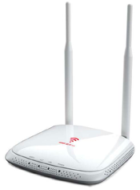
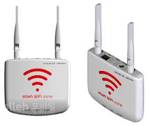
Subway in Korea
Public Egg / Premium Public Egg
  Provided by KT in April 2012
  Receive WiBro signals and convert into Wi-Fi signals
  Major mobile service has been concentrated on Seoul and Pusan subway
    Other vehicles including train, bus
<KT Premium Public Egg>
<KT Public Egg>

Slide 9
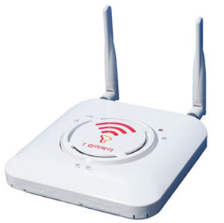
Subway in Korea
Dual Band Bridge
  Provided by SKT
  Free Wi-Fi service for Seoul and Pusan subway
    Bus
  Receive WiBro signals and convert into Wi-Fi signals
    Wi-Fi signals using 2.4GHz / 5GHz
<SKT Dual Band Bridge>

Slide 10
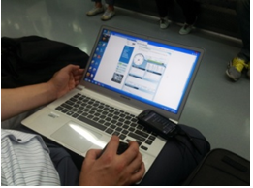
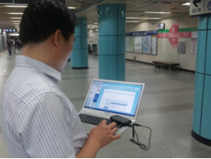
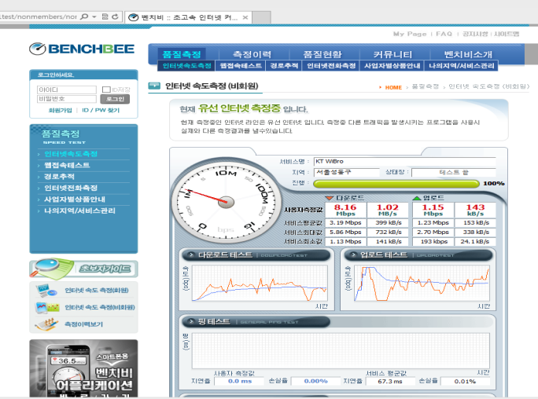
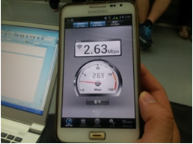
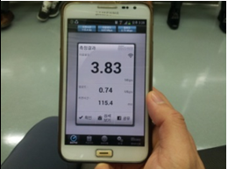
Subway
Data rate measurement inside subway (Seoul subway line 8)
  download / upload speed measured by BENCHBEE
  Avg. rate : WiBro 8Mbps/1.5Mbps, Wi-Fi 7.3Mbps/1.8Mbps

Slide 11
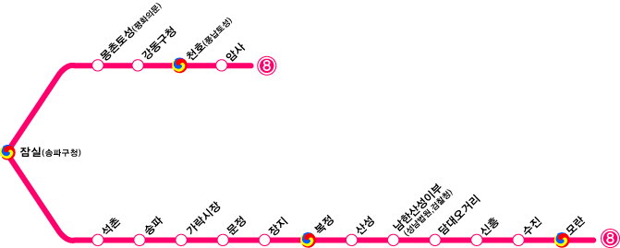
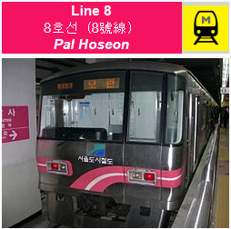
Subway
Mbps
Horizontal axis : stations
Vertical axis : data rate (Mbps)
*터널 : tunnel

Slide 12
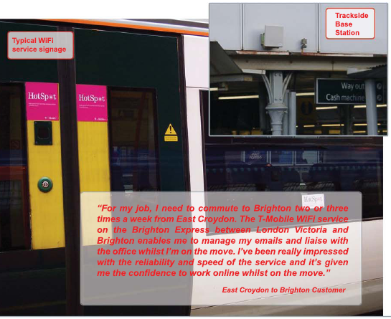
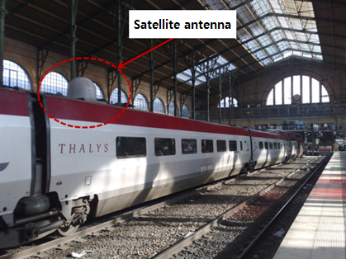
High-speed train
Service situation in each countries ^{[3]}
Country / Company | Radio access technologies |  | Remarks
 | Train – base station | Inside train
British train operator GNER | Satellite (Downlink) Cellular (Uplink) | Wi-Fi | Provided from 2003
British train operator Southern | WiMAX | Wi-Fi | Provided from 2005 Brighton to London express
Europe Thalys | Satellite Cellular (GPRS/UMTS) | Wi-Fi | Provided from 2007
USA Ogden-salt lake Commuter rail | WiMAX | Wi-Fi | Provided from 2008
Japan Shinkansen | LCX (leaky coaxial cables) | Wi-Fi | Provided from 2009
USA AMTRAK | LTE | Wi-Fi | Provided from 2010
<Southern : WiFi service and
WiMAX base station>
<Thalys : satellite antenna>

Slide 13
Comparison of radio access technologies for high-speed train
Radio access Technologies | Features | Application and development case
Satellite | Satellite altitude : 500~36,000km (LEO,MEO,GEO) Use high frequency : severe signal loss (rain attenuation) High latency (250msec) : not good for voice call. Transmission rate : 64kbps ~ 6 Mbps (50 Mbps) | GNER (Britain) Thalys (Europe) ACORDE
WiMAX | Channel BW : 1.75MHz ~ 28 MHz Max. transmission rate (10MHz): downlink (63Mbps per sector), uplink (28Mbps per sector) Support QoS and handover | Southern (Britain) (provide 32Mbps) Ogden ~ salt lake commuter rail (USA)
3GPP LTE | Channel BW : 1.25MHz ~ 20 MHz Max. transmission rate (20MHz) : downlink (100Mbps), uplink (50Mbps) Support QoS and handover | AMTRAK (US) Icomera Xentrans Nomad Digital
LCX ^{[3]} | Tunnel, mine, building, railway Transmission rate : 768 kbps | Shinkansen (Japan)
HAPS | Platforms are vehicles situated in the stratosphere (from 17 ~ 22 km above ground), Offer LOS links over a wide area Max. transmission rate : 120 Mbps | CAPANINA project (Europe)
FLUIDITY | also known as a track-side or a train-to-ground communication system Up to 100 Mbps per base radio/train/car Supported train speed : 320km/h Frequency range : 3.3-3.7, 4.9-5.9 GHz | FLUIDMESH

Slide 14
Objective
A new RAT for high-mobility regions
  The same level of QoE for high-speed group users compared to nomadic users
    High data rate beyond Gbps for mobile wireless backhaul
Wireless Internet use
Low Medium High mobility
(above 100km/h)

Slide 15
Objective
Problems | Solutions
Lack of frequency resources below 6GHz | Higher bandwidth : millimeter-wave
Penetration loss of higher frequency | Mobile wireless backhaul for high-speed vehicle environments
Doppler effect Frequency shift/spread : the faster the movement is, the higher the frequency shift Introduce ICI reducing SNR | Subcarrier spacing Automatic frequency control
Highly frequent handover | Robust handover algorithm (handover reliability)

Slide 16
References
[1] IMT Vision – “Framework and overall objectives of the future development of IMT for 2020 and beyond”
[2] Report ITU-R M.2134
[3] D.T.Fokum and V.S. Frost, "A Survey on Methods for Broadband Internet Access on Trains," IEEE Communications Surveys & Tutorials, vol.12, no.2, pp.171-185, Second Quarter 2010.

