Slide 1
Project: IEEE P802.15 Working Group for Wireless Personal Area Networks (WPANs)
Submission Title: Adaptive Random Access Scheme for PAC
Date Submitted: Nov. 2014
Source: [Byung-Jae Kwak, Kapseok Chang, Moon-Sik Lee]¹,
[Junhyuk Kim, Kyounghye Kim, June-Koo Kevin Rhee] ²
Affiliation: [ETRI, Korea]¹, [KAIST, Korea]²
Address:
E-Mail: bjkwak@etri.re.kr, kschang@etri.re.kr, moonsiklee@etri.re.kr,
kim.jh@kaist.ac.kr, khye.kim@kaist.ac.kr, rhee.jk@kaist.edu,
Re:
Abstract: Description of the adaptive random access for peering period and contention access period for data communication.
Purpose: Approval
Notice: This document has been prepared to assist the IEEE P802.15. It is offered as a basis for discussion and is not binding on the contributing individual(s) or organization(s). The material in this document is subject to change in form and content after further study. The contributor(s) reserve(s) the right to add, amend or withdraw material contained herein.
Release: The contributor acknowledges and accepts that this contribution becomes the property of IEEE and may be made publicly available by P802.15.

Slide 2
Adaptive Random Access Scheme for PAC
Nov. 2014
San Antonio, TX, USA

Slide 3
Introduction
Reuse lessons from Sync period as much as possible.
Synchronization signal vs. Data
Synchronization Signal | Data
Transmitted by all PDs | Transmitted by PDs with data
Transmitted always | Transmitted only when needed
Stable | Dynamic
Criterion: Stability | Criterion: Adaptability

Slide 4
Adaptive p-Persistent CSMA
Probability of transmission: p
  p ≈ 1/CW
  PDs attempt to transmit a packet in each slot with probability p
Policy
  Many PDs in the network: use small p
  Not many PDs in the network: use large p
How to decide to increase/decrease p
  Inter-arrival time
  Fairness
CW vs. p
  CW: updated after packet transmission
  p: updated after packet reception

Slide 5
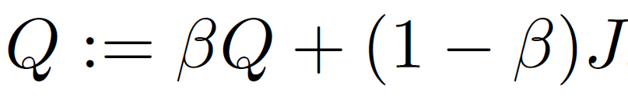
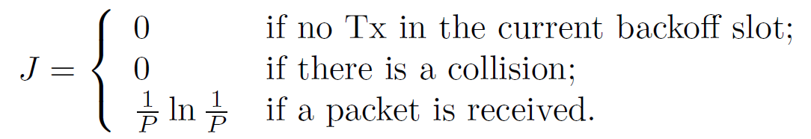

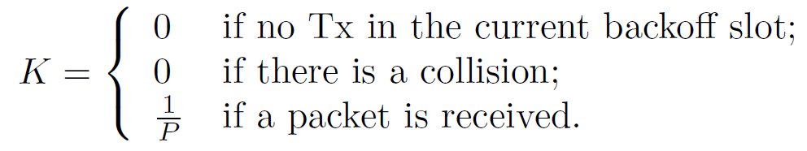
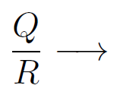
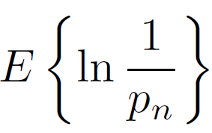
Adaptive p-Persistent CSMA
Update of p

Slide 6
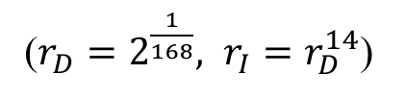
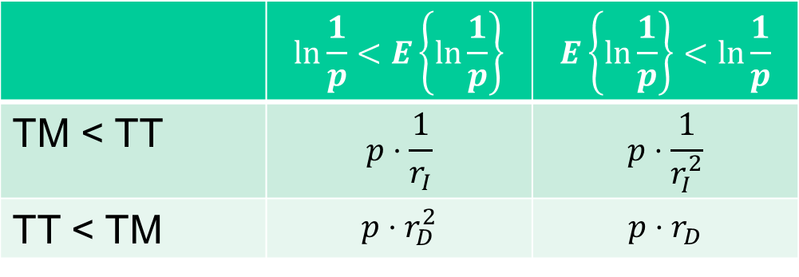
Adaptive p-Persistent CSMA
Update of p
T_{M} := β·T_{M} + (1 - β) ·MIAT
 | $$\ln{\frac{1}{p}}<E\left\{\ln{\frac{1}{p}}\right\}$$ | $$E\left\{\ln{\frac{1}{p}}\right\}<\ln{\frac{1}{p}}$$
TM < TT | $$p⋅\frac{1}{r_{I}}$$ | $$p⋅\frac{1}{r_{I}^{2}}$$
TT < TM | $$p⋅r_{D}^{2}$$ | $$p⋅r_{D}$$
($r_{D}=2^{\frac{1}{168}}, r_{I}=r_{D}^{14}$)

Slide 7
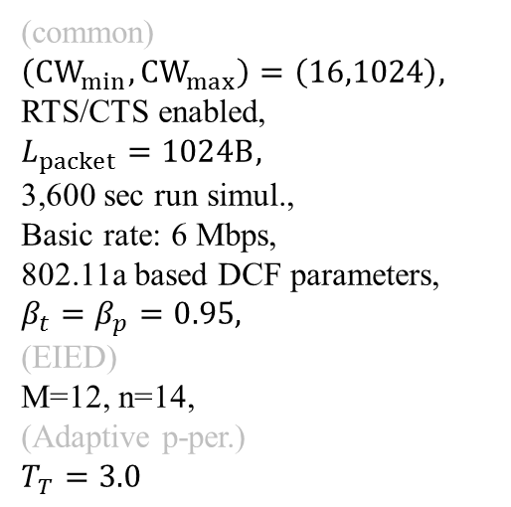
Simulation Results
(BASIC)
(common)
$\left(CW_{min},CW_{max}\right)=\left(16,1024\right),$
RTS/CTS enabled,
$L_{packet}=1024B,$
3,600 sec run simul.,
Basic rate: 6 Mbps,
802.11a based DCF parameters,
$β_{t}=β_{p}=0.95,$
(EIED)
M=12, n=14,
(Adaptive p-per.)
$$T_{T}=3.0$$

Slide 8
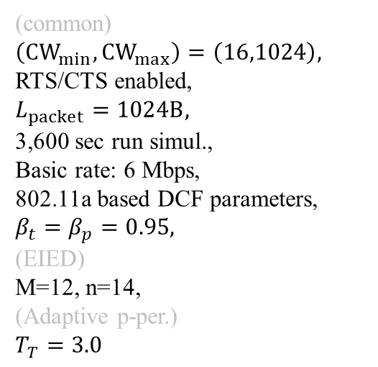
Simulation Results
(RTS/CTS)
(common)
$\left(CW_{min},CW_{max}\right)=\left(16,1024\right),$
RTS/CTS enabled,
$L_{packet}=1024B,$
3,600 sec run simul.,
Basic rate: 6 Mbps,
802.11a based DCF parameters,
$β_{t}=β_{p}=0.95,$
(EIED)
M=12, n=14,
(Adaptive p-per.)
$$T_{T}=3.0$$

Slide 9
Simulation Results
(BASIC)
About 20 ms penalty?
#PDs: 50 → 200

Slide 10
Simulation Results
(RTS/CTS)
About 1 s penalty?
#PDs: 50 → 200

Slide 11
Conclusion
In steady state, EIED and Adaptive p-persistent both perform well EIED with slight edge
If the network load changes suddenly, it takes time for EIED to adapt to the change, but Adaptive p-persistent almost immediately adapt to the change
EIED is more appropriate for Sync period where the traffic is stable
Adaptive p-persistent is more appropriate for data communication where data traffic is more unpredictable
The presented simulation results are for single-hop scenarios
Peering period and CAP requires different tuning
Text proposal will be submitted in Jan 2015 meeting

Slide 12
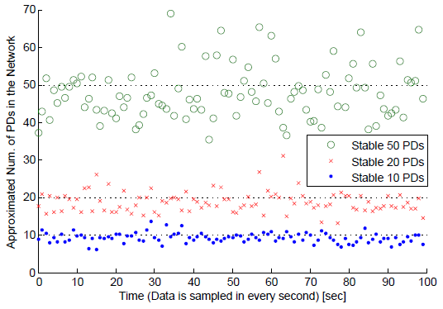
Extra
Estimation of the number of PDs in the network (light load)

Slide 13
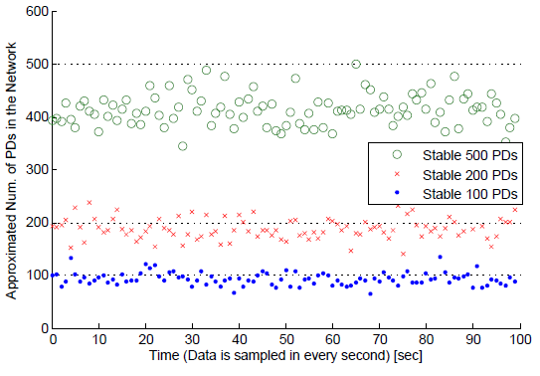
Extra
Estimation of the number of PDs in the network (heavy load)

Slide 14
Discussion

