Slide 1
Project: IEEE P802.15 Working Group for Wireless Personal Area Networks (WPANs)
Submission Title: Comment resolutions on the review comments for the letter ballot LB-95.
Date Submitted: November, 2014
Source: Chandrashekhar Thejaswi PS, Kiran Bynam and Jinesh Nair
E-Mail: c.thejaswi@samsung.com
Abstract: Comment resolutions.
Purpose: Response to the letter ballot comments.
Notice: This document has been prepared to assist the IEEE P802.15. It is offered as a basis for discussion and is not binding on the contributing individual(s) or organization(s). The material in this document is subject to change in form and content after further study. The contributor(s) reserve(s) the right to add, amend or withdraw material contained herein.
Release: The contributor acknowledges and accepts that this contribution becomes the property of IEEE and may be made publicly available by P802.15.

Slide 2
No. | Reviewer | Pg. No | Clause | Ln. no. | Comment | Proposed Change
1069 | Kiran Bynam | 3 | 5.1 | 2 | Kindly mention MAC symbol timing for TASK proposal of clause 30 | Please mention how MAC symbol time is chosen which is used in calculation of length of slots , back off slots etc
Resolution: Revised
Insert the following paragraph and the table in sub-clause 5.1.
“
5.1.1 MAC Symbol duration for ULP-TASK PHY
For ULP-TASK PHY, the symbol duration parameters for MAC and PHY timing parameters, for different bands of operation shall be as given in the Table (insert the reference of the table)

Slide 3
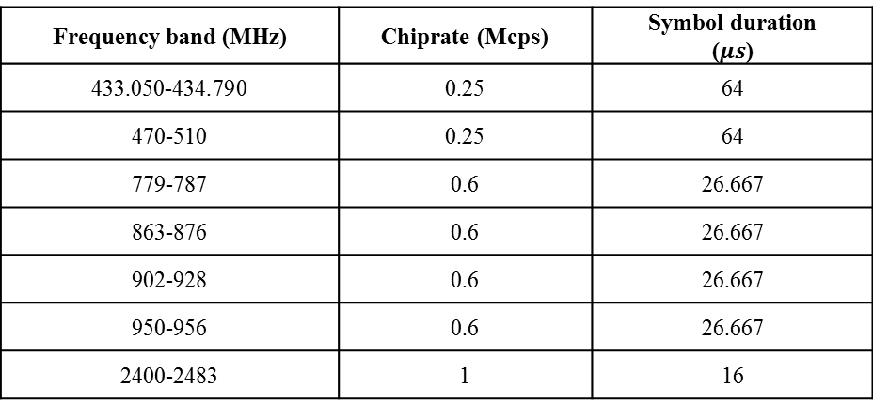
Table XXXX ULP-TASK symbol duration used for MAC and PHY timing parameters
Frequency band (MHz) | Chiprate (Mcps) | Symbol duration ($μs$)
433.050-434.790 | 0.25 | 64
470-510 | 0.25 | 64
779-787 | 0.6 | 26.667
863-876 | 0.6 | 26.667
902-928 | 0.6 | 26.667
950-956 | 0.6 | 26.667
2400-2483 | 1 | 16
”

Slide 4
ID | Reviewer | Pg. No | Clause | Ln. No. | Comment | Proposed Change
1074 | Frederik Beer | 7 | 8.1.2.14 | 16 | The Band 863-876 has only 3 channels, but could serve a lot more. | Adjust number of channels.
Resolution: Revised
In Table 2 (Pg. 7 ), in the cell corresponding to 5th row (band “863-876 MHz”), and 3rd col.(col. “TotalNumChan”)
replace ‘3’ by ‘5’.

Slide 5
ID | Reviewer | Pg. No | Clause | Ln. No. | Comment | Proposed Change
1075 | Frederik Beer | 7 | 8.1.2.14 | 16 | Check the 951 Mhz band. I am not sure if it actually goes from 951-958. And the First centerfreq is 951 which is the lower boundary. But then again I am no expert in Japan bands. | Get someone who knows this band.
Resolution: Revised
In Table 2 (Pg. 7 ), replace the 7th row (band 951-958 MHz) with the following row:
950-956 | 2 | 3 | 951

Slide 6
ID | Reviewer | Pg. No | Clause | Ln. No. | Comment | Proposed Change
1281 | James Gilb | 11 | 30 | 2 | No text is allowed to follow a clause title, it must be in a subclause. | Either delete the text as it is unnecessary, move it to another location or add a sub-clause title 30.1 General.
Resolution: Revised
In Pg. 11, Ln. 2: Immediately after title of the clause 30, insert a new sub-clause 30.1. under the title “General” . In this sub-clause, place the introduction part.

Slide 7
Comments on MCS/MFI/CFI
No. | Reviewer | Pg. No | Clause | Ln. no. | Comment | Proposed Change
1290 | Benjamin A. Rolfe | 12 | 30.1.2.2.3 | 24 | Is a "Modulation Format" exactly the same thing as a "Modulation and Coding Scheme"? Yes it is, and so we should not introduce a new term; use the nomenclature of the standard being amended | Use "Modulation and Coding Scheme" instead of MFI.
1291 | Benjamin A. Rolfe | 12 | 30.1.2.2.3 | 24 | "The MFI field specifies the type of modulation employed" is not a technically correct or complete description of the field. What you probably mean is that the MFI field indicates the Modulation and Coding Scheme used to encode the PHY Payload (a fact I guessed since the text does not specify to what part of the PPDU the MFI applies to, or even if it applies to the PPDU at all). | Change field name to "Modulation and Coding Scheme" to be consistent with the standard; Change to read "The Modulation and Coding field shall be set to the MCS used to encode the PHY Payload" and specify what MCS is used to encode the PHR.
1079 | Frederik Beer | 15 | 30.4.2 | 15 | I find the distinction between MCS and Modulation format a little irritating. | Discuss if this can be merged somehow or find more distinctive names.

Slide 8

Resolution: Revised
MFI/CFI fields have been merged into a single field MCS. References to MFI/CFI are replaced with MCS.
In Pg. 12, replace Figure 8 with the following figure:
Pg. 12-13, delete sub-clauses 30.1.2.2.3 and 30.1.2.2.4 and create a sub-clause
under the title “MCS field”. Add the following text
“The MCS field specifies the modulation and the coding scheme applied on the PSDU. There are four modulation formats and two FEC mechanisms provided. Valid values of the MCS field and the corresponding mapping of the modulation and coding schemes are given in Table 5.”

Slide 9
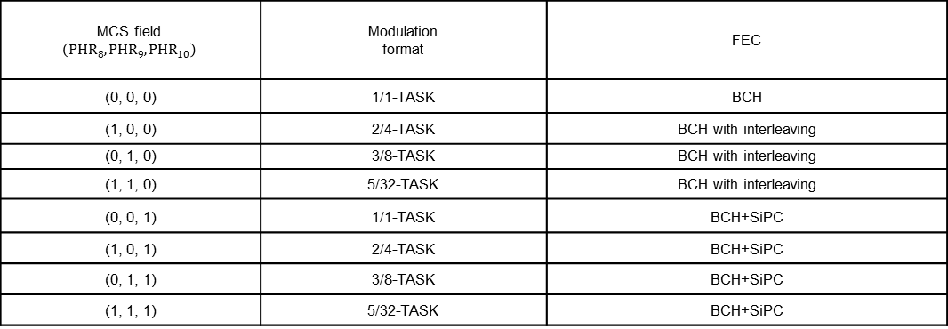
In Pg. 13, replace Table 5 with the following table:
Change the caption for table to “Table 5—Mapping of the MCS field”
Delete the sub-clause 30.4.2 and the Table 7.
MCS field $$\left(PHR_{8}, PHR_{9}, PHR_{10}\right)$$ | Modulation format | FEC
(0, 0, 0) | 1/1-TASK | BCH
(1, 0, 0) | 2/4-TASK | BCH with interleaving
(0, 1, 0) | 3/8-TASK | BCH with interleaving
(1, 1, 0) | 5/32-TASK | BCH with interleaving
(0, 0, 1) | 1/1-TASK | BCH+SiPC
(1, 0, 1) | 2/4-TASK | BCH+SiPC
(0, 1, 1) | 3/8-TASK | BCH+SiPC
(1, 1, 1) | 5/32-TASK | BCH+SiPC

Slide 10
In Pg. 15, sub-clause 30.4.1, replace the entire text with the following text
“MCS identifier is determined by the higher layers based on the data rate requirements, as mentioned in 6.3.1. MCS identifier specifies modulation and coding schemes to be applied on the PSDU. In any given frequency band of operation, eight MCS identifiers (0-7) are defined based on the data rates. First four identifiers specify mandatory modes and the last four identifiers specify optional modes. When MCS identifier takes values from zero to three (MCS identifier = 0, 1, 2, 3), BCH with interleaving shall be used for FEC, otherwise (MCS identifier = 4, 5, 6, 7), concatenation of BCH with interleaving and SiPC shall be used for FEC. MCS identifiers (0-3) are mandatory and MCS identifiers (4-7) are optional. The MCS identifier and the corresponding data rates for different frequency bands are provided in Table 7, Table 8 and Table 9. Also, for each MCS, the parameters such as constellation size (Q), modulation order (M), spreading sequence length (L), and spreading factor (SF) are given in these tables.”

Slide 11
ID | Reviewer | Pg. No | Clause | Ln. no. | Comment | Proposed Change
1285 | James Gilb | 14 | 30.2 | 22 | It is almost as if you don't want people to understand this, so it is expressed in the most obtuse manner possible. That or this is an academic research project that no one has thought of implementing as an actual product. | Just have a table that has the bit, 1 or 0, and the corresponding spreading code. All the c's and fancy math notation distract from the description. Plus the figure is essentially useless.
Resolution: Revised . Retained only one preamble and SFD spreading sequence as a resolution to CID 1298. New table is provided below.
In Pg. 14, delete Figure 11, and it’s the sentence referring to it in Ln. 22.
Replace Table 6 with the following table

Slide 12
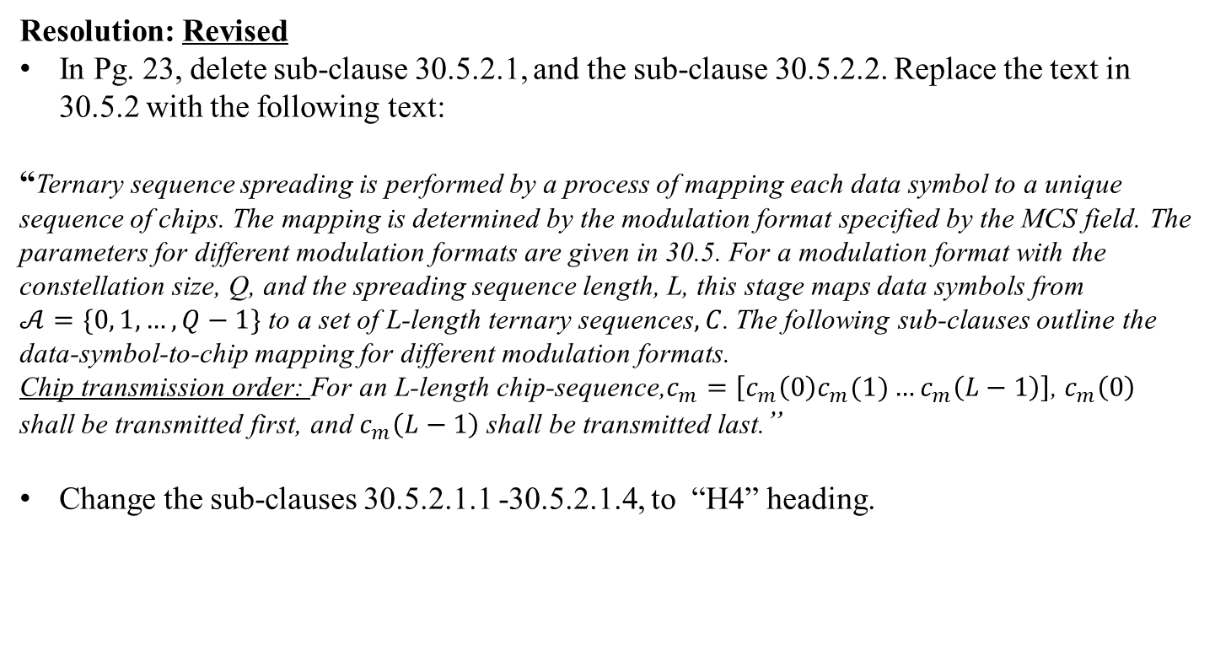
ID | Reviewer | Pg. No | Clause | Ln. no. | Comment | Proposed Change
1060 | Kiran Bynam | 23 | 30.5.2.1 | 29 | There is no need for this subtitle, since it is already mentioned in 30.5.2. Also, ensure notation are consistent. Especially, w.r.t. the set C. | merge 30.5.2.1 with its parent subclause,and also omit duplicated sentences. Also maintatin consistency in the notation.
Resolution: Revised
In Pg. 23, delete sub-clause 30.5.2.1, and the sub-clause 30.5.2.2. Replace the text in 30.5.2 with the following text:
“Ternary sequence spreading is performed by a process of mapping each data symbol to a unique sequence of chips. The mapping is determined by the modulation format specified by the MCS field. The parameters for different modulation formats are given in 30.5. For a modulation format with the constellation size, Q, and the spreading sequence length, L, this stage maps data symbols from $𝒜=\{0, 1, …, Q−1\}$ to a set of L-length ternary sequences$,C$. The following sub-clauses outline the data-symbol-to-chip mapping for different modulation formats.
Chip transmission order: For an L-length chip-sequence,$c_{m}=\left[c_{m}\left(0\right)c_{m}(1)…c_{m}\left(L−1\right)\right]$, $c_{m}\left(0\right)$ shall be transmitted first, and $c_{m}\left(L−1\right)$ shall be transmitted last.”
Change the sub-clauses 30.5.2.1.1 -30.5.2.1.4, to “H4” heading.

Slide 13
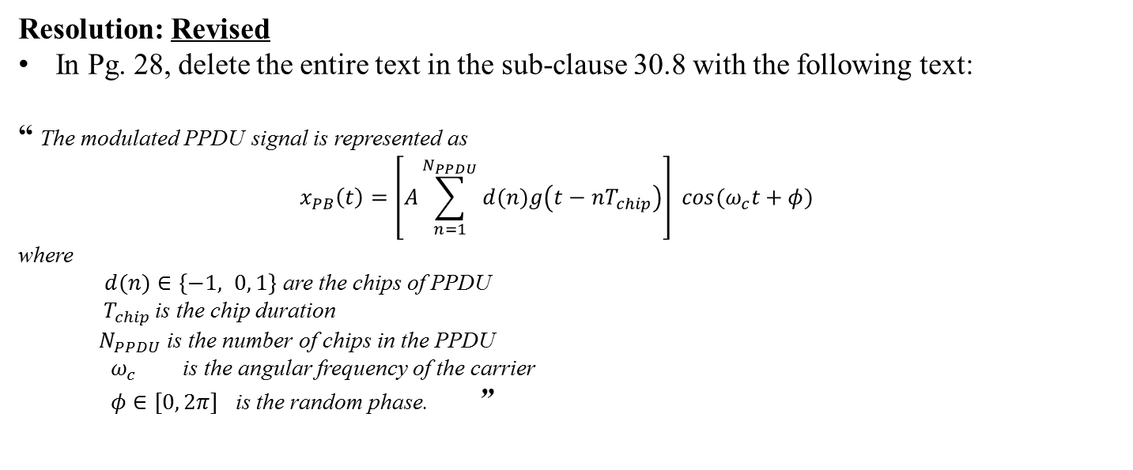
ID | Reviewer | Pg. No | Clause | Ln. no. | Comment | Proposed Change
1288 | James Gilb | 28 | 30.8 | 11 | There is no “baseband signal” in the standard. A compliant implementation is not required to create that baseband signal, only the RF signal is specified. The inclusion of this detail, as with the ASK with negative amplitude (no such thing exists at RF, all amplitude is positive, but it may have a relative phase difference) in the previous subclause cast a shadow on this entire effort. The goal is to create an RF waveform, not a baseband waveform. | Delete the baseband signal representation as it is meaningless.
Resolution: Revised
In Pg. 28, delete the entire text in the sub-clause 30.8 with the following text:
“ The modulated PPDU signal is represented as
$$x_{PB}\left(t\right)=\left[A\sum_{n=1}^{N_{PPDU}}{d(n)g\left(t−nT_{chip}\right)}\right] \cos{{(ω}_{c}t+φ)}$$
where
$d(n)∈\left\{−1, 0, 1\right\}$ are the chips of PPDU
$T_{chip }$is the chip duration
$N_{PPDU}$ is the number of chips in the PPDU
$ω_{c}$ is the angular frequency of the carrier
$φ∈[0, 2π]$ is the random phase. ”

Slide 14

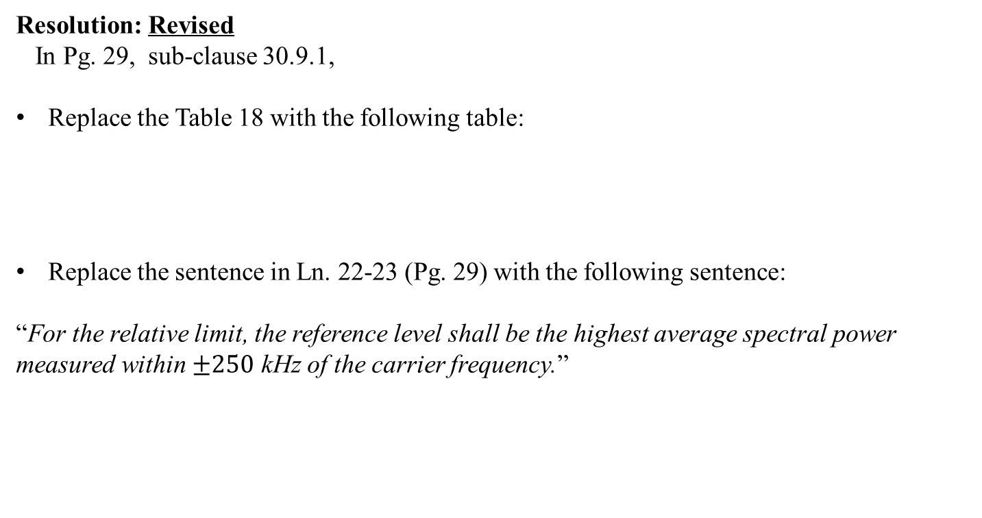
ID | Reviewer | Pg. No | Clause | Ln. no. | Comment | Proposed Change
1104 | Chandrashekhar Thejaswi PS | 29 | 30.9 | 18 | Appropriately mention the transmit PSD limits in 433 and 470 MHz bands. The bandwidths of the channels in each of these bands are mentioned as 400KHz. | incorporate the change
Resolution: Revised
In Pg. 29, sub-clause 30.9.1,
Replace the Table 18 with the following table:
Replace the sentence in Ln. 22-23 (Pg. 29) with the following sentence:
“For the relative limit, the reference level shall be the highest average spectral power measured within $±250$ kHz of the carrier frequency.”
Frequency range | Relative limit | Absolute limit
$\left|f−f_{c}\right|>0.5$ MHz | -20 dB | -20 dBm

Slide 15
ID | Reviewer | Pg. No | Clause | Ln. no. | Comment | Proposed Change
1192 | Pat Kinney | 31 | 30.9.11 | 2 | LQI is required but not used in any mandatory behavior | either specifically state behavior that LQI is used for or delete LQI requirement
Resolution: Revised
Replace the text in the subclause 30.9.12 with the following paragraph:
“The LQI measurement is a characterization of the strength and/or quality of a received packet. The measurement may be implemented using an appropriate signal-to-noise ratio estimation technique. The LQI measurement shall be performed for each received packet. On receipt of every packet, LQI of the packet should be shared with the MAC layer. The minimum and maximum LQI values (0x00 and 0xff) should be associated with the lowest and highest quality compliant signals detectable by the receiver, and LQI values in between should be uniformly distributed between these two limits. The LQI value should be used for determining the supported data rate in PHY layer.”

Slide 16
Comments on FEC/multiple FECs
No. | Reviewer | Pg. No | Clause | Ln. no. | Comment | Proposed Change
1015, 1239, 1301 | Timothy Harrington, James Gilb, M. Lynch | 16 | 30.4.3 | 2 | There is no need to define a new FEC as there are already many defined in 802.15.4. The new FEC does not enable lower power than the existing FECs | Replace the BCH and SiPC with a single FEC from the base standard.
Resolution: Revised
Please see our presentation on FEC refer to the document
DCN 15-15-0664-01-004q
A presentation is prepared to defend the inclusion of two FECS.

Slide 17
Comments on 5C requirement of distinct identity
No. | Reviewer | Pg. No | Clause | Ln. no. | Comment | Proposed Change
1013, 1237, 1299, | Timothy Harrington, James Gilb, M. Lynch | 11 | 30 | 1 | The draft does not meet the 5C requirement of distinct identity. There are already low power PHYs defined in 802.15.4, the O-QPSK PHY, LRP UWB and BPSK PHY all enable power usuage at or below the proposed TASK PHY. The TASK PHY does not take advantage of ASK modulation (it requires phase coherency in the transmitter) nor is it a constant envelope modulation (e.g., FSK) and so the resulting designs will end up even higher power than the currently defined PHYs. | Delete Clause 9 and references to the ULP TASK PHY.

Slide 18
Resolution: Rejected
Meets the requirements of PAR, which are unique:
  Support of multiple data rates in the specified bands up to 1Mbps
  Power consumption <15 mW (as per PAR)
Support in the design of ultra low power receivers, like SRR based receivers etc.
Support for both coherent and non-coherent receivers, due to the employment of
spreading based on ternary sequences.
ULP capability of TASK:
  Supports ULP receivers.
  Advanced transmitter designs are available which can ensure ultralow
  power consumption.

Slide 19
No. | Reviewer | Pg. No | Clause | Ln. no. | Comment | Proposed Change
1289 | Tim Godfrey | 11 | 30 | 1 | This clause does not meet the PAR requirements of specifying a PHY with lower power capabilities compare to those that are already specified in 802.15.4 | Delete this clause, or replace with one that specifies a PHY that offers the capability of one order of magnitude lower power operation compared to existing PHYs
Resolution: Rejected
This clause meets all the requirements of PAR. For more information, please refer to our
recent presentation: slide 24 of DCN IEEE 802. 5-13-0705-00-004q.

Slide 20
Comments on the co-existence document
No. | Reviewer | Pg. No | Clause | Ln. no. | Comment | Proposed Change
1016 | Steve JILLINGS | - | - | - | 15-14-0565-00-004q Coexistence Assurance Document: No supporting documentation to support coexistence of the TASK PHY with existing 802. PHYs operating in collocated frequency bands | Produce supporting documentation
1187 | Mike McInnis | 46 | Annex C Bibliography | 2,3, 4 | If the 15-14-0565-00-004q-coexistence-assurance-for-ieee-802-15-4q.docx document is listed in this paragraph as a reference document, the reference document states in paragraph 2 the following 'The Ultra Low Power (ULP) GFSK and ULP TASK Physical Layers defined in amendment 802.15.4q are substantially similar to the Physical Layers defined in amendments 802.15.4k and 802.15.4p. The bands used are a subset of the union of the bands defined in those amendments. The coexistence assurance documents defined for 15.4k and 15.4p provide adequate analysis for 15.4q environment.' if the TG4q ULP TASK and ULP GFSK PHYs are substantially similar to the PHYs defined in amendments 802.15.4k and 802.15.4p then how do the ULP TASK and ULP GFSK differ enough from all previous 802.15.4 PHYs to justify becoming new 802.15.4 PHYs? | Make the appropriate changes to the coexistence document to resolve this issue or proceed no further with the 802.15.4q draft standard.

Slide 21
Resolution: Revised
802.15.4q PHY and PHY defined in 802.15.4p /802.15.4k are completely different:
  802.15.4p/4k use GMSK, C4FM, QPSK, DQPSK, DSSS-DPSK, DSSS-BPSK,
  whereas 802.15.4q employ TASK (ternary spreading with ASK) and GFSK
  Further, our standard operates in the following set of new bands not defined in 15.4p/4k :
  433MHz, 470-510 MHz, 779-787MHz and 863-876 MHz
UWB PHY of 802.15.4 is also substantially different:
  802.15.4 UWB PHY does not operate in any of the bands specified in this std.
Coexistence assurance document will be prepared for ULP-TASK PHY.

