Slide 1
Project: IEEE P802.15 Working Group for Wireless Personal Area Networks (WPANs)
Submission Title: [Mobile Wireless Backhaul for Fast Moving Cells]
Date Submitted: [5 November, 2014]
Source: [Junhyeong Kim, Hee-Sang Chung, and Il Gyu Kim] Company [ETRI]
Address [218 Gajeong-ro, Yuseong-gu, Daejeon, 305-700, KOREA]
Voice:[+82-10-4818-8166], FAX: [+82-42-860-6732], E-Mail:[jhkim41jf@etri.re.kr]
Abstract: [Mobile Wireless Backhaul for Fast Moving Cells]
Purpose: [To introduce a concept of mobile wireless backhaul for fast moving cells]
Notice: This document has been prepared to assist the IEEE P802.15. It is offered as a basis for discussion and is not binding on the contributing individual(s) or organization(s). The material in this document is subject to change in form and content after further study. The contributor(s) reserve(s) the right to add, amend or withdraw material contained herein.
Release: The contributor acknowledges and accepts that this contribution becomes the property of IEEE and may be made publicly available by P802.15.

Slide 2
Mobile Wireless Backhaul For Fast Moving Cells

Slide 3
Outline
Background
Objective
Technical Issue

Slide 4
Background (1/3)
High mobility environments are getting important
People enjoy mobile internet services at low or high mobility
About 10 billions of passengers yearly in Korea
Bus, subway, and high-speed train
Mobile Internet Use
Freedom of two hands !
Low Medium High mobility
(above 100km/h )

Slide 5
Background (2/3)
‘Home’ and ‘Vehicle’ are the most preferred places to use mobile Internet
89.6
81.3
62.1
62.0
52.6
Where?
Mobile
Internet
34.0
28.0
Home
Vehicle
Streets
Outdoor
(Coffee shops)
Work
Public
space
School
※ Survey 2012 for Mobile Internet Usage by Korea Internet & Security Agency

Slide 6
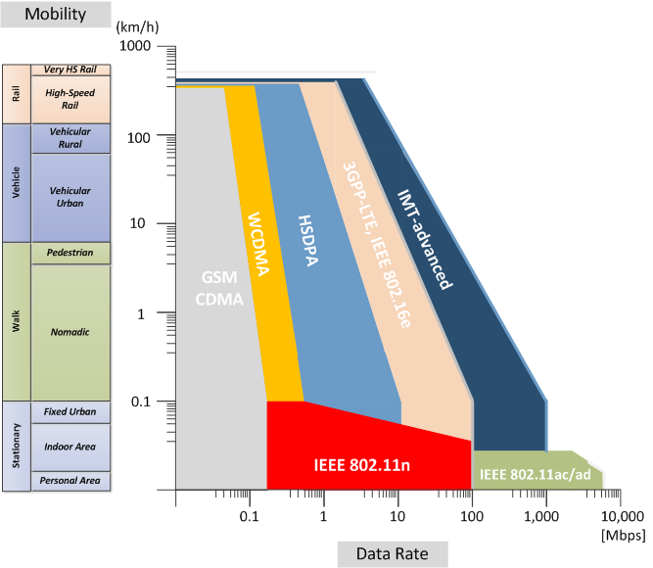
Background (3/3)
Nomadic users have been prioritized
Optimized for (low speed) pedestrian user
Velocity Range | Performance Characterization
0~15 km/h | Optimal
15~120km/h | High
120~350km/h | Functional
Current cellular systems are not
enough to provide multimedia
services for passengers in the
fast moving vehicles!
Wireless Internet use
Low Medium High mobility
(above 100km/h)

Slide 7
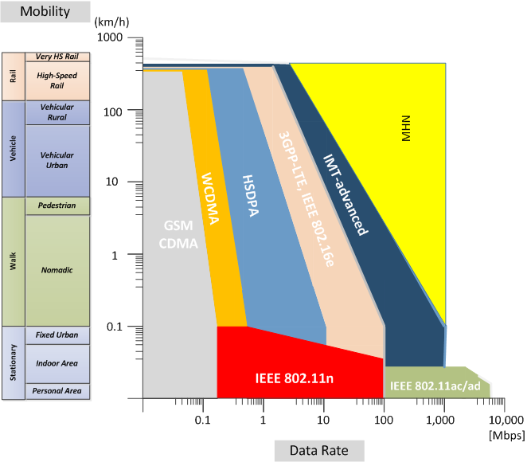
Objective (1/3)
RAT for high-mobility regions
The same level of QoE for high-speed group users compared to nomadic users
High data rate beyond Gbps for mobile wireless backhaul
Wireless Internet use
Low Medium High mobility
(above 100km/h)

Slide 8
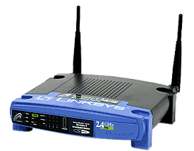
Objective (2/3)
Backhaul and Access Link
GW : Gateway
DU : Digital Unit
RU : Radio Unit
TE : Terminal Equipment
Access Link
(inside vehicle)
Backhaul Link
mmWave
Backhaul Link
mmWave
TE
RU
RU
DU
GW
Public Internet

Slide 9
Objective (3/3)
Features
New RAT for Mobile Wireless Backhaul
Wireless Backhaul Link (Outside Vehicle) | OFDM based on mmWave
Data throughput (DL) | 1 Gbps using 250-MHz bandwidth
Spectral efficiency | 4 bps/Hz
Mobility | 400 km/h
User Access Link (Inside Vehicle) | Small Cell (WiFi or Femto)

Slide 10
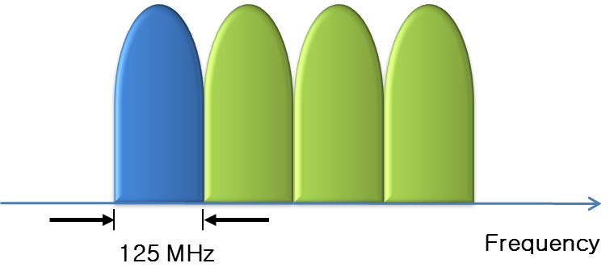
Technical Issues (1/4)
Wide spectrum over millimeter waves
Considerations for frequency resources and implementation
Primary bandwidth : 125 MHz
Carrier aggregation up to 500 MHz

Slide 11
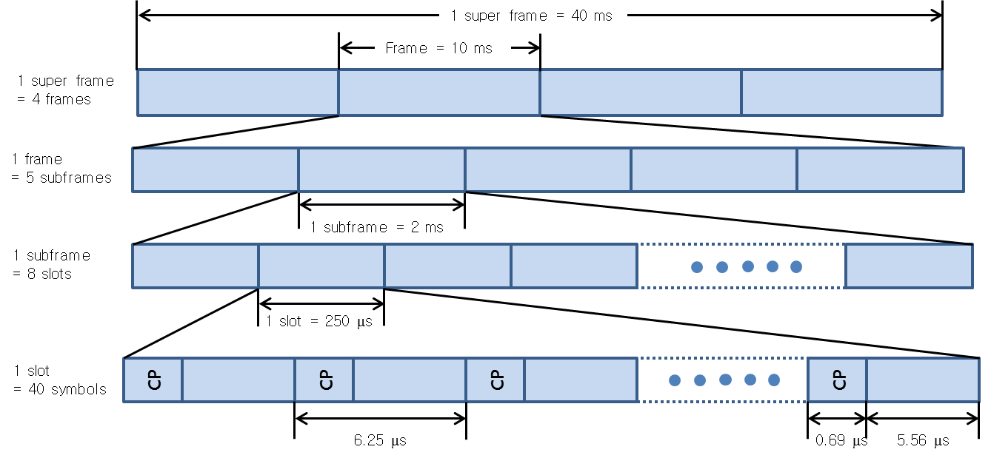
Technical Issues (2/4)
Frame structure

Slide 12
Technical Issues (3/4)
Downlink resource grid

Slide 13
Technical Issues (4/4)
Coverage improvement
Path loss and atmospheric attenuation of millimeter-wave
Doppler effect
High-speed handover

