Slide 1
Project: IEEE P802.15 Working Group for Wireless Personal Area Networks (WPANs)
Submission Title: Choice of BCH and SiPC Codes.
Date Submitted: December, 2014
Source: Chandrashekhar Thejaswi PS, Kiran Bynam and Jinesh Nair
E-Mail: c.thejaswi@samsung.com
Abstract: Comment resolutions.
Purpose: Response to the letter ballot comments.
Notice: This document has been prepared to assist the IEEE P802.15. It is offered as a basis for discussion and is not binding on the contributing individual(s) or organization(s). The material in this document is subject to change in form and content after further study. The contributor(s) reserve(s) the right to add, amend or withdraw material contained herein.
Release: The contributor acknowledges and accepts that this contribution becomes the property of IEEE and may be made publicly available by P802.15.

Slide 2
Comments on FEC/multiple FECs
No. | Reviewer | Pg. No | Clause | Ln. no. | Comment | Proposed Change
1015, 1239, 1301 | Timothy Harrington, James Gilb, M. Lynch | 16 | 30.4.3 | 2 | There is no need to define a new FEC as there are already many defined in 802.15.4. The new FEC does not enable lower power than the existing FECs | Replace the BCH and SiPC with a single FEC from the base standard.
No. | Reviewer | Pg. No | Clause | Ln. no. | Comment | Proposed Change
1298 | Ben Rolfe | 13 | 30.1.2.2.4 | 3 | Support for 2 FEC schemes adds complexity without clear benefit. Pick a codeing method and stick with it. | see comment
Resolution: Revised
Justification are given in slide #3 to slide # 11.
Resolution and the changes are provided in slide#12 onwards.

Slide 3
General Comparison of BCH and RS codes
The BCH codes are binary block-codes while the Reed-Solomon codes are non-binary block-codes.
The coefficient multiplication in the BCH encoder is a simple binary operation while the coefficient multiplication in the RS encoder is a nonbinary operation over GF(2^m)
The (63,51) BCH code corrects two errors in a block of n=63 bits of which k=51 are the message bits.
The Reed-Solomon code of comparable parameters is the (15,13) RS code which corrects a single erroneous symbol in a block of 15 symbols.
This corresponding binary parameters are n=60 and k=52 with ability to upto 4 bit errors so long as the 4 errors are confined to a single symbol.
The possibility of all errors being confined to within a single symbol is remote, especially in presence of interleaving.
The (63,51) BCH, which can correct two errors located anywhere in the 63 length block is a better option than (15,13) RS code which fails beyond a single symbol.
The low complexity (63,51) BCH avoids the complex algorithms such as Berlekamp-Massey algorithm, Peterson's algorithm etc required for the conventional BCH decoding or RS decoding

Slide 4
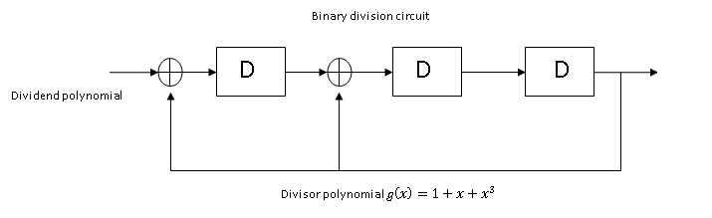
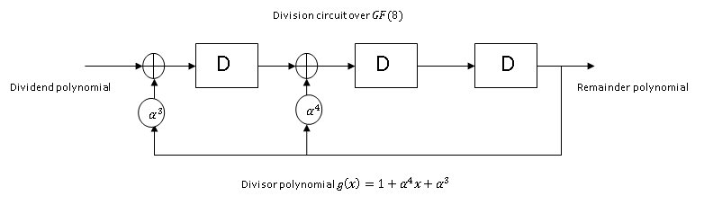

Encoding complexity
The encoding circuit for BCH codes is a binary division circuit while for Reed-Solomon codes, the division circuit is defined over $GF\left(2^{m}\right),$ where $m$ is the size of the symbol.
The addition in the BCH encoder as shown in Fig (a) is binary ‘XOR’ while the addition in the RS encoder in Fig(b) is addition over $GF\left(2^{m}\right)$.
In Fig(a), g(x) represents the generator polynomial for (7,4) BCH code, while g(x) in Fig (b) corresponds to a (7,5) RS code. Here,$α∈$ $GF\left(2^{m}\right)$ is the primitive element of $GF\left(8\right),$ generated by the primitive polynomial $f\left(x\right)=x^{3}+x+1.$

Slide 5
Decoding complexity
Start
Start
Syndrome Computation
Syndrome Computation
Determining Error locator polynomial using a dedicated algorithm(BM, PGZ algorithm)
Simple procedure exist that avoids the error locator polynomial and hence the dedicated algorithms
Solving the error locator polynomial using Chien search to obtain error locations
Deterministic method to solve for error locations exists in literature
Solving for the error values at error locations(Forney’s algorithm)
NA
Stop
The (63,51) BCH avoids the complex algorithms such as Berlekamp-Massey algorithm, Peterson’s algorithm etc.
Substituting the Chien search with a deterministic method with huge complexity reduction.
Solving error values is not required.
Stop

Slide 6
Low complexity (63,51) BCH decoder
(One Shot Algorithm)

Slide 7
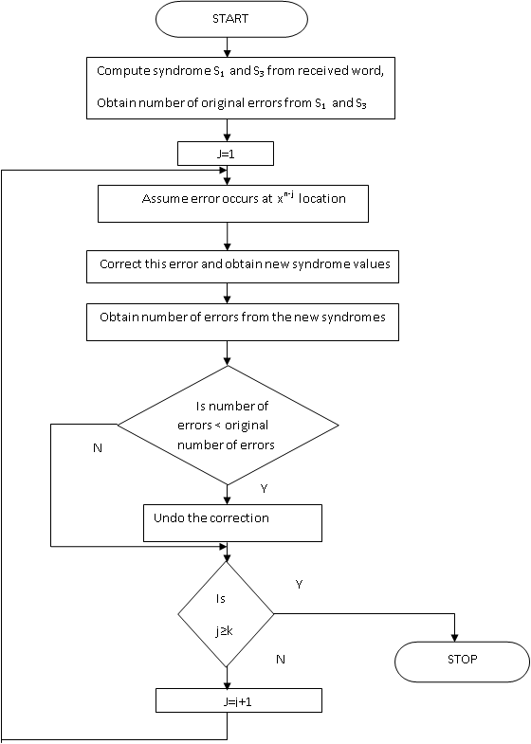
(63,51) BCH step by step decoder decoder
The algorithm is known as the modified step-by-step decoding algorithm [1].
The algorithm enhances the step by step algorithm in [2] for the particular case of double error correcting BCH codes.
The number of original errors are determined based on the syndromes.
Each location is inverted and the syndromes recomputed to determine if there is reduction in number of original errors.
If there is a reduction in the number of original errors, the inversion is retained else the inversion is undone.

Slide 8
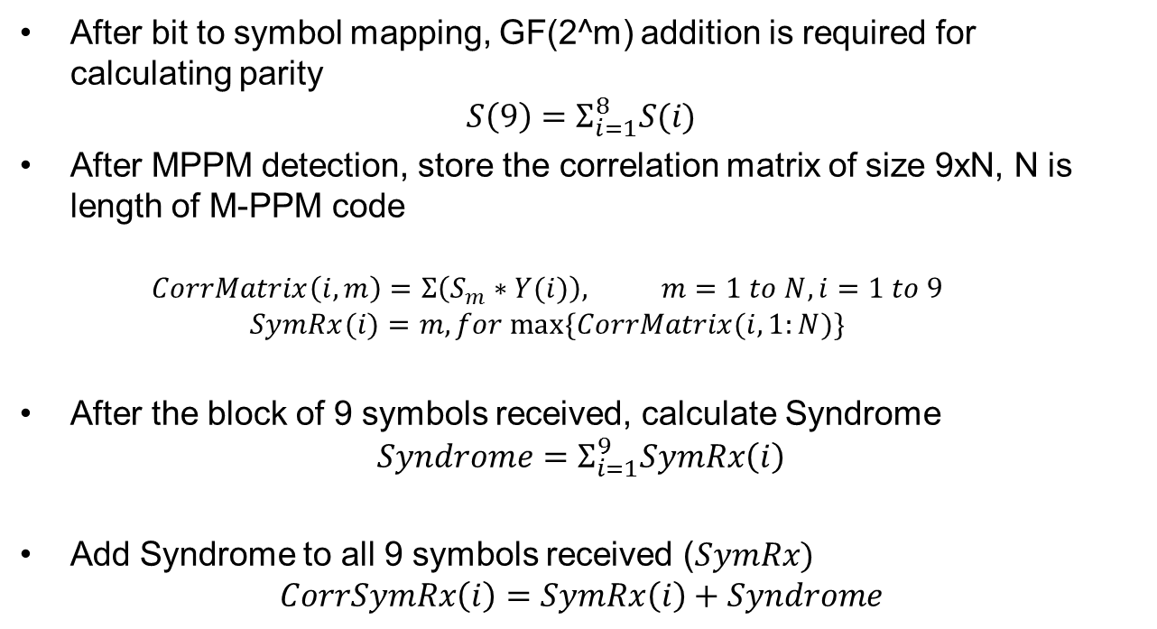
Complexity of SiPC (9,8) decoder
After bit to symbol mapping, GF(2^m) addition is required for calculating parity
$$S\left(9\right)=Σ_{i=1}^{8}S(i)$$
After MPPM detection, store the correlation matrix of size 9xN, N is length of M-PPM code
  $$CorrMatrix\left(i,m\right)=Σ\left(S_{m}∗Y(i)\right), m=1 to N, i=1 to 9$$
  $$SymRx(i)=m, for max⁡\{CorrMatrix(i,1:N)\}$$
After the block of 9 symbols received, calculate Syndrome
$$Syndrome=Σ_{i=1}^{9}SymRx\left(i\right)$$
Add Syndrome to all 9 symbols received ($SymRx)$
$$CorrSymRx\left(i\right)=SymRx\left(i\right)+Syndrome$$

Slide 9
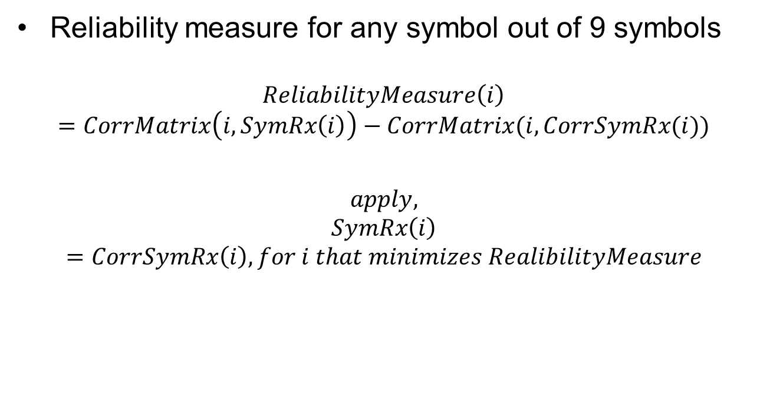
Complexity of SiPC(9,8) decoder
Reliability measure for any symbol out of 9 symbols
$$ReliabilityMeasure\left(i\right)=CorrMatrix\left(i,SymRx\left(i\right)\right)−CorrMatrix(i,CorrSymRx(i))$$
$$apply, SymRx\left(i\right)=CorrSymRx\left(i\right), for i that minimizes RealibilityMeasure$$

Slide 10
Solution for single FEC
Use the concatenation of codes with SiPc as inner code and BCH as outer code
SiPC code is optional.
All data rates using SiPC code are optional for implementation

Slide 11
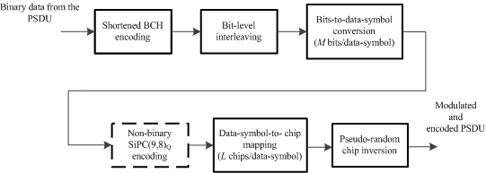
Changes to block diagram
Replace Figure 12 with above block diagram

Slide 12
Resolution: Revised
In MCS modes, apart from BCH+interleaving mode, a new set of modes with the concatenation of BCH codes and SiPC codes are proposed.
Usage of concatenated BCH+SiPC is optional.
Only one preamble format (P2) and one spreading format (C2) is used for SFD+PHR for all MCS modes.
The following changes are be implemented into the draft
Change all the MCS levels from MSC (0-5) to MCS (0-7).

Slide 13
In Page 5, Table 46, Col. 4
Replace the sentence
“ For TASK PHYs, values 0-5 are valid:” with “ For TASK PHYs, values 0-7 are valid:”

Slide 14
In Page 11, Sub-clause 30.1.2.1.2
Delete Figure 7 and its caption.
Delete Table 4 and its caption
Replace the paragraph with the following text:
“ The preamble field shall have an unique sequence of length 32 chips. The 32-chip sequence is given by
[1 0 -1 0 0 -1 0 -1 1 0 1 0 0 -1 0 1 1 0 1 0 0 -1 0 1 -1 0 1 0 0 1 0 1] .”

Slide 15
In Page 11, Sub-clause 30.1.2.1.3
Replace the entire paragraph with the following text
“ The SFD field indicates the end of the SHR field and the beginning of the packet data. The SFD field shall consist of a pattern of eight bits, [0 1 0 1 1 0 0 1], which are spread by a set of ternary sequences as detailed in 30.2.
“

Slide 16

MFI/CFI fields have been merged into a single field MCS. References to MFI/CFI are replaced with MCS.
In Pg. 12, replace Figure 8 with the following figure:
Pg. 12-13, delete sub-clauses 30.1.2.2.3 and 30.1.2.2.4 and create a sub-clause
under the title “MCS field”. Add the following text
“ The MCS field specifies the modulation and the coding scheme applied on the PSDU. There are four modulation formats and two FEC mechanisms provided. Valid values of the MCS field and the corresponding mapping of the modulation and coding schemes are given in Table 5.”

Slide 17
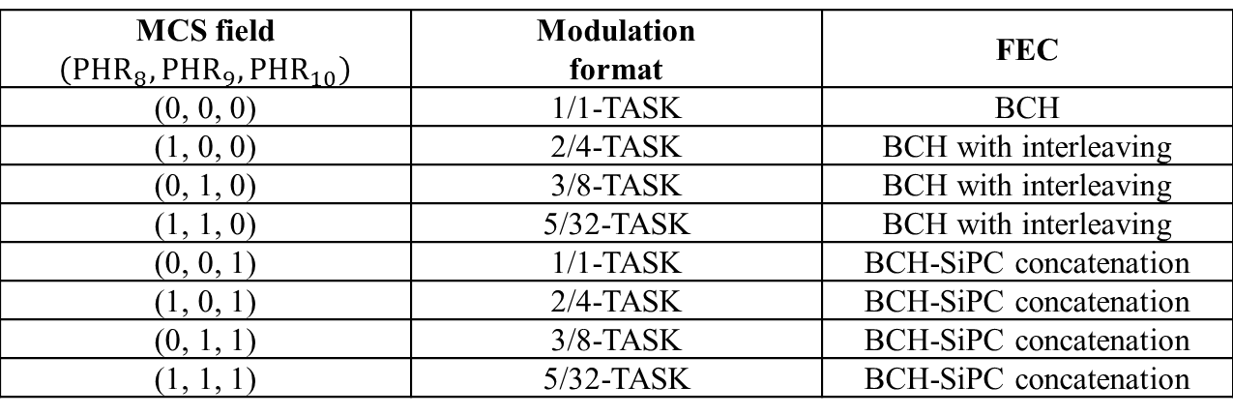
In Pg. 13, replace Table 5 with the following table:
Change the caption for table to “Table 5—Mapping of the MCS field”
Delete the sub-clause 30.4.2 and the Table 7.
MCS field $$\left(PHR_{8}, PHR_{9}, PHR_{10}\right)$$ | Modulation format | FEC
(0, 0, 0) | 1/1-TASK | BCH
(1, 0, 0) | 2/4-TASK | BCH with interleaving
(0, 1, 0) | 3/8-TASK | BCH with interleaving
(1, 1, 0) | 5/32-TASK | BCH with interleaving
(0, 0, 1) | 1/1-TASK | BCH-SiPC concatenation
(1, 0, 1) | 2/4-TASK | BCH-SiPC concatenation
(0, 1, 1) | 3/8-TASK | BCH-SiPC concatenation
(1, 1, 1) | 5/32-TASK | BCH-SiPC concatenation

Slide 18
In Page 14, Sub-clause 30.1.3:
Replace the entire paragraph with following text
The PPDU signal, for a given modulation and coding format, shall be generated
by the following procedure:
Generate the preamble field as explained in 301.2.1.2.
Generate the SFD field as explained in 30.1.2..1.3 and the PHR field as explained in 30.1.2.2.
Concatenate SFD and PHR fields. Perform spreading on the SFD+PHR field as explained in 30.2.
Apply modulation and coding formats on the PSDU as determined by the MCS of the PHR field. Perform pseudo-random chip inversion on the resultant chips to obtain the DATA field. This process is described in 30.6.
Concatenate the preamble field, the spread SFD+PHR field, and the DATA field, according to the format given in Figure 5, to generate PPDU.
Pass the resultant chip sequence of the PPDU through the modulation block (as described in 30.7), followed by the Gaussian pulse shaping filter as described in 30.8.

Slide 19
In Page 14, Figure 10
Change the text in the box “Spreading (C1 or C2)” to “Spreading”
New figure will be provided

Slide 20
In Pg. 14, Subclause 30.2
Rename the title of the sub-clause 30.2 as “Spreading of the SFD and PHR fields”
Replace the entire paragraph with the following text
“The bits in the SFD/PHR field are spread using the following mapping as shown in Table 6. The spreading sequences are of length 8 chips”
Replace Table 6 with the following table:
SFD/PHR bit | Bit –to-sequence mapping
0 | [1 0 -1 0 0 -1 0 1]
1 | [0 -1 0 1 1 0 -1 0]
Delete clause 30.3

Slide 21
In Pg. 15, Sub-clause 30.4.1
Replace the sentences in Ln.10-Ln 13 with the following text:
“MCS specifies modulation and coding schemes to be applied on the PSDU. In any given frequency band of operation, eight modes of MCS (0-7) are defined based on the data rates. When MCS = 0, 1, 2, 3, BCH with interleaving shall be used, and when MCS = 4, 5, 6, 7, concatenation of BCH with interleaving and SiPC shall be used. MCS (0-3) are mandatory and MCS (4-7) are optional. The MCS, and corresponding data rates for different frequency bands are provided in Table 7, Table 8 and Table 9. Also, for each modulation format, the parameters such as constellation size (Q), modulation order (M), spreading sequence length (L), and spreading factor (SF) are given in these tables.”

Slide 22
In Pg. 16,
Replace Table 8 with the following table
MCS | Modulation format | Coding format | Chip rate (Mcps) | M (Bits/data symbol) | L (Chips/data symbol) | Code rate | Data rate (kbps)
0 | 1/1-TASK | BCH | 1 | 1 | 1 | 51/63 | 809.5
1 | 2/4- TASK | BCH | 1 | 2 | 4 | 51/63 | 404.8
2 | 3/8- TASK | BCH | 1 | 3 | 8 | 51/63 | 303.5
3 | 5/32- TASK | BCH | 1 | 5 | 32 | 51/63 | 126.5
4 (Optional) | 1/1-TASK | BCH+ SiPC | 1 | 1 | 1 | 408/567 | 719.5
5 (Optional) | 2/4- TASK | BCH+SiPC | 1 | 2 | 4 | 408/567 | 359.8
6 (Optional) | 3/8- TASK | BCH+SiPC | 1 | 3 | 8 | 408/567 | 269.7
7 (Optional) | 5/32- TASK | BCH+SiPC | 1 | 5 | 32 | 408/567 | 112.4

Slide 23
In Pg. 16,
Replace Table 9 with the following table
MCS | Modulation format | Coding format | Chip rate (Mcps) | M (Bits/data symbol) | L (Chips/data symbol) | Code rate | Data rate (kbps)
0 | 1/1-TASK | BCH | 0.6 | 1 | 1 | 51/63 | 485.7
1 | 2/4- TASK | BCH | 0.6 | 2 | 4 | 51/63 | 242.8
2 | 3/8- TASK | BCH | 0.6 | 3 | 8 | 51/63 | 182.14
3 | 5/32- TASK | BCH | 0.6 | 5 | 32 | 51/63 | 75.9
4 (Optional) | 1/1-TASK | BCH+ SiPC | 0.6 | 1 | 1 | 408/567 | 431.74
5 (Optional) | 2/4- TASK | BCH+SiPC | 0.6 | 2 | 4 | 408/567 | 215.87
6 (Optional) | 3/8- TASK | BCH+SiPC | 0.6 | 3 | 8 | 408/567 | 161.9
7 (Optional) | 5/32- TASK | BCH+SiPC | 0.6 | 5 | 32 | 408/567 | 67.4

Slide 24
In Pg. 16-17,
Replace Table 10 with the following table
MCS | Modulation format | Coding format | Chip rate (Mcps) | M (Bits/data symbol) | L (Chips/data symbol) | Code rate | Data rate (kbps)
0 | 1/1-TASK | BCH | 0.25 | 1 | 1 | 51/63 | 202.375
1 | 2/4- TASK | BCH | 0.25 | 2 | 4 | 51/63 | 101.2
2 | 3/8- TASK | BCH | 0.25 | 3 | 8 | 51/63 | 75.875
3 | 5/32- TASK | BCH | 0.25 | 5 | 32 | 51/63 | 31.625
4 (Optional) | 1/1-TASK | BCH+ SiPC | 0.25 | 1 | 1 | 408/567 | 179.9
5 (Optional) | 2/4- TASK | BCH+SiPC | 0.25 | 2 | 4 | 408/567 | 89.94
6 (Optional) | 3/8- TASK | BCH+SiPC | 0.25 | 3 | 8 | 408/567 | 67.4
7 (Optional) | 5/32- TASK | BCH+SiPC | 0.25 | 5 | 32 | 408/567 | 28.1

Slide 25
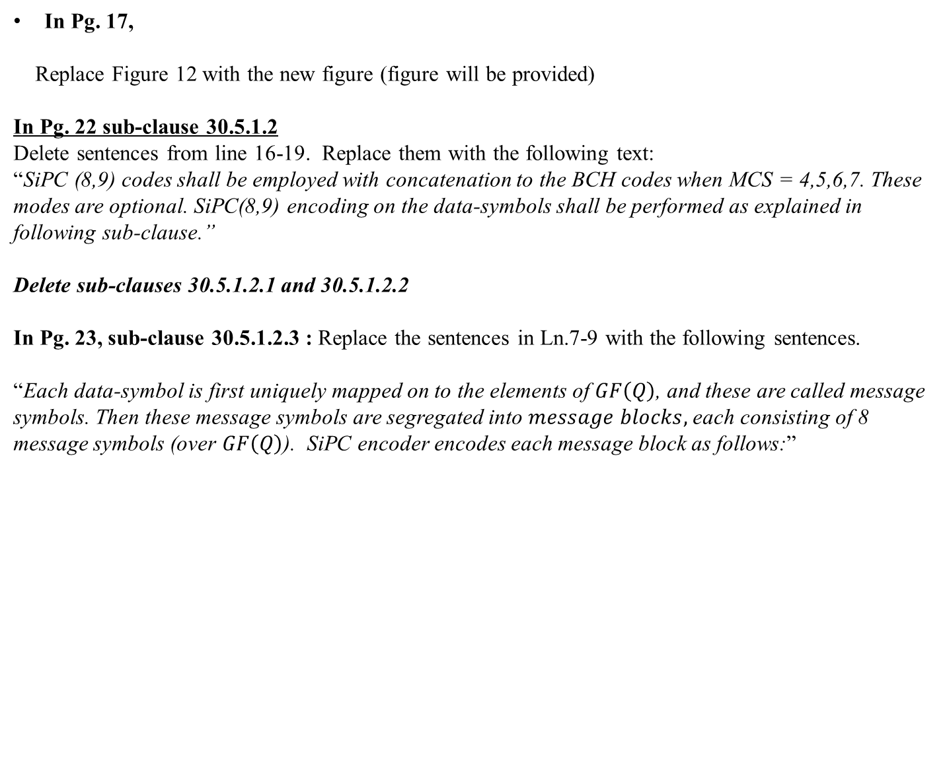
In Pg. 17,
Replace Figure 12 with the new figure (figure will be provided)
In Pg. 22 sub-clause 30.5.1.2
Delete sentences from line 16-19. Replace them with the following text:
“SiPC (8,9) codes shall be employed with concatenation to the BCH codes when MCS = 4,5,6,7. These modes are optional. SiPC(8,9) encoding on the data-symbols shall be performed as explained in following sub-clause.”
Delete sub-clauses 30.5.1.2.1 and 30.5.1.2.2
In Pg. 23, sub-clause 30.5.1.2.3 : Replace the sentences in Ln.7-9 with the following sentences.
“Each data-symbol is first uniquely mapped on to the elements of $GF\left(Q\right)$, and these are called message symbols. Then these message symbols are segregated into $message blocks,$each consisting of 8 message symbols (over $GF\left(Q\right)$). SiPC encoder encodes each message block as follows:”

