Slide 1
Project: IEEE P802.15 Working Group for Wireless Personal Area Networks (WPANs)
Submission Title: Choice of BCH and SiPC codes for IEEE 802.15.4q
Date Submitted: Nov 2014
Source: : Kiran Bynam, Chandrashekhar Thejaswi , Youngsoo Kim (Samsung)
E-Mail: [kiran.bynam@samsung.com]
Re:
Abstract: To request to compare/contrast 2.4 GHz silicon and establish a target for next generation
Purpose: Comment Resolution for IEEE 802.15.4q
Notice: This document has been prepared to assist the IEEE P802.15. It is offered as a basis for discussion and is not binding on the contributing individual(s) or organization(s). The material in this document is subject to change in form and content after further study. The contributor(s) reserve(s) the right to add, amend or withdraw material contained herein.
Release: The contributor acknowledges and accepts that this contribution becomes the property of IEEE and may be made publicly available by P802.15.

Slide 2
Comment Resolution for CID
Comment ID : 1298, 1015, 1239
Comment : why don’t we use one FEC from base standard.
Resolution : deferred

Slide 3
General Comparison of BCH and RS codes
The BCH codes are binary block-codes while the Reed-Solomon codes are non-binary block-codes.
The coefficient multiplication in the BCH encoder is a simple binary operation while the coefficient multiplication in the RS encoder is a nonbinary operation over GF(2^m)
The (63,51) BCH code corrects two errors in a block of n=63 bits of which k=51 are the message bits.
The Reed-Solomon code of comparable parameters is the (15,13) RS code which corrects a single erroneous symbol in a block of 15 symbols.
This corresponding binary parameters are n=60 and k=52 with ability to upto 4 bit errors so long as the 4 errors are confined to a single symbol.
The possibility of all errors being confined to within a single symbol is remote, especially in presence of interleaving.
The (63,51) BCH, which can correct two errors located anywhere in the 63 length block is a better option than (15,13) RS code which fails beyond a single symbol.
The low complexity (63,51) BCH avoids the complex algorithms such as Berlekamp-Massey algorithm, Peterson's algorithm etc required for the conventional BCH decoding or RS decoding

Slide 4
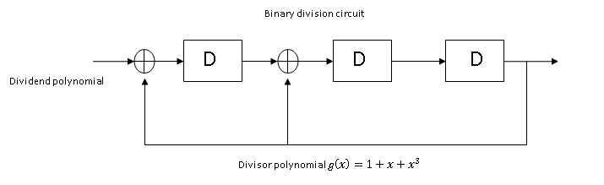
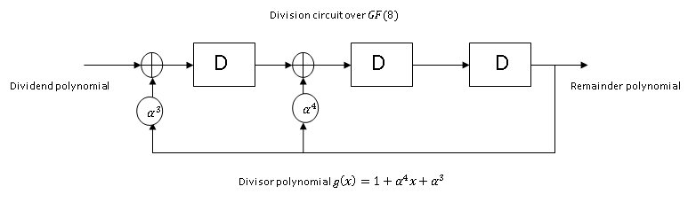

Encoding complexity
The encoding circuit for BCH codes is a binary division circuit while for Reed-Solomon codes, the division circuit is defined over $GF\left(2^{m}\right),$ where $m$ is the size of the symbol.
The addition in the BCH encoder as shown in Fig (a) is binary ‘XOR’ while the addition in the RS encoder in Fig(b) is addition over $GF\left(2^{m}\right)$.
In Fig(a), g(x) represents the generator polynomial for (7,4) BCH code, while g(x) in Fig (b) corresponds to a (7,5) RS code. Here,$α∈$ $GF\left(2^{m}\right)$ is the primitive element of $GF\left(8\right),$ generated by the primitive polynomial $f\left(x\right)=x^{3}+x+1.$

Slide 5
Decoding complexity
Start
Start
Syndrome Computation
Syndrome Computation
Determining Error locator polynomial using a dedicated algorithm(BM, PGZ algorithm)
Simple procedure exist that avoids the error locator polynomial and hence the dedicated algorithms
Solving the error locator polynomial using Chien search to obtain error locations
Deterministic method to solve for error locations exists in literature
Solving for the error values at error locations(Forney’s algorithm)
NA
Stop
The (63,51) BCH avoids the complex algorithms such as Berlekamp-Massey algorithm, Peterson’s algorithm etc.
Substituting the Chien search with a deterministic method with huge complexity reduction.
Solving error values is not required.
Stop

Slide 6
Low complexity (63,51) BCH decoder

Slide 7
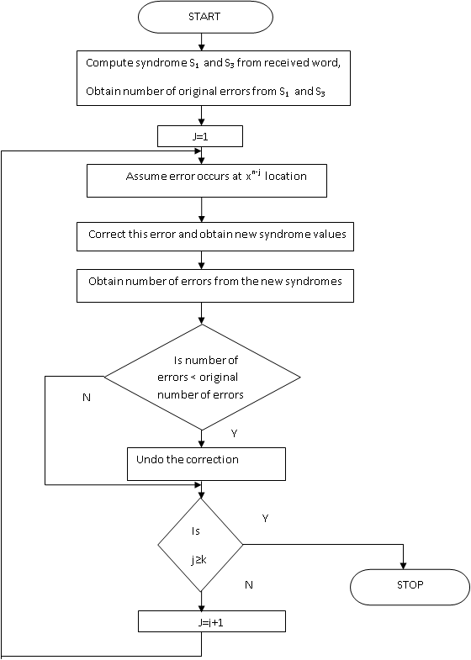
(63,51) BCH step by step decoder decoder
The algorithm is known as the modified step-by-step decoding algorithm [1].
The algorithm enhances the step by step algorithm in [2] for the particular case of double error correcting BCH codes.
The number of original errors are determined based on the syndromes.
Each location is inverted and the syndromes recomputed to determine if there is reduction in number of original errors.
If there is a reduction in the number of original errors, the inversion is retained else the inversion is undone.

Slide 8
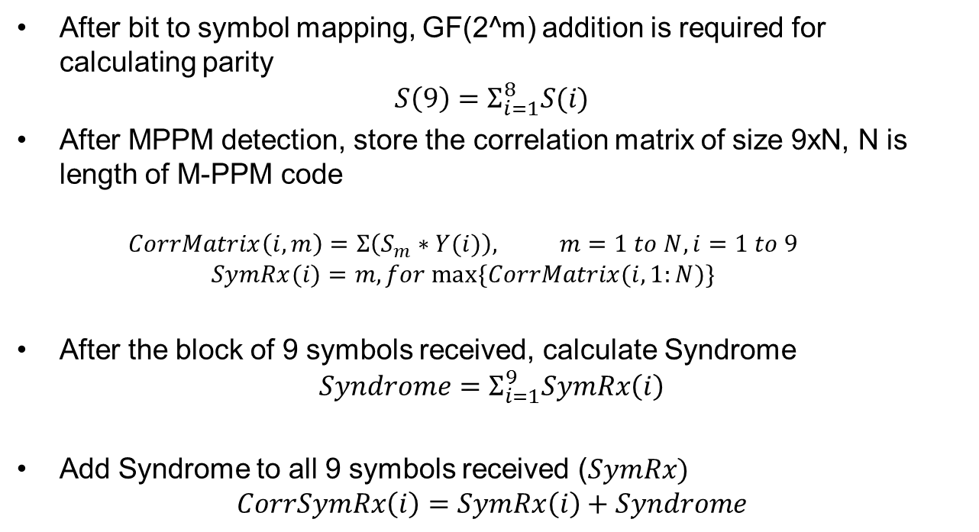
Complexity of SiPC (9,8) decoder
After bit to symbol mapping, GF(2^m) addition is required for calculating parity
$$S\left(9\right)=Σ_{i=1}^{8}S(i)$$
After MPPM detection, store the correlation matrix of size 9xN, N is length of M-PPM code
  $$CorrMatrix\left(i,m\right)=Σ\left(S_{m}∗Y(i)\right), m=1 to N, i=1 to 9$$
  $$SymRx(i)=m, for max⁡\{CorrMatrix(i,1:N)\}$$
After the block of 9 symbols received, calculate Syndrome
$$Syndrome=Σ_{i=1}^{9}SymRx\left(i\right)$$
Add Syndrome to all 9 symbols received ($SymRx)$
$$CorrSymRx\left(i\right)=SymRx\left(i\right)+Syndrome$$

Slide 9
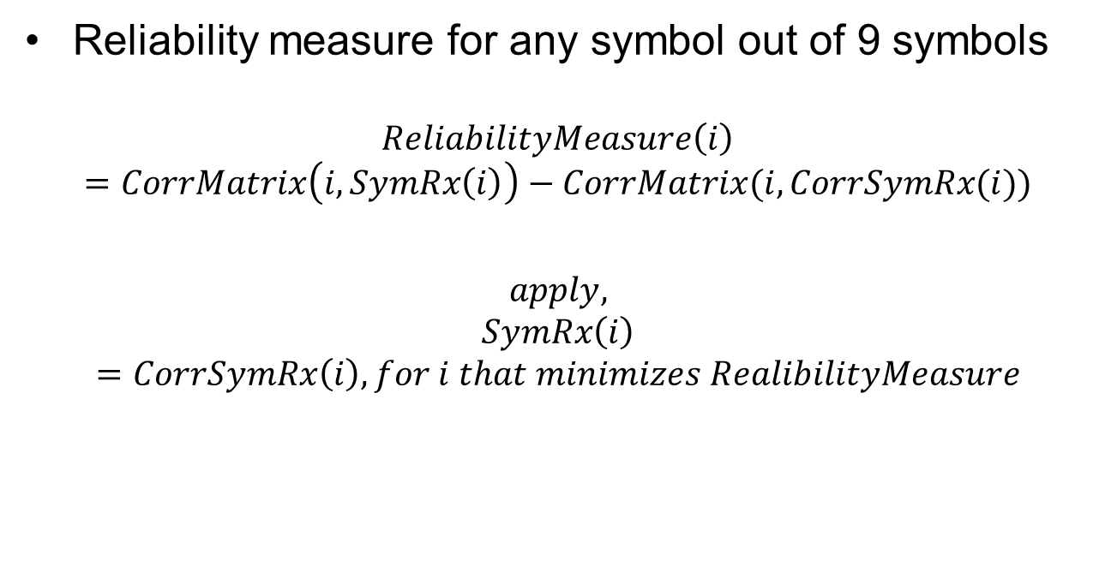
Complexity of SiPC(9,8) decoder
Reliability measure for any symbol out of 9 symbols
$$ReliabilityMeasure\left(i\right)=CorrMatrix\left(i,SymRx\left(i\right)\right)−CorrMatrix(i,CorrSymRx(i))$$
$$apply, SymRx\left(i\right)=CorrSymRx\left(i\right), for i that minimizes RealibilityMeasure$$

Slide 10
Conclusion
The complexity of the chosen BCH codes or SiPC codes are much lesser than the RS codes present in base standard

Slide 11
References
Shyue-Win Wei; Che-Ho Wei,, "High-speed hardware decoder for double-error-correcting binary BCH codes," Communications, Speech and Vision, IEE Proceedings I , vol.136, no.3, pp.227,231, Jun 1989.
Massey, J.L., "Step-by-step decoding of the Bose-Chaudhuri- Hocquenghem codes," Information Theory, IEEE Transactions on , vol.11, no.4, pp.580,585, Oct 1965.
Hartmann, C., "A note on the decoding of double-error-correcting binary BCH codes of primitive length (Corresp.)," Information Theory, IEEE Transactions on , vol.17, no.6, pp.765,766, Nov 1971.
E. Prange, “The use of civet equivalence in the analysis and decoding of group codes,” A.F. Cambridge Res. Cetr., Cambridge, Mass., AFCRC-TR-59-164,

