Slide 1
Project: IEEE P802.15 Working Group for Wireless Personal Area Networks (WPANs)
Submission Title: [Proposed Frame Structure for PAC]
Date Submitted: November 4, 2014
Source: [Byung-Jae Kwak, Kapseok Chang, Byung-Jae Kwak] Company [ETRI]
Address [Daejeon, Korea]
E-Mail: [bjkwak@etri.re.kr]
Re:
Abstract: [Proposes frame structure for PAC]
Purpose: [Approval]
Notice: This document has been prepared to assist the IEEE P802.15. It is offered as a basis for discussion and is not binding on the contributing individual(s) or organization(s). The material in this document is subject to change in form and content after further study. The contributor(s) reserve(s) the right to add, amend or withdraw material contained herein.
Release: The contributor acknowledges and accepts that this contribution becomes the property of IEEE and may be made publicly available by P802.15.

Slide 2
Approved Frame Structure
15-14-0569-01-0008
  Link: https://mentor.ieee.org/802.15/dcn/14/15-14-0569-01-0008-d0-2-frame-structure.doc

Slide 3
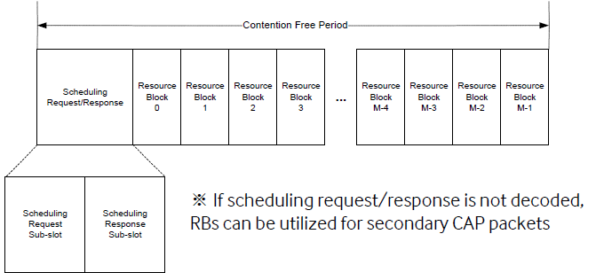
Revisit of Frame Structure
Rationale: Scheduling REQ/RES message are control messages, which may not belong to the communication period.
  https://mentor.ieee.org/802.15/dcn/14/15-14-0557-02-0008-802-15-8-d0-2-communication-period.doc
  https://mentor.ieee.org/802.15/dcn/14/15-14-0640-00-0008-proposed-motions-for-assigned-tasks.pptx
The original design of CFP by the proponent has Scheduling REQ/RES within CFP (https://mentor.ieee.org/802.15/dcn/14/15-14-0254-00-0008-samsung-etri-merged-mac-proposal-to-tg8-cfc.pdf (Slide 30))

Slide 4
Motion
“Move that TG8 accept the frame structure described in 15-14-0569-01-0008 as the frame structure for PAC.”
Moved by:
Seconded by:
Result: Yes/No/Abstain=

