Slide 1
Project: IEEE P802.15 Working Group for Wireless Personal Area Networks (WPANs)
Submission Title: [Proposal to create a new Task Group 15.3e]
Date Submitted: [21 October 2014]
Source: [Andrew Estrada, Keiji Akiyama, Hiroyuki Matsumura, Itaru Maekawa, Ko Togashi, Kiyoshi Toshimitsu, Ichiro Seto, Ken Hiraga and Masashi Shimizu]
Company: Sony, JRC, Toshiba and NTT
Address [16530 Via Esprillo MZ 7032 San Diego, California 92127]
Voice:[858-942-5483], FAX: [], E-Mail:[Andrew.Estrada@am.sony.com]
Re: []
Abstract: [Discussion for the proposal to create a new Task Group ]
Purpose: [Discussion on creating a new Task Group for Close Proximity P2P applications]
Notice: This document has been prepared to assist the IEEE P802.15. It is offered as a basis for discussion and is not binding on the contributing individual(s) or organization(s). The material in this document is subject to change in form and content after further study. The contributor(s) reserve(s) the right to add, amend or withdraw material contained herein.
Release: The contributor acknowledges and accepts that this contribution becomes the property of IEEE and may be made publicly available by P802.15.
Andrew Estrada, Sony

Slide 2
Proposal to create a new
Task Group 15.3e
WNG session
IEEE802.15
November 2014

Slide 3
Why we need an enhanced MAC
Usage focus: kiosk downloading and toll gate use cases
Objectives of MAC enhancements:
  Maximum throughput
  Quick link setup
  Quick link release
Touch motion indicates user’s intention
to make or break the connection
Close Proximity Communication Systems

Slide 4


Kiosk Use Case = Transaction Density
Touch!
kiosk
Touch!
kiosk
Touch!
kiosk
Touch!
kiosk
Touch!
kiosk

Slide 5
Kiosk Use Case = Transaction Density
Touch!
kiosk
Touch!
kiosk
Touch!
Spatial Density
kiosk
Touch!
kiosk
Touch!
Temporal Density
kiosk

Slide 6
1 GByte
250 msec
Total touch time
Total file size
2 hr program
HD H.265

Slide 7
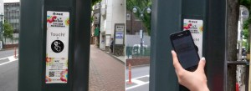






802.15.3 MAC not optimized for kiosk usage
What we need
  Fast transactions (250 ms toll gate, 3s kiosk)
  Single traffic type: File transfer up to 10 GB
  Transaction density: time and space
New proposed touch model
Close proximity “touch” or “swipe”
Existing MAC issues
  Overhead due to multiple DEVs support
  Must support multiple traffic types
  Connection-oriented network
Up to several
meters away
802.15.3c kiosk downloading model

Slide 8
Use case enables key assumptions
A proximity pair is only established to complete a single transaction
A proximity pair consists of a single link between 2 devices
Every link has full access to all the network bandwidth

Slide 9
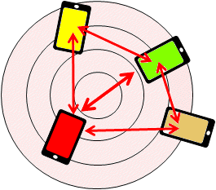
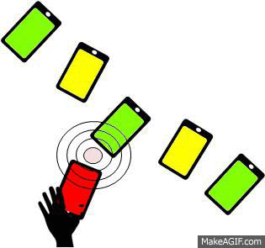
Touch is simple for the user
Conventional network:
  User
  Search
  Discover
  Select
  Connect
  Reserve bandwidth
  Start traffic
Human
New close proximity:
  User
  Touch →
  Automatic
  Search, Discover, Select, Connect, Reserve B/W
  Start traffic
“Touch and Get”
a few cm
kiosk

Slide 10
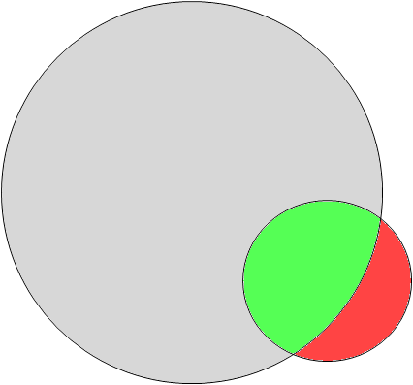


Limitations of 802.15.3 MAC
Connection setup time comparison:
65 msec + α
Legacy 802.15.3 MAC spec
2 msec (toll gate)
Required 802.15.3e MAC items
Enhancements
MAC-level data integrity
Sequential paired P2P access (not multiple simultaneous P2MP access)
Touch!
kiosk
7
6
5
4
3
2
1

Slide 11
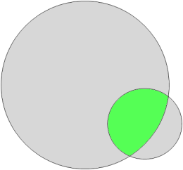
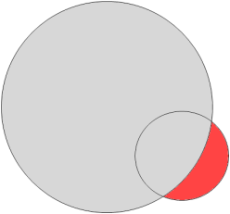
Maximize effective throughput
To fulfill these requirements, one must:
  Operate in P2P (point-to-point) mode
    Limit communications to close proximity range
      Place upper limit on EIRP or field strength
    Remove redundant processes not essential for P2P connectivity
      Remove DEVID → Simplify association step
      Beacon not required after establishment of connection
      Only CAP is required (CTAP not needed)
      etc.
  Guarantee data integrity at MAC level
    Maintain throughput even when errors occur during aggregation
      Unlimited retry
    Reordering buffer not required → Reduce buffer size
    Minimize round trip latency and maximize throughput

Slide 12
Quick link setup and release
Keep Superframe duration short before link setup
  Ex.: under 200usec
  Limited by mMinSuperframeDuration (over 1msec at present)
Simplify Association process
  Eliminate DEVID
  Reduce amount of frame exchanges
    Response to Association Request (ACK, Association Response) not required
  Include mechanism to complete connection setup within MAC level (no need to query upper layers)
To enable quick release:
  Preferably an explicit release scheme not dependent on timeouts
    Connection shutdown after sending Disassociation
Include mechanism to avoid a DEV to re-associate with the same device immediately after disassociating
  MAC level solution preferred. Method other than timer may be needed.

Slide 13
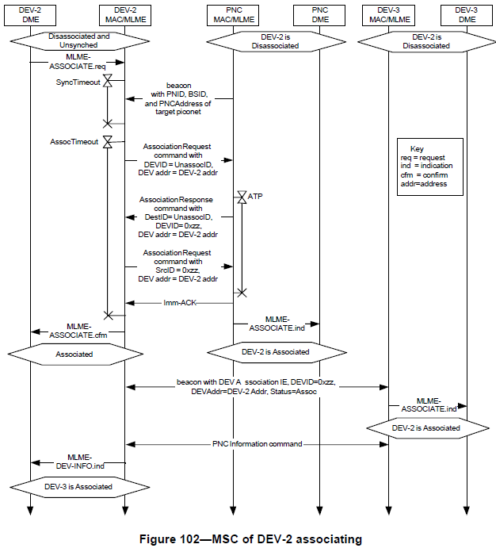
Current and proposed setup procedure
Current procedure:
Proposed new simplified procedure:
Omitted
steps
Omitted
steps
Eliminated steps are shown in shade

Slide 14
Summary of Beacon enhancements
Purpose of Beacon
  Search (not needed after establishment of P2P session)
  Sync (no need to manage traffic)
Short beacon interval before connection; No beacon after connection
  Eliminate notice of Beacon interval change
  Provide method to infer that DEV is no longer sending Beacons
  Remove Beacon-lost procedure from DEV

Slide 15
Hard deadline: 2020 Tokyo Olympics and Paralympics
Need published specification by end 2017
Current plan calls for May 2017

Slide 16
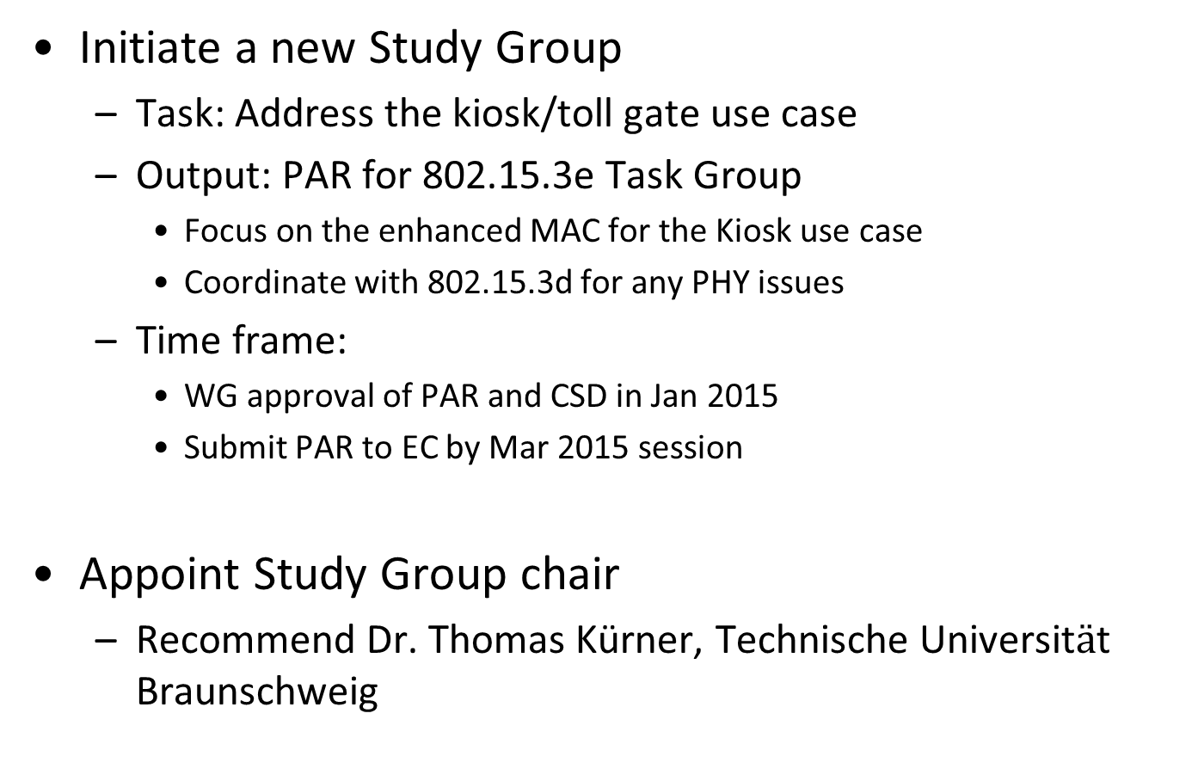
Request to Working Group
Initiate a new Study Group
  Task: Address the kiosk/toll gate use case
  Output: PAR for 802.15.3e Task Group
    Focus on the enhanced MAC for the Kiosk use case
    Coordinate with 802.15.3d for any PHY issues
  Time frame:
    WG approval of PAR and CSD in Jan 2015
    Submit PAR to EC by Mar 2015 session
Appoint Study Group chair
  Recommend Dr. Thomas Kürner, Technische Universit$ä$t Braunschweig

Slide 17
Call for Interest

Slide 18
PHY Rates
Table 3. Options for higher transmission rates:
This table is based on the frequency channels in the 60GHz band
(70% MAC efficiency is used in the calculation of data transmission times)
Modulation | No. of frequency channels | MIMO | Rate [Gbps] | Data transmission time for a 2-hour movie (0.9 GB) [s]*1
16QAM | 1 | (SISO) | 6.6 | 1.6
64QAM |  |  | 9.9 | 1.1
64QAM | 4 |  | 40 | 0.2
256QAM |  |  | 53 | 0.24
1024QAM |  |  | 66 | 0.15
16QAM | 2 | 16x16 | > 100 | < 0.1
64QAM | 1
*1: H.265（Hi-definition, Bitrate = 1 Mbps

Slide 19
Frequency Channels
Figure 8 Unlicensed spectrum allocation in 60 GHz [3]. The limitation of the transmission power is described in Table 95 of IEEE802.15.3c

Slide 20
Toll gate example
Typical Japanese 2 hr program
  114 min of content
  856 MB in H.265 4K
Throughput = 28 Gbps
Total touch time = 250 msec
  3 msec link setup
  247 msec file transfer time

Slide 21
How long will people wait?
(% of subjects that tolerate wait time)
 | Avg | Men | Women | Age 20's | Age 30's | Age 40's
3 sec | 83 | 79 | 88 | 77 | 86 | 85
5 sec | 59 | 53 | 66 | 58 | 62 | 55
8 sec | 51 | 48 | 55 | 51 | 54 | 47
http://www.citizen.co.jp/research/index.html

