Slide 1
Project: IEEE P802.15 Working Group for Wireless Personal Area Networks (WPANs)
Submission Title: [Proposal to create a new Task Group 15.3e]
Date Submitted: [21 October 2014]
Source: [Andrew Estrada, Keiji Akiyama, Hiroyuki Matsumura, Itaru Maekawa, Ko Togashi, Kiyoshi Toshimitsu, Ichiro Seto, Ken Hiraga and Masashi Shimizu]
Company: Sony, JRC, Toshiba and NTT
Address [16530 Via Esprillo MZ 7032 San Diego, California 92127]
Voice:[858-942-5483], FAX: [], E-Mail:[Andrew.Estrada@am.sony.com]
Re: []
Abstract: [Discussion for the proposal to create a new Task Group ]
Purpose: [Discussion on creating a new Task Group for Close Proximity P2P applications]
Notice: This document has been prepared to assist the IEEE P802.15. It is offered as a basis for discussion and is not binding on the contributing individual(s) or organization(s). The material in this document is subject to change in form and content after further study. The contributor(s) reserve(s) the right to add, amend or withdraw material contained herein.
Release: The contributor acknowledges and accepts that this contribution becomes the property of IEEE and may be made publicly available by P802.15.
Andrew Estrada, Sony

Slide 2
Proposal to create a new
Task Group 15.3e
WNG session
IEEE802.15
November 2014

Slide 3
Why we need an enhanced MAC
Usage focus: kiosk downloading and toll gate use cases
Objectives of MAC enhancements:
  Maximum throughput
  Quick link setup
  Quick link release
Touch motion indicates user’s intention
to make or break the connection
Close Proximity Communication Systems

Slide 4






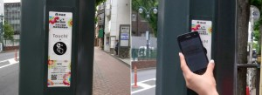
Issues with the current 802.15.3 MAC for kiosk usage
Support for multiple DEVs
Capable of covering several meters
Capable of supporting various traffic types
Connection-oriented network
Up to several
meters away
802.15.3c kiosk downloading model
Download services impractical where
time restrictions or delays exist
Data transfer must finish within wicket passage time
Must be able to initiate transfer to next device immediately after completion of previous transfer
Spatial density: Must support many independent proximity pairs in the same local area
New proposed touch model
Close proximity “touch” or “swipe”

Slide 5
Use case enables key assumptions
A proximity pair is only established to complete a single transaction
A proximity pair consists of a single link between 2 devices
Every link has full access to all the network bandwidth

Slide 6
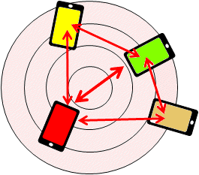
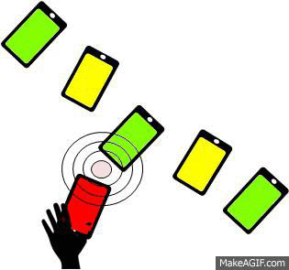
Touch-based usage model
Conventional network-based connection steps:
  Search
  Discover
  Select
  Connect
  Reserve bandwidth
  Start traffic
New close proximity steps:
  Touch
  Start traffic
Human
“Touch and Get”
a few cm

Slide 7
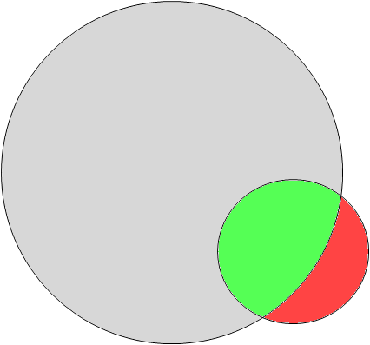



Limitations of 802.15.3 MAC
Connection setup time comparison:
65 msec + α
Legacy 802.15.3 MAC spec
2 msec (kiosk usage only)
Required 802.15.3e MAC items
Enhancements
MAC-level data integrity
Sequential paired P2P access (not multiple simultaneous P2MP access)
Touch!
kiosk
7
6
5
4
3
2
1

Slide 8

Kiosk Use Case = Transaction Density
Touch!
kiosk
Touch!
kiosk
Touch!
kiosk
Touch!
kiosk
Touch!
kiosk

Slide 9
Kiosk Use Case = Transaction Density
Touch!
kiosk
Touch!
kiosk
Touch!
Spatial Density
kiosk
Touch!
kiosk
Touch!
Temporal Density
kiosk

Slide 10
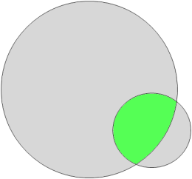
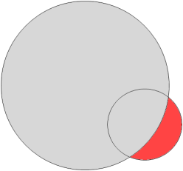
Maximize effective throughput
To fulfill these requirements, one must:
  Operate in P2P (point-to-point) mode
    Limit communications to close proximity range
      Place upper limit on EIRP or field strength
    Remove redundant processes not essential for P2P connectivity
      Remove DEVID → Simplify association step
      Beacon not required after establishment of connection
      Only CAP is required (CTAP not needed)
      etc.
  Guarantee data integrity at MAC level
    Maintain throughput even when errors occur during aggregation
    Reordering buffer not required → Reduce buffer size

Slide 11
Quick link setup and release
Keep Superframe duration short before link setup
  Ex.: under 200usec
  Limited by mMinSuperframeDuration (over 1msec at present)
Simplify Association process
  Eliminate DEVID
  Reduce amount of frame exchanges
    Response to Association Request (ACK, Association Response) not required
  Include mechanism to complete connection setup within MAC level (no need to query upper layers)
To enable quick release:
  Preferably an explicit release scheme not dependent on timeouts
    Connection shutdown after sending Disassociation
Include mechanism to avoid a DEV to re-associate with the same device immediately after disassociating
  MAC level solution preferred. Method other than timer may be needed.

Slide 12
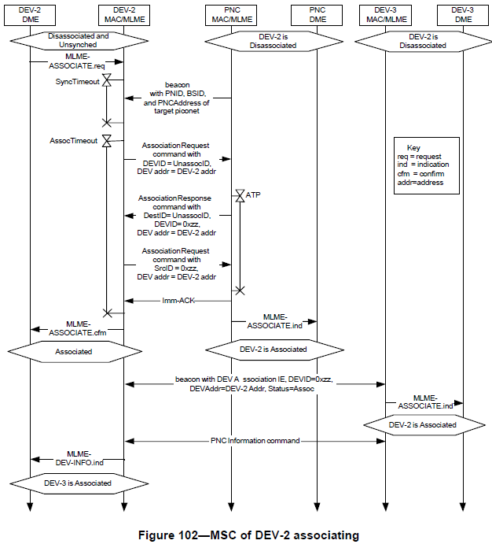
Current and proposed setup procedure
Current procedure:
Proposed new simplified procedure:
Omitted
steps
Omitted
steps
Eliminated steps are shown in shade

Slide 13
Summary of Beacon enhancements
Purpose of Beacon
  Search (not needed after establishment of P2P session)
  Sync (no need to manage traffic)
Short beacon interval before connection; No beacon after connection
  Eliminate notice of Beacon interval change
  Provide method to infer that DEV is no longer sending Beacons
  Remove Beacon-lost procedure from DEV

Slide 14
Hard deadline: 2020 Tokyo Olympics
Need published specification by end 2017
Current plan calls for May 2017

Slide 15
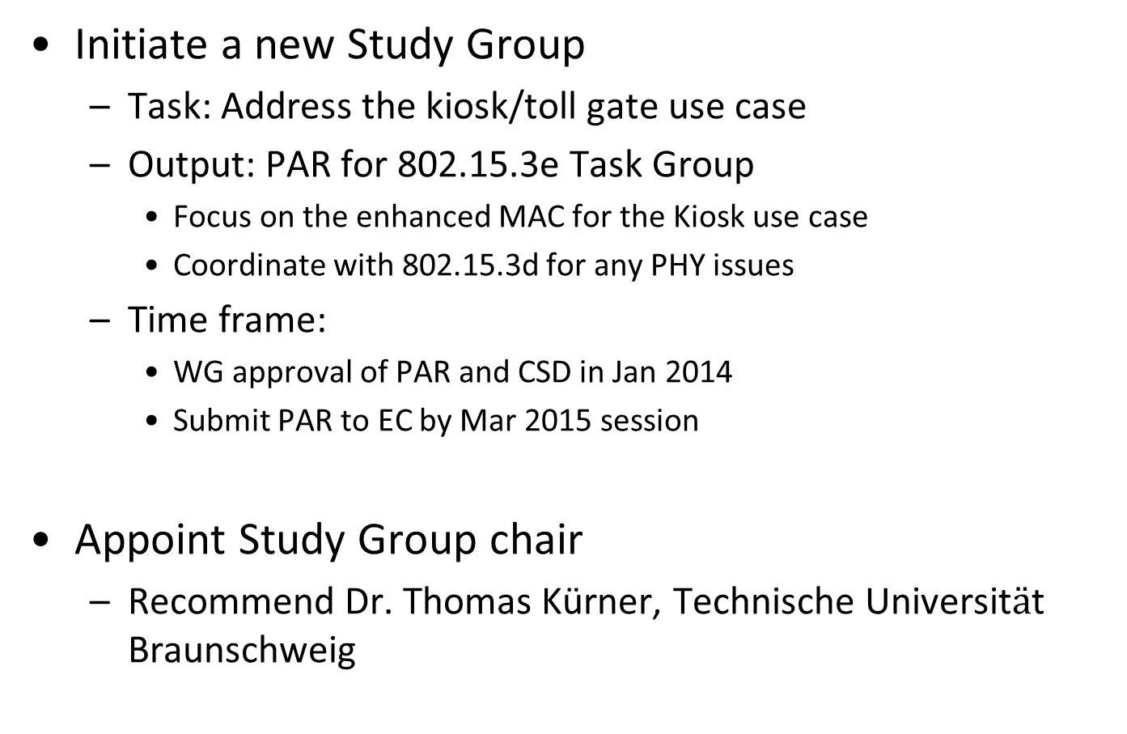
Request to Working Group
Initiate a new Study Group
  Task: Address the kiosk/toll gate use case
  Output: PAR for 802.15.3e Task Group
    Focus on the enhanced MAC for the Kiosk use case
    Coordinate with 802.15.3d for any PHY issues
  Time frame:
    WG approval of PAR and CSD in Jan 2014
    Submit PAR to EC by Mar 2015 session
Appoint Study Group chair
  Recommend Dr. Thomas Kürner, Technische Universit$ä$t Braunschweig

Slide 16
Call for Interest

