Slide 1
WLAN Frame Collision Information
Date: 2014-09-17
Authors:

Slide 2
Abstract
Frame Collision in 11ax scenarios is a severe problem, which is an obstacle to realizing the goals of 11ax.
In this contribution, we propose that supporting the use of Frame Collision information will be useful for reducing collisions by management and control in 11ax.

Slide 3
Background 1/2
  Frame Collision is when two (or more) frame signals are transmitted or arrive at the same time
Frame Collisions occur when CSMA/CA fails
  Failure of carrier-sensing (”hidden-terminal”)
  Failure of avoidance due to identical backoff times
Frame Collisions cause performance degradation
  Interference, frame errors, retransmissions
Frame Collisions occur often in 11ax scenarios with many terminals and high transmission rates [1][2]
  Necessity of collision management in 11ax has been mentioned in TGax [3][4]

Slide 4
Background 2/2
  Information related to Frame Collision is effective for reducing collisions by management and control
    Examples: Site Survey, Channel Selection, Association, Rate Control, Power Control, etc.
Various forms of Frame Collision information can be obtained
  Examples: Transmitter side, Receiver side, separate sensor (“sniffer”)
  Frame Collision Detection (FCD) is needed to provide useful Frame Collision information

Slide 5
Examples of FCD: Power Signal Analysis
(a) Power before and after frame
Frame Collision Pattern
Power Signal
power
colliding frames
power
interference
時間
time
frame
time
(b) Power changes during frame
power increase
power fluctuation

Slide 6
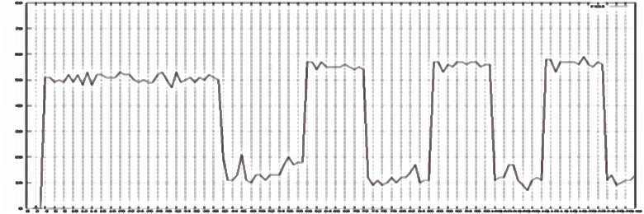
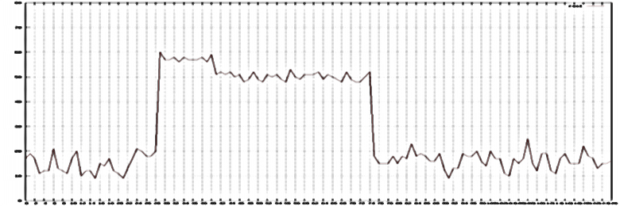
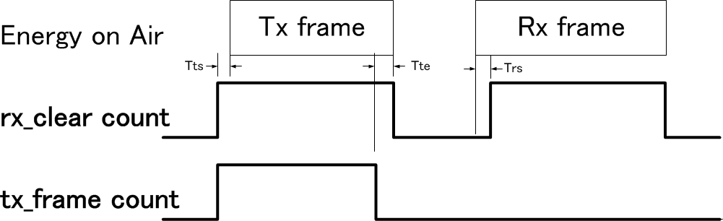
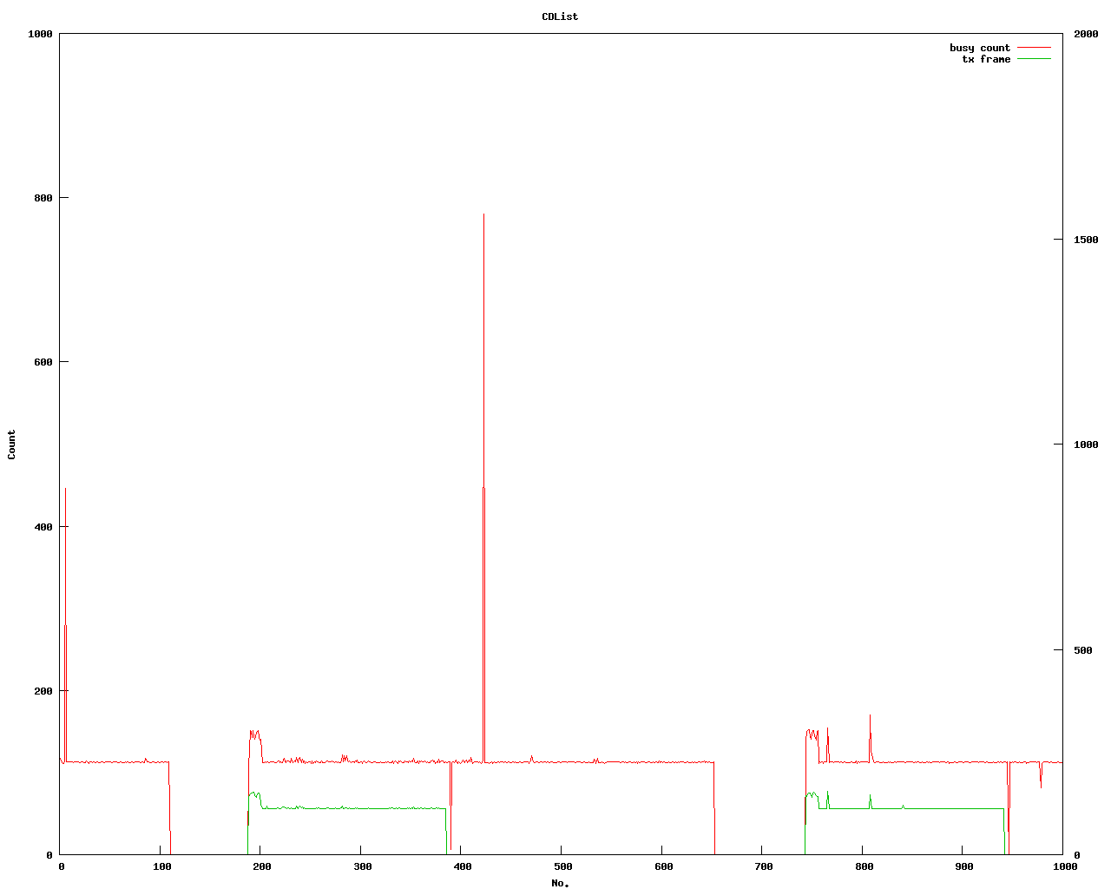
Examples of FCD: Power Signals
RSSI signal from power signal sensor [5] or spectral scan mode of WLAN card [6]
PHY state signal from WLAN card [7]
No collisions
Collision
power
power
RSSI
RSSI
Frame-B
Frame-A
Frame-A
Frame-A
Frame-A + Frame-B
time
time
count
tx_frame/2
Collision
rx_clear
time

Slide 7
Frame Collision (FC) Information
Examples
  Existence or non-existence of collision events
  Statistics of collisions
    ex. number or percentage of collisions
  Collision TYPE information
Store and share as Information Elements
Use for management and control

Slide 8
Using FC information for Control 1/2
Example of Rate Control
Incorrect rate control (unknown cause of loss):
Decrease
transmission rate
Leads to increased
probability of collision
No ACK received
Optimal rate control (loss cause known to be collision):
No ACK received
+ collision detected
Increase
transmission rate
Leads to decreased
probability of collision

Slide 9


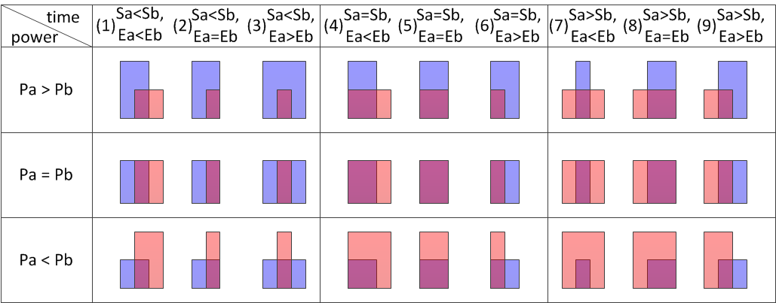

Example of Collision Types
: Frame A
: Frame B(interference)
Power
Sa<Sb
Sa=Sb
Sa>Sb
Pa
Pb
t
Sa
Ea
Sb
Eb
Type I
transmitter of frame B
cannot sense frame A
Type II:
transmitters of A and B choose same backoff
Type III
transmitter of frame A
cannot sense frame B

Slide 10
Using FC information for Control 2/2
Examples of use of Collision Type Information
Example of collision | Collision type | Examples of control by transmitter of frame A
 | Type I: transmitter of frame B cannot sense frame A | Increase transmission power
 | Type II: transmitters of A and B choose same backoff | Do nothing, or Increase CWmin
 | Type III: transmitter of frame A cannot sense frame B | Decrease CCA level
A
B
A
B
A
B
: Frame A
: Frame B(interference)

Slide 11
Use power time series information before, during and after frames
Examples of Collision Type Classification Method
Power Signal
Frame Collision Pattern
Colliding signal
A
Threshold
B
frame A
時間
Colliding signal
A
Threshold
B
時間
frame A

Slide 12
Summary and Next Steps
  Proposal of use of Frame Collision information for improving management and control in 11ax
  Examples of Frame Collision Detection using power signal analysis
  Examples of control using Frame Collision information
  For greater effect, information of collision types can be used
Next:
Propose method for handling FC information in 11ax

Slide 13
References
[1] “MAC Efficiency Analysis for HEW SG”, IEEE 802.11-13/0505r0, Minyoung Park (Intel)
[2] “Possible Approaches for HEW”, IEEE 802.11-13/0758r0, Katsuo Yunoki (KDDI Labs)
[3] “Understanding Current Situation of Public Wi-Fi Usage - Possible Requirements for HEW -”, IEEE 802.11-13/0523r2, Katsuo Yunoki (KDDI Labs)
[4] “Consideration on Efficiency Enhancement”, IEEE 802.11-13/0854r1, SangHyun Chang (Samsung
[5] IEICE Technical Report, SIP2012-125, p259-264, March 2014 , P. Shao
[6] “ath9k spectral scan”, http://wireless.kernel.org/en/users/Drivers/ath9k/spectral_scan/
[7] “Fwd: FW: Channel busy cycles”, ath9k-devel ML, http://article.gmane.org/gmane.linux.drivers.
ath9k.devel/9887/

Slide 14
Backup: Example of rx_clear count
power
time
Result of CCA
0
2
4
4
4
4
2
0
time
rx_clear count
time
:0
:1

