Slide 1
Project: IEEE P802.15 Working Group for Wireless Personal Area Networks (WPANs)
Submission Title: Updates on Fully Distributed Synchronization Scheme for PAC
Date Submitted: Sept. 14, 2014
Source: [Byung-Jae Kwak, Kapseok Chang, Moon-Sik Lee]¹,
[Junhyuk Kim, Kyounghye Kim, June-Koo Kevin Rhee] ²
Affiliation: [ETRI, Korea]¹, [KAIST, Korea]²
Address:
E-Mail: bjkwak@etri.re.kr, kschang@etri.re.kr, moonsiklee@etri.re.kr,
kim.jh@kaist.ac.kr, khye.kim@kaist.ac.kr, rhee.jk@kaist.edu,
Re:
Abstract: Description of the latest enhancement of the fully distributed synchronization scheme for PAC and give heads up on issues related network synchronization.
Purpose: Discussion
Notice: This document has been prepared to assist the IEEE P802.15. It is offered as a basis for discussion and is not binding on the contributing individual(s) or organization(s). The material in this document is subject to change in form and content after further study. The contributor(s) reserve(s) the right to add, amend or withdraw material contained herein.
Release: The contributor acknowledges and accepts that this contribution becomes the property of IEEE and may be made publicly available by P802.15.

Slide 2
Updates on Fully Distributed Synchronization Scheme for PAC
Sept. 2014
Athens, Greece

Slide 3
Executive Summary (1/2)
Synchrony among PDs is the fundamental assumption in PAC
No discovery, no data communication without synchrony
Sync performance has significant implication for other designs
  Ex: frame length, preamble design of RB, length of guard period, etc.
  Synchronization is a prerequisite for other progress

Slide 4
Executive Summary (2/2)
What is not change?: The basic concept.
  Structure of Sync. Period
  Timing reference signal is transmitted using random access
  Scalable over large range of # PDs
What have been changed?
  No more collision detection → Use inter-arrival time instead
  Better efficiency: smaller timing reference signal
  More fairness: new backoff method

Slide 5
Collision Detection vs. Inter-Arrival Time
Objective: to adapt to PD density
  Ex: Too many collision: CW is too small
  Ex: Too short inter-arrival time: CW is too small
Collision Detection
  Not reliable if two timing reference signals with a big power difference collide
  Requires frequency sync: could be a problem for “Initial Synchronization Procedure”
  Collision is a good indicator of PD density, but is not foolproof
Inter-arrival time
  Does not require special field
  More reliable indicator of PD density then collision detection

Slide 6
Firefly
Source
  O. Simeone, U. Spagnolini, Y. Bar-Ness, S. Strogatz, “Distributed Synchronization in Wireless Networks,” IEEE Signal Processing Magazine, vol. 25, no. 5, Sept. 2008, pp. 81-97.
  R. E. Mirollo, S. H. Strogatz, “Synchronization of pulse-coupled biological oscillators,” SIAM J. Appl. Math., vol. 50, no. 6, pp. 1645-1662, Dec. 1990.
Ideal assumptions: Single hop, no collision, no path-loss, full duplex, etc.
Interesting math problem that provides valuable insights: You only need to make it work for real problems! ;-)
Random access based distributed sync: Only plausible scheme for scalable fully distributed D2D like PAC.

Slide 7
The Sync Period
Frame: periodic time resource of fixed duration
Sync period
  Comprises backoff slots
  Where timing reference signal is transmitted

Slide 8
Timing Reference Signal
Consists of three fields
  Preamble: packet detection, AGC, frequency offset, frame sync, channel estimation, etc.
  Timing offset indication field: # backoff slots
  CW indication field: CW of transmitter

Slide 9
Transmission of Timing Reference Signal
Use random access
Transmission must be completed within sync period

Slide 10
Random Access Procedure

Slide 11
Random Access Procedure: Ex 1
3 PDs, CW = 16

Slide 12
Random Access Procedure: Ex 2
PD A performing CCA and transmitting timing reference signal.

Slide 13
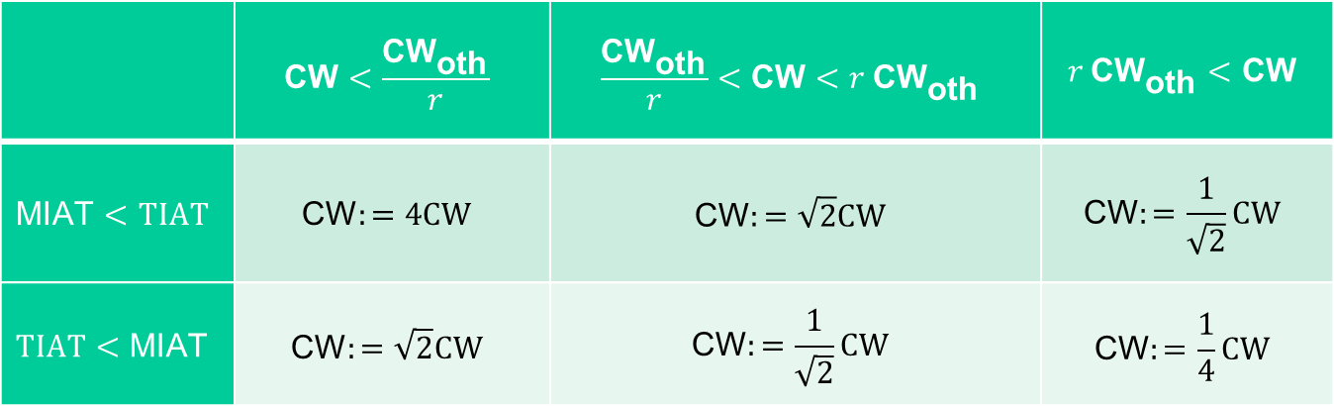

Update of CW
$$\text{MIAT}≔β_{A}∙\text{MIAT}+(1−β_{A})∙IAT$$
$${\text{CW}}_{\text{oth}}≔β_{B}∙{\text{CW}}_{\text{oth}}+(1−β_{B})∙CW$$
 | $$\text{CW}<\frac{{\text{CW}}_{\text{oth}}}{r}$$ | $$\frac{{\text{CW}}_{\text{oth}}}{r}<\text{CW}<r {\text{CW}}_{\text{oth}}$$ | $$r {\text{CW}}_{\text{oth}}<\text{CW}$$
$$\text{MIAT}<TIAT$$ | $$\text{CW}:=4CW$$ | $$\text{CW}:=\sqrt{2}CW$$ | $$\text{CW}:=\frac{1}{\sqrt{2}}CW$$
$$TIAT<\text{MIAT}$$ | $$\text{CW}:=\sqrt{2}CW$$ | $$\text{CW}:=\frac{1}{\sqrt{2}}CW$$ | $$\text{CW}:=\frac{1}{4}CW$$

Slide 14
Phase Update (1/5)
Frame vs. phase (timing)

Slide 15
Phase Update (2/5)
2 hop example

Slide 16
Phase Update (3/5)
Phase update using “concave down” function

Slide 17
Phase Update (4/5)
Phase update using “180º rule”
  If a PD receives a timing reference signal and its phase is smaller than 180º at the time of reception, it maintain its phase.
  If a PD receives a timing reference signal and its phase is greater than 180º at the time of reception, it updates its phase to 360º.
Other rules tried: “360º rule”, averaged timing, etc.

Slide 18
Phase Update (5/5)
Phase update in the presence of timing offset (backoffs)

Slide 19
Synchronization Stages

Slide 20
Initial Synchronization Procedure
Scan for timing reference signal
No sync found → starts my own timing → make transition to maintaining synchronization procedure
Single timing found → follow the sync → make transition to maintaining synchronization procedure
Multiple timing found → randomly follow one of the timings found → follow a procedure to achieve network with neighboring PDs (Next page)

Slide 21
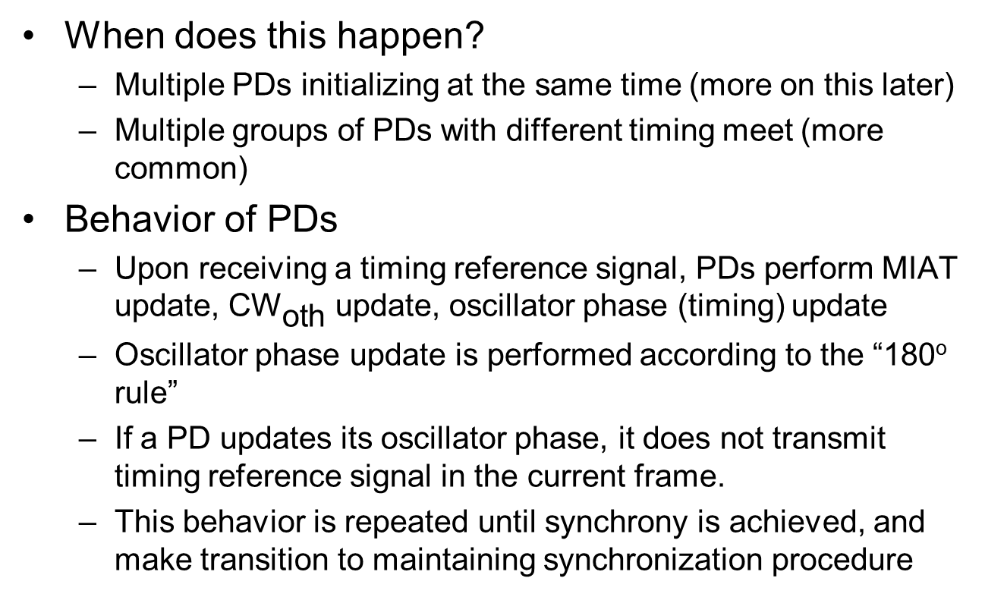
Multiple Timing
When does this happen?
  Multiple PDs initializing at the same time (more on this later)
  Multiple groups of PDs with different timing meet (more common)
Behavior of PDs
  Upon receiving a timing reference signal, PDs perform MIAT update, ${\text{CW}}_{\text{oth}}$ update, oscillator phase (timing) update
  Oscillator phase update is performed according to the “180º rule”
  If a PD updates its oscillator phase, it does not transmit timing reference signal in the current frame.
  This behavior is repeated until synchrony is achieved, and make transition to maintaining synchronization procedure

Slide 22

Synchronization Performance
Average of 10 independent runs
500 x 500 m² area (multi-hop)
Timing reference signal = 3 backoff slots
$b=3,$ and $ε=0.1.$
 | 180º rule | Concave down
Single-hop (1000 PDs) | 108.1 | 36.3
Single-hop (83 PDs) | 54.2 | 23.4
Multi-hop (1000 PDs, Clustered random drop) | 53.8 | 2 out of 10 runs did not converge
Multi-hop (1000 PDs, Uniform random drop) | 82.3 | 2 out of 10 runs did not converge

Slide 23
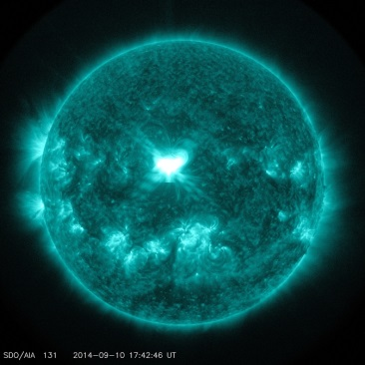
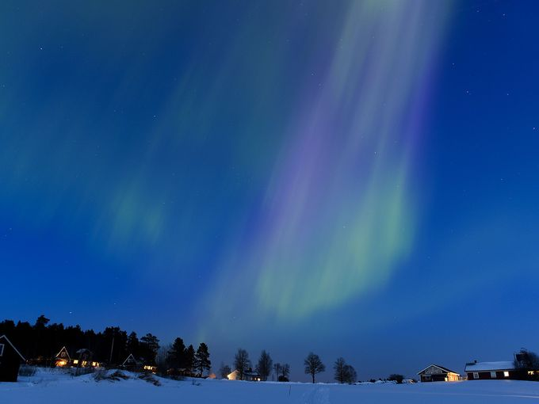
  Multiple PDs Initializing at the Same Time
  When does this happen?
    Rarely, if ever!
    Ex: Geomagetic storm caused by Solar Eruption¹
  We should be more concerned about multiple groups of PDs meeting
(Source: NASA)
(Source: Wikipedia)
1: Latest major eruption 2014.09.10. Ejects billions of tons of hydrogen and helium ions, electrons, and protons, and causes Northern lights, but also disturbance in radio communications.

Slide 24
Maintaining Synchronization
Fine adjustment of timing error due to drift, interference, etc.
Detection of lost synchrony
Merging two (or more) networks when they meet
  Quite common
  We do not want interruption of communications
  Belong to re-sync?

Slide 25

Merging Networks When They Meet
When does this happen? All the time.
When train arrives
Busy commercial area

Slide 26
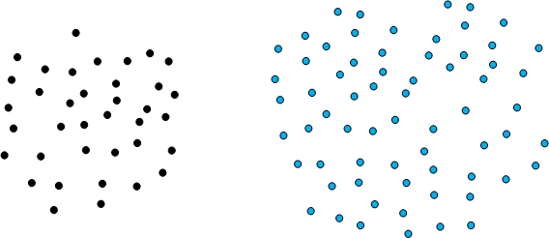
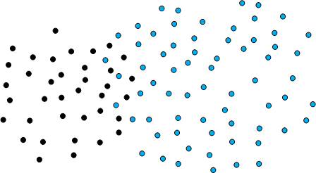
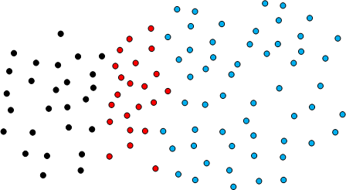
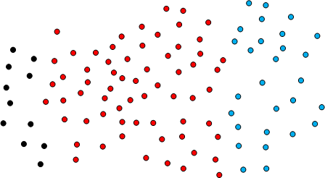
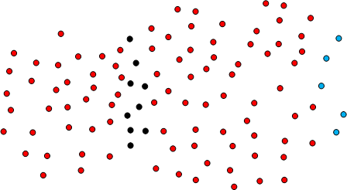
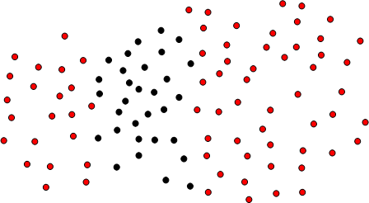
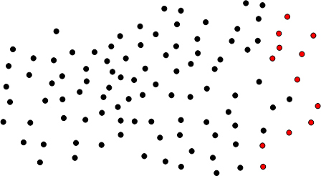
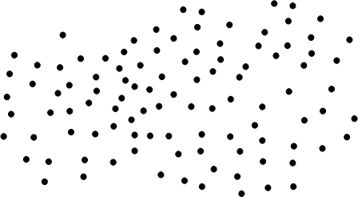
Merging Networks When They Meet
Disruptive
or seamless?

Slide 27
Re-synchronization
What is it?
  When? Why? How?
Disruptive or seamless?
  Stop communication altogether?
  Different frame length?
  Do we need a scheme different from initial sync procedure?

Slide 28

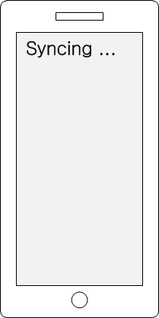
How Does PAC Handle This?
How do we gracefully fail if we have to?

Slide 29
Discussion

