Slide 1
Doc: IEEE 802.15-14-0541-00-007a
Project: IEEE 802.15.7a OCC Study Group
Submission Title: [Technical Topics for Location Based Service based on Smart Device Camera and LED light]
Date Submitted: [15 Sep, 2014]
Source: [*Sang Kook Han, *Yong Hwan Son, **Jae Sang Cha, ***Yeong Min Jang]
[*Yonsei University, **Seoul National Univ. of Science & Technology, ***Kookmin Univ.]
Address : [Yonsei University, Seoul, Korea]
Voice: [82-2-2123-4016], FAX: [82-2-364-4016], E-Mail:[skhan@yonsei.ac.kr]
Re: []
Abstract: [Technical Topics for Location Based Service based on Smart Device Camera and LED light are introduced in the presentation.]
Purpose: [Contribution to IEEE 802.15.7a Optical Camera Communication]
Notice: This document has been prepared to assist the IEEE 802.15. It is offered as a basis for discussion and is not binding on the contributing individual(s) or organization(s). The material in this document is subject to change in form and content after further study. The contributor(s) reserve(s) the right to add, amend or withdraw material contained herein.
Release: The contributor acknowledges and accepts that this contribution becomes the property of IEEE and may be made publicly available by IEEE 802.15
Slide 1
Notes:
doc.: IEEE 802.15-09-0117-00-0007
<month year>

Slide 2
Contents
Doc: IEEE 802.15-14-0541-00-007a
LED and Smart Device Camera Based LED lighting System for Location Based Service
VLC based on Smart Device Camera using MIMO System
Smart Device Camera based Detection system using RGB-LED
Application of Location Based Service using VLC based on Smart Device Camera
Conclusion

Slide 3
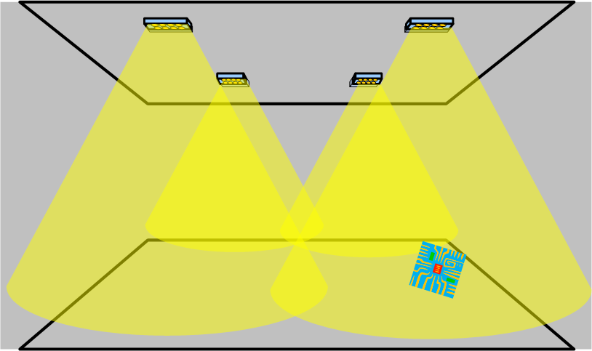
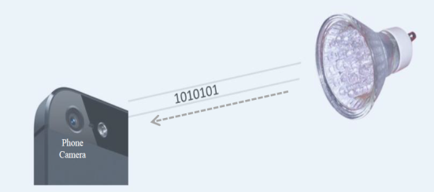
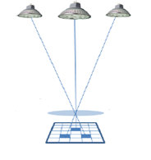
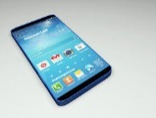
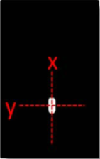
Doc: IEEE 802.15-14-0541-00-007a
LED and Smart Device Camera Based
LED lighting System for Location Based Service
LED Tx
Position data
[Position data transmission]
Smart device
camera module
Smart Device Rx
LED-based Location Based Service
[Position detection by image processing]
Position data transmitted from LED transmitters strike the focal plane (pixel array) of the image sensor through the lens of a smart device camera receiver.
Estimate user’s location information using Position data and coordinates by image processing algorithm

Slide 4
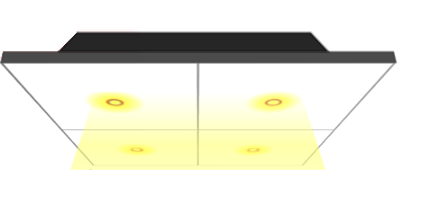
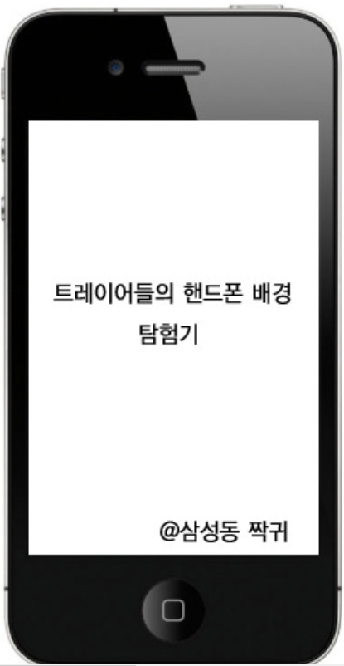
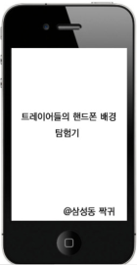
Doc: IEEE 802.15-14-0541-00-007a
VLC based on Smart Device Camera
using MIMO System
101100101
001001101
111001010
010100110
Image sensor in the smart device receives different signals from each LEDs
Different signals are extracted from received image
Sang Kook Han, Yonsei University
.

Slide 5
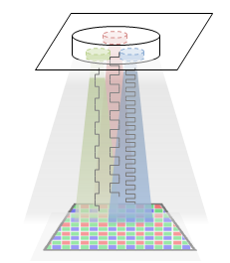
Doc: IEEE 802.15-14-0541-00-007a
Smart Device Camera based Detection system
using RGB-LED
RGB-LED Tx
Smart Device Camera module & Interface Board
(Android based Smart Phone )
Smart Device Camera Rx
Transmitting the data by RGB- LED to increase data capacity (Tx module)
Image sensor in the smart device camera receives the data from RGB-LED (Rx module)
Sang Kook Han, Yonsei University
.

Slide 6
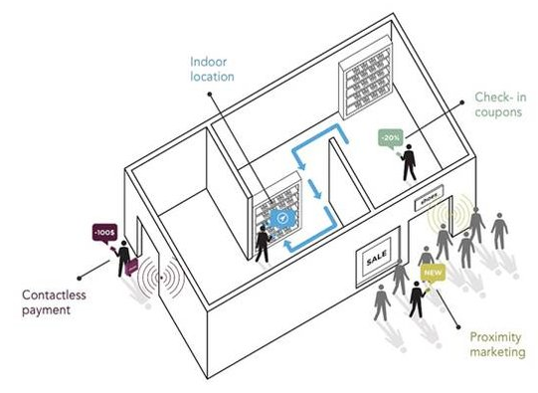
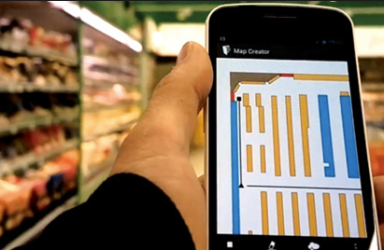
Sep 2014
Doc: IEEE 802.15-14-0541-00-007a
Application of Location Based Service using VLC
based on Smart Device Camera
Estimating users’ location is accomplished by visible light communication
Navigation and pop-up advertisement could be fulfilled based on estimated position
There are possible to provide location based service using visible light communication based on smart device camera.
Slide 6

Slide 7
Doc: IEEE 802.15-14-0541-00-007a
Conclusion
In this submission, we proposed LED and smart device camera based visible light communication system for location based service.
Position data are transmitted from LED to smart device camera by MIMO system.
Estimate user’s location information using Position data and coordinates by image processing algorithm
The smart device camera based visible light communication system’s ability to fuse communication and image processing results has potential for prompting emergence of new applications.

