Slide 1
15-14-0524-01-0010
Project: IEEE P802.15 Working Group for Wireless Personal Area Networks (WPANs)
Submission Title: [802.15 to 802.3 adaptation for L2R]
Date Submitted: [August 2014]
Source: [Behcet Sarikaya] Huawei [Add name of Affiliation]
Address [5340 Legacy Dr, Plano TX 75024]
Voice:[Add telephone number], FAX: [Add FAX number], E-Mail:[sarikaya@ieee.org]
Re: [Interconnecting 802.15 WPANs with Ethernet Networks]
Abstract: [Some nodes WPAN may be connected to 802.3 in addition to 802.15.4. We summarize how this can be exploited in an L2R protocol. We also bring up 802.3 to 802.15.4 adaptation issue.]
Purpose: [802.15 Interim in Athens, Sept. 2014.]
Notice: This document has been prepared to assist the IEEE P802.15. It is offered as a basis for discussion and is not binding on the contributing individual(s) or organization(s). The material in this document is subject to change in form and content after further study. The contributor(s) reserve(s) the right to add, amend or withdraw material contained herein.
Release: The contributor acknowledges and accepts that this contribution becomes the property of IEEE and may be made publicly available by P802.15.
NOTE: Update all red fields replacing with your information; they are required. This is a manual update in appropriate
fields. All Blue fields are informational and are to be deleted. Black stays. After updating delete this box/paragraph.

Slide 2
802.15.4 and 802.3 Interconnection and L2R
Behcet Sarikaya

Slide 3
OmniRAN TG
802.1CF or OmniRAN TG is working on point to point link versus shared link issues on all IEEE 802 technologies, including 802.15
OmniRAN is interested in only the 802 technologies that are compatible with 802.3 or Ethernet, i.e. PHYs that can support 1500 MPDUs

Slide 4
Multiple Interface Issue
OmniRAN is also looking for an architecture where there are nodes connected to two IEEE 802 technologies like 802.15.4 and 802.3
This brings MAC frame format incompatibilities and the need for adaptation

Slide 5
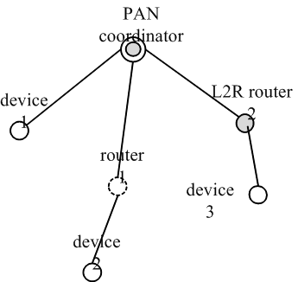
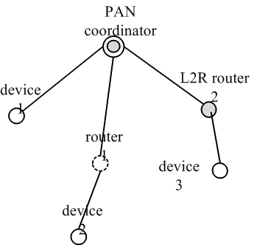
What Can 802.15 do?
Scenario 1. Destination is Device 3 in PAN 2
Scenario 2. Destination is Server
802.3 link

Slide 6
802.15.4 to 802.3 Adaptation
802.15.4 MAC address long format is 64 bits or 8 octets, 802.3 supports 48 bit MAC address, i.e. 6 octets
Most 802.15.4 PHY limit MPDUs to 127 octets, 802.3 has 1500 octet MPDUs

Slide 7
Frame Formats
802.15.4 MAC Data Frame
802.3 MAC Data Frame
8 6
6 2 0 to 1500 0 to 46
4
Preamble
Destination
Source
Type
Data
Pad
Checksum
address
address

Slide 8
MPDU Size for 802.15.4
802.15.4 amendments that can support 1500 octets: 802.15.4g, 802.15.4m
Others like 802.15.4k do not
Limit the adaptation to those that can support
Limit point to point link establishment to those that can support
Notes:
Check these 802.15.3 802.15.1 802.15.6

Slide 9
Thank you! Questions

