Slide 1
Project: IEEE P802.15 Working Group for Wireless Personal Area Networks (WPANs)
Submission Title: Overview of ISO/IEC 17568:2013 MAC Specification
Date Submitted: 02 Sept, 2014
Source: Keiji Akiyama and Kiyoshi Toshimitsu
Company: Sony Corporation and Toshiba Corporation
Address 1-7-1 Konan Minato-ku, Tokyo, 108-0075 Japan
Voice:+81 50 3141 2629, FAX: +81 3 6748 4268, E-Mail: Keiji.Akiyama@jp.sony.com
Re: N/A
Abstract: This presentation provides information about an overview on ISO/IEC 17568:2013 MAC Specification operating in 4.48GHz band
Purpose: Informational only
Notice: This document has been prepared to assist the IEEE P802.15. It is offered as a basis for discussion and is not binding on the contributing individual(s) or organization(s). The material in this document is subject to change in form and content after further study. The contributor(s) reserve(s) the right to add, amend or withdraw material contained herein.
Release: The contributor acknowledges and accepts that this contribution becomes the property of IEEE and may be made publicly available by P802.15.

Slide 2
Overview of ISO/IEC 17568:2013
MAC Specifications

Slide 3
ISO/IEC 17568:2013 System Overview
PHY/MAC layer of this system is identical to that of TransferJetTM referred in the Draft ARD.
“Close Proximity Electric Induction Wireless Communications” system is designed specifically for P2P (Point-to-Point) communications.
Easy and quick “Touch-and-Get” Operation is possible.
4.48GHz band is used as one channel
560MHz bandwidth / 375Mbps MAC Throughput
Range is intentionally restricted to a few centimeters by using an electric induction field antenna (“Coupler”).
Each device is identified by a 64bit-long unique ID (UID).

Slide 4
ISO/IEC 17568:2013 System Overview(Cont’d)
No superframe like structure on the air
  Frames transmitted on demand
  No bandwidth reservation methods or isochronous communication channels
  Communication with only one device within the “proximity area”
No periodic beacon after establishing connection.

Slide 5
ISO/IEC 17568:2013 PHY Summary
Parameter | Specification
Chip Rate | 560M cps
Symbol Rate | 280M sps
Modulation | π/2 shift BPSK + DSSS
Chip Rate Accuracy | +/- 50ppm
FEC | ½ Convolutional code + Reed Solomon Code
Transmit Power | -70dBm/MHz max.
Antenna | A specially designed “Coupler” antenna element for transmitting and receiving electric induction waves

Slide 6
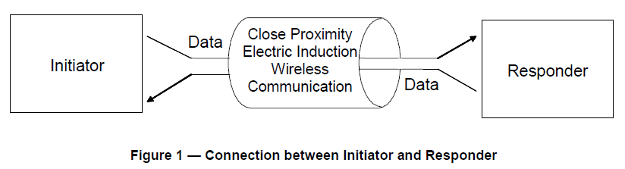
System Connection Model
Initiator ←→ Responder Model
Initiator: Entity which wishes to establish a connection (send a connection request) to the other entity.
ex. sends content to or retrieves content from the other entity.
Responder: Entity which receives the connection request from the other entity.
ex. receives content from the other entity or has content to be sent.

Slide 7
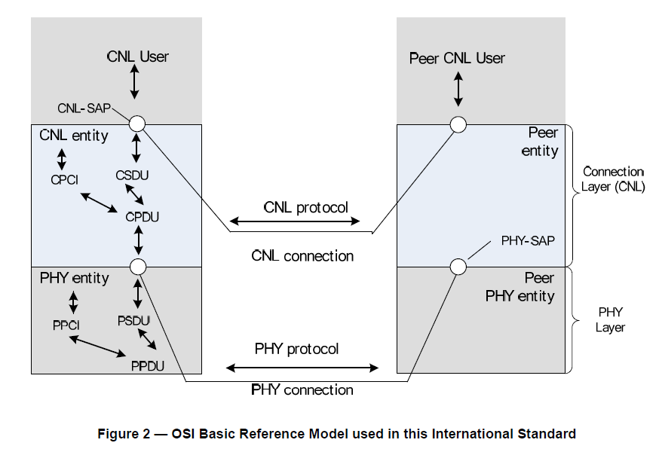
OSI Reference Layer Model
MAC Layer

Slide 8
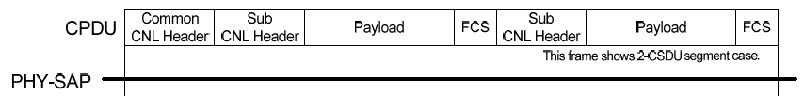
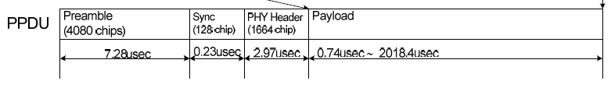

PHY/MAC Frame Structure
MAC Frame
PHY(Air) Frame
PHY Header

Slide 9
MAC Frames (1)
Three types of MAC Frames are used:
  Data Frame
  Management Frame
  ACK Frame

Slide 10

MAC Frames - Data Frame
Data Frame
  Exchange of User Data
  Maximum of two SubFrames are available within one MAC Frame
  0 to 4096 bytes of payload (User data) per one SubFrame
  Maximum of 8192 bytes of payload available per one Frame
#2 Sub Frame(Sub Header + Payload)
(Optional)
Common Header
#1 Sub Frame(Sub Header + Payload )

Slide 11
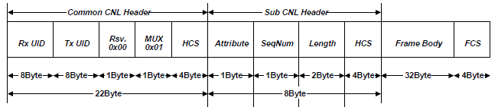
MAC Frames -
Management Frame
Management Frame
  For Link Management
  Fixed 32bytes of payload (Management Messages)
Common Header
Sub Frame(Sub Header + 32bytes Management Data )

Slide 12
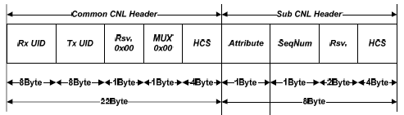
MAC Frames - ACK Frame
ACK Frame
  ACK for both Data and Management Frames
  Only Headers (No payload)
Common Header
Sub Frame( Only Sub Header)

Slide 13
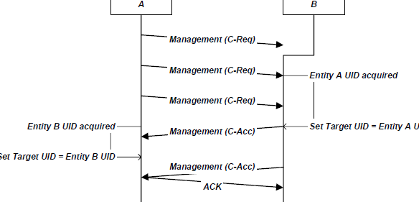
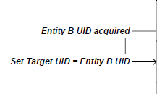
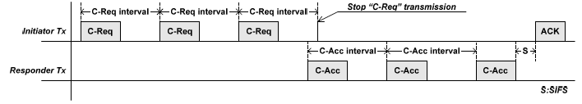
Connection Setup Procedure
Initiator
Responder
C-Req: Connection Request
C-Acc: Connection Accept
[standby]
[active]
Notify to Upper Layer
(Software Process)
Notify to Upper Layer
Upper Layer Order
(Software Process)
Upper Layer Order
Connection Established
Connection
Established
100us
100us
43.3us + Random backoff
29.3us
29.3us

Slide 14
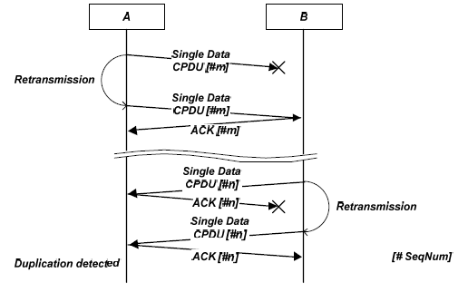
Sequence Number
Sequence Number (SeqNum) is a cyclic incrementing sequence of integers within the range of 0 to 255 indicating to the other entity about the order of Data or Management frame bodies.
ACK Frame always returns the sequence number of the last frame body that has been received in correct sequence.
If ACK is not received within ACK Timeout or the sequence number in ACK frame is smaller than that of the frame body last sent, the sender shall retransmit the missed data frame or management frame.
Connection Established

Slide 15
Summary
Overview of ISO/IEC 17568:2013 MAC Specification designed specifically for P2P (Point-to-Point) communications is described.

Slide 16
References
[1] ISO/IEC 17568:2013 Information Technology -- Telecommunications and information exchange between systems -- Close proximity electric induction wireless communications
http://www.iso.org/iso/catalogue_detail.htm?csnumber=60037
[2] Applications Requirements Document (ARD) https://mentor.ieee.org/802.15/dcn/14/15-14-0304-03-003d-applications-requirement-document-ard.docx

