Slide 1
Project: IEEE P802.15 Working Group for Wireless Personal Area Networks (WPANs)
Submission Title: Proposed resolutions for CIDs 30 and 527 from LB94
Date Submitted: 14 August, 2014
Source: Wun-Cheol Jeong
Company: ETRI
Address: 161 Gajeong-dong, Yuseong-gu, Daejeon, KOREA
Voice: +82-42-860-5104, FAX: +82-42-860-4197, E-Mail: wjeong@etri.re.kr
Re:
Abstract: Proposed resolutions for CIDs 30 and 527 from LB94.
Purpose: To propose resolutions for CIDs 30 and 527 from LB94
Notice: This document has been prepared to assist the IEEE P802.15. It is offered as a basis for discussion and is not binding on the contributing individual(s) or organization(s). The material in this document is subject to change in form and content after further study. The contributor(s) reserve(s) the right to add, amend or withdraw material contained herein.
Release: The contributor acknowledges and accepts that this contribution becomes the property of IEEE and may be made publicly available by P802.15.

Slide 2
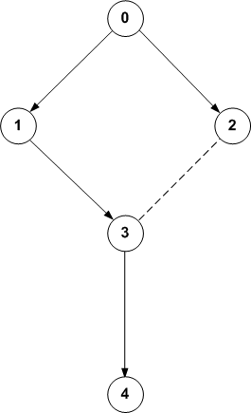
Figure 63
Node 3 is requesting 2 slots to transmit data frames to node 1.
DSME-GTS Request, unicast
Payload : Number of slots (2), Direction(Tx),
Preferred Superframe ID(1),
SAB sub-block
{0000100010000000
0000000010000000
…
0000000010000000}
Assuming slot (0, 15) is already assigned by node 4 for transmitting data frames from node 4 to node 3 and channel 19 is a bad channel.
DSME-GTS Reply
Slot = tuple (time slot, channel)
DSME-GTS
Request
2. DSME-GTS Reply, broadcast
Payload : Dst addr (0x3), Direction(Tx),
Preferred Superframe ID (1),
newly allocated SAB sub-block
{0000000000000000
0000001000000000
0000001000000000
…
0000000000000000}
3. DSME-GTS Notify, broadcast
Payload : Dst addr (0x1), Direction (Tx),
newly allocated SAB sub-block
{0000000000000000
0000001000000000
0000001000000000
…
0000000000000000}
DSME-GTS Notify
Every node that hears the broadcasts updates its slot allocation bitmap (SAB)
Notes:
2

