Slide 1
Proposed MAC Peering
Ad Hoc PM1 (7/17)
Doc: 15-14-0471-00-0008
July 17, 2014

Slide 2
Motion: Peering /Re-peering/De-peering
MAC shall support the following procedures
Peering
Re-peering
De-peering
Peering is the procedure to establish a link between a pair of PDs or links among multiple PDs discovered during the discovery procedure.
Re-peering is the procedure to re-establish a link between a pair of PDs or links among multiple PDs which peered previously. In the re-peering procedure, peering may be simplified.
De-peering is the procedure to disconnect the link established by peering.

Slide 3
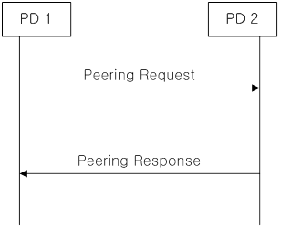
Motion: Peering Messages
MAC shall support the following peering messages:
Peering Request message
Peering Response message

Slide 4
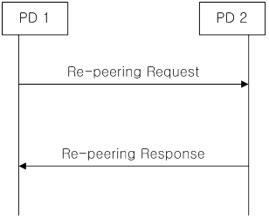
Motion: Re-peering Messages
MAC shall support the following re-peering messages:
Re-peering Request message
Re-peering Response message

Slide 5
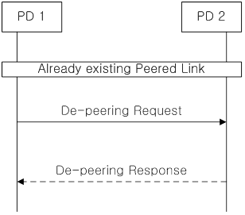
Motion: De-peering Messages
MAC shall support the following De-peering messages:
De-peering Request message
De-peering Response message

Slide 6
Motion: Peering Procedure
The peering procedure is initiated by sending a peering request message including peering information.
Responder shall send a peering response message to requestor to indicate whether the peering request is accepted or rejected.
The response message may include peering information if the request is accepted.

Slide 7
Motion: Re-peering Procedure
Re-peering procedure is similar to peering procedure. The main differences are:
  1) some of the previous peering information may not be included in request and response messages;
  2) the PD receiving the re-peering request validates re-peering information with the corresponding peering information before it accepts the re-peering request.
  TBD: parameters for validation may be Peering IDs, or Link IDS, etc.

Slide 8
Motion: De-peering Procedures
De-peering procedure starts with a de-peering request. De-peering response is optional.

Slide 9
Motion: Working Assumption
PHY Peering Procedure
The following proposals are working assumptions and the final procedure is TBD.reewxxx
ETRI: PPDU Format for Peering Request in PSDU
NICT: the peering request is implemented as Random Access Preamble illustrated

